Slide 1
Data Visualization
transforming the invisible into rich intelligence
Kim Rees
@krees, @periscopic
kim@periscopic.com
Notes:
The thing I want to stress with data visualization, is that you’re transforming the invisible, the intangible, and sometimes the unimaginable into the sphere of recognition.

Slide 2
Demos
Yahoo! Mail Visualization
http://visualize.yahoo.com
- launching at the end of September
GE Healthymagination Twitter Visualization
http://visualization.geblogs.com/visualization/cancerconversation/

Slide 3
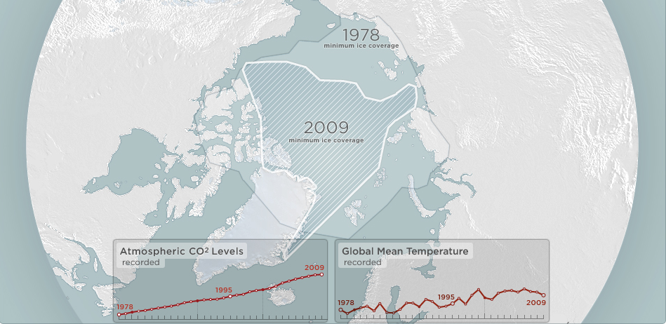
“We want to tell a story”
Know your data at the outset.
Don’t put visualization before data.
Sometimes the right data isn’t being captured. Or perhaps, under analysis, it doesn’t support the assumptions.
Notes:
Client desire to tell a story, but don’t know the data. Always start with the data. Knowing something anecdotally is not the same as having the data to support your claims.

Slide 4
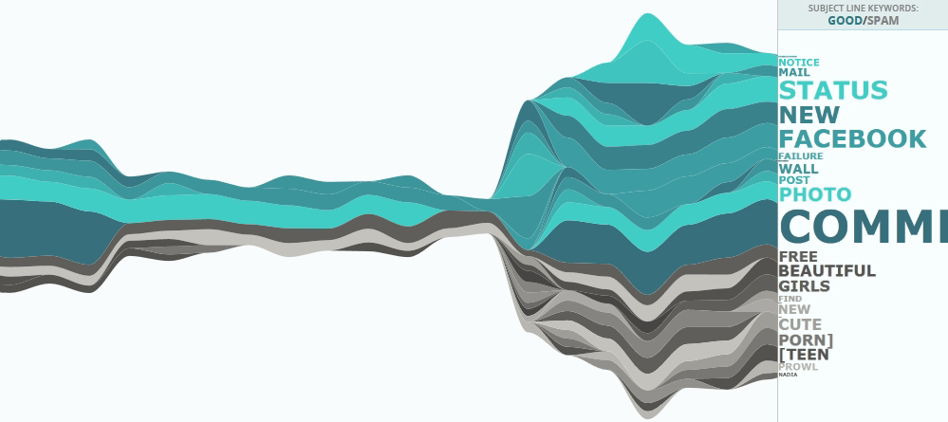
“We have real-time data, but…”
Expect unpredictability
To filter or not to filter
Embrace the unknown
Notes:
Yahoo! keywords aren’t always “nice” and neither are posts about breast cancer (crude humor). However, filtering “bad” words can be a slippery slope and can also inadvertently water down an experience. Embracing reality can sometimes reveal interesting results.

Slide 5
“Can we visualize 280 TB of data?”
Performance issues
Sampling
Clustering
Aggregating
Use pixels
Notes:
Big data presents a problem to visualization. It’s hard to represent that much data. However, there are some techniques that can help solve this problem.
Sampling = include only a certain number of cases.
Clustering = grouping similar data cases together
Aggregating = combining data together
Pixels: 1920 x 1080 display gives just over 2 million pixels, but beware of performance issues if you plan to animate them.

Slide 6
“We want a visualization, but don’t want to show our data.”
Solicit champions of the cause internally to get data release buy-in.
Provide industry and high-level (government) examples to convince.
Be sure to run things past the legal department.
Notes:
Seriously, is this the 1800s where ladies wore full gowns to go swimming at the beach? It’s like that with some organizations and their data. It’s almost like it feels too intimate. Some people need convincing about data transparency.

Slide 7
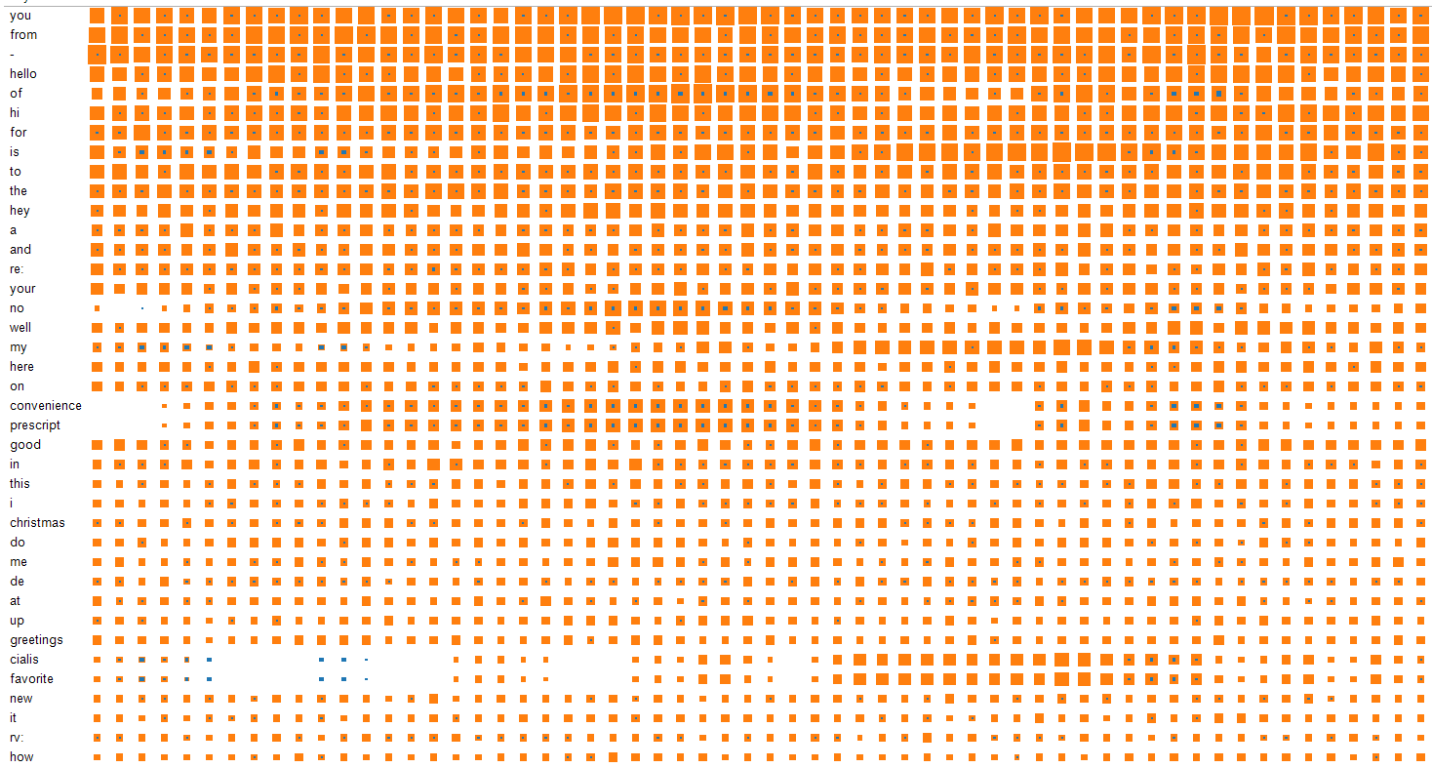
“What should we show?”
If you haven’t “seen” your data, look at it.
Unless the visualization is completely exploratory in nature, do the analysis up-front.
Visualization is not analysis. Don’t mistake visual analysis for data visualization.
Notes:
We recently started work on a project concerning an index that had adjustable weighted scores. However, the countries were scored so similarly, that changing the weights doesn’t impact their rank. Analysis should be done prior to concepting the visualization.

Slide 8
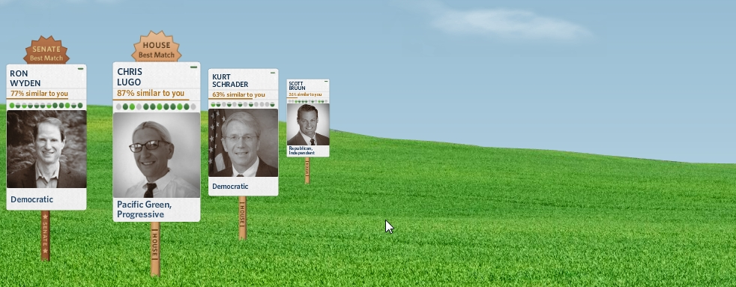
“Can we show waves of cash?”
Deciding whether to use metaphor or not. Don’t abstract when the data is already telling a good story.
Don’t overcomplicate or shoehorn something in.
Do use metaphor when there are socially accepted visual cues or language about the data… it will welcome the user to the visualization.
Notes:
This screenshot is from our voter tool: http://voteeasy.org

Slide 9
“We want to show everything about water.”
You can never tell the whole story. There will always be other data and ancillary stories to tell.
Need to focus on essential and narrow scope of the visualization.
Don’t show lots of things at once. Allow the visitor to drill into the pieces of interest.

Slide 10
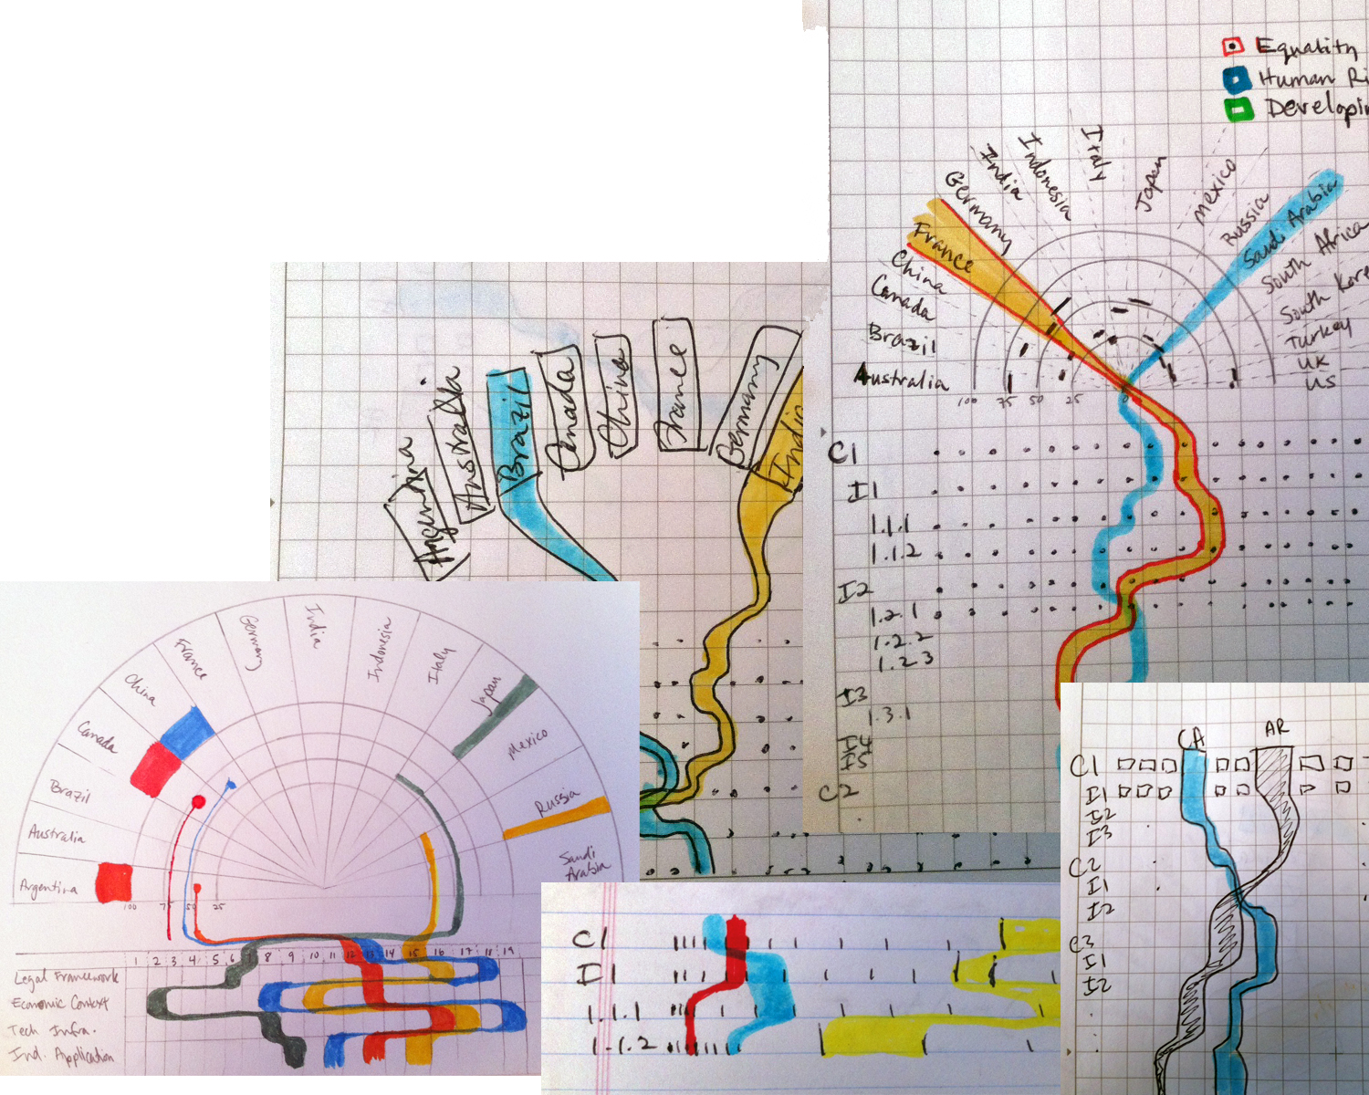
“Please include the concept in your proposal.”
A good idea always takes longer to arise than expected. Adequate time must be budgeted.
This strategic phase encompasses many tasks.
Don’t underestimate it.
Notes:
These images are from one person at our company for one project over a two week period. There were four people brainstorming the concept of this project and many more ideas and sketches. The strategic phase includes information gathering, research, perhaps analysis, brainstorming, concepting, and wireframing. It’s an uncomfortable phase with a lot of unknowns. If you give this phase room to breathe, you will be rewarded with a rich and useful visualization.

Slide 11
Data Visualization
transforming the invisible into rich intelligence
Kim Rees
@krees, @periscopic
kim@periscopic.com
Notes:
http://periscopic.com
http://now.periscopic.com

