Slide 1
Data Challenges in Health Monitoring and Diagnostics
Dr Anthony E Smart
Chief Science Officer, Scanadu, Inc.
Notes:
Abstract:
Automated health monitoring and diagnostics rely on combining local measurements with information from large clinical datasets. The validity of such inputs and stochastic analyses of existing data drive recommendations whose integrity can be a matter of life and death. At Scanadu we are developing, building, and applying hand-held diagnostic systems whose data must be good enough to assure both accuracy and comprehensive capability. This talk discusses six of many ways that information and process can become untrustworthy and introduces some preliminary ways to enhance confidence – reducing the ‘garbage in - garbage out’ effect. (1) Correlation does not guarantee causal relationship, nor even a common source – results of clinical testing are usually reported only in statistical terms, often without fully developed explanatory mechanisms. (2) Self-referentiality and non-independence, where allegedly unique data are untraceably derived from the same source – Internet searches particularly propagate such potentially uncorrectable errors. (3) Machine derived conclusions may be mathematically and logically sound but still ridiculous, requiring some common sense oversight that is difficult to quantify. (4) Heuristic algorithms, especially based on neural nets, may produce output whose derivation is not necessarily well understood, and may therefore be suspect. (5) In medical diagnosis, an experienced practitioner may take into account subconscious observations that are neither numerical nor available to the machine. (6) A system as complex as a human may not actually yield unambiguously computable diagnostics on the basis of the available information. While many such potential data limitations exist, the accuracy of medical diagnoses is particularly sensitive to those outlined above. Noting that ‘all significant choices are made with insufficient information’, we still want the input parameters and their values to be as complete and correct as possible to provide general usability and acceptance of any automatic or even semi-automatic diagnostic system.

Slide 2
What is Scanadu?
and why this talk?
Notes:
Scanadu has been established to develop and build a hand held device capable of measuring vital signal and possibly a wide range of other exhibited properties. It will integrate current measurements with existing records and access greater knowledge and computing power than is available locally. More than being a new and clever widget it can ultimately introduce a paradigm shift in health care.

Slide 3
Why this Talk?
Scanadu builds systems to make measurements,
integrate with existing data, and support medical doctors.
Correct medical diagnoses depend on data being
as trustworthy as possible.
This talk reviews some obvious ways that data may become untrustworthy, leading to wrong medical conclusions.
Good Data may lead to LIFE
Bad Data can lead to DEATH
Notes:
Medical Diagnoses depend of the best Data accuracy.
Because poor data can lead to poor diagnoses and be less than might be desired for diagnoses and health care in general it is worth guarding against some of the more obvious pitfalls, which we review here.

Slide 4
From Data to Diagnosis – 13 Risks
Ways that the available Data
may not be all
that we believe or wish,
compromising medical diagnoses
Notes:
Data can go bad.
I shall briefly step though 13 obvious ways in which data may become less trustworthy than desired. All are fairly obvious, but this talk is a kind of checklist for the
This talk reviews some of the obvious potential pitfalls of trusting data.

Slide 5
From Data to Diagnosis – 13 Risks
Correlation need not imply Cause – but it may
Notes:
All are fairly obvious, but this talk is a kind of checklist for the worst things that can happen to data or our conclusions from them.

Slide 6
From Data to Diagnosis – 13 Risks
Correlation need not imply Cause – but it may
Self-referentiality and/or Non-independence of Data

Slide 7
From Data to Diagnosis – 13 Risks
Correlation need not imply Cause – but it may
Self-referentiality and/or Non-independence of Data
Garbage in – Garbage Out

Slide 8
From Data to Diagnosis – 13 Risks
Correlation need not imply Cause – but it may
Self-referentiality and/or Non-independence of Data
Garbage in – Garbage Out
Computability and Completeness

Slide 9
From Data to Diagnosis – 13 Risks
Correlation need not imply Cause – but it may
Self-referentiality and/or Non-independence of Data
Garbage in – Garbage Out
Computability and Completeness
Intrinsic and Heuristic Algorithms

Slide 10
From Data to Diagnosis – 13 Risks
Correlation need not imply Cause – but it may
Self-referentiality and/or Non-independence of Data
Garbage in – Garbage Out
Computability and Completeness
Intrinsic and Heuristic Algorithms
Inverse Problems and Instabilities

Slide 11
From Data to Diagnosis – 13 Risks
Correlation need not imply Cause – but it may
Self-referentiality and/or Non-independence of Data
Garbage in – Garbage Out
Computability and Completeness
Intrinsic and Heuristic Algorithms
Inverse Problems and Instabilities
Noise and Filters

Slide 12
From Data to Diagnosis – 13 Risks
Correlation need not imply Cause – but it may
Self-referentiality and/or Non-independence of Data
Garbage in – Garbage Out
Computability and Completeness
Intrinsic and Heuristic Algorithms
Inverse Problems and Instabilities
Noise and Filters
Irrationality and Self-interest

Slide 13
From Data to Diagnosis – 13 Risks
Correlation need not imply Cause – but it may
Self-referentiality and/or Non-independence of Data
Garbage in – Garbage Out
Computability and Completeness
Intrinsic and Heuristic Algorithms
Inverse Problems and Instabilities
Noise and Filters
Irrationality and Self-interest
Error and Fraud

Slide 14
From Data to Diagnosis – 13 Risks
Correlation need not imply Cause – but it may
Self-referentiality and/or Non-independence of Data
Garbage in – Garbage Out
Computability and Completeness
Intrinsic and Heuristic Algorithms
Inverse Problems and Instabilities
Noise and Filters
Irrationality and Self-interest
Error and Fraud
Sub-optimization

Slide 15
From Data to Diagnosis – 13 Risks
Correlation need not imply Cause – but it may
Self-referentiality and/or Non-independence of Data
Garbage in – Garbage Out
Computability and Completeness
Intrinsic and Heuristic Algorithms
Inverse Problems and Instabilities
Noise and Filters
Irrationality and Self-interest
Error and Fraud
Sub-optimization
Archive Accessibility

Slide 16
From Data to Diagnosis – 13 Risks
Correlation need not imply Cause – but it may
Self-referentiality and/or Non-independence of Data
Garbage in – Garbage Out
Computability and Completeness
Intrinsic and Heuristic Algorithms
Inverse Problems and Instabilities
Noise and Filters
Irrationality and Self-interest
Error and Fraud
Sub-optimization
Archive Accessibility
Self-consistency

Slide 17
From Data to Diagnosis – 13 Risks
Correlation need not imply Cause – but it may
Self-referentiality and/or Non-independence of Data
Garbage in – Garbage Out
Computability and Completeness
Intrinsic and Heuristic Algorithms
Inverse Problems and Instabilities
Noise
Irrationality and Self-interest
Error and Fraud
Sub-optimization
Archive Accessibility
Self-consistency
Necessity and Sufficiency
Notes:
All are well known and understood; many are trivial, but the inadvertent neglect of any one can lead to serious degradations of health care.

Slide 18
Correlation need not imply Cause – but it may
In 1303, soldiers from one village were killed in a single battle.
45 years later plague killed one third of the general population.
In this village none died of the plague.
Notes:
Correlation does not imply Causation.
In a single French battle in 1303 at the beginning of the ‘Hundred Years War’, many young men conscripted from Devonshire villages were killed, but from one village almost all died. In 1348 the ‘Black Plague, killed one third of the general population, but no one in this village died.
Correlation does not guarantee causal relationship, nor even a common source – results of clinical testing are usually reported only in statistical terms, often without fully developed explanatory mechanisms.

Slide 19
Correlation need not imply Cause – but it may
In 1303, soldiers from one village were killed in a single battle.
45 years later plague killed one third of the general population.
In this village none died of the plague.
Real Connection: Widows and spinsters
keep cats for company.
Notes:
A correct causal correlation.
The causal explanation is that widows and spinsters kept cats for companionship. Few rats lived in that village and the absence of a rats and their fleas as plague vector meant that none died.

Slide 20
Correlation need not imply Cause – but it may
In 1303, soldiers from one village were killed in a single battle.
45 years later plague killed one third of the general population.
In this village none died of the plague.
Real Connection: Widows and spinsters
keep cats for company.
In 1953, traces of lanthanides in Russian shipments of raw cellulose perfectly tracked vanadium dust in the stack of a local power station.
Notes:
My father spotted a perfect but most unlikely correlation between measurements from unrelated chemical analyses.

Slide 21
Correlation need not imply Cause – but it may
In 1303, soldiers from one village were killed in a single battle.
45 years later plague killed one third of the general population.
In this village none died of the plague.
Real Connection: Widows and spinsters
keep cats for company.
In 1953, traces of lanthanides in Russian shipments of raw cellulose perfectly tracked vanadium dust in the stack of a local power station.
False Connection: Sampling statistics were based on random numbers from a well-used library book that tended to fall open at the same page.
Notes:
An incorrect causal correlation.
He traced it to a book of random numbers in a commonly used library – it was 80 or more years ago before computer generated random numbers. This old, well used and dog-eared book tended to fall open at a preferred page.

Slide 22
Correlation need not imply Cause – but it may
In 1303, soldiers from one village were killed in a single battle.
45 years later plague killed one third of the general population.
In this village none died of the plague.
Real Connection: Widows and spinsters
keep cats for company.
In 1953, traces of lanthanides in Russian shipments of raw cellulose perfectly tracked vanadium dust in the stack of a local power station.
False Connection: Sampling statistics were based on random numbers from a well-used library book that tended to fall open at the same page.
Medical diagnoses from unexplained correlations may be suspect.
People can Die!
Notes:
This is especially serious in medical diagnoses and health in general.
Correlation does not guarantee causal relationship, nor even a common source – results of clinical testing are usually reported only in statistical terms, often without fully developed explanatory mechanisms.

Slide 23
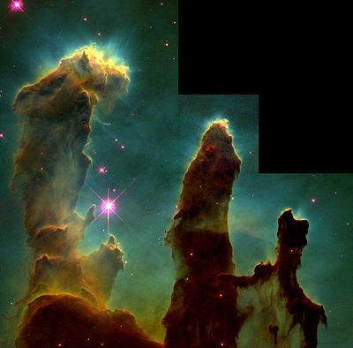
Self-referentiality of Data
Obvious:
Matter is that which occupies Space. [OED]
Space is that which can be occupied by Matter.
Notes:
Self-referentiality is common where logical support is derived from a circular argument.
The Oxford English Dictionary offers several circular definitions.

Slide 24
Self-referentiality of Data
Obvious:
Matter is that which occupies Space. [OED]
Space is that which can be occupied by Matter.
More Subtle:
“Nothing exists.”
∃ 0
∃
Notes:
Slightly more subtle is a statement that denies itself.

Slide 25
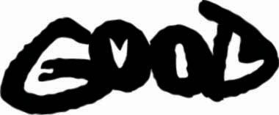
Self-referentiality of Data
Obvious:
Matter is that which occupies Space.
Space is that which can be occupied by Matter.
More Subtle:
“Nothing exists.”
Tricky:
“I am not lying.” or alternatively, “I am lying.”
∃ 0
Notes:
Syntactically acceptable. Semantically contradictory. Paradox of Epimenides.
It is linguistically frequent and not always trivial to detect, particularly if it is clouded by emotion, prior belief, unwarranted certainty, observational bias or just common prejudice.
Why are we here? We are here ||:because we are here :||. Recursive arguments exacerbate this. Most such errors are typified by the exemplary paradox of Epimenides the Cretan, whose is alleged to have asserted that “All Cretans are liars.”Recursive arguments exacerbate this. Most such errors are typified by the exemplary paradox of Epimenides the Cretan, whose is alleged to have asserted that “All Cretans are liars.”

Slide 26
Self-referentiality of Data
Obvious:
Matter is that which occupies Space.
Space is that which can be occupied by Matter.
More Subtle:
“Nothing exists.”
Tricky:
“I am not lying.” or alternatively, “I am lying.”
Dangerous:
“My data and conclusions assure their correctness.”
∃ 0
Notes:
Self assuring.
Most dangerous is the assertion that something is true because it says so. The introduction to the King James Bible is an excellent, if somewhat sycophantic example of this self justification

Slide 27
Non-independence of Data
Data sources reference earlier work that may appear well supported.
Observational bias of new data may enhance apparent agreement.
But traceability may be poorly verified, weak or suspect.
References may actually relate back to a single common claim –
That original claim may be in error.
Examples:
Urban legends: Ironically slight variations may enhance plausibility,
seeming to derive from different sources.
Social pressure: The tendency to give unwarranted credence to that which is already believed. (Galileo had trouble with this.)
Wrong medical diagnosis. People can Die!
Notes:
Apparently different sources arise by divergence from a single unverified original statement.
Non-independence occurs where data are accidentally derived from alternative versions of the same source by apparently different routes, but are erroneously believed to have arisen from independent sources with different supporting measurements. This is common in Internet proliferation and indeed well approved technical publications are not immune to it.
The mechanism is the primary sustainer of ‘urban legends’ generated by one creative fantasist. Slight divergences acquired by errors and additions lead to the delusion that they may be independent – for example the four Christian New Testament gospels – we even use ‘gospel’ to imply unimpeachable truth.
Traceability can become quite difficult in complex inferences from many supposedly independent factors, especially if these carry a statistical weight that may be derived without adequate provenance.

Slide 28
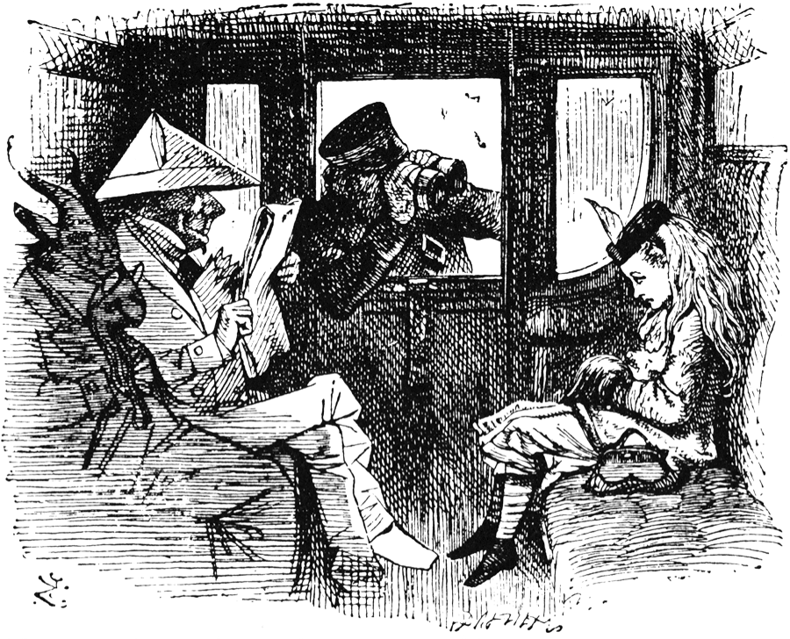
Garbage in – Garbage Out
A: “Why do you throw balled-up newspaper from the train window every five miles?”
Notes:
The dangers of logical traps.
Every few miles, a man in a first class railway carriage in Southern England, would screw up a page of his Financial Times and throw it from the window. A fellow passenger, asking why he was doing this.

Slide 29
Garbage in – Garbage Out
A: “Why do you throw balled-up newspaper from the train window every five miles?”
B: “To keep the wild elephants away.”
Notes:
He received the explanation, “It is to keep wild elephants away.”

Slide 30
Garbage in – Garbage Out
A: “Why do you throw balled-up newspaper from the train window every five miles?”
B: “To keep the wild elephants away.”
A: “But there are no wild elephants within thousands of miles of here.”
Notes:
Persisting with “But there are no wild elephants within thousands of miles of here,” he received the smiling confidence -

Slide 31
Garbage in – Garbage Out
A: “Why do you throw balled-up newspaper from the train window every five miles?”
B: “To keep the wild elephants away.”
A: “But there are no wild elephants within thousands of miles.”
B: “Effective, isn’t it?”
Notes:
Makes no sense, but is hard to refute.
“Effective, isn’t it?”

Slide 32
Garbage in – Garbage Out
A: “Why do you throw balled-up newspaper from the train window every five miles?”
B: “To keep the wild elephants away.”
A: “But there are no wild elephants within thousands of miles.”
B: “Effective, isn’t it?”
Even the best language engines handle Zen koans poorly.
So far human doctors are better at detecting nonsense –
whether the input is silly, or the output is ridiculous.
Notes:
Natural language processing is one of the more difficult tasks currently faced by the man machine interface.
An experienced medical practitioner may realize a statement is ridiculous – a computer, even one capable of passing the Turing test, may not.

Slide 33
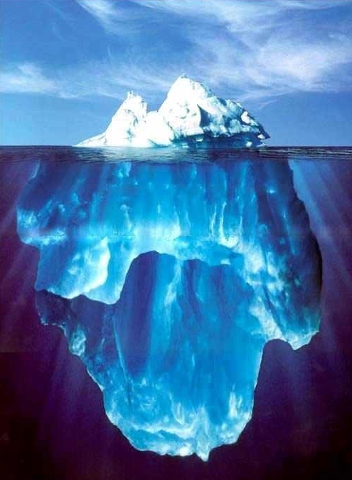
Computability and Completeness
The Whole Truth
Medicine is messy and complex – as are people.
Assigning numbers implies biological reductionism.
Not everything is as rational as we like to believe.
But treatment choices depend on diagnoses calculated from statistical inferences, e.g. clinical trials.
Is not always
visible
How do we know we are not missing a piece whose inclusion might change our outcome?
People can Die!
People Live
Notes:
Is the Universe truly computable, or are there random and unsuspected unknowns?
Wolfram/Alpha appears to have the underlying paradigm that the Universe is intrinsically computable, and as such its direct application to medical diagnostics would be unimpeachable. I am less sure that I even do believe that the Universe is computable, despite the convincing reductionism of the last few centuries. I cannot readily dismiss Gödel’s theorem, and Einstein’s assertion that ‘God does not play dice’ significantly increases my skepticism. In any areas as messy as medicine, where the machinery is so complex and not yet sufficiently well understood, unambiguous diagnoses based upon machine inference may be quite untrustworthy. Having said that, a human diagnosis may be even worse.
Ernest Rutherford said “If your experiment needs statistics, you ought to have done a better experiment.”

Slide 34
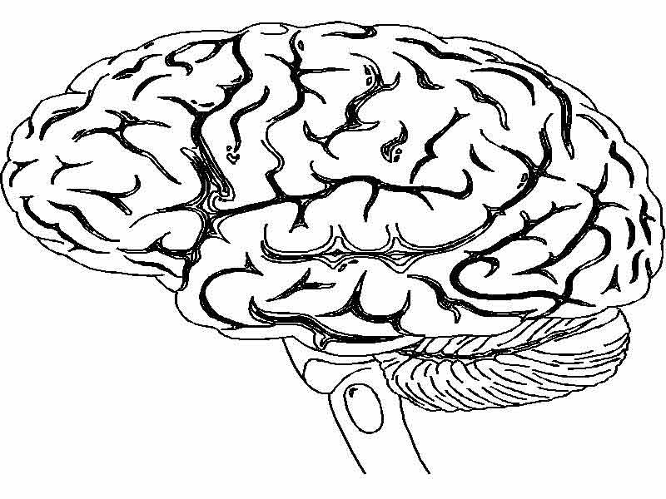
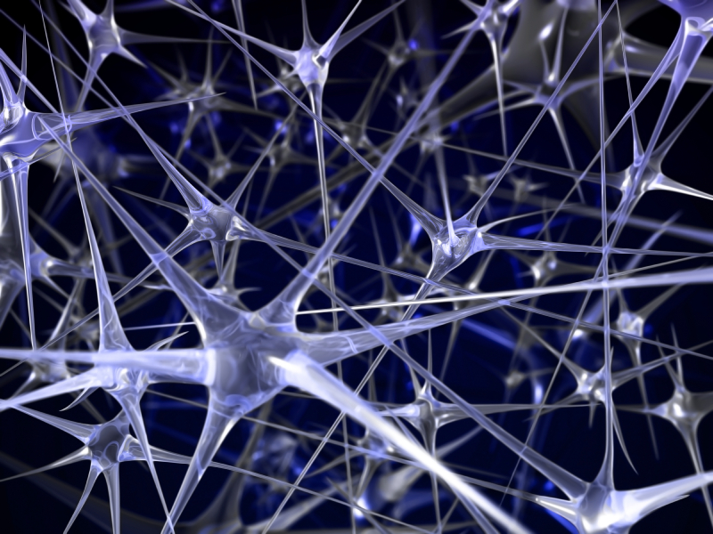
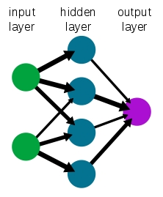
Intrinsic and Heuristic Algorithms
We used our Brains to invent Neural Nets
We use Neutral Nets to investigate the Brain
But we can remain ignorant of internal mechanisms
– hidden layers
An intrinsic algorithm can be effective
A heuristic adaptation of that algorithm can be much better
But generalizing such a mysterious process to different problems in medical diagnoses may be risky.
People may DIE.
Notes:
Something built to solve a specific problem may not apply to a superficially similar problem.
We design the best algorithms we can. Heuristic evolution improves performance; automated versions more efficiently, but with changes in hidden layers. Later generalizations to a slightly different problems may not be justified.

Slide 35
Inverse Problems and Instabilities
Single Valued Deterministic and Unique
Forward is easy until chaotic: Backward is intractably difficult
797,003,437 × 817,504,243 = 651,553,691,433,083,191
651,553,691,433,083,191 = ??????? × ???????
↓
↓
Notes:
Forward inference is OK – until noise make it chaotic, like weather prediction.
Backward inference may be very difficult, if it is possible at all.
A forward inference from trusted numerical data yields a single trustworthy outcome only sufficiently far ahead to be justified by the precision of the input numbers. Further out the predictions become chaotic.
With access only to the outcome of an evolved system, the reverse inference to find the prior state may be intractably difficult, or may be impossible with available resources.
Even when possible, it cannot be proven that the discovered prior state is unique.
Many real situations, particularly those applicable to the complex conditions of biological health, could be derived from complex combinations of large numbers of steps, making reverse inferences unreliable.
Worse still any of several equally plausible reverse solutions may be sufficiently different as to suggest different pathologies requiring different treatments.

Slide 36
Inverse Problems and Instabilities
Single Valued Deterministic and Unique
Forward is easy until chaotic: Backward is intractably difficult
797,003,437 × 817,504,243 = 651,553,691,433,083,191
651,553,691,433,083,191 = ??????? × ???????
Mandelbrot Set Recursion Generator: z ← z² + c
{R=-1.35611321948817682, I=0.0546703660365892457}
↓
↓
→
←⎯⎯
Notes:
Even when possible, it cannot be proven that the discovered prior state is unique.
Many real situations, particularly those applicable to the complex conditions of biological health, could be derived from complex combinations of large numbers of steps, making reverse inferences unreliable.
Worse still any of several equally plausible reverse solutions may be sufficiently different as to suggest different pathologies requiring different treatments.

Slide 37
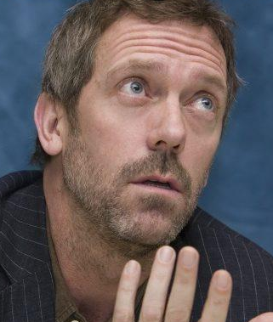
Inverse Problems and Instabilities
Single Valued Deterministic and Unique
Forward is easy until chaotic: Backward is intractably difficult
797,003,437 × 817,504,243 = 651,553,691,433,083,191
651,553,691,433,083,191 = ??????? × ???????
Mandelbrot Set Recursion Generator: z ← z² + c
{R=-1.35611321948817682, I=0.0546703660365892457}
↓
↓
→
←⎯⎯
Complex, ill-bounded, poorly quantified
Sick Patient, Multiple Symptoms
↓ ↓ ↓ ↓ ↓ ↓ ↓ ↓ ↓
←
Ambiguous
Treatment
←
Multiple Possible Diagnoses
Notes:
Health diagnostics may be ambiguous. Any believed remedial action may exacerbate the situation. Hippocratic Oath – Above All do no Harm.
Many real situations, particularly those applicable to the complex conditions of biological health, could be derived from complex combinations of large numbers of steps, making reverse inferences unreliable.
Worse still, any of several equally plausible reverse solutions may be sufficiently different as to suggest different pathologies requiring different treatments.

Slide 38
Noise and Filters
Input
Output
“No” Filter
Signal
Noise
‘Truth’
Notes:
Without filtering we have the truth – but there are always boundaries that behave as filters.
All signals contain some noise. Without any filtering of the signal the output is a true representation of the input, with all its noise and defects. However some filtering is always implicit in any transfer function.

Slide 39
Noise and Filters
Input
Output
Output
“Good”
Filter
“No” Filter
Signal
Noise
‘Truth’
Less Noise,
Distortion
Possible
Notes:
A well chosen filter to reduce noise may also introduce distortion.
A fairly appropriate filter may be used to reduce the effects of noise – if you know what you are looking for. However even the best filters can introduce distortion and bias of their own. The effect of the filter changes both the signal and the noise in possibly different ways, intending to reduce the effect of noise, but also having some inevitable effect upon the signal.

Slide 40
Noise and Filters
Input
Output
Output
Output
“Good”
Filter
“Poor”
Filter
“No” Filter
Signal
Distortion
Degradation
Inaccuracy
Error
Fiction
Noise
Fantasy
‘Truth’
Less Noise,
Distortion
Possible
Notes:
A less good filter may cause all sorts of problems. In limit of noise without signal the output can be anything you want – or don’t want.
A poorly chosen filter may at best distort the signal, and with increasing noise is likely to produce serious output not present in the input. In the limit of an input of noise alone the output is dependent solely upon the filter. It can produce anything you want.

Slide 41
Irrationality and Self-interest
"What is 2 times 2 ?”
Notes:
Time for a joke – what do I mean ‘joke’?
Sometimes a joke may illuminate fallacious reasoning – particularly relevant where clever people are self-interested to the extent of irrational denial of evidentiary validity - the so called ‘peasant cunning’.

Slide 42
Irrationality and Self-interest
"What is 2 times 2 ?”
Physicist: Most probably between 3 and 5.
Notes:
A cautious assertion.
Sometimes a joke may illuminate fallacious reasoning – particularly relevant where clever people are self-interested to the extent of irrational denial of evidentiary validity - the so called ‘peasant cunning’.

Slide 43
Irrationality and Self-interest
"What is 2 times 2 ?”
Physicist: Most probably between 3 and 5.
Mathematician: No idea, but I can prove an answer exists.
Notes:
True but unhelpful.
Sometimes a joke may illuminate fallacious reasoning – particularly relevant where clever people are self-interested to the extent of irrational denial of evidentiary validity - the so called ‘peasant cunning’.

Slide 44
Irrationality and Self-interest
"What is 2 times 2 ?”
Physicist: Most probably between 3 and 5.
Mathematician: No idea, but I can prove an answer exists.
Philosopher: What do you mean by “2”?
Not everyone dealing with data is rational
Notes:
Questioning the premise.
Sometimes a joke may illuminate fallacious reasoning – particularly relevant where clever people are self-interested to the extent of irrational denial of evidentiary validity - the so called ‘peasant cunning’.

Slide 45
Irrationality and Self-interest
"What is 2 times 2 ?”
Physicist: Most probably between 3 and 5.
Mathematician: No idea, but I can prove an answer exists.
Philosopher: What do you mean by “2”?
Logician: What do you mean by “times”?
Not everyone dealing with data is rational
Notes:
Questioning the operation.
Sometimes a joke may illuminate fallacious reasoning – particularly relevant where clever people are self-interested to the extent of irrational denial of evidentiary validity - the so called ‘peasant cunning’.

Slide 46
Irrationality and Self-interest
"What is 2 times 2 ?”
Physicist: Most probably between 3 and 5.
Mathematician: No idea, but I can prove an answer exists.
Philosopher: What do you mean by “2”?
Logician: What do you mean by “times”?
Accountant: What do you want it to be?”
Not everyone dealing with data is rational
Notes:
Invoking human motivation.
Sometimes a joke may illuminate fallacious reasoning – particularly relevant where clever people are self-interested to the extent of irrational denial of evidentiary validity - the so called ‘peasant cunning’.

Slide 47
Irrationality and Self-interest
"What is 2 times 2 ?”
Physicist: Most probably between 3 and 5.
Mathematician: No idea, but I can prove an answer exists.
Philosopher: What do you mean by “2”?
Logician: What do you mean by “times”?
Accountant: What do you want it to be?"
Lawyer: We can sue. That will be $650 per hour.
Not everyone dealing with data is rational
Notes:
Invoking obdurate self interest.
Sometimes a joke may illuminate fallacious reasoning – particularly relevant where clever people are self-interested to the extent of irrational denial of evidentiary validity - the so called ‘peasant cunning’.

Slide 48
Irrationality and Self-interest
"What is 2 times 2 ?”
Physicist: Most probably between 3 and 5.
Mathematician: No idea, but I can prove an answer exists.
Philosopher: What do you mean by “2”?
Logician: What do you mean by “times”?
Accountant: What do you want it to be?"
Lawyer: We can sue. That will be $650 per hour.
Government Agent: Who wants to know?
Not everyone dealing with data is rational
Notes:
Translating to personal paranoia.
Sometimes a joke may illuminate fallacious reasoning – particularly relevant where clever people are self-interested to the extent of irrational denial of evidentiary validity - the so called ‘peasant cunning’.

Slide 49
Irrationality and Self-interest
"What is 2 times 2 ?”
Physicist: Most probably between 3 and 5.
Mathematician: No idea, but I can prove an answer exists.
Philosopher: What do you mean by “2”?
Logician: What do you mean by “times”?
Accountant: What do you want it to be?"
Lawyer: We can sue. That will be $650 per hour.
Government Agent: Who wants to know?
Politician: Maybe next year.
Not everyone dealing with data is rational
Notes:
Irrelevant distraction.
Sometimes a joke may illuminate fallacious reasoning – particularly relevant where clever people are self-interested to the extent of irrational denial of evidentiary validity - the so called ‘peasant cunning’.

Slide 50
Irrationality and Self-interest
"What is 2 times 2 ?”
Physicist: Most probably between 3 and 5.
Mathematician: No idea, but I can prove an answer exists.
Philosopher: What do you mean by “2”?
Logician: What do you mean by “times”?
Accountant: What do you want it to be?"
Lawyer: We can sue. That will be $650 per hour.
Government Agent: Who wants to know?
Politician: Maybe next year.
Not everyone dealing with data is rational
Despite overwhelming evidence, half of Americans deny evolution.
Half also deny that humans affect the climate, or even the environment.
My data are complete and consistent. (Who was this Gödel guy?)
Notes:
Irrationality is surprisingly common.
Sometimes a joke may illuminate fallacious reasoning – particularly relevant where clever people are self-interested to the extent of irrational denial of evidentiary validity - the so called ‘peasant cunning’.
Evolution has much supporting evidence, and none whatsoever against, and yet half of Americans believe it to be incorrect. A similar fraction deny our effect on the Earth, as though not having caused it would somehow free us from having to adapt to its consequences. Dangerous thinking.

Slide 51
Error and Fraud
Sometimes our data were not obtained the way we thought
Mistaken Provenance
Accidental errors and omissions, unchecked sources
Historical convictions, incorrect expectations, stubborness
Remedy: Check everything. Have your detractors evaluate it.
Notes:
People make mistakes.

Slide 52
Error and Fraud
Sometimes our data were not obtained the way we thought
Mistaken Provenance
Accidental errors and omissions, unchecked sources
Historical convictions, incorrect expectations, stubborness
Remedy: Check everything. Have your detractors evaluate it.
Conscious or Unconscious Intention to Deceive
Bias toward publication of successful clinical trials
Distortion by ideological preference, cultural prejudice
Remedy: I know of no satisfactory mitigation of this.
Notes:
Some people are crooks or ideological or religious bigots. Maybe rare and wicked, but not to be dismissed.

Slide 53
Sub-optimization
1. The tendency to devote most of our attention to things we think we understand best
Notes:
Neglect the things we don’t understand or fear.

Slide 54
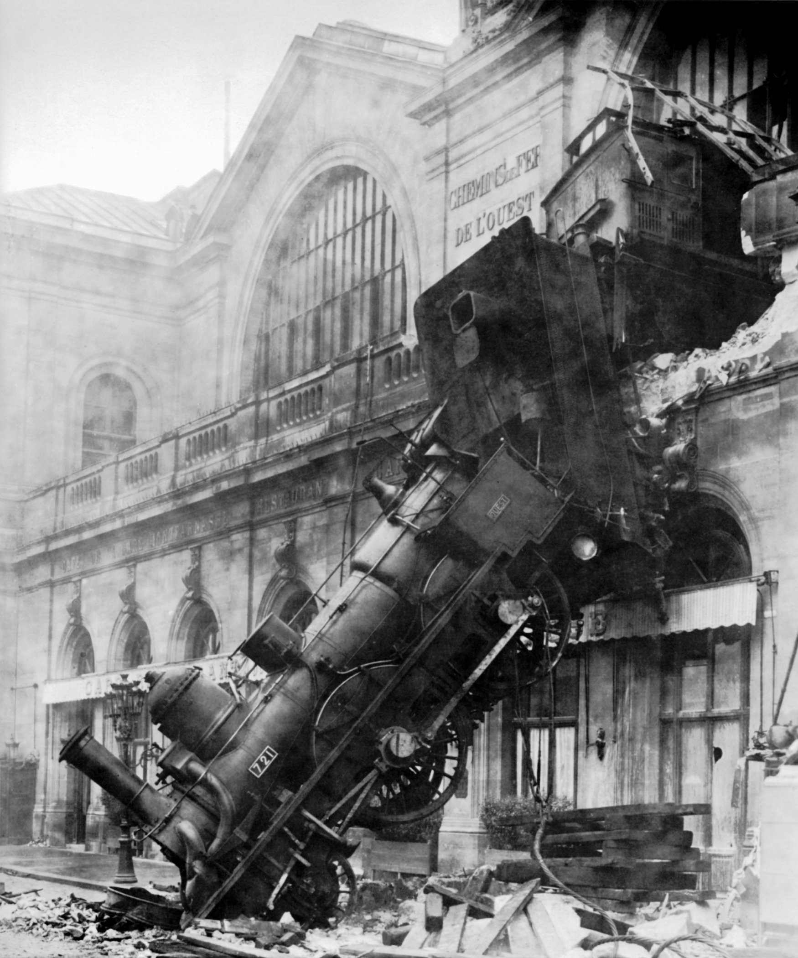
Sub-optimization
1. The tendency to devote most of our attention to things we think we understand best
2. The tendency for one part to compete with another to the detriment of the whole.
Notes:
Adopting a piecemeal approach to a systems problem.

Slide 55
Sub-optimization
1. The tendency to devote most of our attention to things we think we understand best
2. The tendency for one part to compete with another to the detriment of the whole.
Data can be unconsciously biased by our prejudices and expectations
Notes:
Take the most unbiased and honest overview accessible.

Slide 56
Sub-optimization
1. The tendency to devote most of our attention to things we think we understand best
2. The tendency for one part to compete with another to the detriment of the whole.
Data can be unconsciously biased by our prejudices and expectations
Attend to the unknowns first. Look at the whole picture.
Notes:
Handle the unknowns first. Review the whole picture, and look for unknown unknowns.

Slide 57
Sub-optimization
1. The tendency to devote most of our attention to things we think we understand best
2. The tendency for one part to compete with another to the detriment of the whole.
Data can be unconsciously biased by our prejudices and expectations
Attend to the unknowns first. Look at the whole picture.
Acting on the tiniest intuitive suspicion may save your patient’s life.
Notes:
Listen to your intuition based on unconscious accumulation of experiences. Since these data are not formally encoded, machines are not good at this.
Faced by a situation of which we know and understand little – and all situations are like this for the first time – we have an innate tendency to focus on the things we understand, hoping vaingloriously that we shall understand more later about the things of which we are presently ignorant. As Norman Augustine established “Hope is not a strategy.” This ostrich philosophy, apart from its metaphoric usefulness, is lethal. Painful though it may be, those areas of our highest ignorance, identified by our intuitive suspicion that something can go wrong, are the ones most worthy of our immediate concentration.
The classical train wreck at Montparnasse Station on 22nd, October 1895, cause by a driver making up lost time and a failed Westinghouse brake. Neglect of the most obvious joint causative agents.
We tend to give less care to things we don’t know,
or don’t know whom or where to ask,
or don’t understand,
or just can’t handle,
or fear.

Slide 58
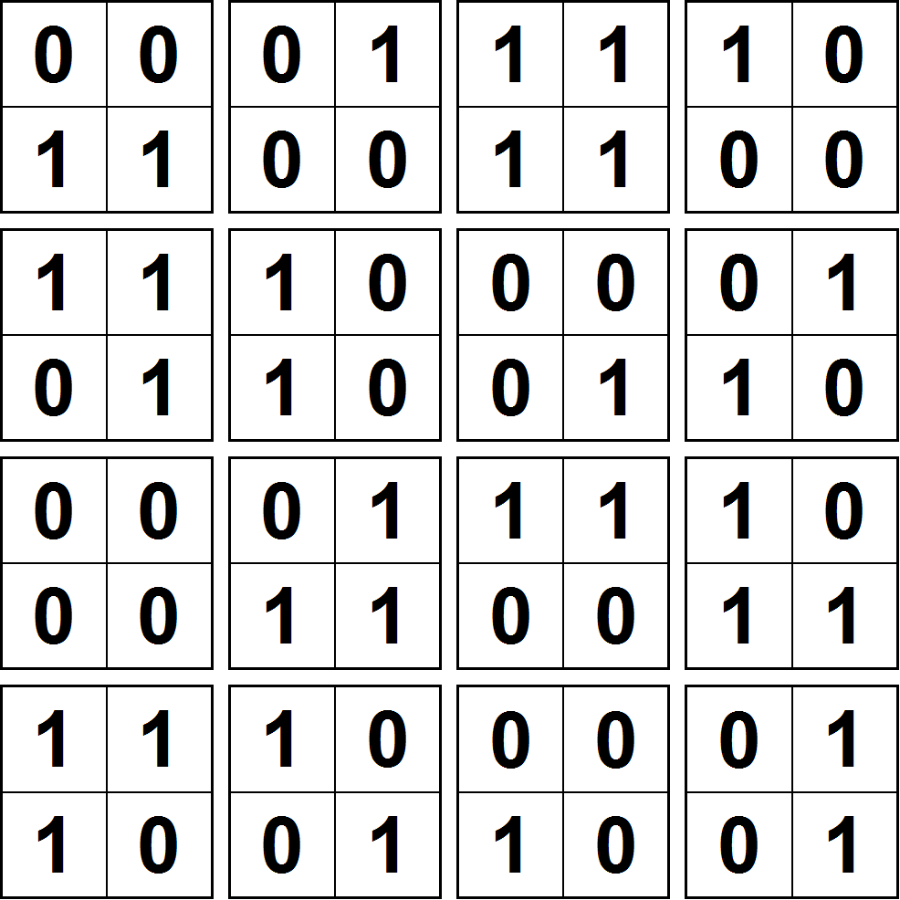
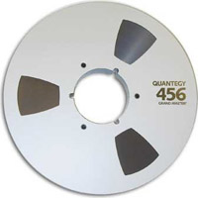
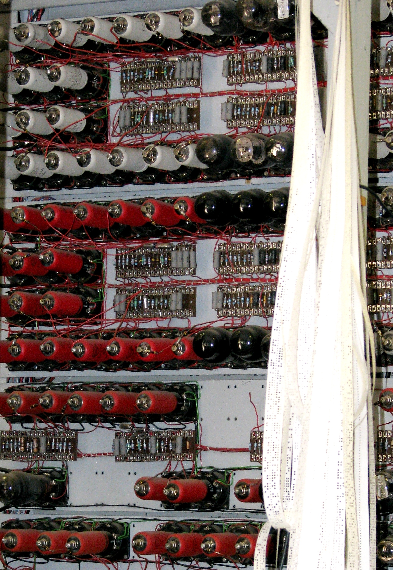
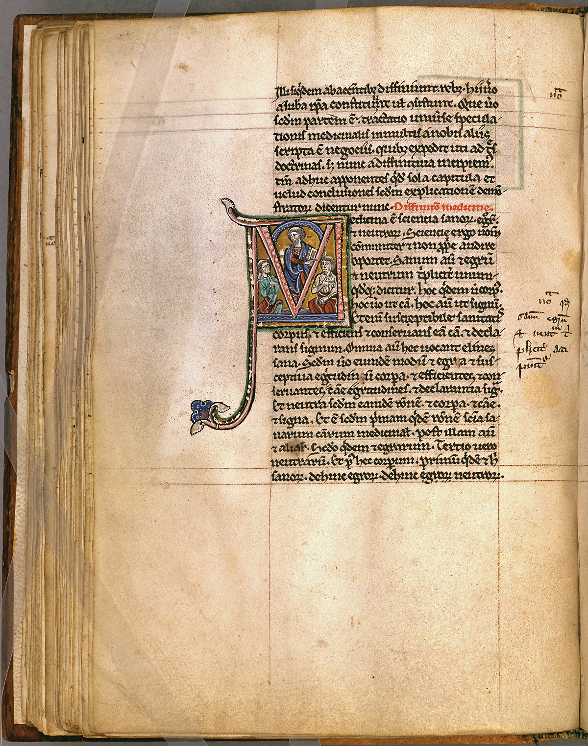
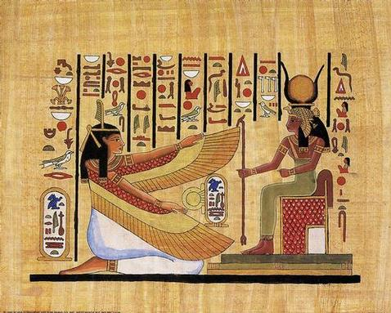
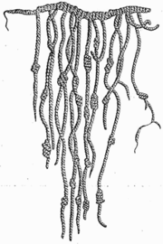
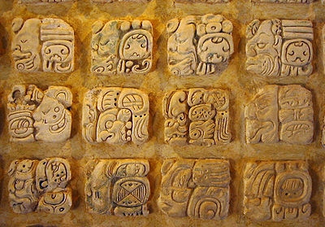
Archive Accessibility
Ones and Zeroes in the Cloud
DVD
Magnetic tape
Film
Server Farm
Memory
Jacquard Loom
5- hole paper tape
Printing
Quill & Scroll
Hieroglyphic
Handwriting
DNA
Clay Cuneiform
Illuminated Manuscript
Quipu
Mayan Glyphs
Notes:
Data storage and archive media are varied and discontinuous.
Problems are (1) single copy loss, (2) reading needs special machines, whose existence is evanescent, and may no longer be available, (3) accumulation of errors, and (4) loss of linguistics or symbolic translation references.
The cloud is proposed as a next step, but I am not yet wholly convinced that it solves all the previous problems.
Recording media evolve and do not always offer physical or linguistic continuity. Media suffer from deterioration, loss, translation errors, linguistic evolution and translation discontinuity. All these are now worse with modern media.
Illustrated examples are a Sumerian clay tablet with envelope (burning the library fires the clay), an Egyptian Papyrus with monumental hieroglyphic, an illuminated Medieval manuscript on vellum, an Inca quipu, Mayan glyphs, DNA with a Caduceus, the idea of remembering as “Memory”, a quill and scroll with Handwriting, moveable type (and other) Printing, Jacquard loom program roll, 5-hole paper tape (with Colossus at Bletchley Park), Magnetic tape, Film, a Digital Video Disk, a Sever farm, and the Cloud (with a binary pandiagonal magic square).
{Albrecht’s Durer’s version painted in 1514 is less pure so that the date appears in the two consecutive center squares of the lowest row – an elegant if egotistical sophistry.}

Slide 59
Archive Accessibility
Single copy loss
No good method of backup
Memory
Quill & Scroll
Hieroglyphic
Handwriting
Clay Cuneiform
Illuminated Manuscript
Quipu
Mayan Glyphs
Notes:
If there is only one copy it is vulnerable to total loss. No one has ever lost a file. Right?
Single copy loss. Burning a Sumerian clay tablet fires the clay, but other single copies media may be destroyed.

Slide 60
Archive Accessibility
DVD
Magnetic tape
Film
Jacquard Loom
5- hole paper tape
Reading machines are no longer available
Tapes Cassette, Punched, 8-track, VHS
Disks Vinyl Records, Floppy, Laser
Notes:
Any special reading tools may have been lost. I have some 8-inch floppies.
Many media require special machinery to read them. They may not longer be available.

Slide 61
Archive Accessibility
DVD
Accumulation of Errors
Magnetic tape
Aging deterioration
Damage in Storage
Successive copying
Film
Memory
Quill & Scroll
Handwriting
DNA
Illuminated Manuscript
Notes:
Successive copying accumulates errors.
Error may accumulate, either by deterioration through aging, damage in storage, successive copying.

Slide 62
Archive Accessibility
Ones and Zeroes in the Cloud
DVD
Loss of the Translation Capability between Encoding Methods
Magnetic tape
No ‘Rosetta Stone’
Ogham
Linear A
Indian Pictographs
Hieroglyphic
DNA
Clay Cuneiform
Quipu
Mayan Glyphs
Notes:
Translation correspondences can be lost.
Loss of linguistic or symbolic translation references, no one knows any longer how the symbolic representation translates into modern intelligible concepts.

Slide 63
Archive Accessibility
Ones and Zeroes in the Cloud
Server Farm
Maybe the Current Ideas Solve all these Problems
Maybe not !
Notes:
The cloud is proposed as a next step, but I am not yet wholly convinced that it solves all the previous problems.

Slide 64
Self-consistency
If data are not internally consistent, then some or all are wrong.
If the data are internally consistent, then some or all may not be wrong.
Self-consistency is Necessary but not Sufficient.
For large data sets, even self-consistency can be difficult to confirm.
Some apparent conflict may be resolved by including
supplementary information not intrinsic to the data
For medical health much that we have is circumstantial support.
Notes:
Self-consistency (Gödel notwithstanding) is certainly necessary in data to be used for medical diagnosis.
For large data sets it may not be trivial to confirm this condition, and even if true it may not be sufficient.

Slide 65
Necessity and Sufficiency
Necessity
Measurements must be as good
and Data bases as complete and accurate as possible.
Sufficiency
Enough trustworthy information must be available
for accurate medical diagnoses
For large data sets a sufficient criterion for trustworthiness may not always be readily accessible – probabilities rule, but we rely on
Clinical Trials, Experience, Likelihood, Plausibility, Acceptability
And yet we LIVE or DIE by these innumerate guidelines.
Notes:
Sufficiency is even harder to achieve and guarantee, but is critical nevertheless.
While the best quality and trustworthiness of our information is always necessary, it need not always be sufficient. Conversely – and perversely – an accurate observation by an intuitive diagnostician may by sufficient to diagnose and predict a cure for a mysterious condition in and unlikely patient. Wed wish to bias the probabilities in favor of the economical machine diagnosis being more often right than the expensive trained medical practitioner, from nurses to specialists in different areas with less overlap that might be ideal.

Slide 66
The Ideal Criterion
We want a
General Economical Machine
to be
RIGHT more often
than an
Expensively Trained Medical Professional or Specialist
We would like it to be right all the time !
Notes:
We want automated methods of helping overworked medical practitioners in an ever increasingly stressed condition.
The target of all the challenges of using big data for medical diagnoses and potential treatment recommendation is to make the machine not only more universally applicable and available than a range of highly trained medical specialists and professionals, but to be substantially more economical.

Slide 67
Summary and Conclusion
We LIVE or DIE by accurate medical evaluation.
We increasingly have access to enormous and growing data bases.
Challenge #1
How do we assure accuracy in a data-driven world?
What error sources deserve our greatest attention?
How do we guarantee data beyond reproach?
Challenge #2
Medical practitioners must trust inevitable changes.
The paradigm shift must be perceived as enhancement.
Notes:
We want to be as accurate as possible as often as possible, and the tools to do this are beginning to be available
We have two major challenges:
(1) Getting Accurate Data
(2) Earning Trust
The medical profession bases most of its conclusions on statistical inferences and marginal assurances of differential advantages, c.f. clinical testing. While Wolfram/Alpha is fully capable of manipulating such inferences and their statistical levels of assurance, it is certainly not a straightforward application of specific numerical calculation, and I know of no currently implementable ‘sanity checks’. An experienced person may realize a statement is ridiculous – a computer, even one capable of passing the Turing test, may not.

Slide 68
Thank you for your Attention
Questions?
Comments?
Observations?
SCANADU
Notes:
Thank you for your Attention
Questions? Comments? Observations?
Final slide inviting questions, comments and observations and reinforcing SCANADU with log.

