Slide 1
Open Statistical Data in Italy
Giovanni A. Barbieri Istat
Data Summit 2010
Washiungton DC, September 9-10, 2009

Slide 2
Summary
Just provide the data, we’ll do the rest
Answers
Aggregated data
Microdata
Questions
Statistical disclosure
Metainformation and analysis

Slide 3
Just Provide the Data
Our proposal is simple: The new administration should specify that the federal government’s primary objective as an online publisher is to provide data that is easy for others to reuse, rather than to help citizens use the data in one particular way or another [Robinson,Yu, Zeller and Felten 2008]
We argue that when providing data on the Internet, the federal government’s core objective should be to build open infrastructures that enable citizens to make their own uses of the data. If, having achieved that objective, government takes the further step of developing finished sites that rely on the data, so much the better. Our proposal would reverse the current policy, which is to regard government websites themselves as the primary vehicle for the distribution of public data, and open infrastructures for sharing the data as a laudable but secondary objective

Slide 4
Crowdsourcing Government Transparency
Government information that is nominally publicly available is in fact difficult to access either because it is not online or, if it is online, because it is not available in useful and flexible formats [Brito 2008]
“Structured data” […] means that information is presented in a format that allows computers to easily parse and manipulate it
While a static web page that lists a series of news stories or proposed regulations is not structured, the web page may have a companion XML file containing the same information
A structured XML file would allow a user to sort the data by ascending or descending date, alphabetically by headline or author, by number of words, and in many other ways that a static web page does not afford

Slide 5
Brito’s Recommendations
Data should […] be made meaningfully publicly available and in today’s day and age this means it should be made available online
Information should not just be made available online, but […] online resources must also be useful. This means putting data online in structured, open, and searchable formats
Dissemination of raw data in useful formats is a government role:
Government holds the digital originals of the data and can ensure the integrity and quality of the data made available online
Rather than offering simply “one best way” to utilize data, government should allow myriad third parties to develop innovative tools that utilize the data

Slide 6
Italy’s Statistical Law
Public statistical information is provided to the Country and to international organizations through the National Statistical System
Data produced by statistical surveys included in the national statistical program are an asset of the national community
Released for research aims (rules, procedures and statistical disclosure issues set by the law)

Slide 7
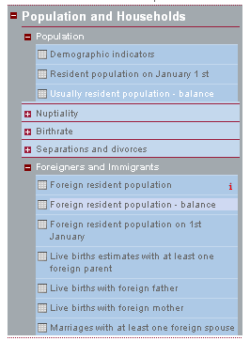
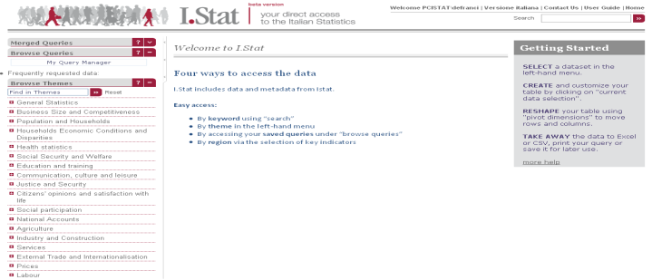
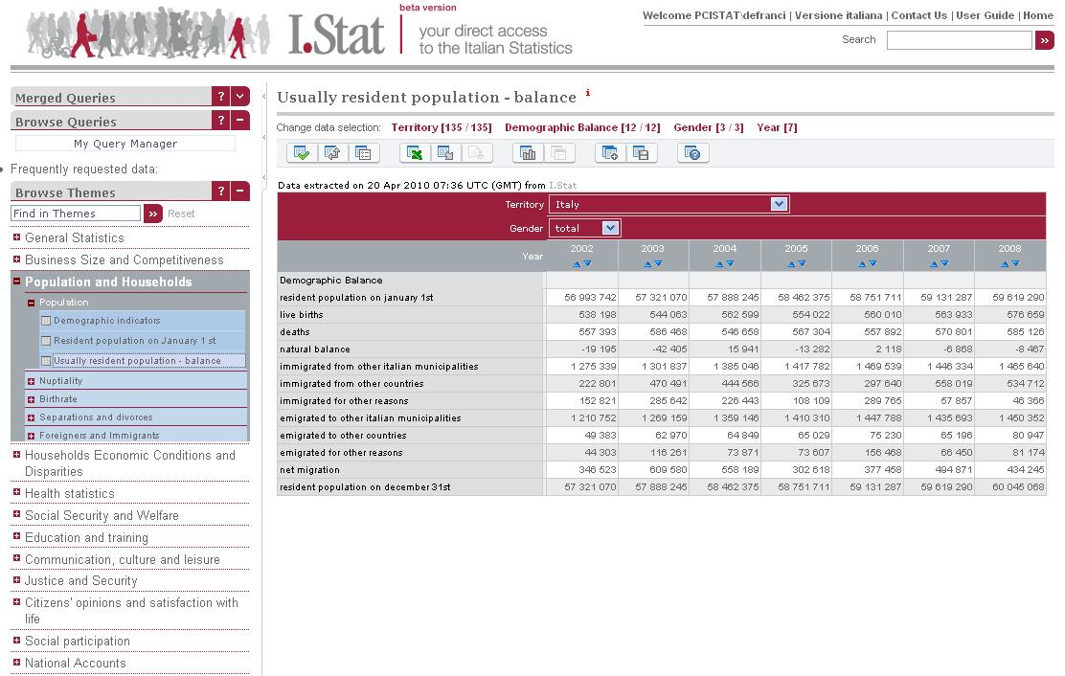
Istat’s Answers – Aggregated Data
The project I.Stat has been implemented through the customization of OECD.Stat, the OECD data warehouse
Theme
The customization has involved the graphical layouts, the interfaces translation into the Italian language, the setting of the software according to the owned hardware
The statistical contents are broken into themes and sub-themes and are based on multidimensional data structures (Hypercubes)
Subthemes
INDICATORS
Datasets
TIME
TERRITORY
THEMATIC STRUCTURE
HYPERCUBE
STATISTICAL TABLE
TERRITORY
Release dates
May 2010: beta version on the Istat Intranet
July 2010: beta version on the Istat Web site
INDICATORS
YEARS

Slide 8
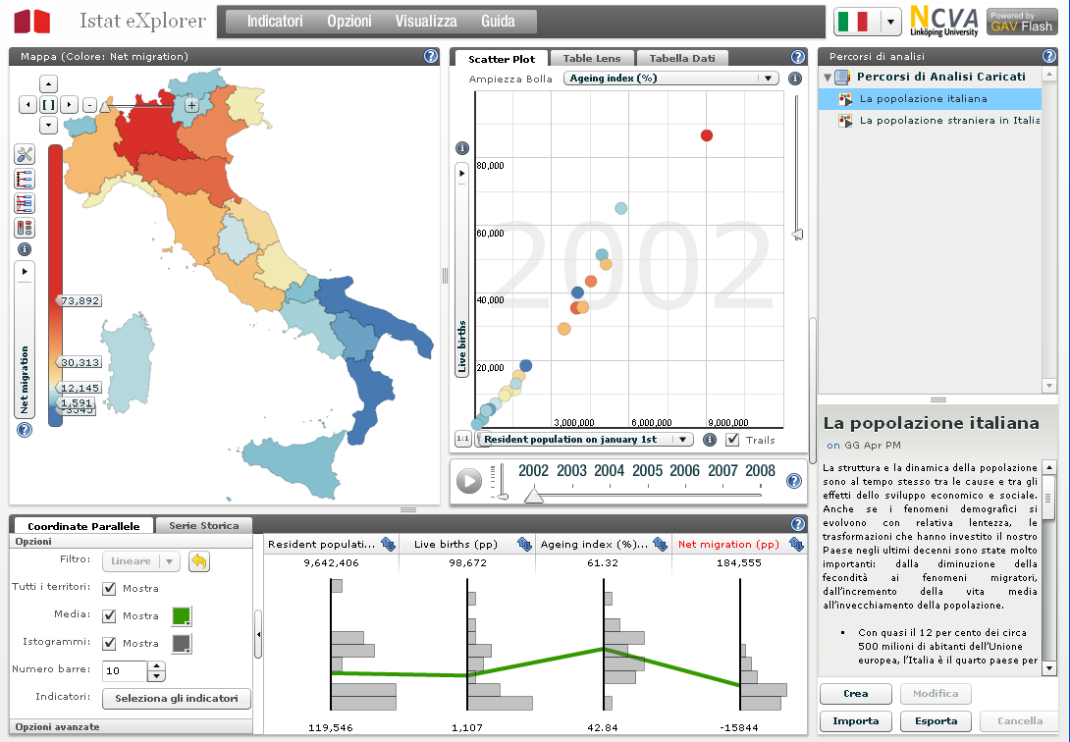
Istat’s Answers – Visualizing Data
Thematic maps
Dynamic scatter plots
Statistics eXplorer – developed by NComVA - is a web compliant application that enables users to explore simultaneously spatial, temporal and multivariate data from multiple perspectives, to discover interesting relationships, to share their incremental discoveries with colleagues and finally to communicate selected relevant knowledge to other users
In August 2010 Istat and NComVA concluded a Technical Services Agreement to use Statistics eXplorer at Istat
Ultimate goal is to develop Istat.eXplorer as the corporate GeoAnalytics Visualization environment
Now we are going to adopt Statistics eXplorer for NoiItalia, a publication which provides data by regions, enabling users to exploit all the features of this application
Integrated graphs
Storytelling

Slide 9
Istat’s Answers – Microdata
ARMIDA, an archive of validated microdata
Free circulation within the National Statistical System (except for direct identification data and for sensitive personal data – as stated by the law)
A Data Archive for National Italian Statistics, an ongoing project
Partners:
Istat (Statistics Italy)
Bank of Italy
National Statistical System

Slide 10
International Background
As the world economy becomes more global, complex and diverse, comprehensive and good quality of micro-data has become an important tool for evidence-based decision making on complex issues… Access to official micro-data confronts NSOs (National Statistical Offices) with a serious challenge. They need to provide policy makers and analysts with the best information available but in doing so, they run the risk of disclosing confidential information (Ribeiro, OECD)
Confidential data which allow direct or indirect identification can be disseminated to another producer of national statistics as well as to Eurostat and the Ecb in accordance with their respective spheres of competence. However, in order to ensure an efficient collection, compilation and dissemination of European Statistics, the Ecb would find it useful to extend the scope of the exchange of confidential data … (Trichet, ECB)

Slide 11
The Rational for Microdata
But the rationale for using microdata was made by Herbert Simon already in 1986:
We must find new sources of evidence and new ways of analyzing the evidence if we are to make progress toward viable economic theories that can make correct predictions of economic events.
When physicists find themselves in a situation where their observations are not refined enough to reveal the phenomena they wish‘ to study, they concentrate on improving their instruments, not their statistical techniques
The new strategy that can help us out of our difficulties is to make full use of the microdata that we have generally neglected in the past
When we move downward from the abstraction and aggregation of markets and whole economies, we encounter economic agents – real flesh-and-blood human beings who are engaged in problem solving and decision making

Slide 12
The Project
Statistical disclosure risk management
Production and release of microdata files
Public Use Files
Research Files
Techniques for creating synthetic files
A collective methodological effort
Research Data Center (with remote access)
ADELE + BIRD
Integrated datasets
E.g. KombiFiD, Combined firm data for Germany
Development of the Data Archive for National Italian Statistics
Governance issues

Slide 13
Open Issues [1]
Should statistical disclosure control rules be a crystallized concept?
Personal/household data vs. business data
Normal distribution vs. asymmetrical or power law distributions
E.g. household size vs. enterprise size
Timely vs. “stale” data
Disclosed individual information may be detrimental for an enterprise if it is in real time
It may affect fair competition
What if the typical release lag for structural business information is 18 months after the reference year?
What if the P&L account information is already public?

Slide 14
Open Issues [2]
Are experts superseded by number crunchers (Ian Ayres)?
Statistical techniques are essential in many fields (epidemiology, marketing, quality control, accounting, forecasting, polls, R&D, insurance …)
The scientific method is largely based on standardized procedures of statistical inference (definition of hypotheses, experiment design, analysis of results)
A new class of experts: authority not based on expertise and personal evaluation, but on quantitative information and the application of formalized techniques
Statistics substituted judgments with rules

Slide 15
Open Issues [3]
Is hacking and mashing without contraindications?
Information is a social relationship
The value of information is where its meaning is, and meaning stems from the meeting of social actors (Wittgenstein) :
A common language and terminology
Attention
Interest
A shared paradigm
Information is a service:
Its value is in its relevance (relevance is goal dependent!)
The possibility for the user to access the competence of the producer

Slide 16
Towards the Knowledge Society
Data | The quantitative representation of a phenomenon captured in the moment it happens or is produced
⇓
Information | The comprehension and interpretation of the data, stemming from the interaction of social actors and the attribution of meaning on the receiving side
⇓
Knowledge | The attribution of value to the information, depending on the perspective of satisfying specific user’s needs and using the information in a decision making process

