Slide 1

Data Sharing and Archiving:
A Professional Society View
Clifford S. Duke
Ecological Society of America
September 9, 2010
Notes:
What I will try to do today is give you a snapshot of how a scientific research society has worked to promote data sharing and archiving.

Slide 2

The Ecological Society of America
Promoting the science of ecology
  Founded in 1915
  The nation’s leading professional society of ecologists
  Approximately 10,000 scientists, researchers, policy-makers, and managers
  Programs
  Education
  Meetings
  Public Affairs
  Publications
  Science
Notes:
ESA background

Slide 3





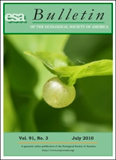
Journals
Notes:
We publish 5 peer-reviewed journals, including Frontiers, which goes to all members, and Ecosphere, new open-access online-only journal. The Bulletin is our on-line journal for member and Society news.

Slide 4
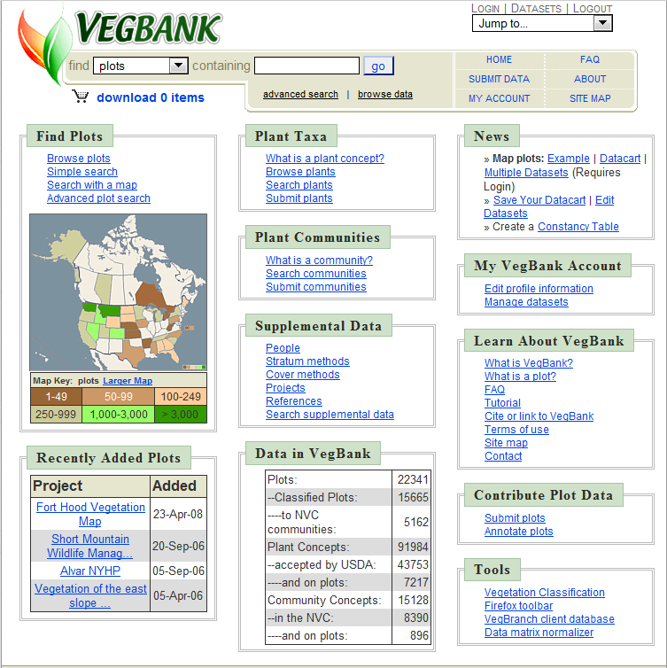
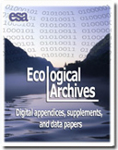
Data Repositories
Notes:
We have two data repositories. Ecological Archives (edited by Bill Michener) publishes materials that are supplemental to articles that appear in the ESA journals as well as peer-reviewed Data Papers with abstracts published in the printed journals. Ecological Archives is published in digital, Internet-accessible form.
VegBank is the vegetation plot database of ESA’s Panel on Vegetation Classification.
(VegBank consists of three linked databases that contain (1) the actual plot records, (2) vegetation types recognized in the U.S. National Vegetation Classification and other vegetation types submitted by users, and (3) all plant taxa recognized by ITIS/USDA as well as all other plant taxa recorded in plot records. Vegetation records, community types and plant taxa may be submitted to VegBank and may be subsequently searched, viewed, annotated, revised, interpreted, downloaded, and cited.)

Slide 5
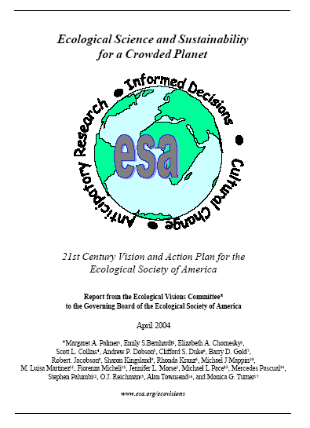
ESA and Data Sharing
Ecological Visions Report 2004
ESA should
“promote the standardization of data collection, data documentation, and data sharing.”
Recommended actions include:
  Development of ESA data registry
  Requiring data and metadata availability
  Convincing funders and federal agencies to require and support open access to data
  Encourage training in ecoinformatics
Notes:
ESA has worked on data sharing and archiving since at least the early 90’s. Our recent efforts originated in 2004 with the ESA Visions Report. A key recommendation of the report was that ESA should promote data sharing. Specific recommendations included…..

Slide 6
Data Sharing Workshops
Society Summit, September 2004
    Brought together 12 societies to explore development of common policies on data sharing.
Set the stage for workshops to discuss resource needs and obstacles in more detail:
    Data registries (July 2006)
    Data centers (December 2007)
    Cultural obstacles to data sharing (May 2008)
    Incentives for data sharing (February 2009)
Notes:
Following that recommendation, over the last 6 years, ESA has organized a series of NSF-sponsored workshops bringing together representatives of professional societies and other organizations in ecology, evolution, and organismal biology. The discussions have focused on how to encourage data sharing in our communities and on the resources needed to make that possible.
Society Summit: brought together 12 professional societies to explore development of common policies on data sharing and to identify issues needing further discussion.

Slide 7
Obstacles to Data Sharing
Goals
Clearly delineate what barriers exist to data sharing.
Develop recommendations to reduce or eliminate those barriers.
Notes:
I’ll briefly describe the two workshops on obstacles and incentives. Obstacles workshop in May 2008.

Slide 8
Obstacles to Data Sharing
Recommendations
Require deposition of data as a condition of publication.
Tie sharing of data to funding.
Make data archiving simple, user friendly.
Rigorous and well-informed financial and legal analysis is fundamental to the future development of data sharing practices.
Journals and agencies should develop policies to address sensitive data.

Slide 9
Incentives for Data Sharing
    Goal
  Identify incentives and recommend steps to overcome barriers to productive sharing of scientific information from the perspective of funders, researchers, and publishers.
Notes:
Incentives workshop in Feb. 2009.
The goal of this workshop was essentially to help identify paths forward for data sharing.

Slide 10
General Recommendations
Make it easy
Pay for it
Give credit
Add value
Make it universal
Notes:
General recommendations from the incentives workshop, building on the others.

Slide 11


Roles of Professional Societies
Advocate for resources
Set requirements for data sharing for authors in journals
Provide recognition
Provide training
Notes:
Some overall comments on the roles of professional societies based on our efforts and those of the American Society of Naturalists, who have participated in our workshops.

Slide 12

A Research Commons
[a] set of resources available to all scientists, either as part of the public domain or on standard terms and conditions that facilitate scientific collaboration, efficient reuse of materials and data, and dissemination of knowledge
Notes:
The ultimate challenge: a “research commons,” as described by Schofield et al. in Nature last year, in an article about a Rome meeting of mouse researchers.
“The heart of a research commons is one in which academic research is not impeded by restrictions on use and access to data and materials, in line with the principles of the Creative Commons (see Science Commons Database Protocol http:// sciencecommons.org/resources/faq/database-protocol)”
“we believe the [mouse] research commons is not just a utopian dream. Rather it should create a paradigm shift to establish this as a norm for the research community.”
I suggest that this should become the norm for the research community as a whole.
PN Schofield et al. 2009. Post-publication sharing of data and tools. Nature 461:171-173.

Slide 13

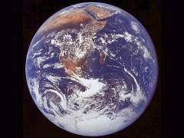
Conclusions
“…technology and infrastructure are not the ultimate limiting factors for data sharing — the individual scientist is.” - C. Duke, Frontiers October 2006
Notes:
In conclusion, in order to help solve emerging global problems in ecology, we need hardware and software and financial resources to make data sharing easier and more efficient.
But ultimately, data sharing is a fundamental moral obligation on the part of individual (emphasis added) scientists, which enriches both individual research and science as a whole.

Slide 14

1990 M Street NW, Suite 700
Washington, DC 20036
(202) 833-8773
www.esa.org/science
csduke@esa.org

