Slide 1
OPEN DATA AT THE WORLD BANK Neil Fantom Development Data Group

Slide 4
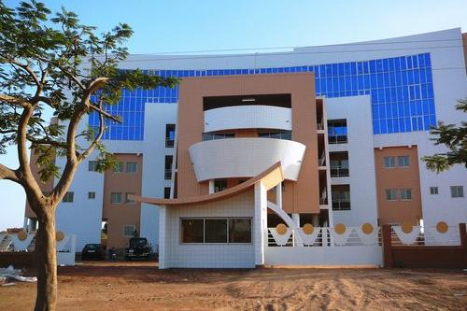

Slide 5
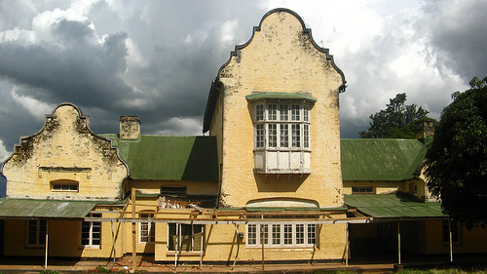

Slide 6
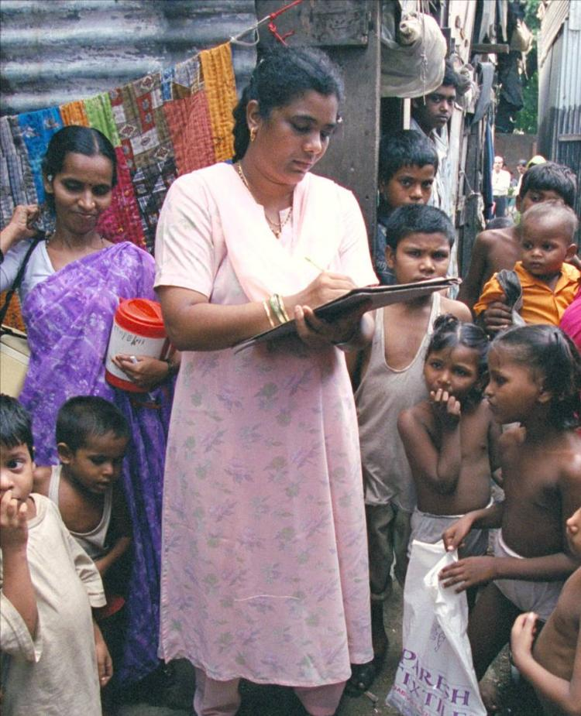
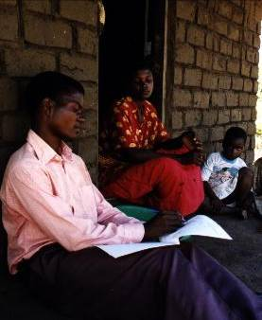

Slide 7
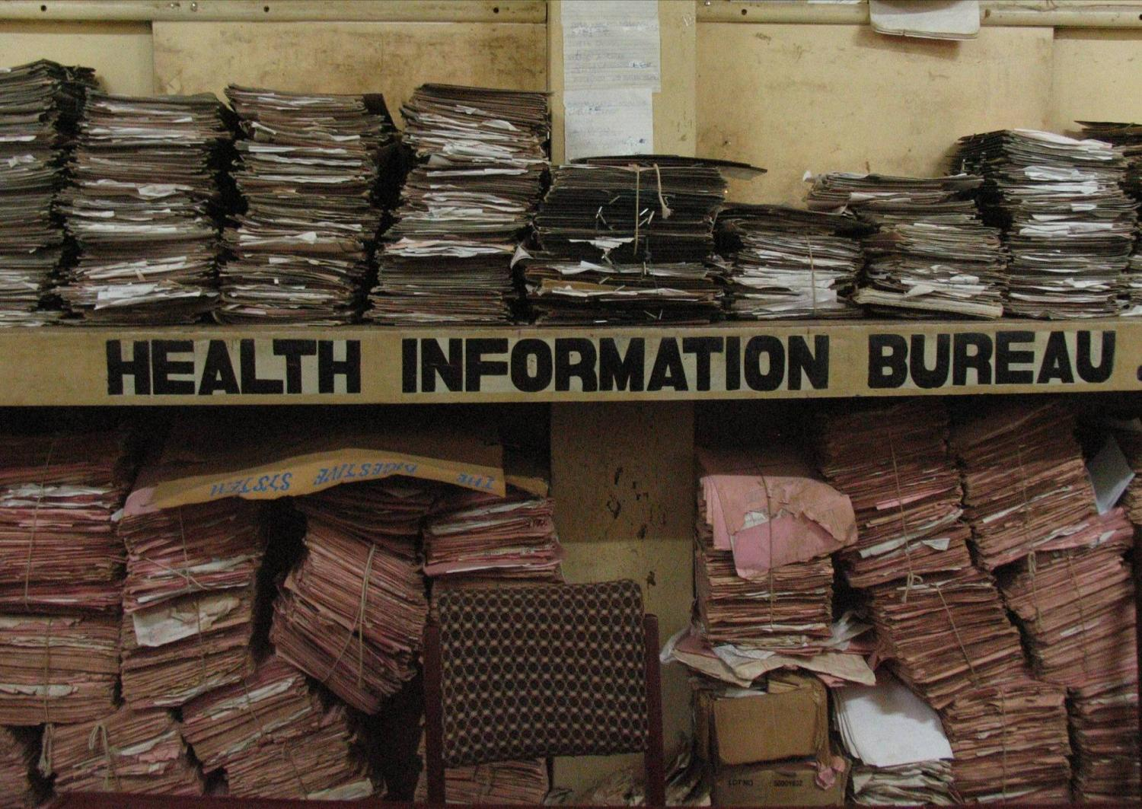

Slide 9
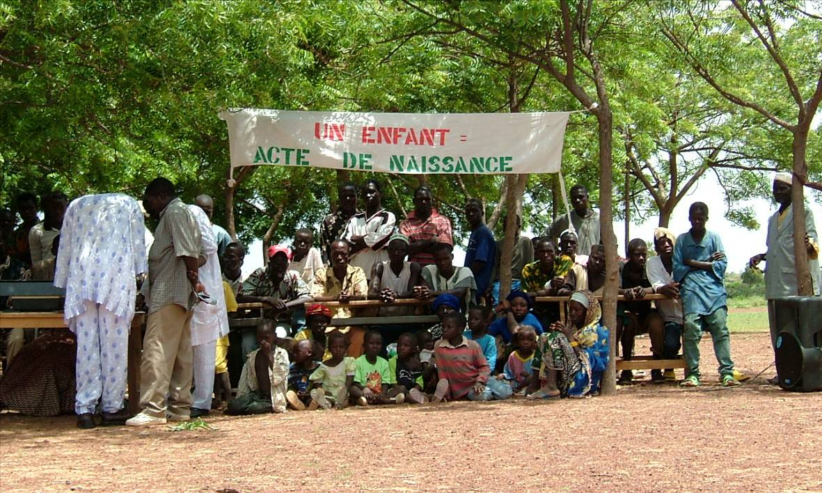

Slide 10
Objectives
Open
data freely available
Accessible
data easy to use and re-use
Searchable
data easy to find

Slide 11
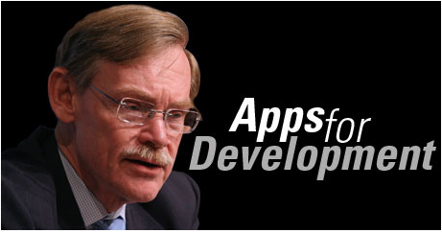
Motivation
Part of a broader move, including new Access to Information Policy
Aim is to stimulate use of development data to help solve development problems
Builds on global Open Data initiatives

Slide 12
Approach
Initial focus on popular time series indicators
New website
Best practice Terms of Use
Multiple access options: downloads, query tool, search, Application Programming Interface (API) for developers, Drupal modules, embeddable widgets…
Organizing competition to technology and development community

Slide 13
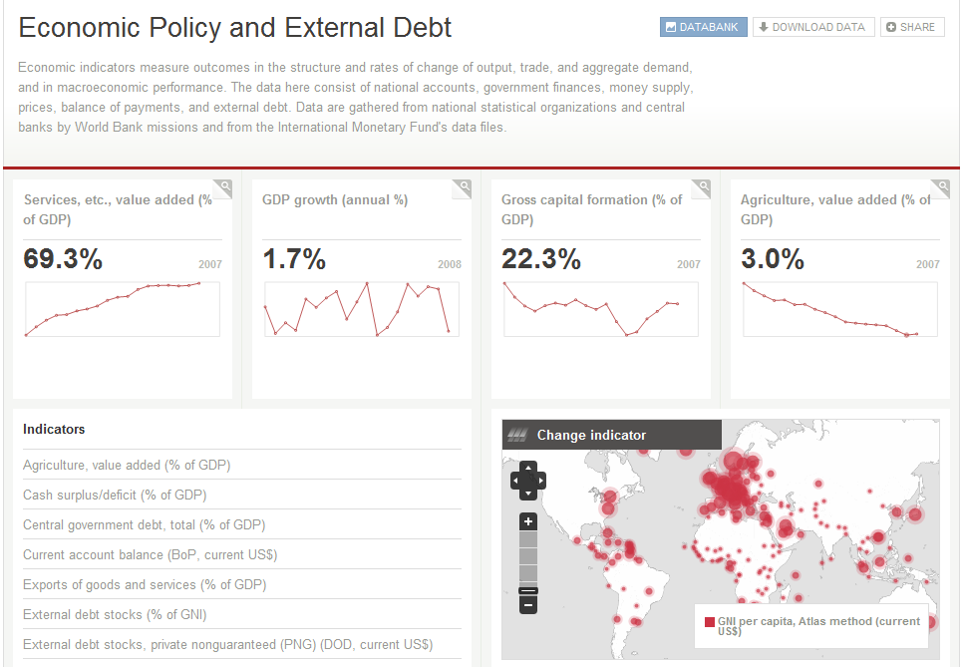
New site: data.worldbank.org

Slide 14
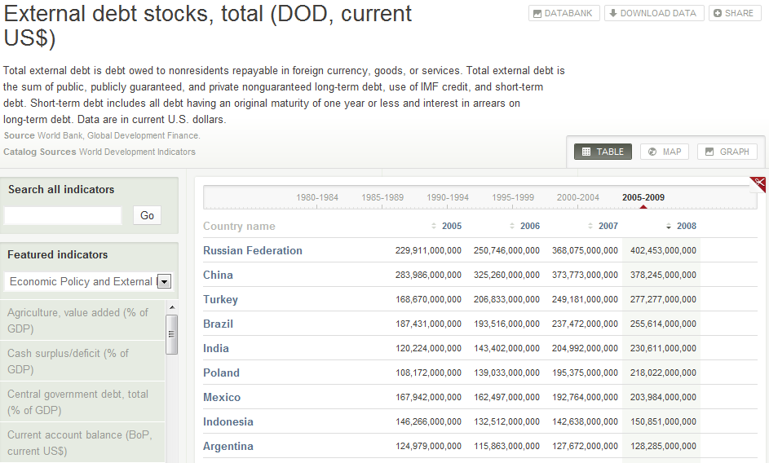
More indicators…

Slide 15
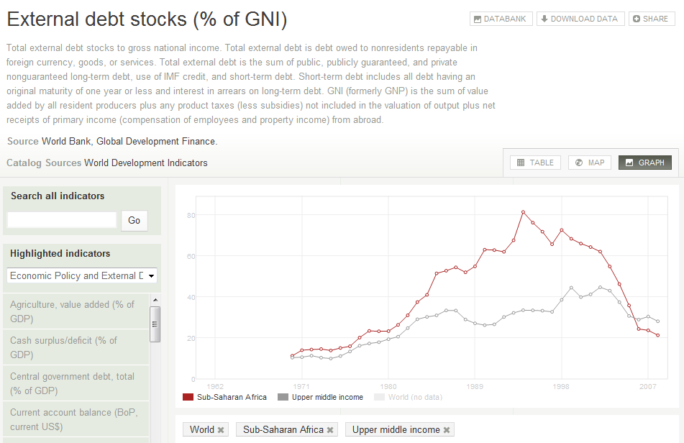
Better charts…

Slide 16
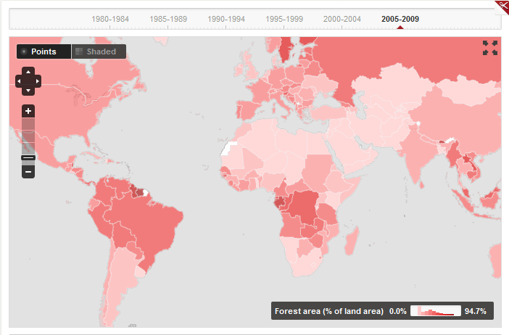
Better maps…

Slide 17
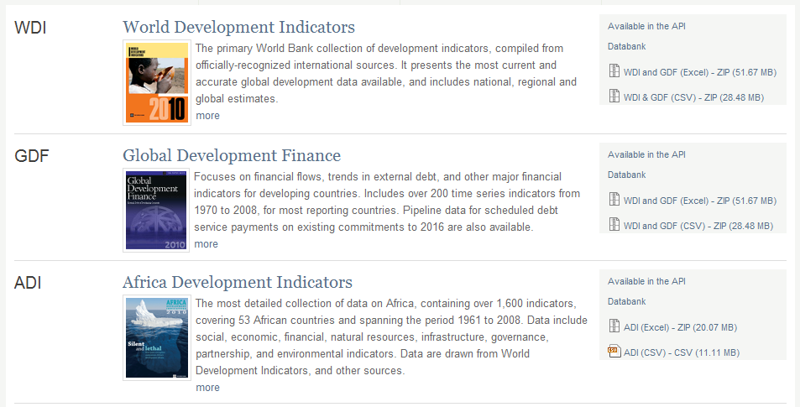
More datasets…

Slide 18
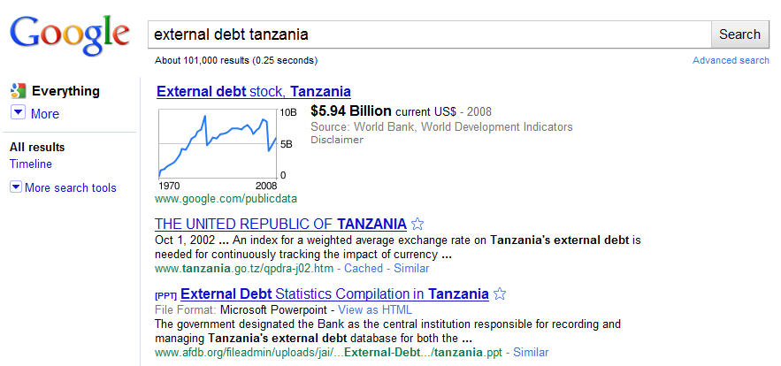
What others are doing with our data

Slide 19
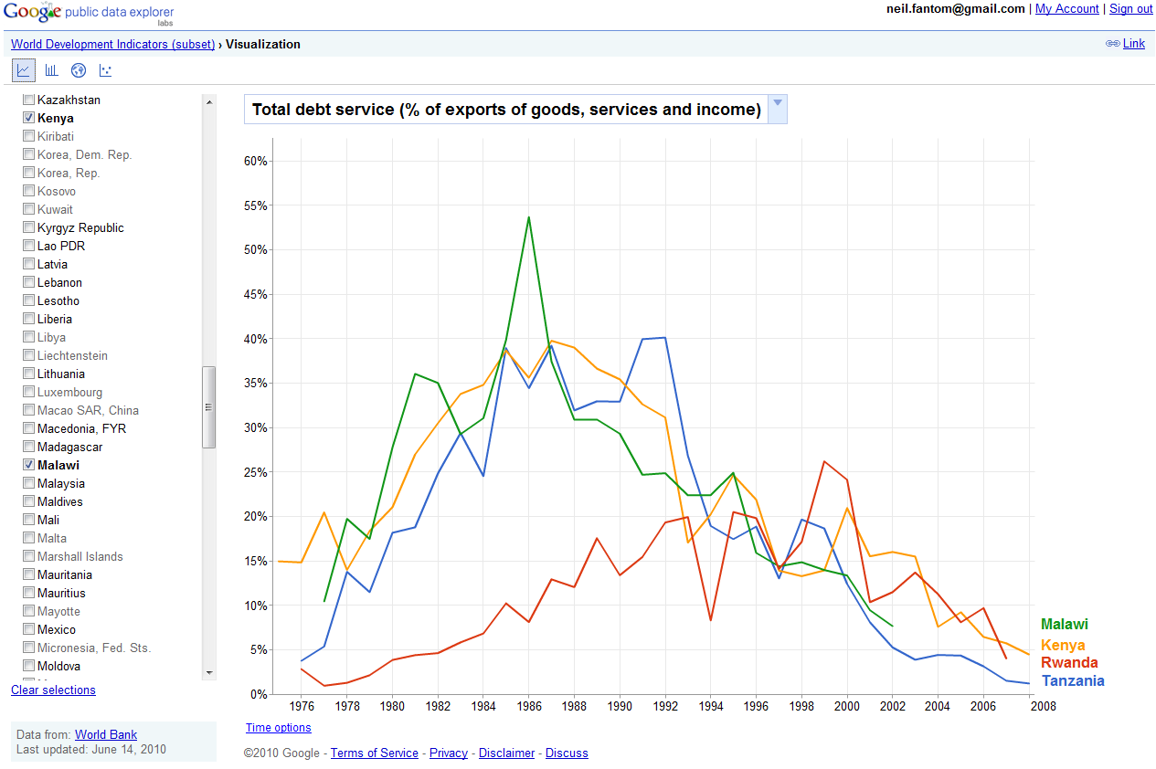
What others are doing with our data

Slide 20
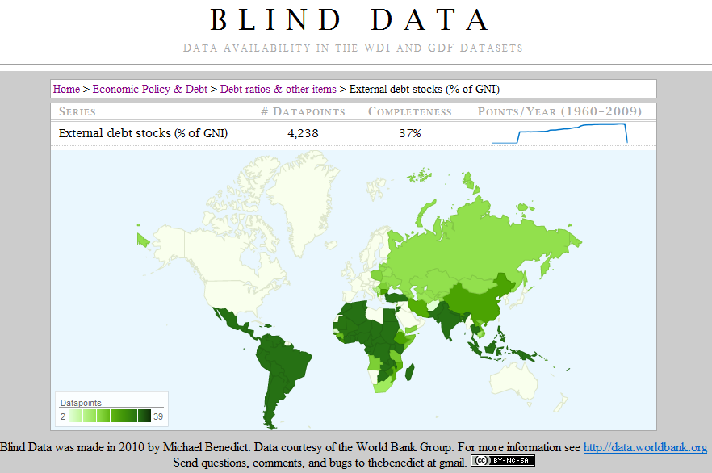
What others are doing with our data

Slide 21
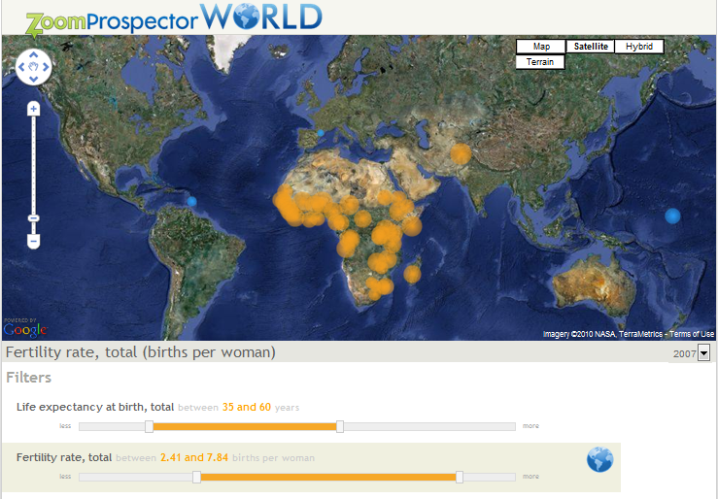
What others are doing with our data

Slide 22
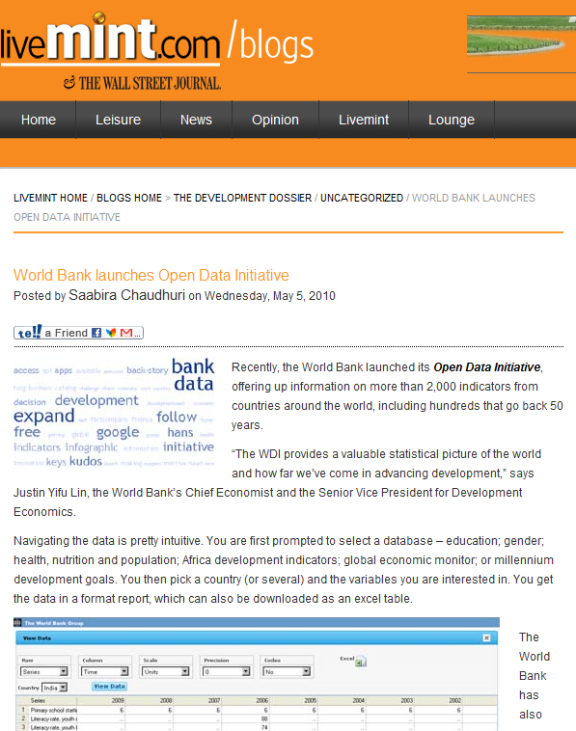
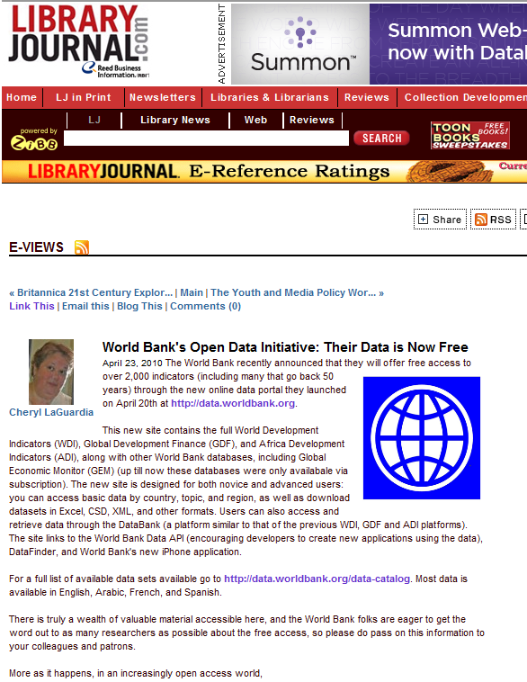
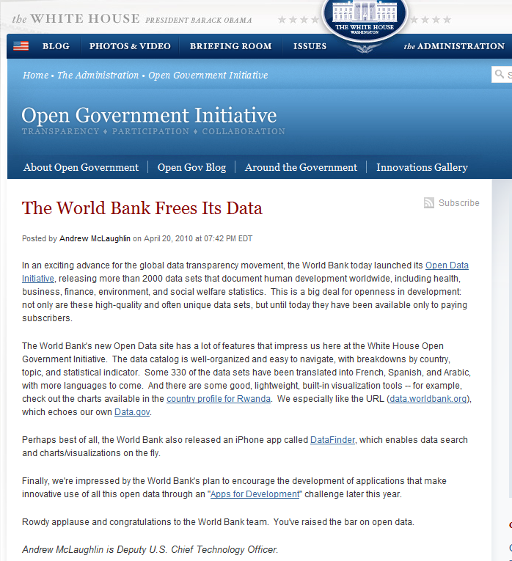
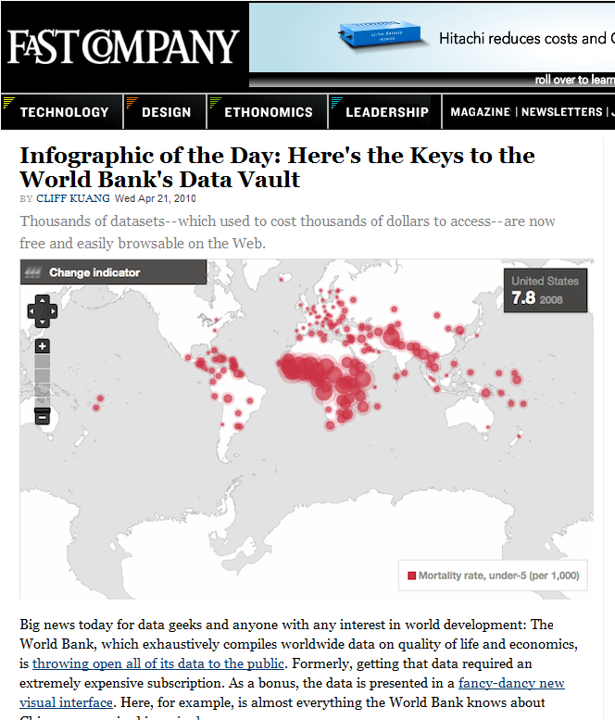
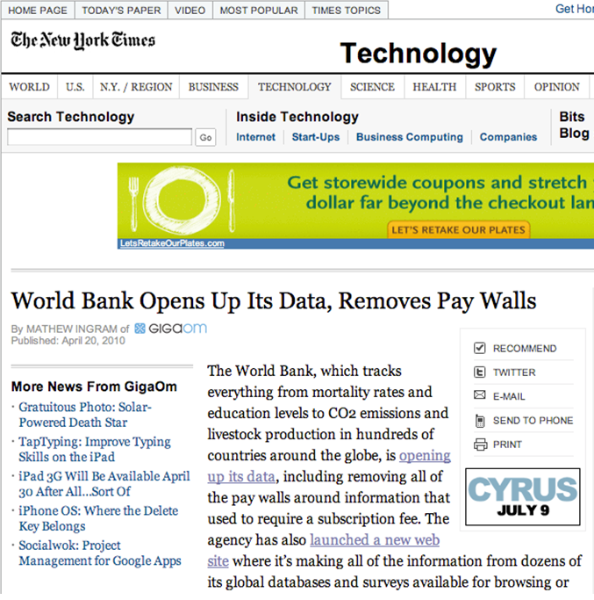
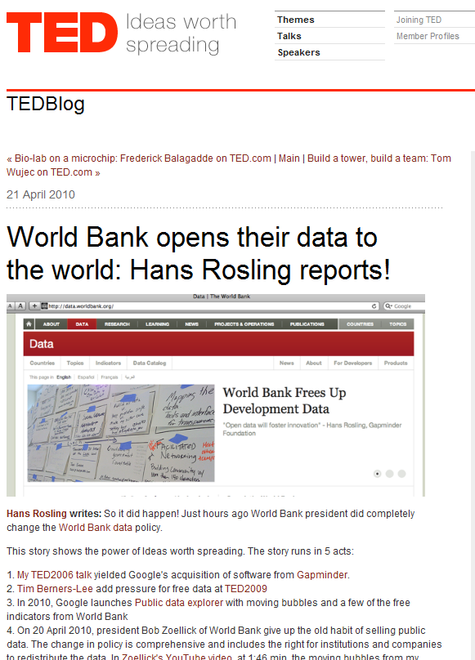
What they are saying…

Slide 23
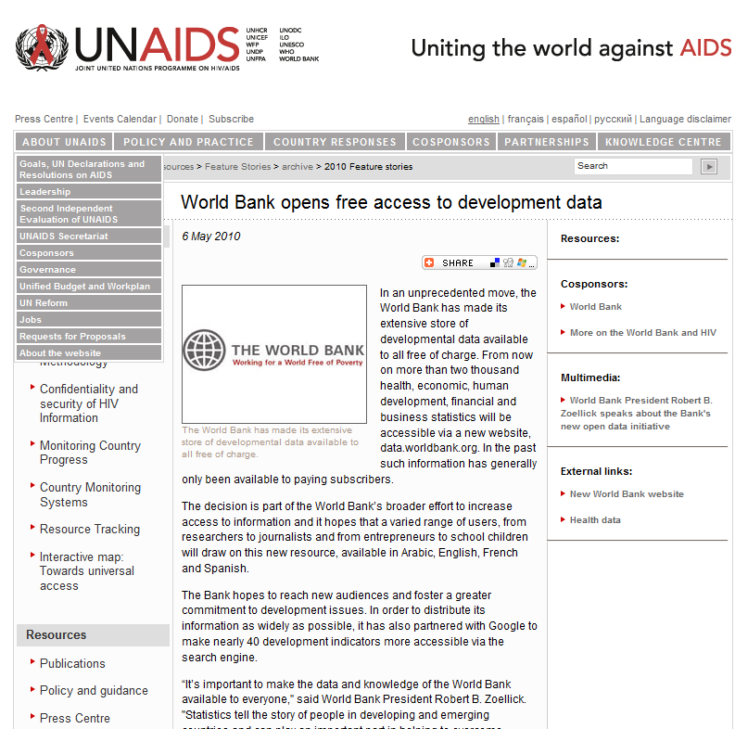
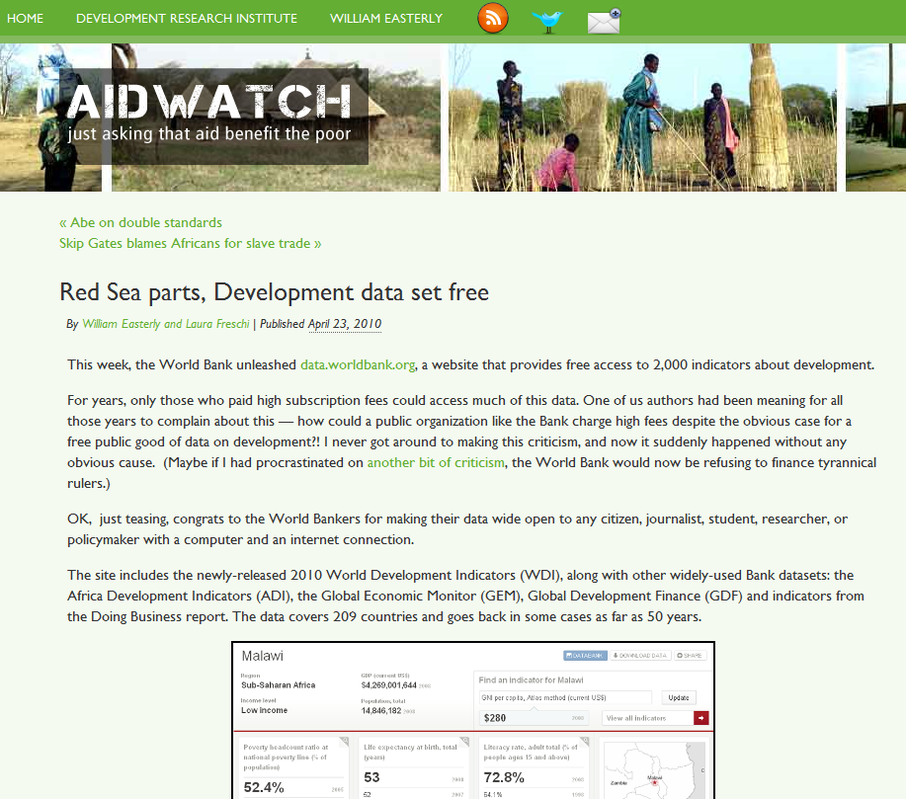
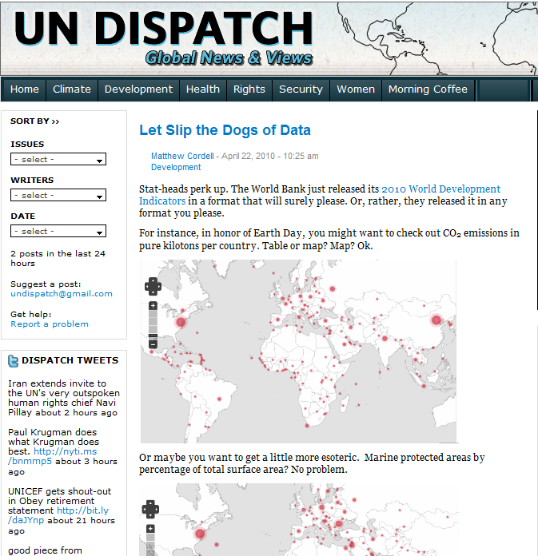
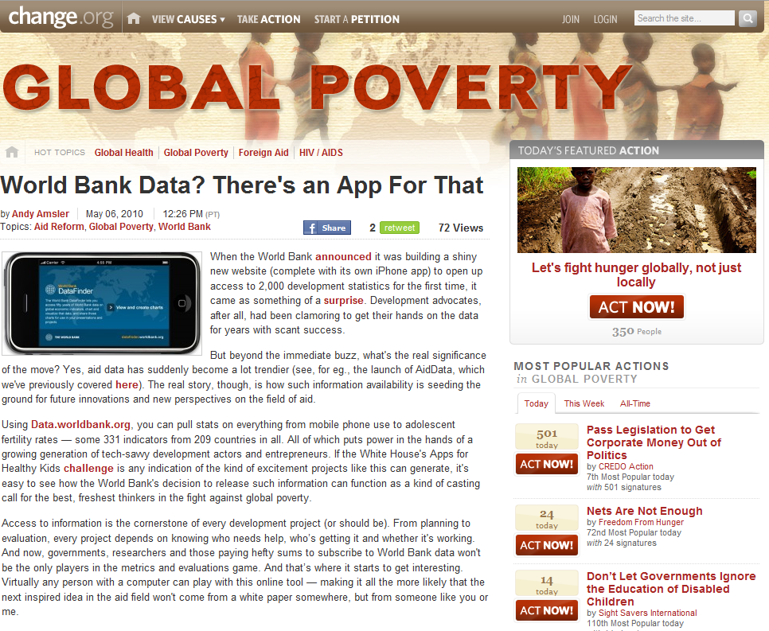
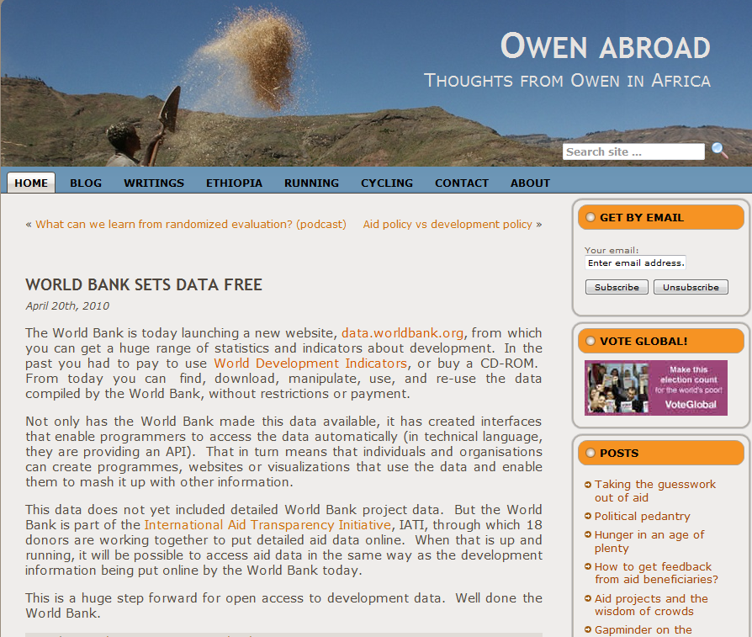
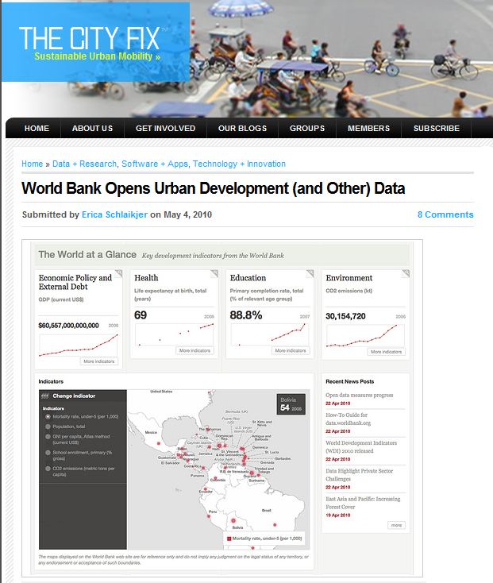
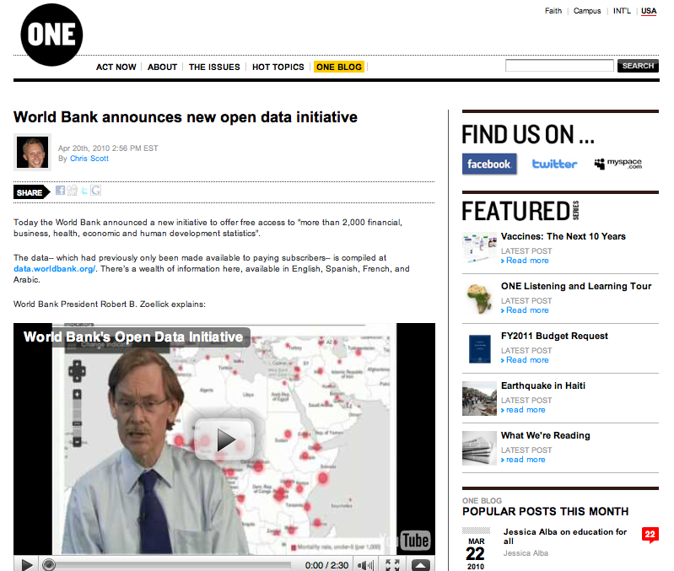
What they are saying…

Slide 24
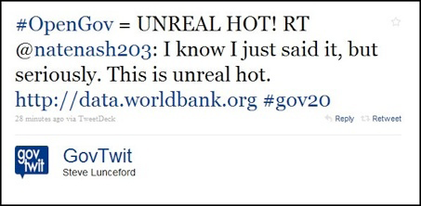
What they are saying…
Andrew McLaughlin, Deputy White House Chief Technology Officer:
“It’s really fantastic to have the World Bank join -- and now lead -- the global open data movement. It opens huge new possibilities.”

Slide 25
Issues
No more subscriptions:
Have to find data curation and distribution costs elsewhere
Much greater interest in data:
Both within and from external users: provides opportunity for improved internal collaboration and dialogue with external users

Slide 26
Issues
A few suppliers not able to provide data for free:
Try to manage through “exclusions” list in Terms of Use
Need for improved data support functions:
More users have more questions
Must maintain focus on data quality

