Slide 1
Data Aggregation in Wolfram|Alpha
C. Alan Joyce
Content Manager, Wolfram|Alpha

Slide 2
3 Stages of Data
Stage 1: Closed data
Stage 2: Open data
Stage 3: Computable data

Slide 3
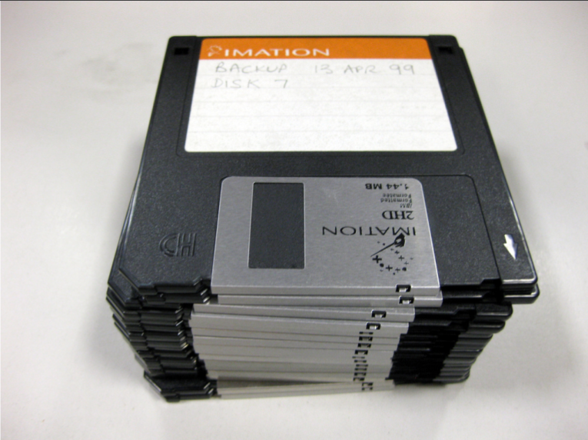

Slide 4
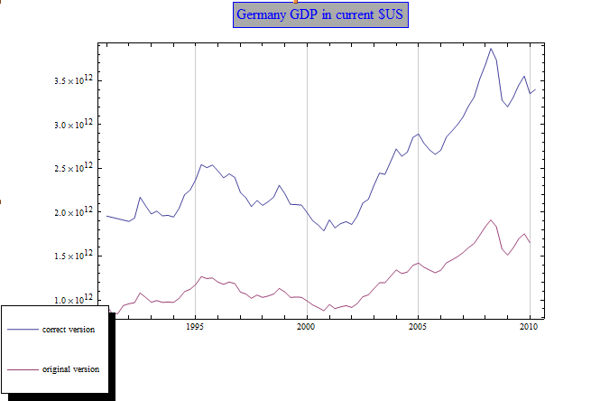

Slide 5
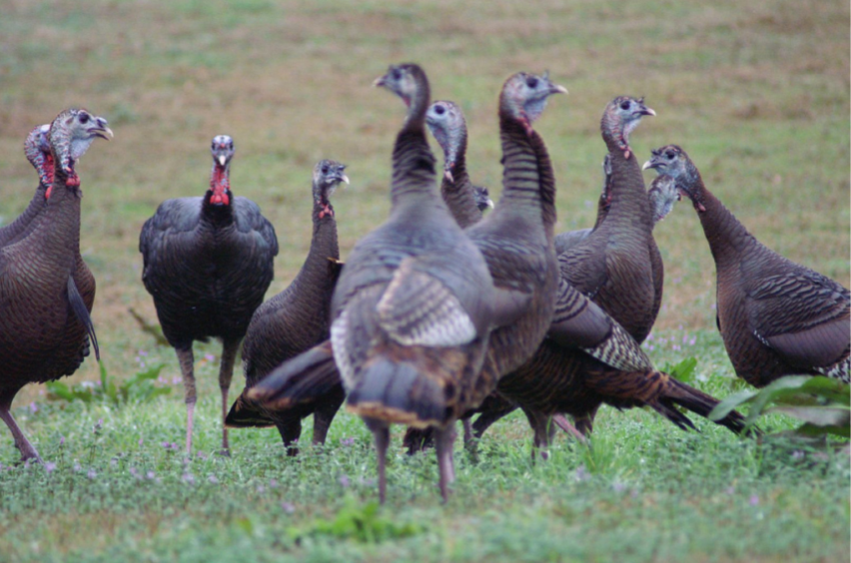

Slide 6
