Slide 1
DATA FOR DEVELOPMENT
Ms. Sabrina Juran
Census Analyst
United Nations Population Fund (UNFPA)
Technical Division, Population and Development Branch

Slide 2
Population and Housing Census as Critical Planning Tool
Principal source of information on number and characteristics of populations and its housing
Basic data, but foundation for information in areas such as:
demography, health, employment, environment etc.
Unique advantage: Representation of the entire statistical universe, down to the smallest geographical units.
For purposes that require data at particular levels of aggregation, the census has no match.
Notes:
A PHC is the primary source of information on the number and characteristics of the population and its housing in each locality and in the country as a whole.
It takes stock of the most important asset of a country: human capital.
Especially in less and least developed countries without population registration systems, censuses are the only source of such information.
Although the census provides only basic data, it is the foundation for information in the areas such as:
Demography, health, employment, and environment etc.
The unique advantage of the PHC — which is ideally completed once every ten years — is that it represents the entire statistical universe, down to the smallest geographical units.
So, for purposes that require data at particular levels of aggregation, such as municipalities, or even city neighbourhoods, the census has no match.

Slide 3
Evidence Base for Decision-Making
Fundamental for decision making: Statistics are critical in evidence-based decision-making
Critical planning tool, helping policymakers plan for the future:
    predict and plan for demographic trends.
    reveal the number of people with disabilities and orphans by area
    uncover gender disparities
    map types of dwellings, sources of drinking water, etc.
Basis for informed policy formulation and for monitoring the MDGs
Notes:
Information from PHC is fundamental for decision making: Statistics are critical in evidence-based decision-making across all cultural and historical backgrounds of countries and irrespective of their level of development.
The census is a critical planning tool, helping policymakers plan for the future in terms of schools, clinics and hospitals, roads, urban infrastructure and more.
- PHC measure fertility, mortality and spatial distribution, and thus allows for predicting and planning for demographic trends.
- It can reveal the number of people with disabilities and orphans by area and
- can uncover gender disparities in employment, literacy, age of marriage and assets.
- With it we can also map out the types of dwellings, sources of drinking water, access to telecommunications and patterns of energy use, etc.
A census provides us with an indispensable basis for informed policy formulation and for monitoring the Millennium Development Goals at the national, regional and international levels.

Slide 4
Evidence Base for Decision-Making
Contribution to poverty reduction through:
1. identification of beneficiaries and gaps in services,
2. monitoring indicators of the MDGs
2010 MDGs Summit, increased demand for consistent and comparable statistical information:
1. for monitoring progress and
2. assessing and realigning plans and strategies.
Notes:
As we heard yesterday from our colleague from MEASURE EVALUATION, through the identification of beneficiaries and gaps in services, as well as through monitoring indicators the MDGs and other development targets, census data can contribute to poverty reduction.
It can also empower local communities by giving them access to local data.
And it can encourage participation in local decision-making by increasing knowledge of local needs and ensuring representation based on accurate numbers.
Within the context of the current round of PHC, and the upcoming 2010 MDGs Summit, the demand increased for consistent and comparable statistical information:
1. for monitoring progress towards the goals and
2. assessing and realigning plans and strategies.
Because so much hinges on the data numbers, the process can become highly charged and require careful monitoring.

Slide 5
Major Challenge: Accessibility of Census Data
In the context of confidentiality concerns, limited access given to census micro-data
Main characteristic of censuses – Confidentiality
Need for public access to data and availability of micro data
Key: Understand data as a public good
    Promote wide accessibility to data
Notes:
A major challenge with respect to census data is the accessibility of Census Data
In the context of confidentiality concerns, limited access given to census micro-data
We learn however, that confidentiality, the fact that disaggregated data is dealt with confidentiality which doesn’t allow for the identification of persons or households – is one of the main characteristics of censuses
What results from that is the Need for public access to data and the availability of micro-data.
For this, it is key: understand data as a public good and promote large accessibility to data,

Slide 6
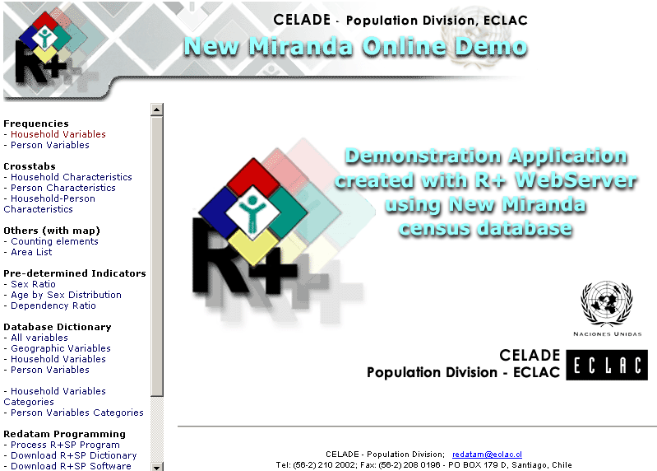
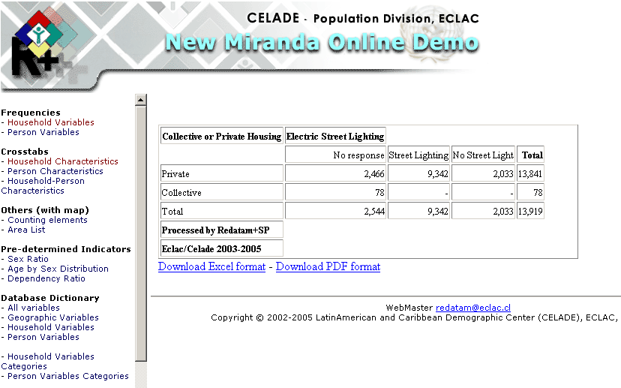
Notes:
As an example for tools to retrieve accessible information from complex databases such as the census, I would like to show you REDATAM - REtrieval of Census DATa for Small Areas by Microcomputers
Major contributions of the Latin American Population Division of UN ECLAC, regarding tools for demographic data processing and analysis
Database management tool that administrates large volumes of census micro-data with hierarchical structure down to the smallest area of the census
In the bigger picture on the left you see the various variables you can choose from to generate frequencies or cross tabulations, and below in the image you see a demonstration of a cross tabulation of household characteristics and availability of electric street lighting.

Slide 7
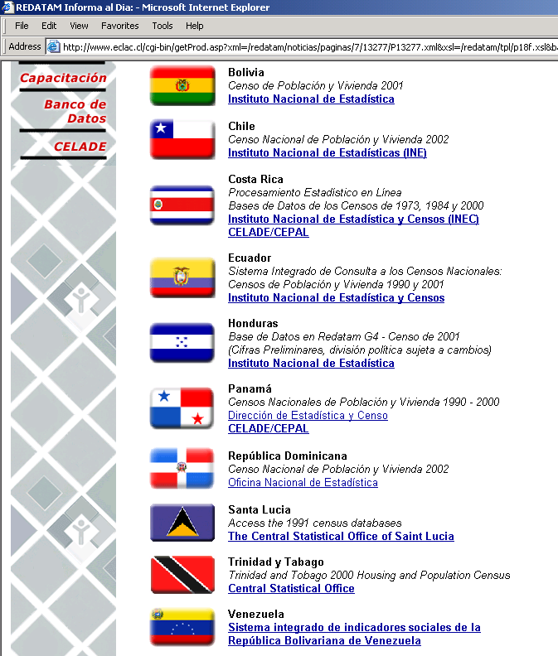
On-line access to 29 national census information
CELADE: mirror site of the NSO web site or actual server for some countries census access.
29 (22) countries offer on-line census processing with REDATAM
  18 in Latin America and Caribbean
  10 (3) in Africa (Cameron, Uganda y
  Kenya)
  and Cambodia
Notes:
CELADE is the mirror site of the NSO web site or is the actual server for some countries census access.
29 (22) countries offer on-line census processing with REDATAM
18 in Latin America and Caribbean
10 (3) in Africa (Cameron, Uganda y
Kenya)
and Cambodia

Slide 8
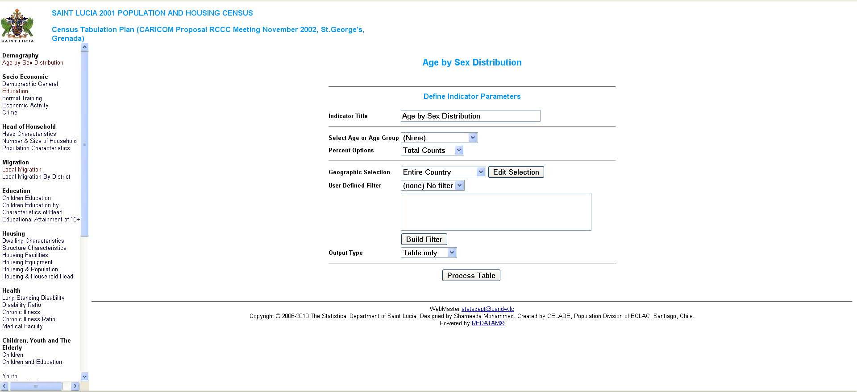
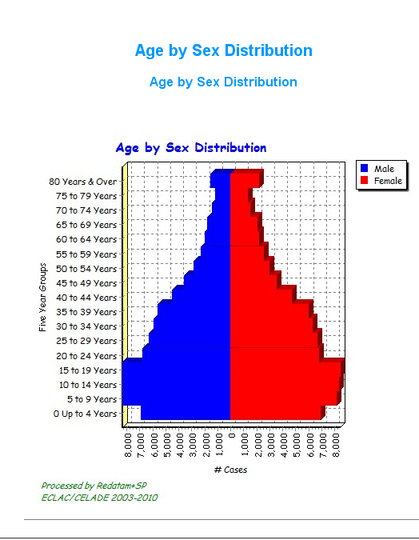
Notes:
Here is an example of the SAINT LUCIA 2001 POPULATION AND HOUSING CENSUS.
I selected the Age by Sex distribution and as a outcome a pyramid displaying every 5 year age groups.

Slide 9
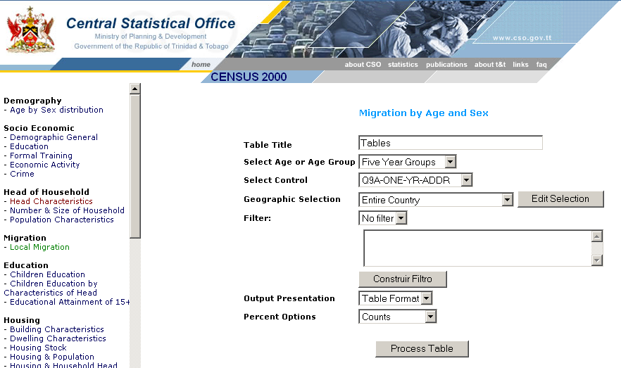
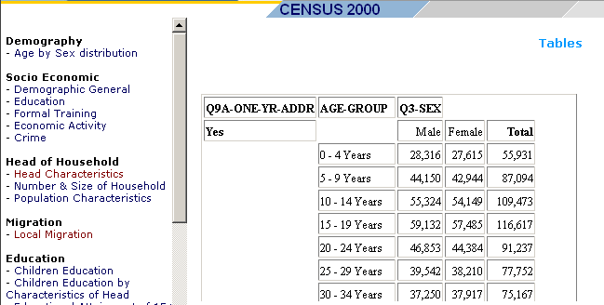
Each tabulation
can be displayed
as table, graph
or map
Notes:
Another example comes from the Trinidad and Tobago census in 2000.
On the first page you make the selection of Indicator (in this case Local Migration by age and sex) and then the specific subgroups: Age or Age Group (5 year age groups) , Geographic Selection (entire country) and the Output Type (table).
The variables and the type of tabulation you want to generate, each selection can be displayed as table, graph or map.

Slide 10
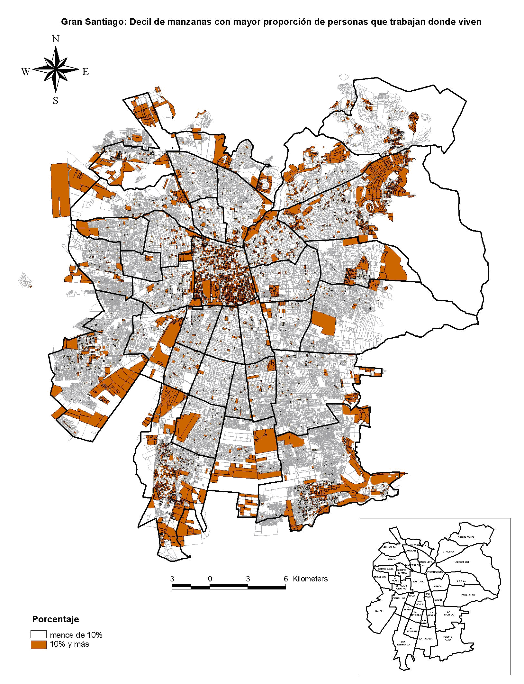
Metropolitan area of Santiago: blocks with higher proportion of people that work in the same county where they live
  Data analysis
  performed at small geographic units
  such as the census block level
  with data on internal migration
  analyzed from the 2002 Chilean census
  and processed with Redatam
Notes:
Data analysis is performed at small geographic units such as this map of Santiago city at the census block level with data on internal migration analyzed from the 2002 Chilean census and processed with Redatam
In the map you see the metropolitan area of Santiago de Chile illustrating the blocks with a higher proportion of people that work in the same county where they live.

Slide 11
Spatial analysis method used for child poverty assessment
Statistical methods
specifically developed for
geo-referenced data such
as Spatial Autocorrelation
were used to identify if
there existed spatial
grouping or clusters in
relation to child poverty.
Spatial correlation for the
variable
Percentage of Children (0 – 17) living with shelter
deprivation
Notes:
A last example illustrates spatial analysis of child poverty.
What we see here is the spatial correlation of the variable: percentage of children (between age 0 and 17 years) living with shelter deprivation.
Statistical methods specifically developed for geo-referenced data such as Spatial Autocorrelation were used
to identify if there existed spatial grouping or clusters in relation to child poverty.

Slide 12
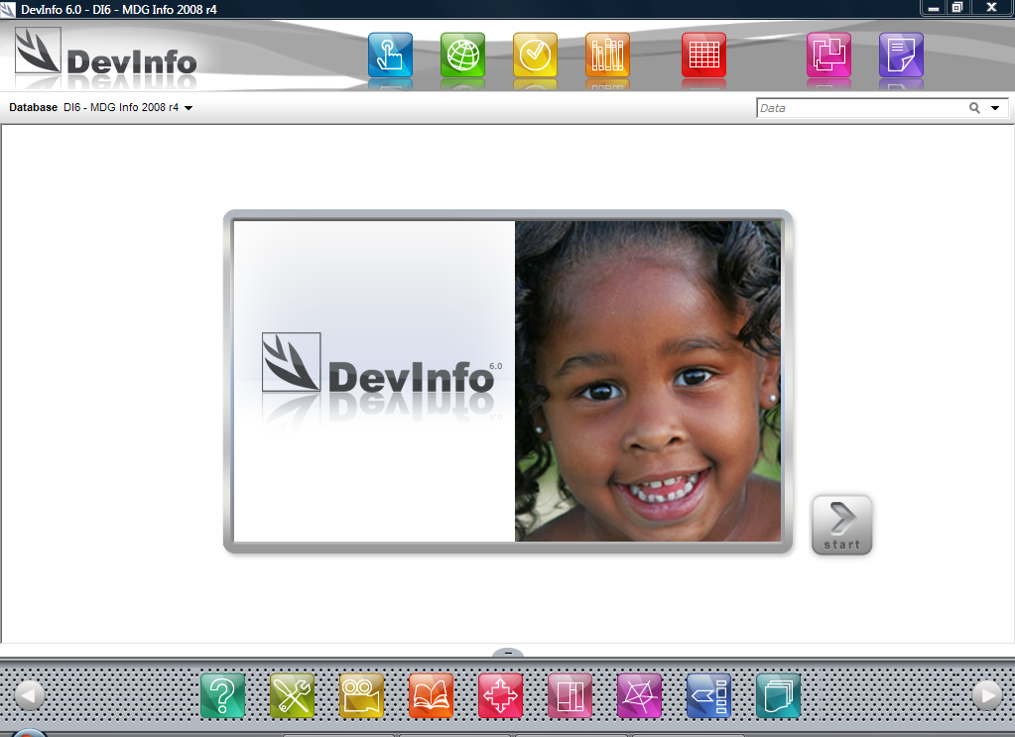


Notes:
Something similar to REDATAM is DevInfo, a database system to monitor indicators on human development and create beautiful material to include in reports and advocacy material.
It is a database that provides the UN and the broader public with a method to organize, store and display data on the MDGs, and more, in a uniform format to facilitate data sharing at the country level across government departments and UN agencies using the same system.

Slide 13
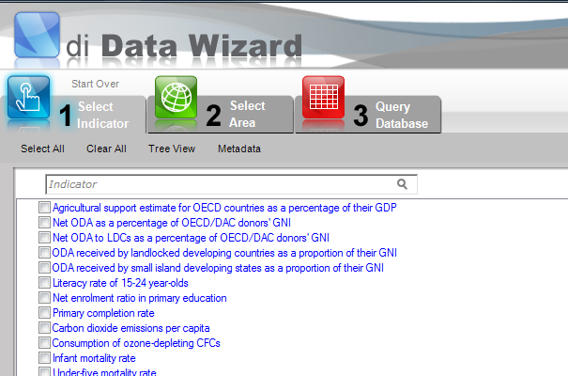
Notes:
The user interface contains a Data Wizard that enables users to easily access data and generate presentation objects - tables, graphs and maps - with minimal user training.
Click either Select Indicator or Select Area to begin searching for data.
The Data Wizard will then guide you through an easy three-step process to search for and view your data as a table, graph and map.

Slide 14
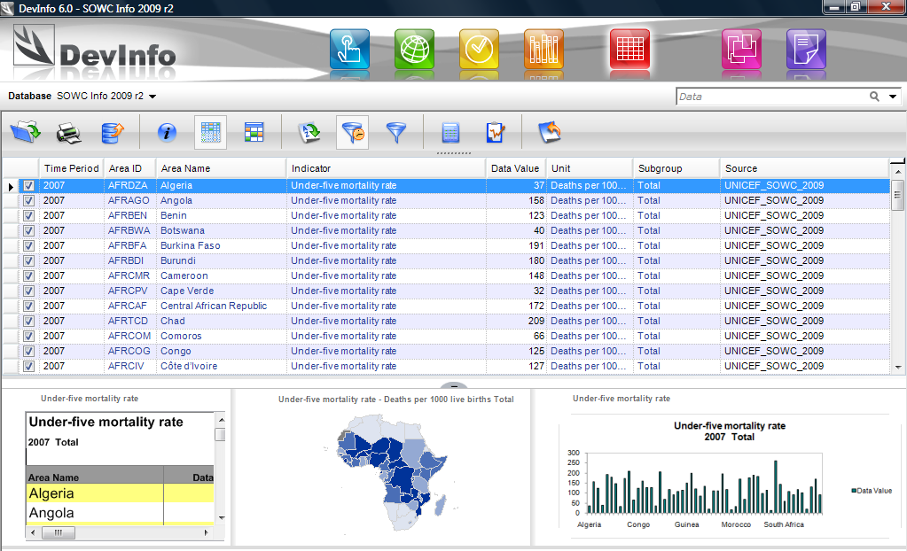

Slide 15
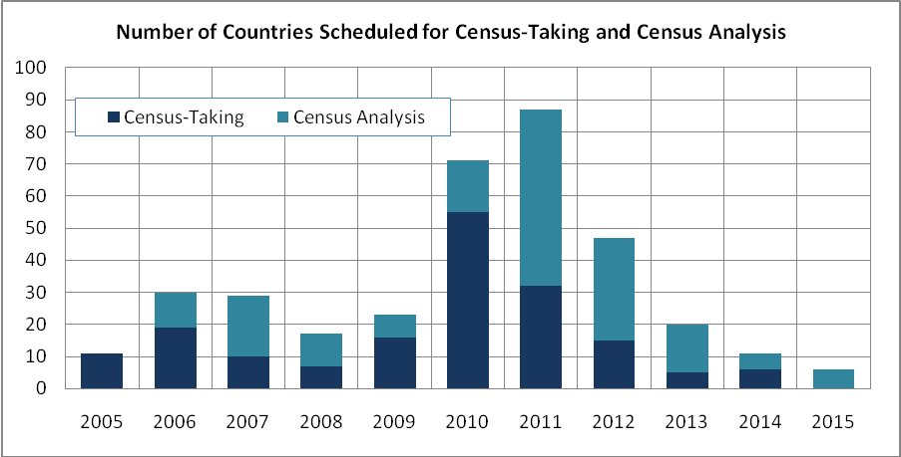
The 2010 Round of Population and Housing Census
Notes:
The 2010 round of population and housing census refers to censuses that take place from 2005-2014.
Due to the importance and relevance we assign PHCs, our focus is on the successful implementation of the 2010 round of population and housing censuses.

Slide 16
UNFPA’s Special Initiative on Census
Support the successful implementation of a high-quality census
Support is aimed at ensuring that:
  No country fails to carry out a PHC during the 2010 census round due to financial constrains or to lack of technical capacity
  Data generated are widely disseminated and extensively used for the preparation of development plans and programmes, as well as for their monitoring and evaluation
Development and assessment of tools for census conduct
Develop national statistical capacity for data collection, processing and analysis
Capacity building for using census data for evidence-based decision making
Notes:
That's why, UNFPA has created a Special Initiative on Census to the successful implementation of a high-quality census
UNFPA support is aimed to ensure that:
- No country fails to carry out a population and housing census during the 2010 census round due to financial constrains or to lack of technical capacity;
- Data generated from the 2010 census round are widely disseminated and extensively used for the preparation of development plans and programmes, as well as for their monitoring and evaluation
Activities of the SIC include
Development and assessment of tools for census conduct
Develop sustainable national statistical capacity for data collection, processing and analysis
Capacity building for using census data for evidence-based decision making
Other support is directed towards the maintenance of a database of census expertise worldwide, while another one if the facilitation of access to technical resources and training opportunities and the encouragement of South-South cooperation across countries and regions.
resource mobilization, funding, technical assistance, or developing capacity in cartography, new technologies. , data collection, processing or analysis.

Slide 17
Thank you!
For more information visit:
http://www.unfpa.org/public/home/datafordevelopment

