Slide 1
The Challenges in Using Whole Genome Sequencing Data for Clinical Research
Scott D Kahn, PhD
9 September 2010
© 2009 Illumina, Inc. All rights reserved.
Illumina, illuminaDx, Solexa, Making Sense Out of Life, Oligator, Sentrix, GoldenGate, GoldenGate Indexing, DASL, BeadArray, Array of Arrays, Infinium, BeadXpress, VeraCode, IntelliHyb, iSelect, CSPro, and GenomeStudio are registered trademarks or trademarks of Illumina, Inc. All other brands and names contained herein are the property of their respective owners.

Slide 2
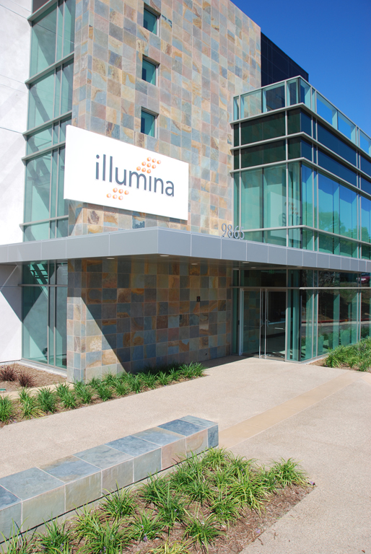
Top Level Metrics
Founded in 1998
Initial Public Offering on July 27, 2000
Headquarters in San Diego, CA
More than 500,000 square ft. of facility space in 6 countries
Over 1,800 employees
IP portfolio of 135 issued patents and 168 pending applications
Ranked #1 on Forbes’ list of Fastest Growing Technology Companies in 2009 & 2007
Added to the NASDAQ-100 listing in 2008

Slide 3
Illumina’s Mission Innovating for the Future of Genetic Analysis
From Genome Wide Discovery…
To Targeted Validation and Beyond…
To be the leading provider of integrated solutions that advance the understanding of genetics and health

Slide 4
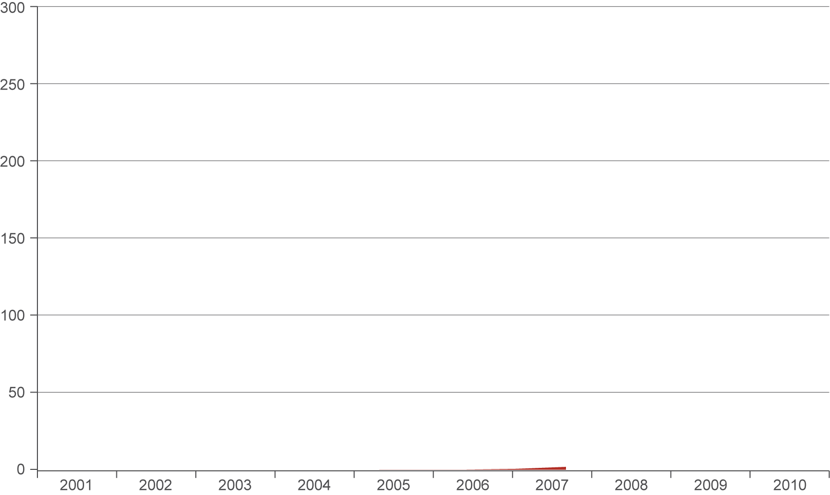
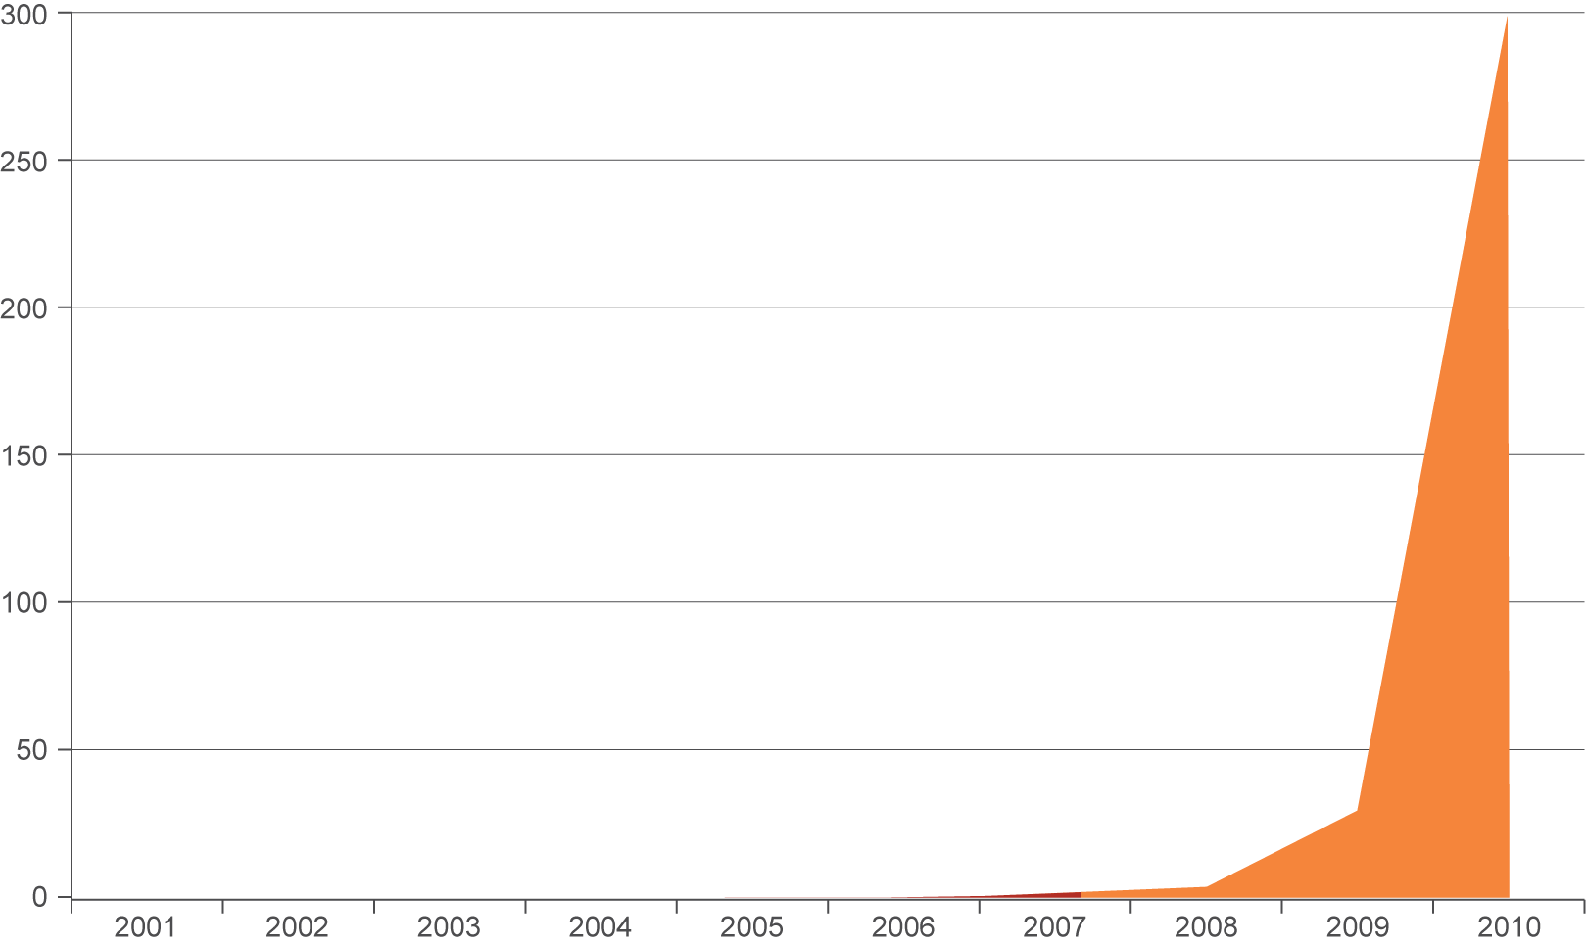
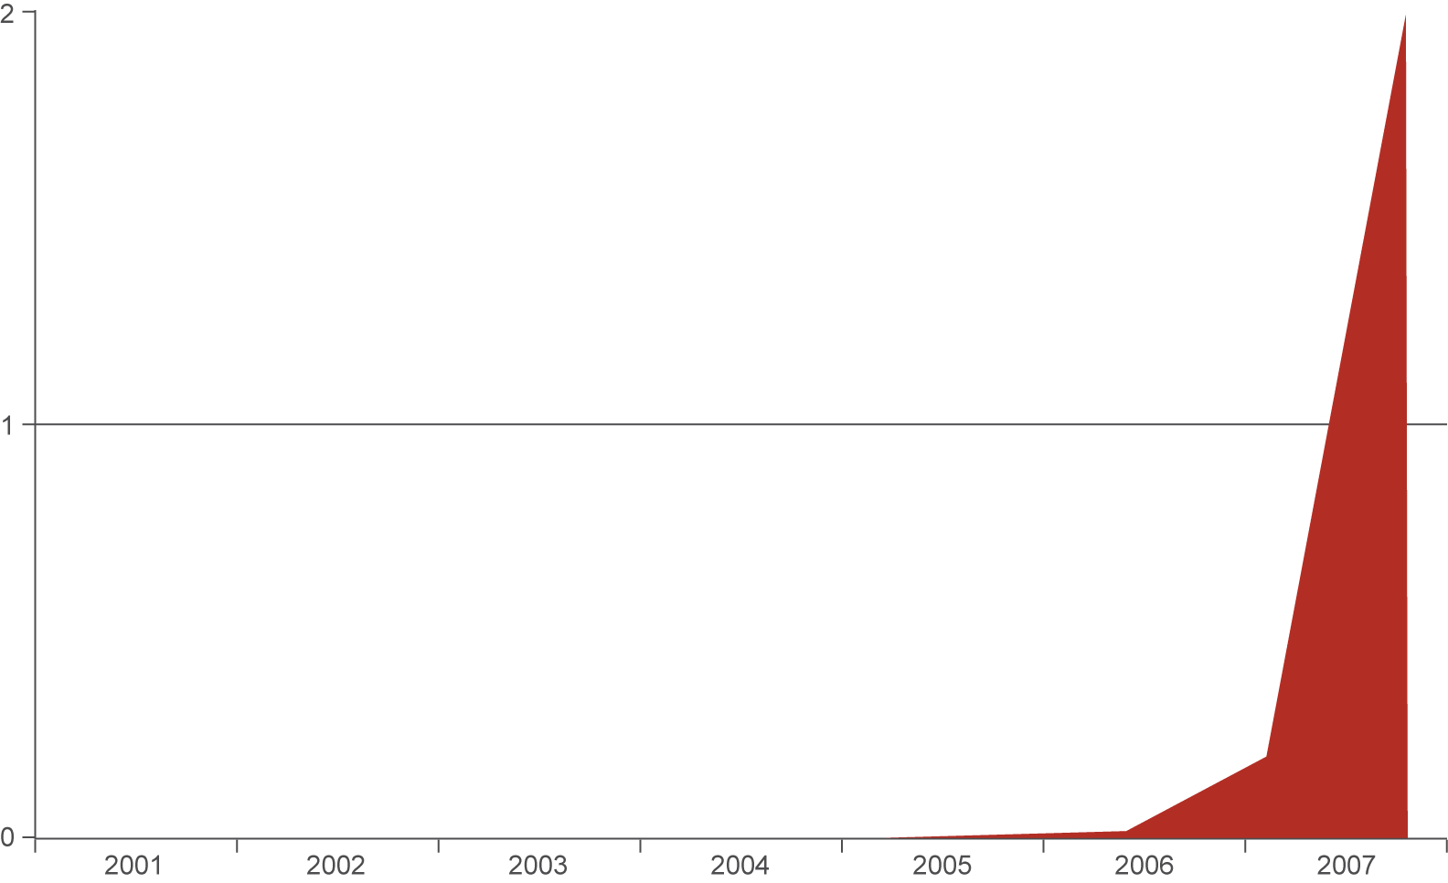
The Impact of Scale in Sequencing
Gb / run
Human Genome finished here
Year
10⁴ scale in throughput; 10⁷ scale in parallelization in 5 years

Slide 5
A Tipping Point in Human Genome Sequencing
Costs
Genomes
$100M
1M
Venter / capillaries
$10M
100k
Watson / 454
$1M
10k
Cost per Human Genome
African, Asian, Cancer pair
$100k
169 in Genbank
1,000
Individual Genome Sequencing
$10k
100
2007
2008
2009
2010
2011
2012
Time
Each human genome is 30x 3Gbases that occupies ~300GB of raw storage
Notes:
5
DNA Sequencing is a very large part of this transition into the kinds of markets were looking at in the future. The same questions that we first looked at with respect to genotyping can also be consider from a DNA sequencing perspective. Again, just as in genotyping, we have seen historical barriers to approaching these questions in a cost effective manner with any real level of scientific credibility. We see these same characteristics evolving within the DNA Sequencing market as we enable innovative, high quality sequencing applications at lower and lower costs. The collective Human Genome project cost approximately $5 billion…to construct a composite sequence of 5 different individuals. Just a couple years ago it cost approximately $15million to sequence a single human genome. To date, there have only been two whole human genomes sequenced beyond the Human Genome Project. So, as we enable whole human genome sequencing at a cost of about $100,000 on our technology today, we’re beginning to see a tipping point on the horizon as continue to drive the cost curve down even further. We certainly envision a world where once we begin to approach $10,000 and then a $1,000 to sequence a whole human genome that we will see an explosion in the demand for sequencing applications like we have begun to see in genotyping.

Slide 6
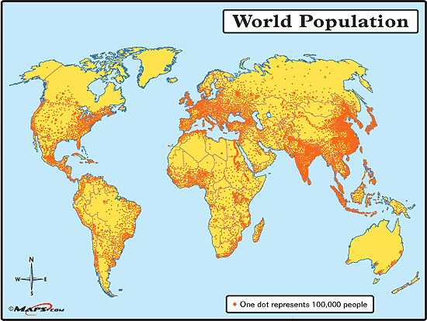
How Many Genomes Should We Expect?
7B people worldwide
100M born per year
15% in Western world
15% get cancer
2,250,000 cancers per annum
6,100 cancers per day
15% → 1000/day
.7B
4 B
.3B
1B
.8B
Notes:
Define foundational data standards; 2) Frame multiple genome comparison; 3) Enable/unlock multiple genome analyses
Region 2008
World 6707
Asia 4054
Africa 973
Europe 732
Latin America and the Caribbean * 577
Northern America * 337
Oceania 34

Slide 7
Analysis Challenge – Standards, Expertise, ...
Human Genome View
Functional annotation
Sequencing
PGI id: 5910322 – 61215923014
Clinical studies
Populations
PPARg
3: 12,300
3: 12,400
( kb )
Issued: 01 MAR 07 Recommended next check: 28 FEB 10
GENOMIC ANNOTATION
(in public domain)
PERSONAL SEQUENCE
(owned by individual)
Consultation
Consent
Clinical assessment
Variant: | C3 : 12,450,610 : T0.7/C0.3 : PPARG : Pro/Leu :
Medical consequence: | Associated with severe insulin resistance, diabetes mellitus, hypertension
Pharmacological consequence: | Resistant to thiazolidinediones
Selected risk information
RISK VARIANTS (approved for clinical use)
CLINICAL DECISION
Bentley et al. Nature 429: pp. 440-5 (2004)

Slide 8
How Might the Future of Genomic Data Evolve?
Personal Health Records, EMR?
Genomic semantic information systems?
Cancer diagnostics?
Newborn screening?
Personalized Medicine?
Health Management?

