Slide 1
Clean Energy Commons
Accelerating Transitions to Clean Energy Systems
Stuart Macmillan
Wolfram Data Summit
Washington, D.C. September 9, 2010

Slide 2
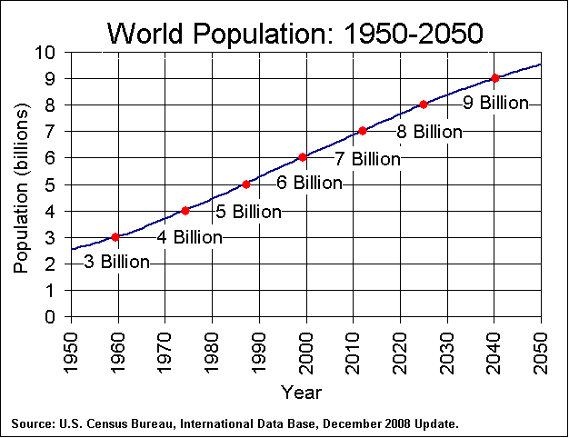
The Energy Challenge
Economy
Society
Security
Environment
How do we meet the growing demand for energy while protecting the planet?
Adapted from Sally Benson 2010

Slide 3
Why so difficult?
WHY
global
temporal
disruptive
high uncertainty
interconnected
impact
urgent
Economy
Society
Security
Environment
Requiring innovation and collaboration
at an unprecedented scale
Adapted from the 2010 Arrow Lecture by Jeffry Sachs

Slide 4
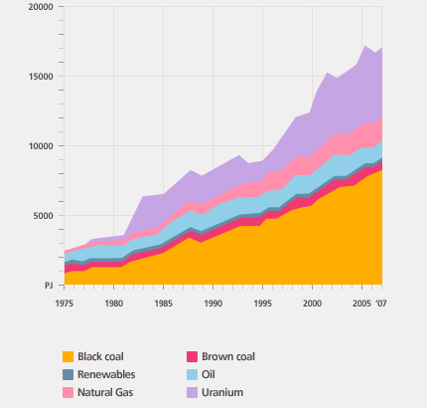
Energy decisions questions
WHY
WHAT
technology
policies
investments
business models
research
education
Energy Choices
We need trusted foundational knowledge
that informs our energy decisions

Slide 5
Virtuous energy cycle
informed researchers
informed investors
informed policy-makers
Informed companies
informed workforce
informed consumers
Educators
Government
Industry
Investors
Consumers
Researchers
Informed decisions build confidence and momentum
Poor decisions undermine trust and action

Slide 6
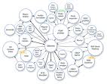
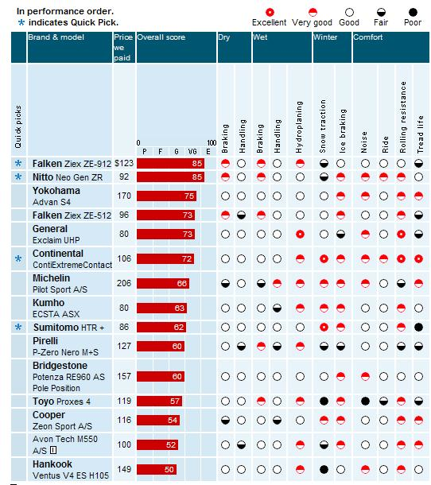
Clean Energy Commons
openei.org
Improved access to energy information
Community supported contributions
Easy, legal and scalable sharing
Actionable quality assessments
Accessible and trusted information that
informs our energy decisions

Slide 7
Virtual Aggregation
BBC Later + TOTP
Semi Web Central
Fresh- meat
AFDC
Smart
Grid.gov
FOAF
Open- Guides
Focus on the meta-data
Link to established data-sets
Link to real-time data feeds
Enable community aggregation
Link to modeled data services
Archive historical data
FOAF
ECS Southampton
Music-brainz
Music-brainz
Data.
gov
Recovery.
gov
DBTune
SIOC
Revyu
Revyu
Geo-names
DBpedia
Clean Energy Commons
ORNL
Data
World
bank
IEA
DBLP Berlin
EIA
US Census
DBLP Berlin
RDF Book Mashup
World Fact Book
Stanford
Euro-stat
Project Gueten-berg
DBLP Hannover
Gov-track
W3C
WordNet
W3C
WordNet
Improved access to energy information
Notes:
USING SEMANTIC WEB TECHNOLOGIES
Link to large energy datasets that vertically integrate domain expertise, curator and stewardship
Link to live datasets that provide real-time feeds to current information
Enable aggregation of community input to create high value datasets
Link to data services that provide modeled/computed data
Archive historical data

Slide 8
Distributed Work
Distribute work to the most able
Shared standards for integration
Open the system for value add
Higher value through higher use
Higher quality through many eyes
Community support for contributions & collaboration

Slide 9
Publish Content
PUBLISH ENERGY DATA
Reconstruction of the public domain
Fallback to CC BY 3.0
Leverage embargo periods
PUBLISH ENERGY TOOLS & MODELS
Choose a specific OSI approved license
Mandating BSD – most consumable by business, most interoperable
PUBLISH ENERGY KNOWLEDGE
CC BY or BY-SA 3.0 easiest to use
Think carefully before adding non commercial clause
Easy, legal and scalable sharing
Source: Wilbanks 2010

Slide 10
Quality Assessment
Can I Trust and Act on the Information?
Available – Efficient
Providence – Reputation
Reliable – Objective - Accurate
Verifiable – Reproducible
Useful – Timely
Systematic improvement
Actionable quality assessments &
systematic improvement

Slide 11
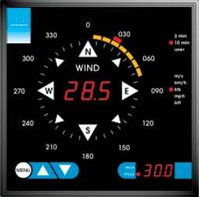
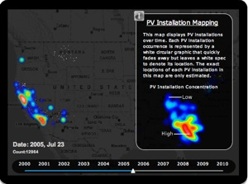
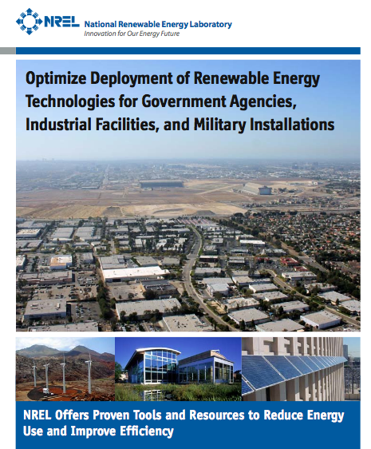
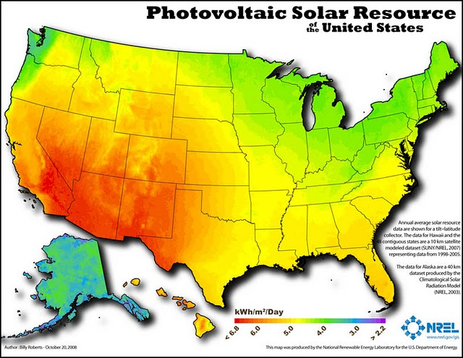
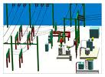
What’s In The Commons?
energy
ECONOMIC
TECHNICAL
POLICY
DATA
MODELS
TOOLS
KNOWLEDGE
TECHNOLOGY
RESEARCH
EDUCATION
INVESTMENT
Published collective intelligence of the community

Slide 12
Information Sources
Community
“The Wiki Way”
Centralized
“The Blog Model”
Born Digital
“The Machine Way”
Authoring
Aggregation of Community Input
Single Individual or Institution
Machine Controlled Model or Sensors
Distribution
Open
Open
Open
Feedback
Community+
Users+
Users+
Examples
Integration of multiple & diverse information sources

Slide 13
Content contributors
GOVERNMENTS (H)
Publish mandate
Largest contributor
Open government
INDUSTRY (L-M)
Technical
Financial/performance
Deployments
Educators
Researchers
RESEARCHERS (H)
Research universities
National laboratories
NGOs
Government
Industry
EDUCATORS (L)
Derived content
Case studies
Instructional content
Investors
Consumers
INVESTORS (L-M)
Banks
VCs
Funds (indirect via industry)
CONSUMERS (L-M)
Individual content
Demand change
Significant if aggregated
Researchers
Initial focus was on existing curated energy content

Slide 14
Content users
GOVERNMENTS (H)
Goals & policies
Incentives & mandates
Invest & assess
INDUSTRY (M)
Product development
Commercial R&D
Competitive analysis
Educators
Researchers
RESEARCHERS (H)
Cross disciplines
Collaboration
Accelerated discovery
Government
Industry
EDUCATORS (M-H)
Databooks
Courseware
Case Studies
Investors
Consumers
)
CONSUMERS (L-M)
Comparison shopping
Energy efficiency
Cost –benefit analysis
INVESTORS (M)
Commercialization
Risk reduction
Deployments
Researchers
Initial focus was on government & researchers

Slide 15
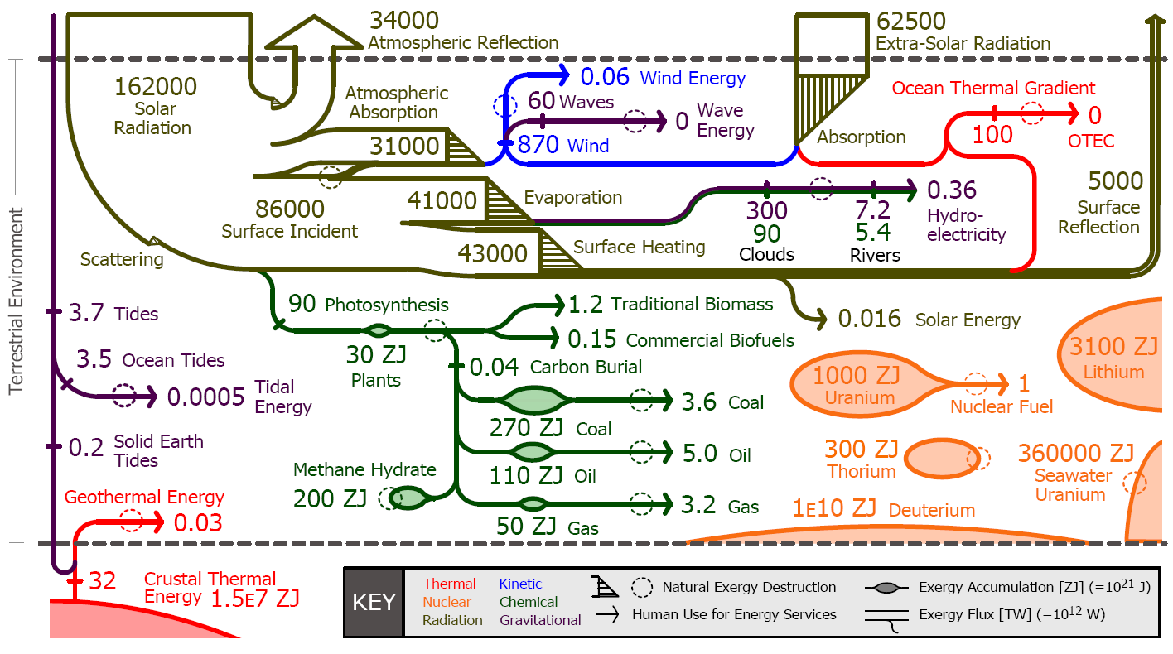
Exergy flow of earth
KEY
Thermal
Nuclear
Radiation
Kinetic
Chemical
Gravitational
Source: Stanford GCEP 2010
What energy resources do we use?
What resources do we use?
Source: Stanford GCEP, 2010
Notes:
Exergy is the useful portion of energy that allows us to do work and perform energy services. While energy is conserved, its exergy content can be destroyed when the energy undergoes a conversion. We gather exergy from distinct, energy-carrying substances in the natural world we call resources. These resources are converted into forms of energy called carriers that are convenient to use in our factories, vehicles, and buildings. This diagram traces the flow of exergy through the biosphere and the human energy system, illustrating its accumulations, interconnections, conversions, and eventual natural or anthropogenic destruction. Choices among exergy resources and exergy carriers and the manner of their utilization have environmental consequences. An examination of the available resources and current human exergy use places the full range of energy options available to our growing world population and economy in context. This perspective may assist in efforts to both reduce exergy use and decouple it from environmental damage. (Source: GCEP)

Slide 16
U.S. View

Slide 17
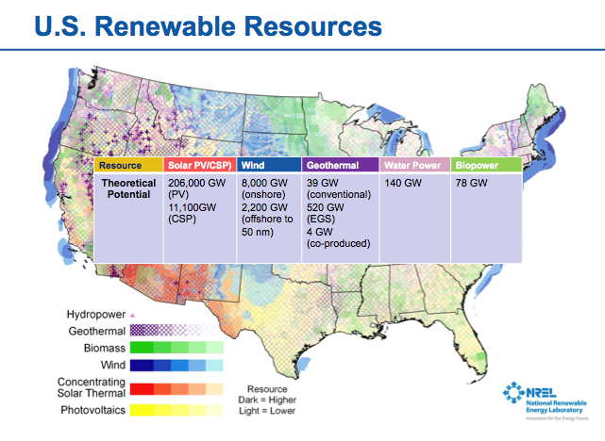
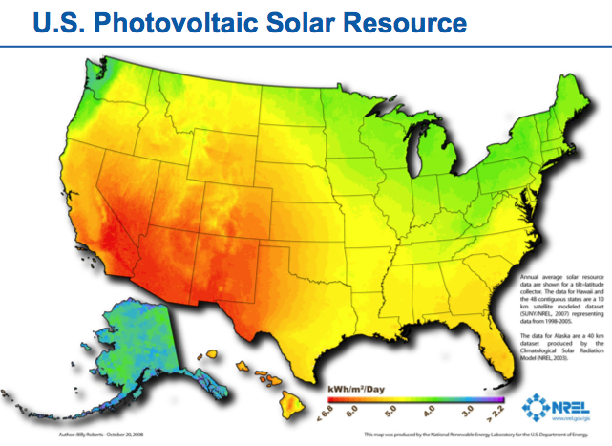
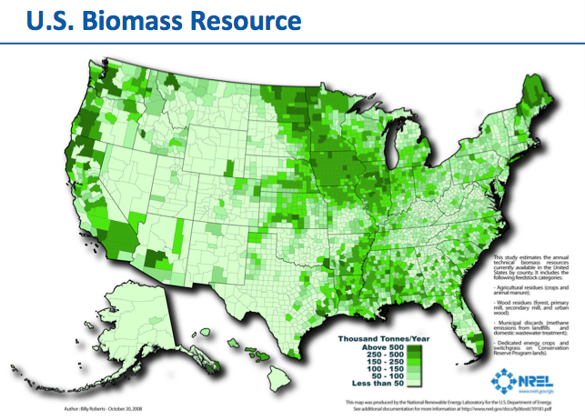
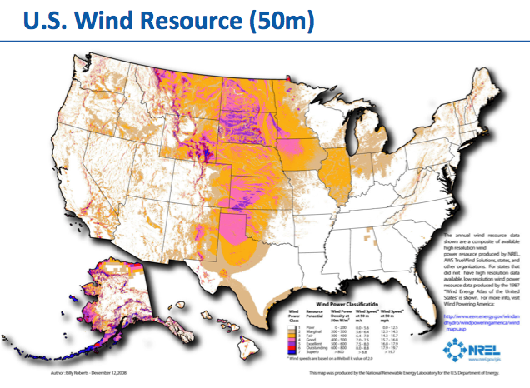
Energy Resources
Source: Stanford GCEP, 2010

Slide 18
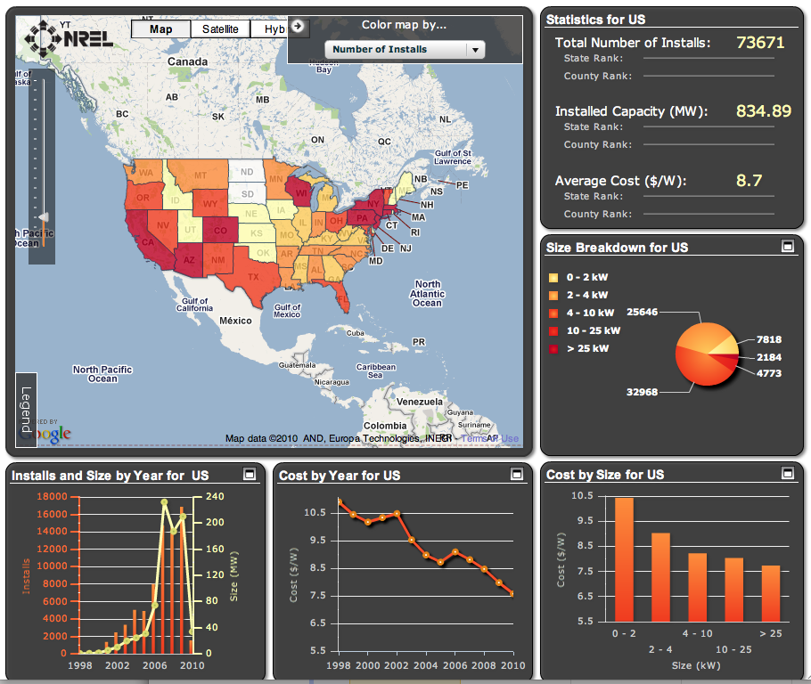
Renewable Deployments
OpenPV
installers
utilities
individuals
government
OpenPV, NREL 2010
Value created by the aggregation of distributed data

Slide 19
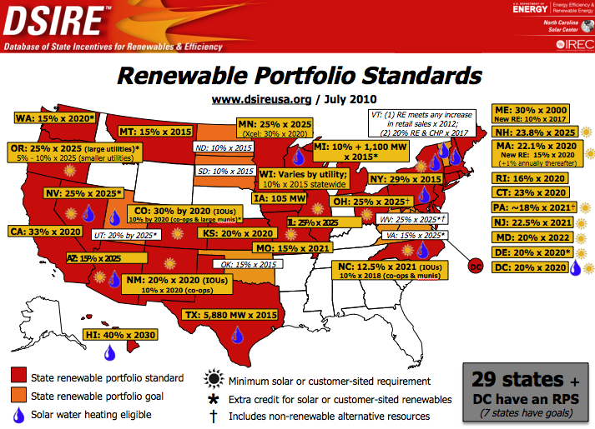
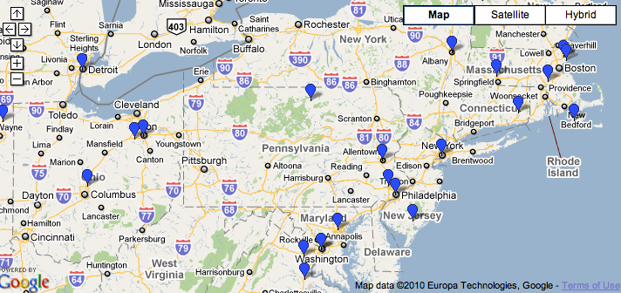
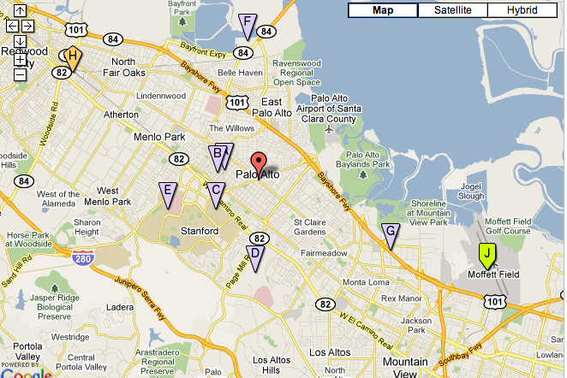
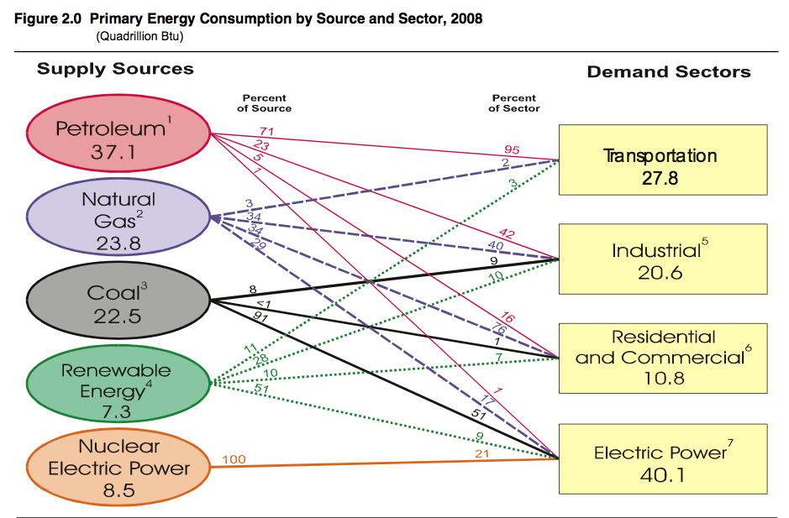
Energy Policy
DSIRE incentives data
ARRA Smartgrid Investments
DOE alternative fuel availability
EIA source – demand mapping
Source: Stanford GCEP, 2010
Notes:
For Example: Incentives and Mandates that support policy goals
- Incentive programs are constantly changing
- Inventive programs can operate at all levels of government (Federal, State, Local)
- Core data kept current at the federal and state level of governments can be supplemented and improved by community contributed information
Data.gov, Government Transparency (counterparts globally)
DSIRE RPS standards by state
EIA mapping supply to demand
DOE alternative fuels data center -- fuel availability map
Smartgrid.gov - smartgrid investment grant program ARRA (100 projects)

Slide 20
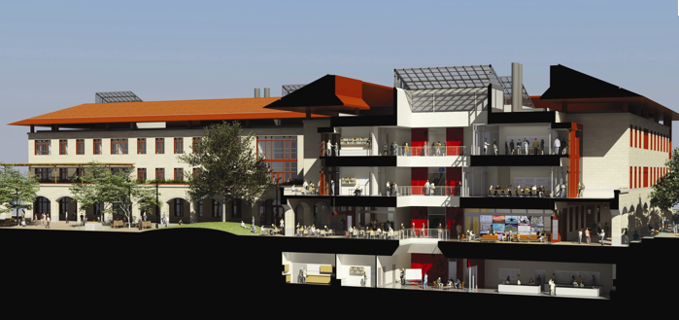
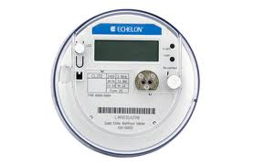
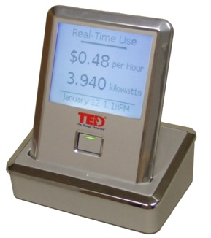
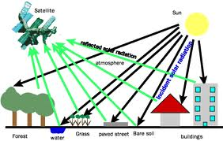
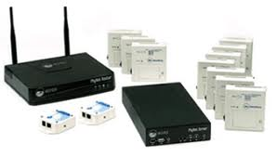
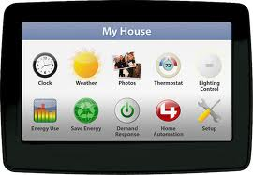
Born digital data
Sensor & Modeled Energy Data
resource
generation
usage
pricing
energy efficiency
performance
Design vs. Performance Stanford, Y2E2 Building
Remote Sensing of Energy Resources
The tsunami of born digital energy fills gaps
and helps improve quality

Slide 21
Energy Decisions
Analysis – Synthesis - Evaluation
Application
Comprehension
Knowledge
Analysis – Synthesis – Evaluation
Analyze elements, relationships, principles
Compile information in new ways
Judge information, ideas or work
Application
Solve problems in new situations by applying acquired knowledge, facts, techniques and rules
Comprehension
Organize, compare, translate, interpret, describe, summarize
Knowledge
Recall facts, terms, concepts and answers
Reason
Compute
Lookup
* Source: Anderson & Krathwohl, 2001
Foundational knowledge
Definitive answers to factual questions
Transparent reasoning for complex judgments

Slide 22
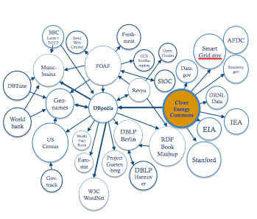
Questions
Stuart Macmillan
stuart.macmillan@nrel.gov
smacmillan@stanford.edu

