Slide 1
Wordsourcing
Erin McKean

Slide 4
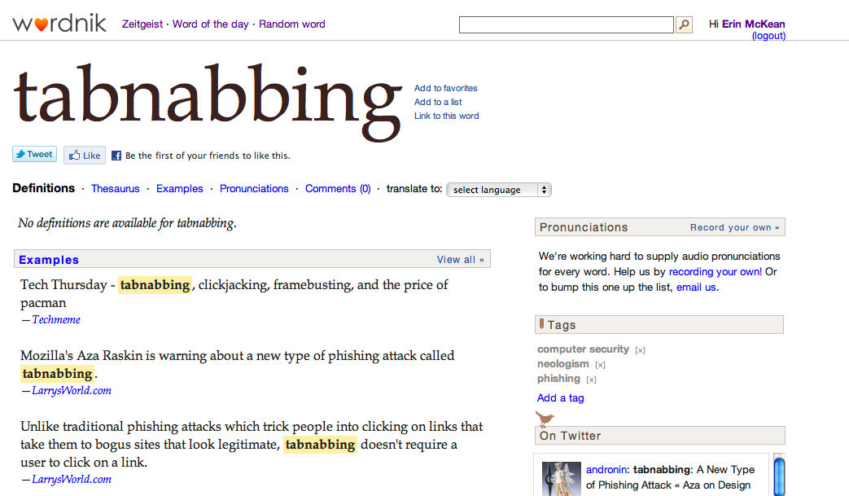

Slide 5
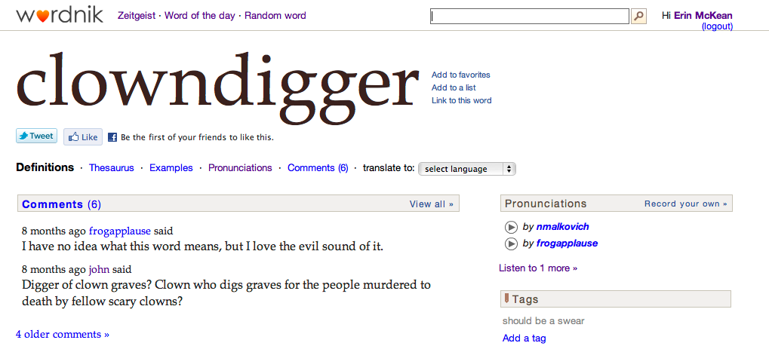

Slide 6
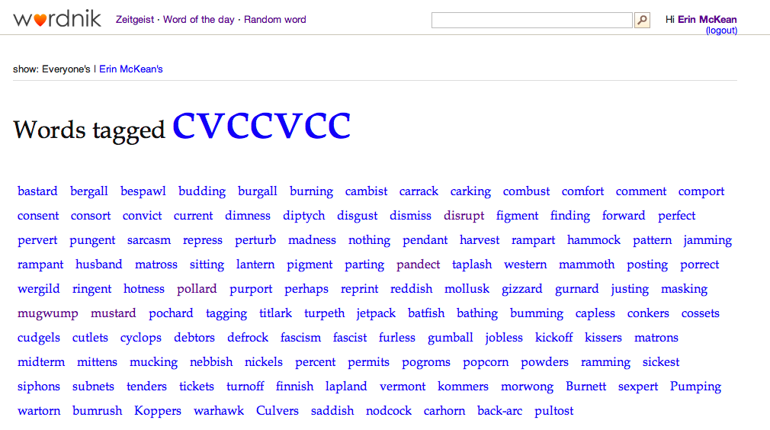

Slide 7
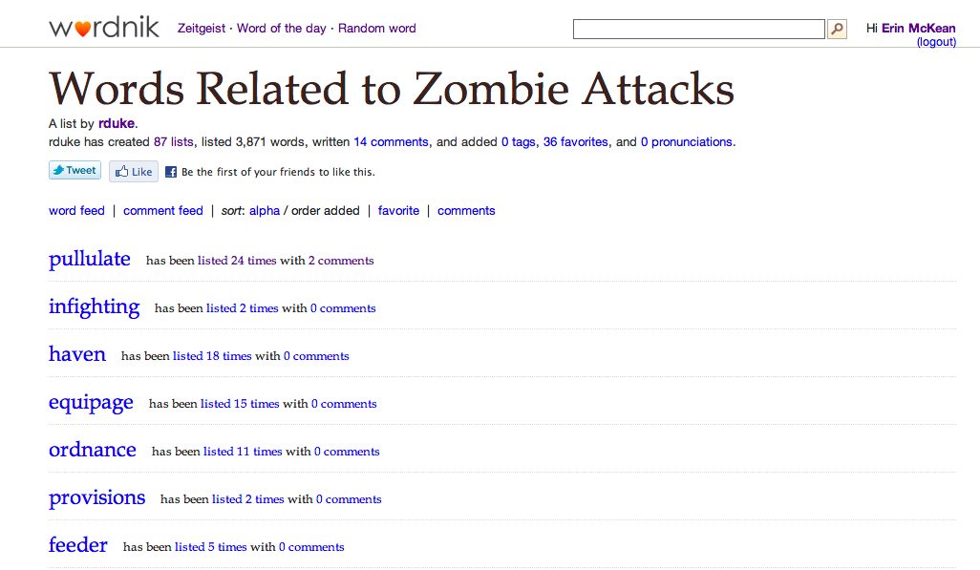

Slide 8
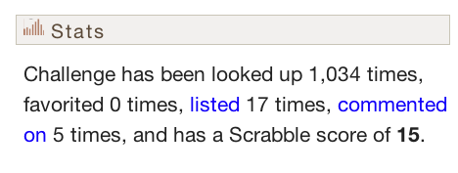

Slide 9
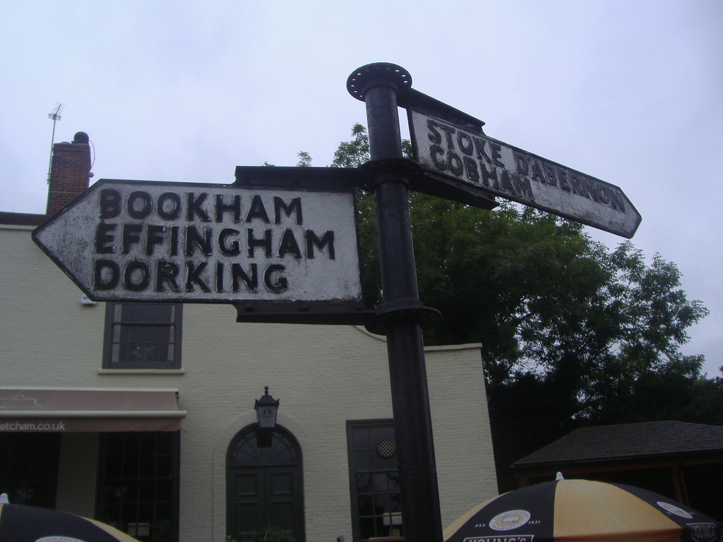
Flickr: CC BY-2.0: Satguru.

Slide 10
erin@wordnik.com
www.wordnik.com/developers

