Slide 1
Overview of SDMX:
Statistical Data and Metadata eXchange
Technical and Content Standards for Statistical Data
Ann McPhail, Division Chief
Statistics Department, International Monetary Fund
September 2010
The views expressed herein are those of the author and should not be attributed to the IMF, its Executive Board, or its management
Notes:
The International Monetary Fund (IMF) works to foster global monetary cooperation, secure financial stability, facilitate international trade, promote high employment and sustainable economic growth, and reduce poverty around the world. Created in 1945, the IMF is governed by and accountable to the 187 governments of the countries that make up our near-global membership.
I work in the Statistics Department of the IMF, managing a division that collects econ & fin statistics from all of our members for dissemination via print, electronic media and the web; we also support the economic data warehouse at the Fund. But today I am speaking on behalf of the SDMX community, which is a consortium of 7 int’l organizations that are working on developing and promulgating technical standards and content guidelines for stats data.

Slide 2




SDMX Stakeholders
“ SDMX fosters the development and use of technical standards and content-oriented guidelines for greater efficiency in the exchange, sharing and dissemination of data and metadata using mainstream technology as well a in production processing involving internal statistical systems” (from sdmx web site)
Seven Sponsor organizations that collect statistical data from their member organizations:
SDMX is used by our member organizations that must report data, e.g., Central Banks, National Statistical Offices, other national agencies; plus other Regional and International Organizations . Users may also include data distributors and web applications.
Notes:
Note: SDMX regularly reports on its activities to the Committee for the Coordination of Statistical Activities (about 25 international organizations) which has adopted SDMX for data exchange and sharing, and the UN Statistical Commission has recognized SDMX as the preferred standard for the exchange and sharing of data and metadata and encouraged further implementations by national and international statistical organizations.
Support was related to member countries’ burdens of having to report the same or similar data to multiple international organizations!

Slide 3
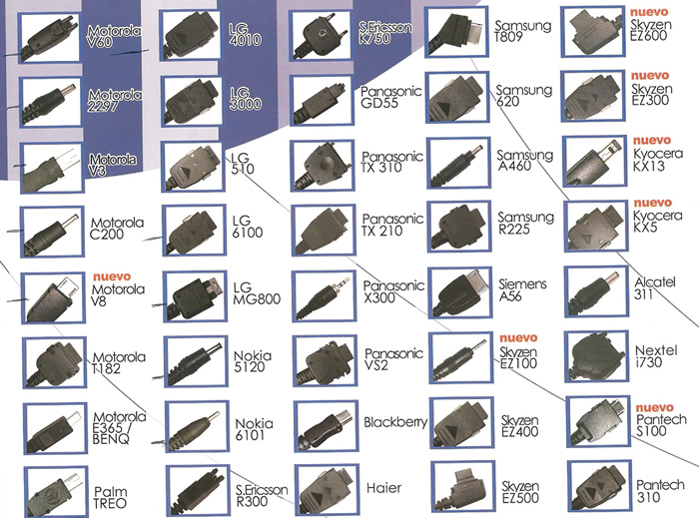

Why We Need SDMX
The Past
The same data transmitted (or requested) in different formats, to/from national and international organizations .
The Future
One standard format that all can use and reuse to transmit data.
Expensive and inefficient…
Cost effective and efficient
Notes:
The Past/Present
Different types of data and metadata files exchanged
→ Conversion of formats needed
No standardisation of the statistical contents
→ Renaming, mappings needed
Problem of correspondence between variables, codes, etc
The way forward: creation of technical, IT and statistical standards related to official data and metadata
Benefits :
For producers
One charger ➔ cheaper prod. costs
One package➔ cheaper transport costs
For clients
One charger serves all ➔ convenience
Lower prod. Costs ➔ lower phone prices
Possible charging from computers
For everyone
Less chargers needed ➔ environmental benefits

Slide 4
SMDX Components
Standards, Guidelines and Tools
All major building blocks of framework in place
Technical Standards (information model, formats, architecture)
  Version 2.0 (Approved by Sponsors in November 2005; Version 1.0 ISO 17369)
  Version 2.1 being prepared
Content-Oriented Guidelines
  Cross-domain concepts, code lists subject-matter domains and metadata common vocabulary
Tools
  DSD/key family creation, format transformations, registry implementation
Notes:
Also available:
On-line user forum
Bi-annual Global Conferences
Information Model and syntax specifications form what is named “technical standards”
Version 1.0 specification of the technical standards has been approved by the International Organization for Standardization (ISO) as a Technical Specification (ISO/TS 17369: 2005 SDMX).
The Version 2.0 specification (November 2005) broadens the framework to support wider coverage of metadata exchange as well as a more fully articulated architecture for data and metadata exchange. Steps are also being taken to bring this work forward within the context of ISO, assuring that SDMX technical standards build on other recognized standards and providing the basis for interoperability with them.
The development of the content-oriented guidelines is being undertaken outside the ISO framework. This should facilitate steps by the SDMX sponsoring institutions to broadly involve content-oriented efforts of a wide range of experts that are already working in many subject-matter domains within the global statistical community.

Slide 5
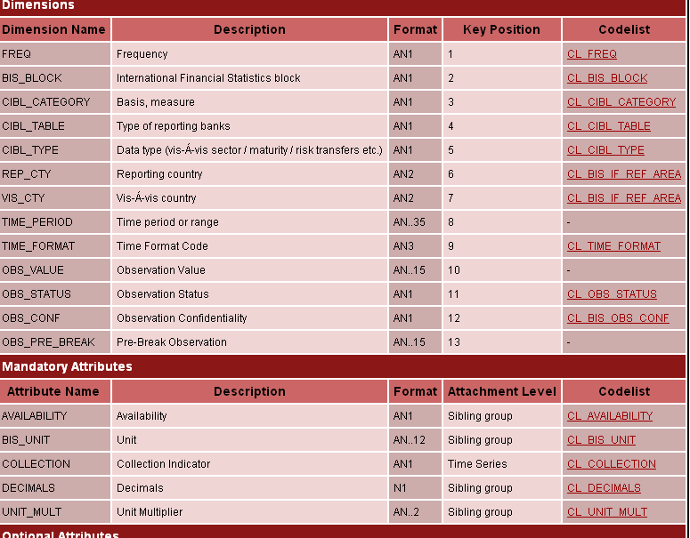
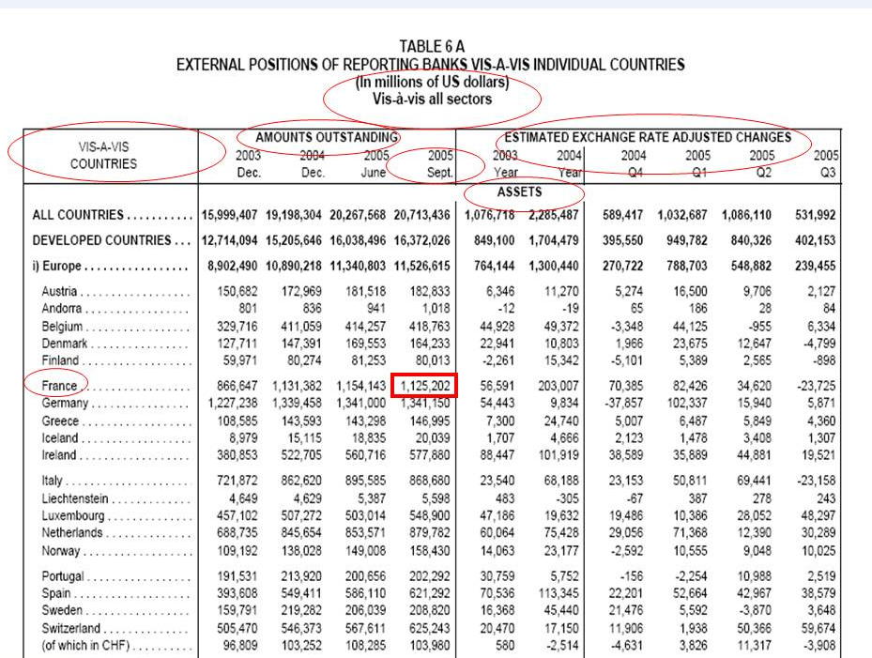
Sample Data Structure Definition (DSD)
The data and metadata in the table below are defined by a DSD (right) using dimensions, attributes and code lists.
Source: Bank for International Settlements
Notes:
To make sense to users data need to be
Identified (eg by a unique key)
Qualified (eg by „attributes“)
In the example table we can distinguish identifying concepts:
Reporting country (= “all reporting countries“)
Vis-a-vis country ( = list of countries, “France”)
Sector (= “all sectors”)
Type (= Assets / Liabilities)
Measure (=Amounts outstanding / Exchange rate adjusted) flows)
Qualifying concepts
Unit of measure (millions of US dollars)
And Time ….(Period)
Code lists (ie lists of possible values) exist for our concepts
Other data can be organised in this way

Slide 6
Applications of SDMX
Bilateral data and metadata exchange
  Bulk data files w/ metadata
  Web services
Data and metadata dissemination
  Web services
  Data visualization
Data and metadata model
  Basis for statistical processing (storage and metadata)
  Data warehouse applications
Here are some examples…
Notes:
Also available:
On-line user forum
Bi-annual Global Conferences

Slide 7
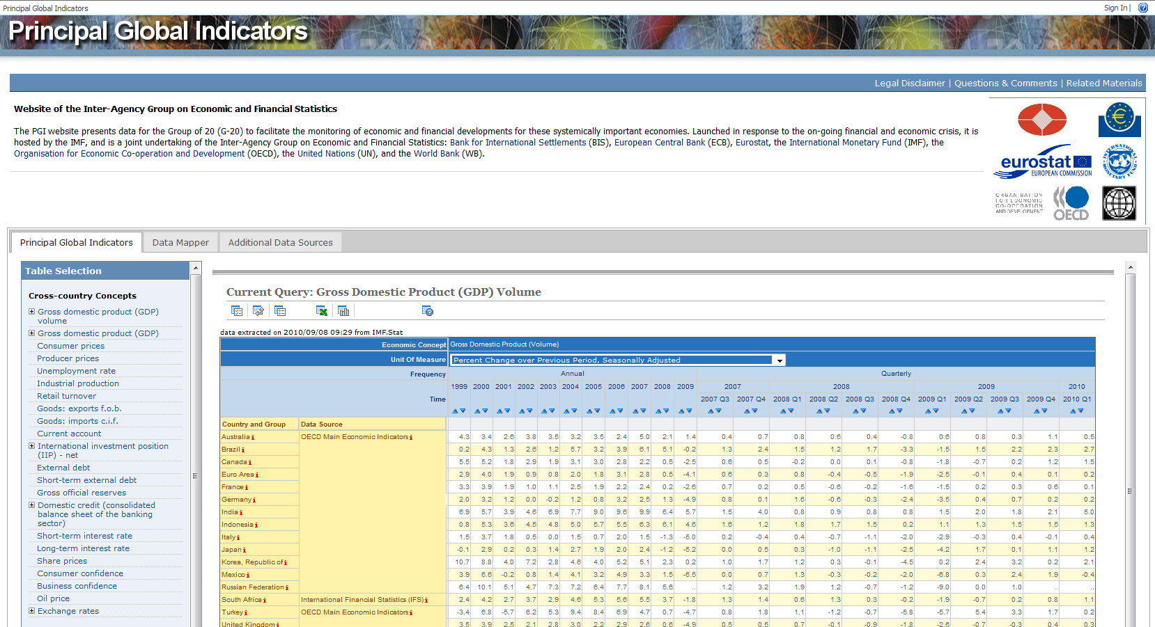
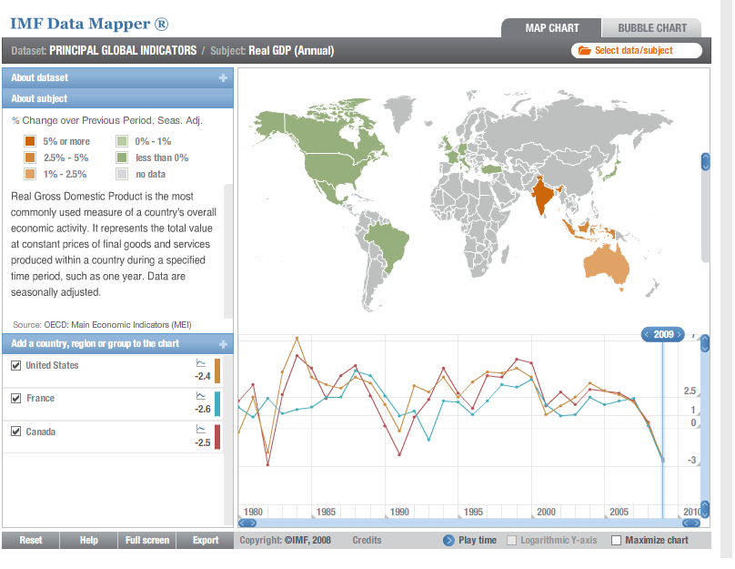
Data Dissemination using SDMX
Source: G20 Principle Global Indicators
http://www.principalglobalindicators.org/default.aspx
Notes:
The PGI website presents data for the Group of 20 (G-20) to facilitate the monitoring of economic and financial developments for these systemically important economies. Launched in response to the on-going financial and economic crisis, it is hosted by the IMF, and is a joint undertaking of the Inter-Agency Group on Economic and Financial Statistics: Bank for International Settlements (BIS), European Central Bank (ECB), Eurostat, the International Monetary Fund (IMF), the Organisation for Economic Co-operation and Development (OECD), the United Nations (UN), and the World Bank (WB).
Use of SDMX: data are dynamically displayed using an SDMX web service from the IMF’s economic data warehouse; a data visualization tools is also feed data using an SDMX web service.
Plans are to make this site a “showcase” for SDMX (given its contributors are sponsors) using the full range of SDMX services (collection, dissemination, output formats)

Slide 8

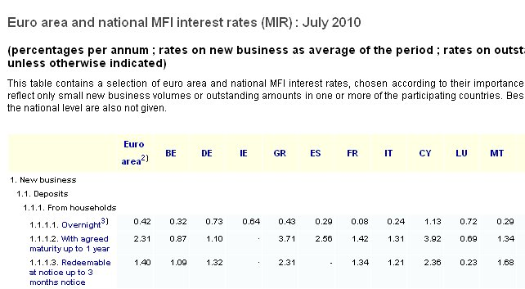

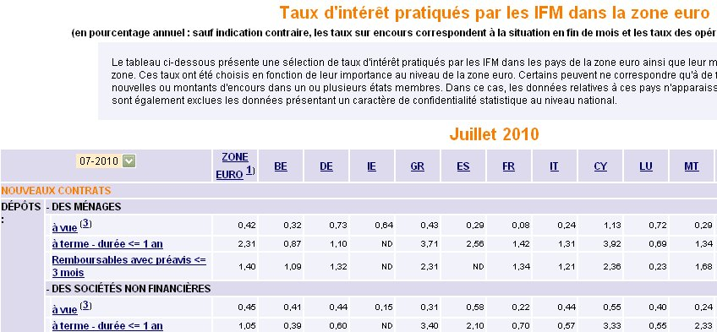
Data sharing in a cross-institutional framework
Web site of the European Central Bank; source data files in SDMX-ML
Web sites of the national central banks of the Eurosystem “pulling” the data (same source database; national look and feel)
Source: http://www.ecb.europa.eu/stats/services/sdmx/html/index.en.html
(“Selected euro area statistics and national breakdowns”)
Notes:
The European System of Central Bank (i.e. the ECB together with all national central banks of the European Union) is a very heavy user of the SDMX standards for 10 years already, basing all its data and metadata exchange (almost exclusively) on the sharing of SDMX data files. The standards are used in both “push” mode (when national central banks report data to the ECB and the ECB disseminates back bulk data files) and “pull” mode (institutions pulling data from the web site of another institution in an automated manner).
This slide illustrates the second case (“selected euro area statistics and national breakdowns”), demonstrating how the European Central Bank (ECB) and the central banks of the euro area in particular (the term “Eurosystem” used in the slide means the ECB together the national central banks of the countries using the euro) act as a network of institutions using the same source databases. The data are initially reported from national central banks to the ECB and stored in its databases where additional data are calculated (e.g. euro area aggregates). Then, this is the source database for the data and graphs shown on the ECB web site. In parallel, as these are also made available in SDMX-ML format, the national central banks of the Eurosystem “pull” these files and display the same data using the national web site’s language and “look & feel”. This allows perfect synchronisation of data and full automation, without compromising the particular features of the national web sites.

Slide 9
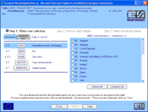

Data Sharing via SDMX Hub
National Statistical Institute
How the Census Hub works
Eurostat Census
Hub
National Statistical Institute
Source: Eurostat http://91.914.86.67.8080/CensusHub2
Notes:
This diagram shows how a data request from a user (left) to the Census Hub is processed using SDMX.
First, using a series of drop downs, the user defines the query (selecting relevent data dimensions, geo, age, gender, etc) and this is how the data are delivered:
1. The Census Hub converts the user request into SDMX Query and sends SDMX Query to NSI Web Service
2. NSI Web Service converts SDMX Query into a set of SQL queries and sends them to NSI data warehouse
3. NSI data warehouse sends the result to NSI web service
4. NSI Web Service converts the result in a SDMX-ML Data message and sends it to Hub
5. The same steps are repeated for all appropriate NSIs
6. Hub puts together all the SDMX-ML data messages proceeding from NSIs and presents the result in the web browser.
The

Slide 10
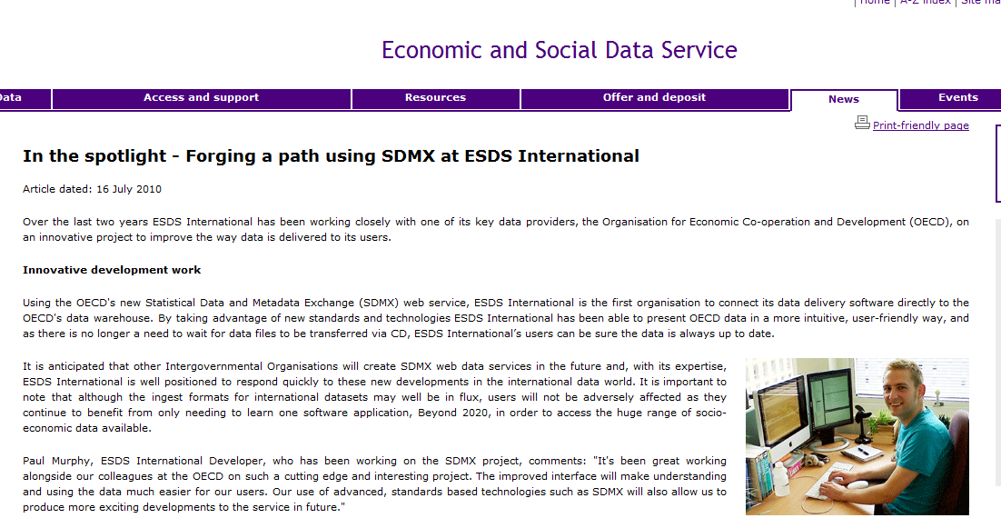
Automated data feeds using SDMX
Source: http://www.esds.ac.uk/news/spotlight/spotlight.asp
Notes:
About the Economic and Social Data Service
The Economic and Social Data Service is a national data archiving and dissemination service which came into operation in January 2003. The service is a jointly-funded initiative sponsored by the Economic and Social Research Council (ESRC) and the Joint Information Systems Committee (JISC).
The ESDS is a distributed service, based on a collaboration between four key centres of expertise:
UK Data Archive (UKDA), University of Essex
Institute for Social and Economic Research (ISER) , University of Essex
Manchester Information and Associated Services (MIMAS), University of Manchester
Cathie Marsh Centre for Census and Survey Research (CCSR), University of Manchester
These centres work collaboratively to provide preservation, dissemination, user support and training for an extensive range of key economic and social data, both quantitative and qualitative, spanning many disciplines and themes. The ESDS provides an integrated service offering enhanced support for the secondary use of data across the research, learning and teaching communities.

Slide 11
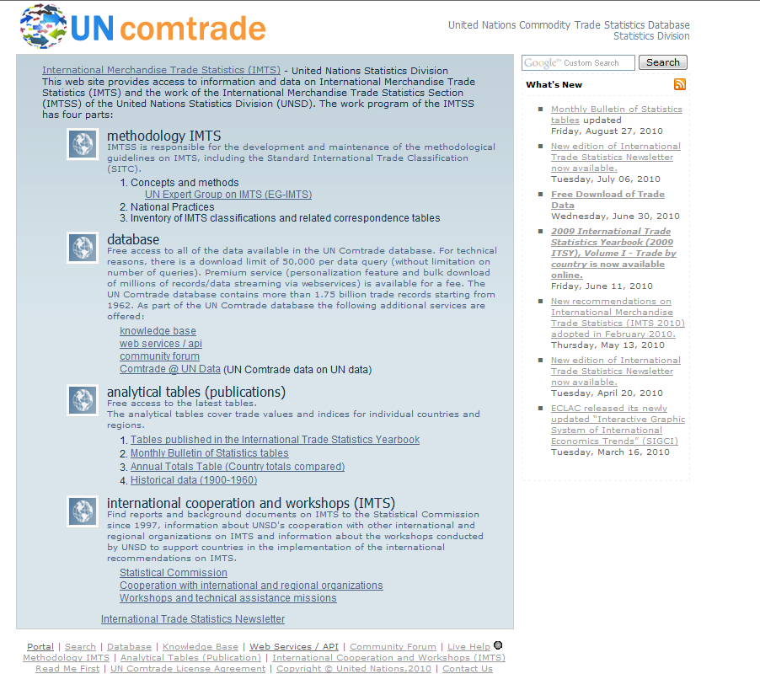
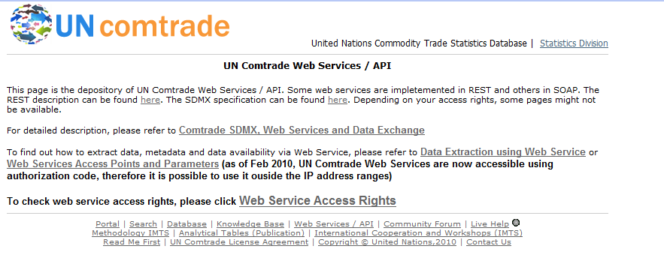
Data Dissemination using SDMX
Source: United Nations http://comtrade.un.org/
Notes:
United Nations Commodity Trade Statistics Database
Coverage : Imports, Exports, Re-exports; Commodity by Trading Partner; Annual data; Value in US dollars; Net weight and secondary quantities; About 140 reporters per year (>90% of the World Trade)
Notes
Comtrade was the first test case for SDMX Cross Sectional (data series)
Comtrade SDMX initially used for data exchange between UNSD and OECD
Comtrade uses SDMX cross-sectional format.
Each commodity classification has a specific Key Family. Therefore, there are 6 key families: for HS2002, HS1996, HS1992, SITC Rev.3, SITC Rev.2, and SITC Rev.1 Explanatory notes are integrated with Comtrade SDMX.
This is a beta version. The SDMX structure can be modified.
Comtrade Web Services are available for limited users.

Slide 12
Some Benefits
After a phase of investment the burden on national and international statistical organizations for data exchange is in general reduced
Powerful data model can accommodate any data or domain; easy to add new data flows simply by adding new dimensions & code lists
Data and metadata can be exchanged together; strong focus on metadata
Fosters common understanding and harmonization within and across statistical organizations
Re-use of concepts and code lists within and across organizations
More extensible than predecessor (GESMES), web compatibile, non-proprietary, human readable
Standards are public and open source; IT tools created by sponsoring or other organizations are made freely available
Notes:
More extensible than GESMES, lity”: new features/structures could easily be added later on without impacting backward compatibility. This is the main reason for having replaced the previous limited Gesmes standard by a new XML-based standard (together with web compatibility, non-proprietary, human readable).

Slide 13
Where to find more information: http:\\sdmx.org
Attend the next SDMX Global Conference
May 2-4, 2011, Washington DC co-hosted by the IMF and World Bank
Contact me at amcphail@imf.org

Slide 14
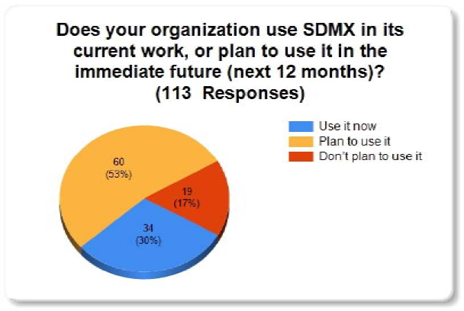
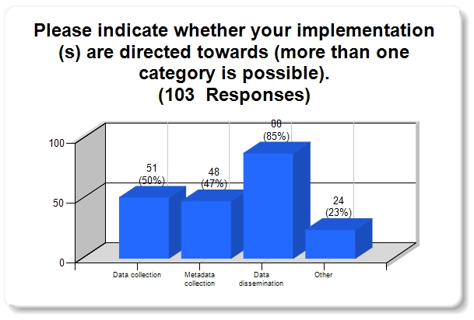
Additional information
Some findings from the 2009 Survey about SDMX
(involving responses from more than 110 institutions)
Source: 2009 SDMX Global Conference Report
Notes:
SDMX Global Conference 2009 – Summary Report, 19-21 January 2009, hosted by the OECD in Paris
Towards building an SDMX community
More than 240 experts from 65 countries and nearly 20 international organisations joined together to launch 2009 with a highly successful conference on ways to use SDMX standards and guidelines with mainstream technology to support statistical processes.
Source: Conference report (Download the report.)
At its 2008 meeting, the UN Statistical Commission agreed to recommend SDMX as preferred standard for exchange and sharing of statistical data and metadata.

