Slide 1
ALFRED: Capturing data as it happens
Katrina Stierholz, Director of Library and Information Services
Federal Reserve Bank of St. Louis

Slide 2
“How is the economy doing?”
Depends on when you ask.

Slide 3
Federal Reserve Bank of St. Louis & data
Long History (Homer Jones)
FRED is the Flagship
Over 22,000 economic time series
Aggregates data from many sources, in one convenient location
ALFRED is bigger than FRED
Collection of vintage versions of U.S. economic data available on FRED
Captures every iteration of data

Slide 4
Looking for revisions, and then solutions
Our former Director of Research, Bob Rasche, was looking for the economic data that were released originally—not the revised data that we have now.
We searched high and low...
Philadelphia Fed created a database with important economic series with the data points that were originally released, with monthly or quarterly observations (we wanted a day-by-day history)
Libraries removed news releases when the final version is published
Agencies historically wrote over the data, as the computing storage costs were high

Slide 5
2nd quarter 2010 real GDP 2.4%

Slide 6
2nd quarter 2010 real GDP 1.6%

Slide 7
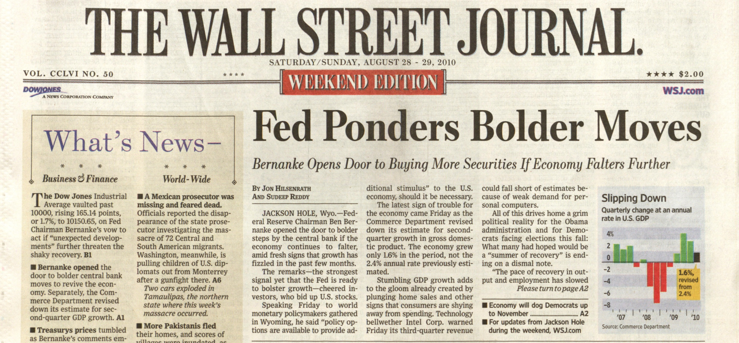

Slide 8
The value to capturing this history
Revisions reflect the level of accuracy regarding early estimates
Allows researchers and analysts to evaluate policy decisions using information available at the time, not what is known in hindsight
Allows economists to model the economy using data that was actually available

Slide 9
ALFRED
FRED

Slide 10
FRED and ALFRED
Underneath the hood, FRED and ALFRED are the same application.
ALFRED was populated by collecting historical data for series in FRED, and ALFRED continues to be extended by capturing "expiring" FRED values when new ones are published.
ALFRED only contains historical data on series that are in FRED -- it does not go back further than FRED.

Slide 11
FRED graph

Slide 12
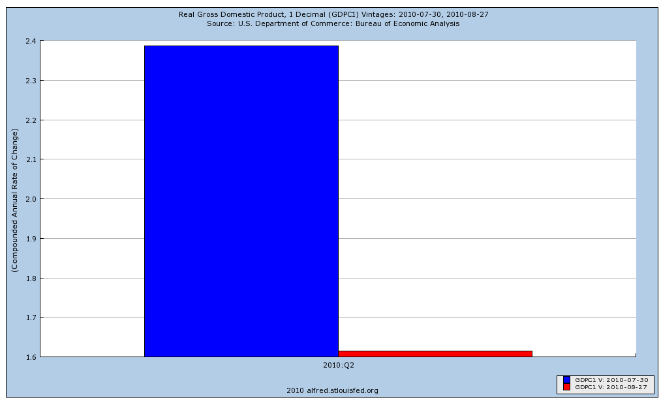
A quick bar chart available in ALFRED. The red bar shows the current release; the blue bar illustrates the previous release. Vintages are listed in the title, and on the legend (below).

Slide 13
A quick download from ALFRED of the quarterly GDP data released so far this year.
Users can download the history of the real GDP back to 1991; vintage Gross National Product data are available back to 1947. The earliest vintage available is 1927 for Industrial Production Index.

Slide 14
Background
Our programmer, George Essig, used Richard T. Snodgrass’ book Developing Time-Oriented Database Applications in SQL.
These data are saved only when there are revisions; each data value has three pieces of information
The time period it applies to (e.g., 2nd quarter 2010)
The time period it is true for (e.g., from July 30th to August 26th)
The date that the information was entered into the database to allow for tracking of data entry errors

Slide 15
Negative Saving Rate—or not
Remember the negative saving rate? I thought I’d use those data and an article in our librarian newsletter for a talk I was giving to an economic education class.

Slide 16
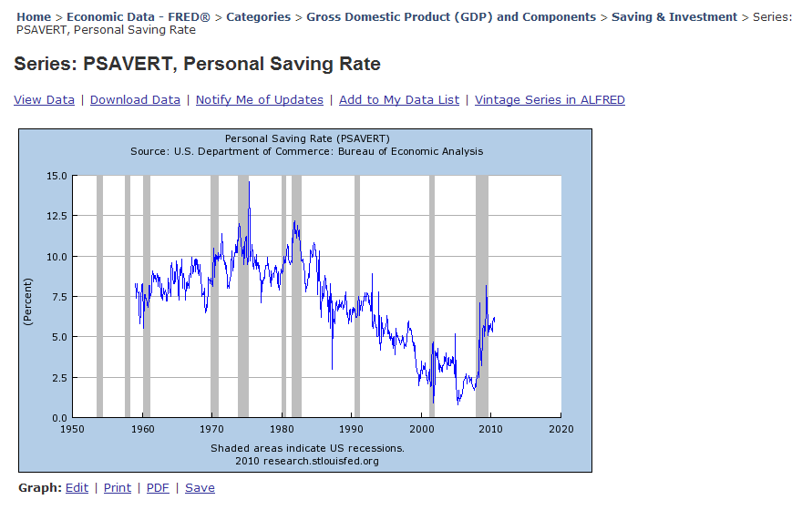
From a Liber8 article: “The U.S. personal saving rate fell into negative territory during the third quarter of 2005 and has remained close to zero since then.” Here’s the data: What’s the problem?

Slide 17
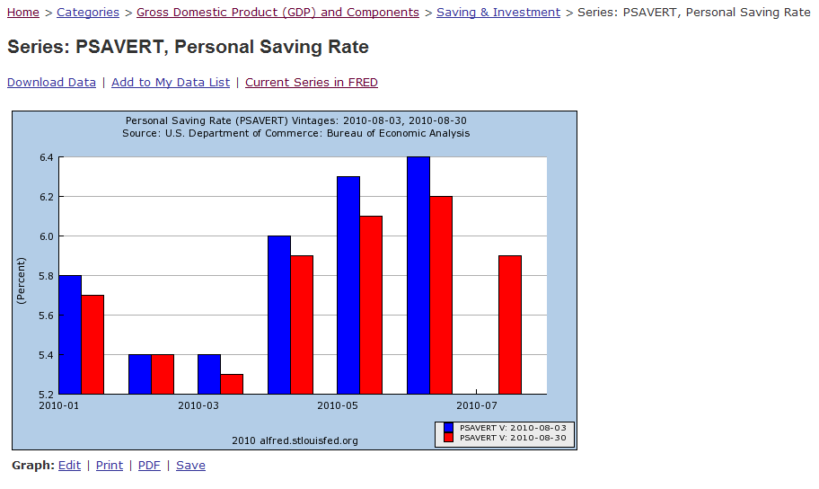
Just a quick check to get into ALFRED and to see what revisions look like for this data. I’m going to edit this to see an earlier vintage.

Slide 18
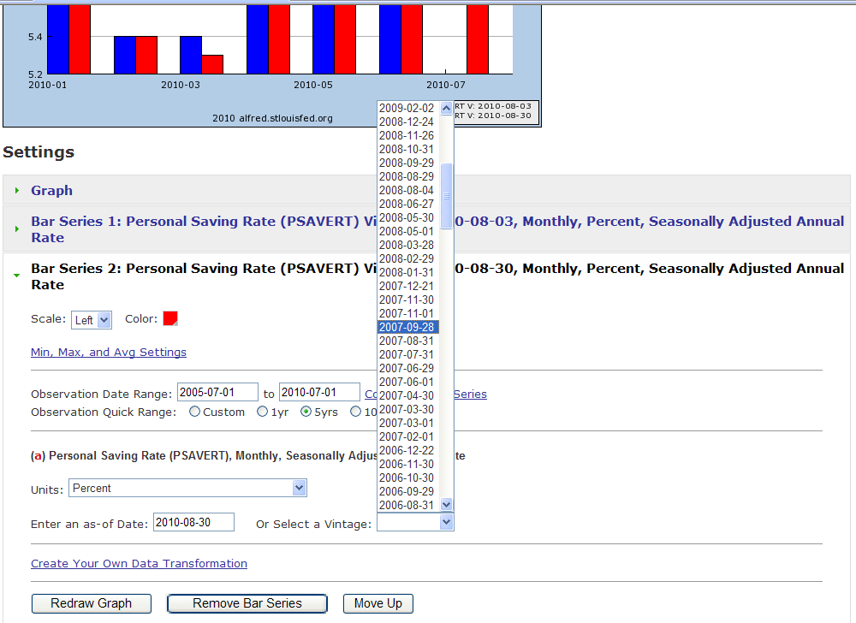
I changed the vintage to the vintage just before the publication of our Liber8 article.
The observations date range is the last 5 years.

Slide 19
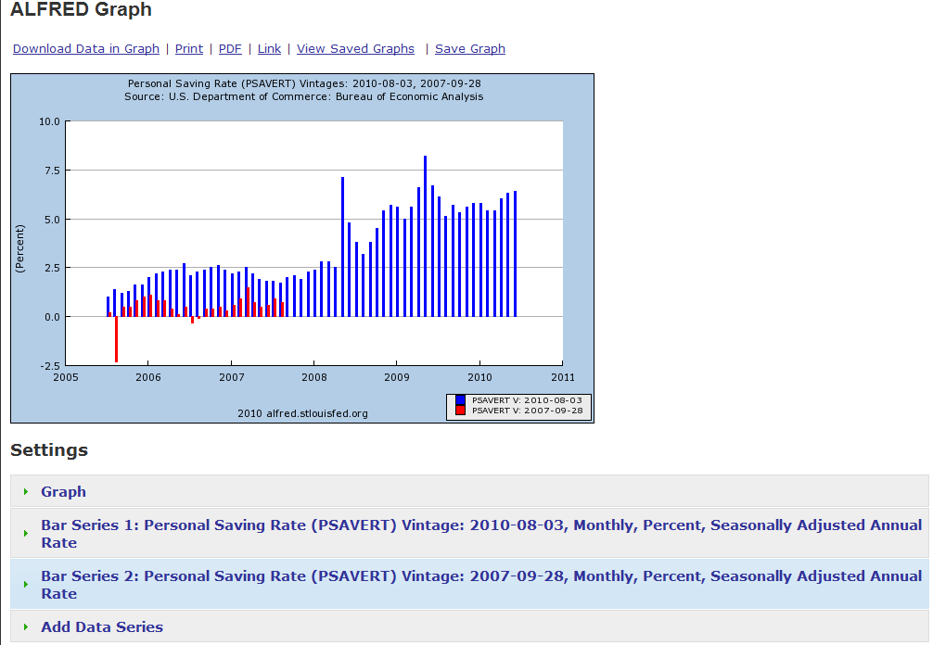
Here’s the chart with the original series and the revised data. Revisions have moved the saving rate into positive territory.

Slide 20
ALFRED’s goals
ALFRED allows users to see the revisions to a series. Users may also select a particular date and see the data as they were at that point in time.
Unique information, easily accessed
Preserving important data for future research
http://alfred.stlouisfed.org/

