Slide 1
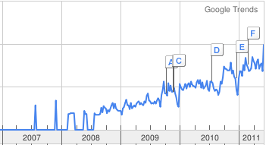

Slide 2
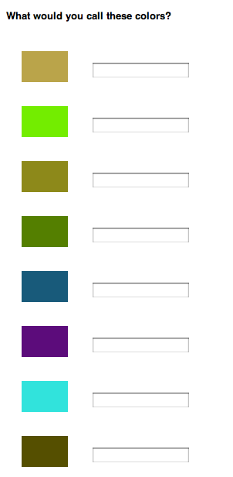

Slide 3
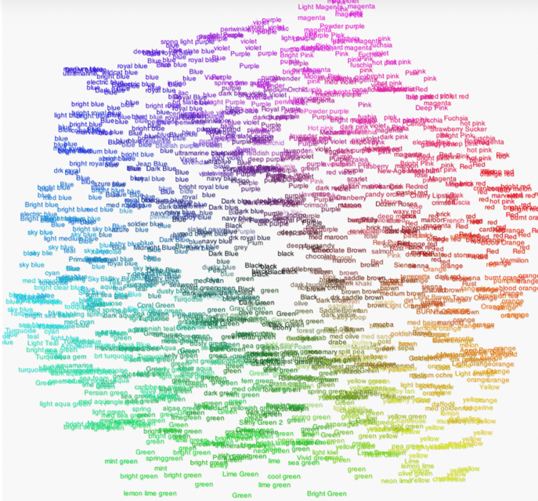

Slide 4
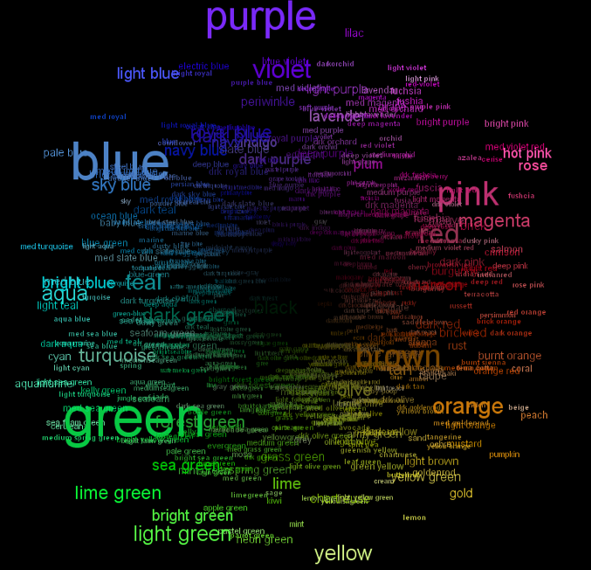

Slide 5
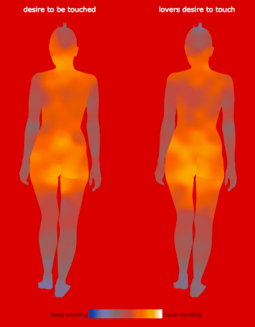

Slide 6
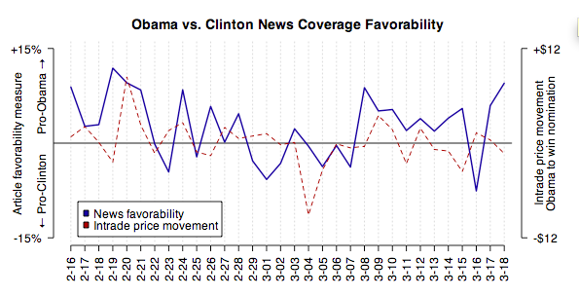

Slide 7
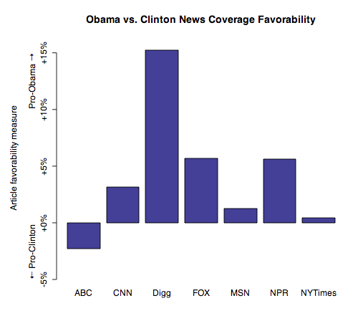

Slide 8

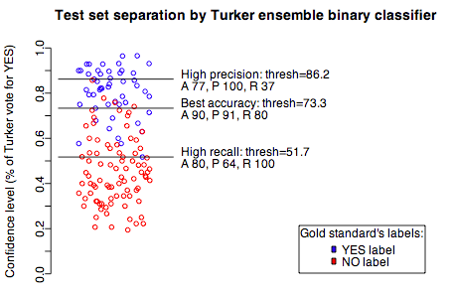

Slide 9
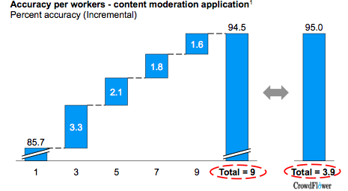
Quality

Slide 10
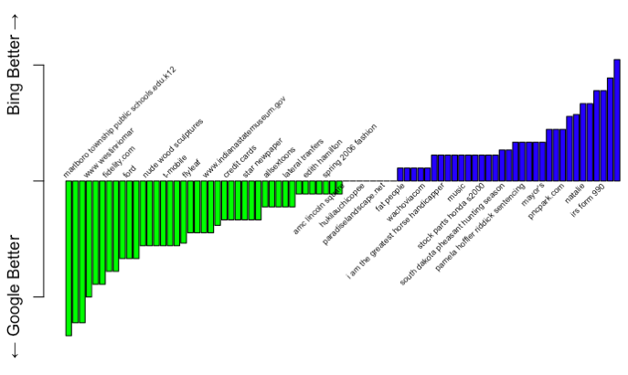

Slide 11


Slide 12
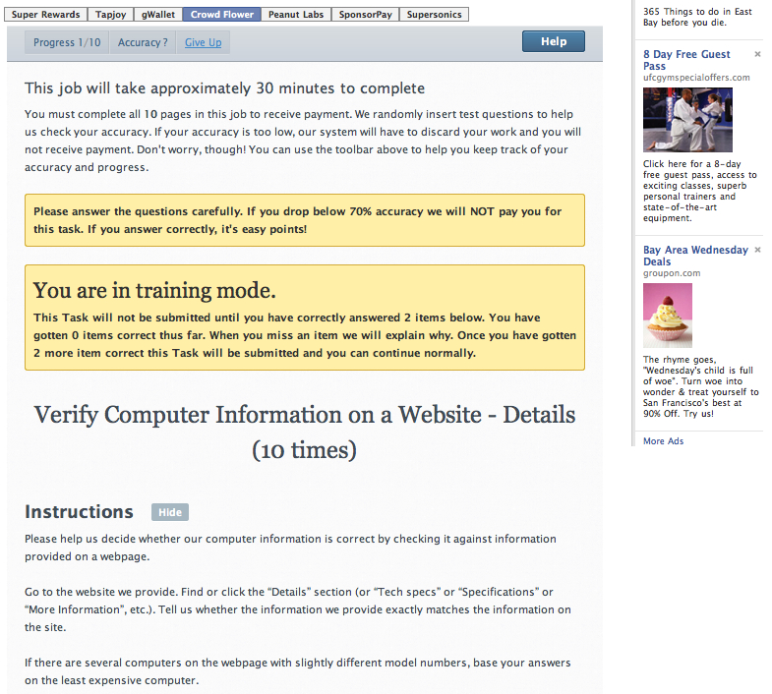

Slide 13


Slide 14


Slide 15
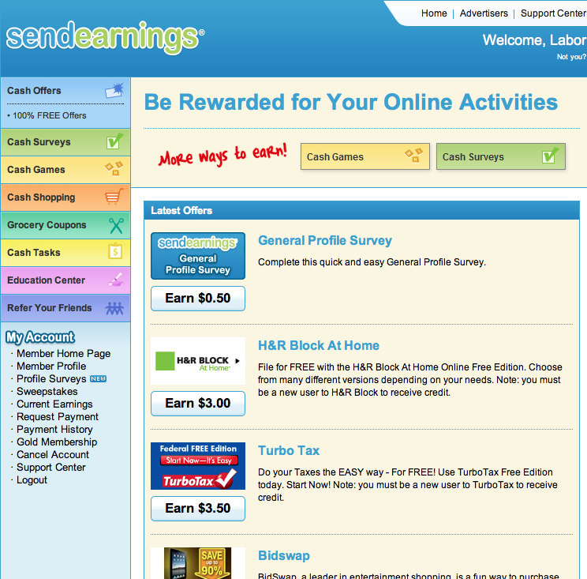

Slide 16


Slide 17


Slide 18
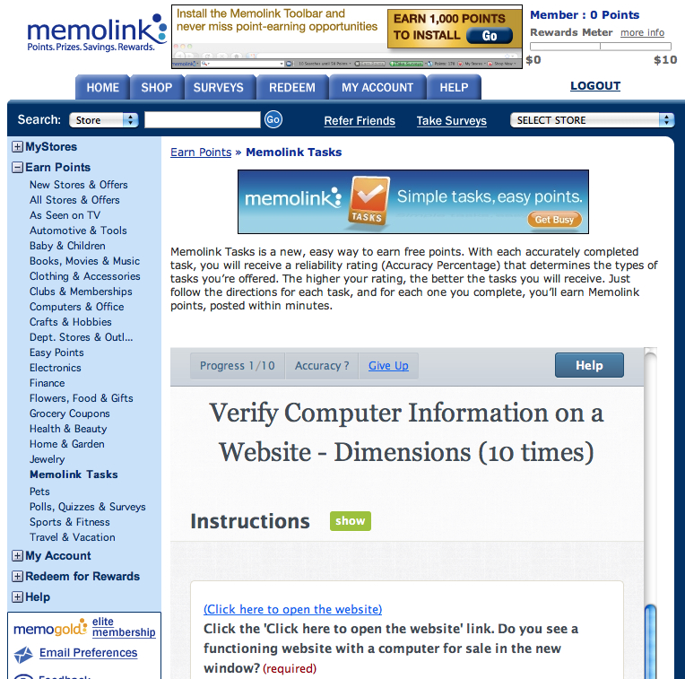

Slide 19
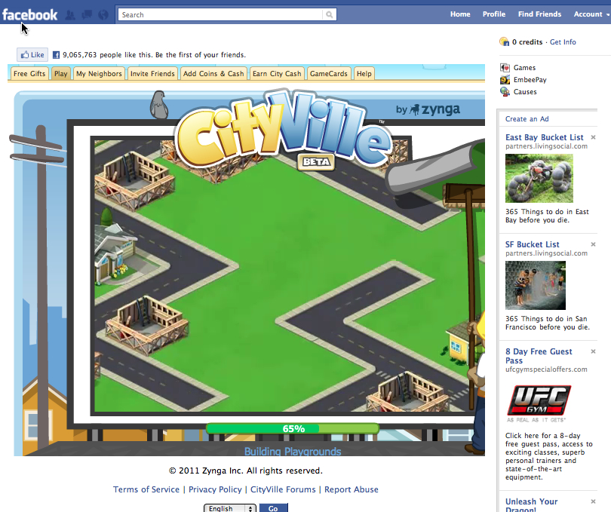

Slide 20
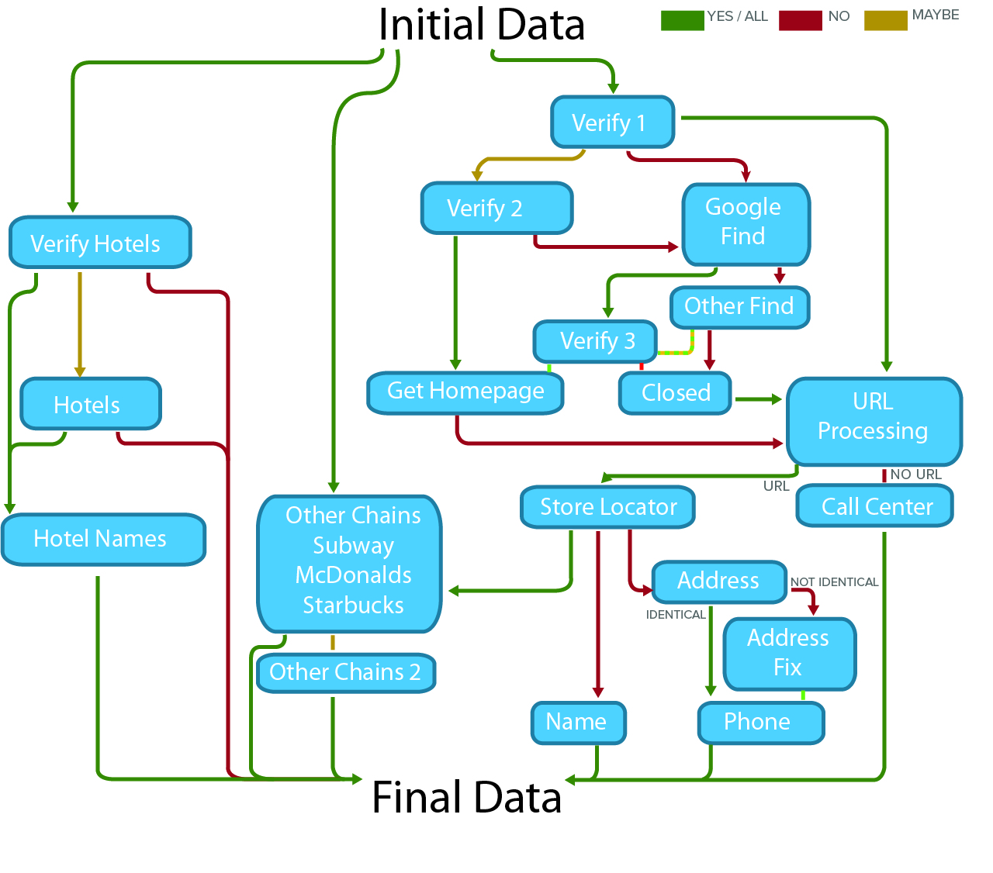
Workflow

Slide 21
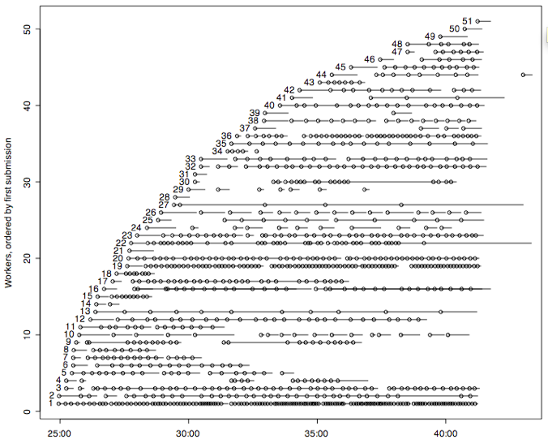
Routing

Slide 22
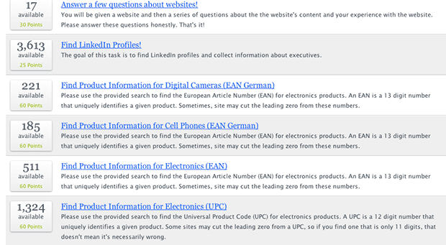
Task Design

Slide 23

Incentives

Slide 24
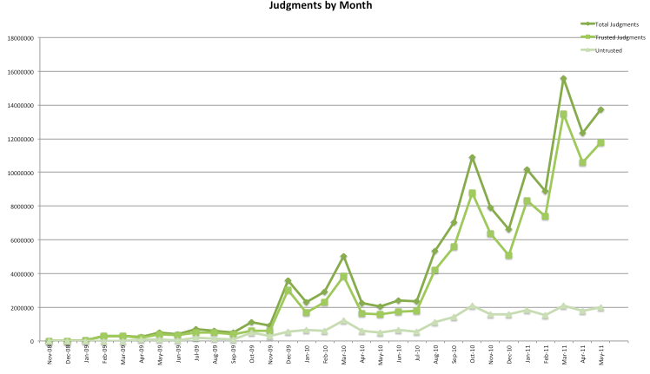
CrowdFlower Judgments

Slide 25
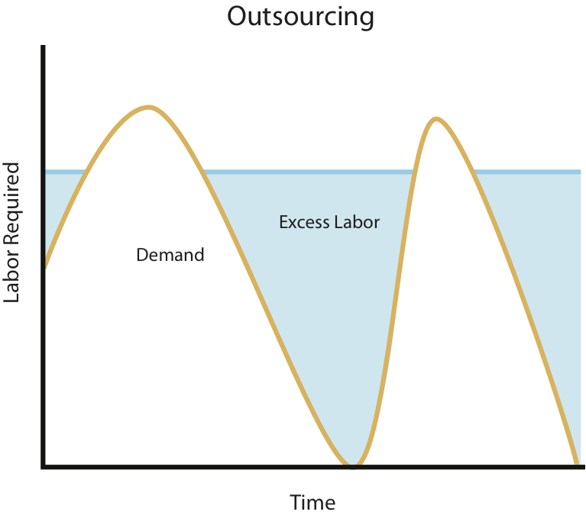
Labor Efficiency Problem

Slide 26
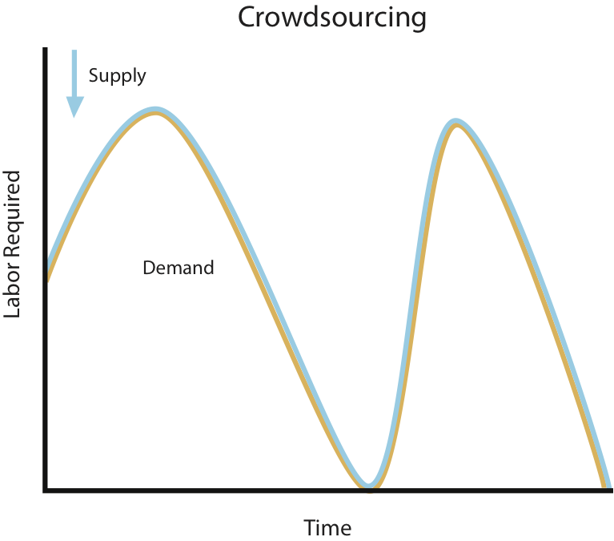
Labor Efficiency Solution

Slide 27
Daily FTE for CrowdFlower tasks: May 2010 – Nov 2010
Number of FTEs
6,000
1,000
500
0
Daily FTE for CrowdFlower tasks: 8/28/2010 - 9/6/2010
Number of FTEs
Scaling up
5,689 FTEs in 5 days
Scaling down
5,685 FTEs in 4 days
28-Aug
29-Aug
30-Aug
31-Aug
1-Sep
2-Sep
3-Sep
4-Sep
5-Sep
6-Sep
Notes:
Big conservative companies
Take a mission critical business process and send it to millions of strangers on the internet?

Slide 28
Workforce Elasticity
Daily Worker Hours Needed to Mirror CrowdFlower Throughput
Outsourcing
Hours
Q1 2011

Slide 29
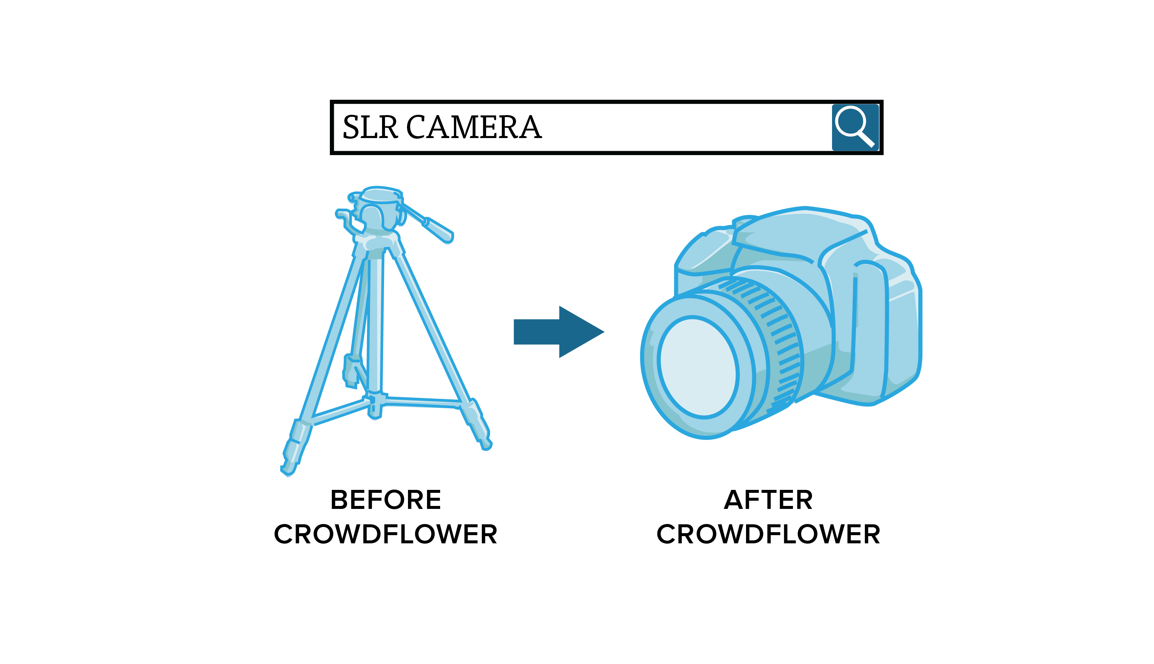

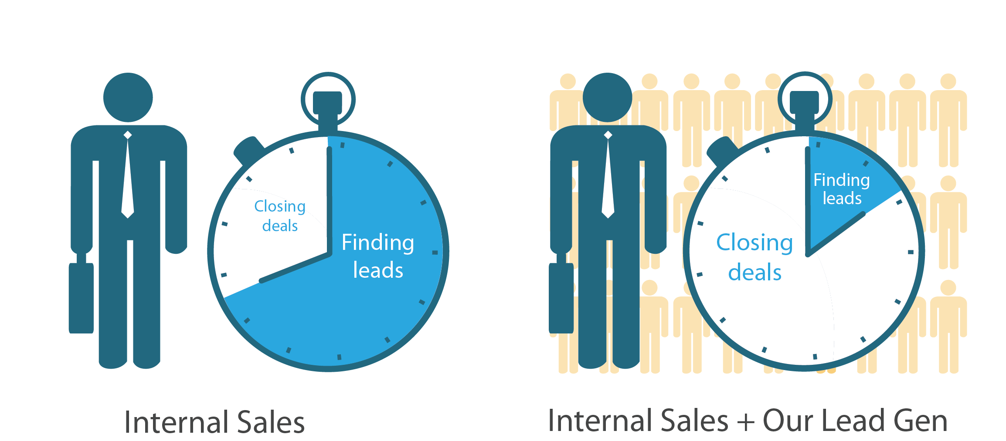
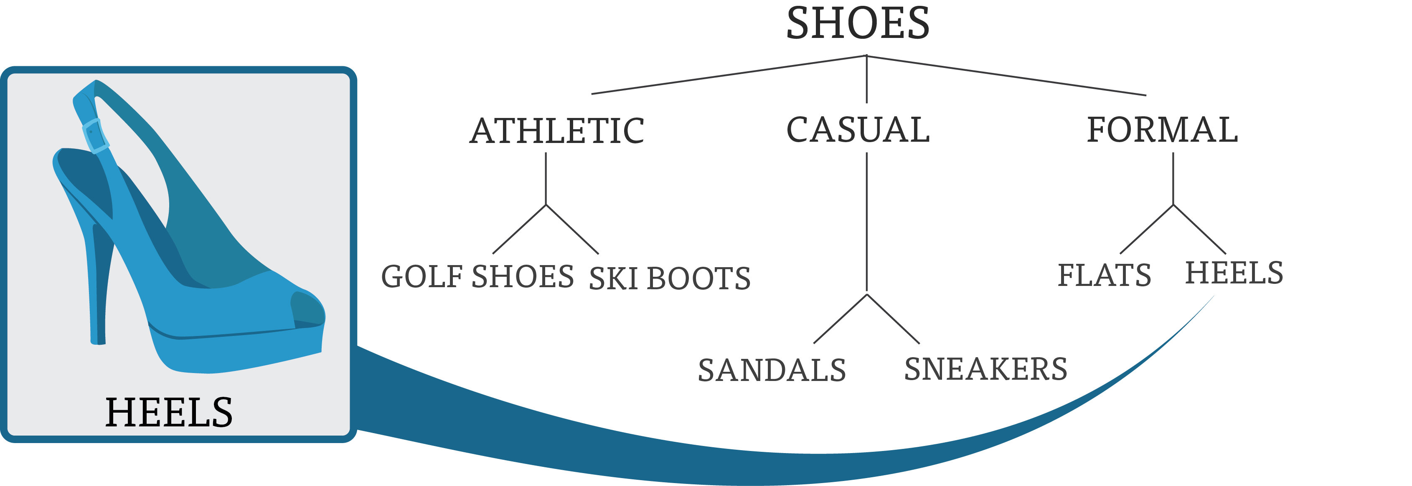
CrowdFlower Services
Business Listing Verification
Search Relevance
Product Categorization
Lead Generation

Slide 30

Notes:
This image was a bit clearer but thought made same point as school girls and men in factory.

Slide 31
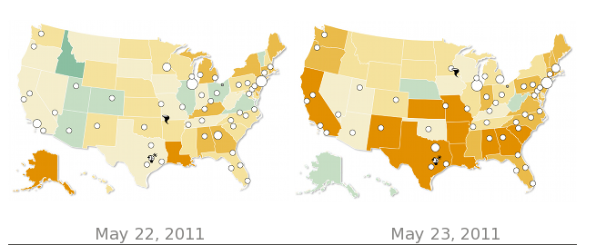
Dialogue Earth

Slide 32
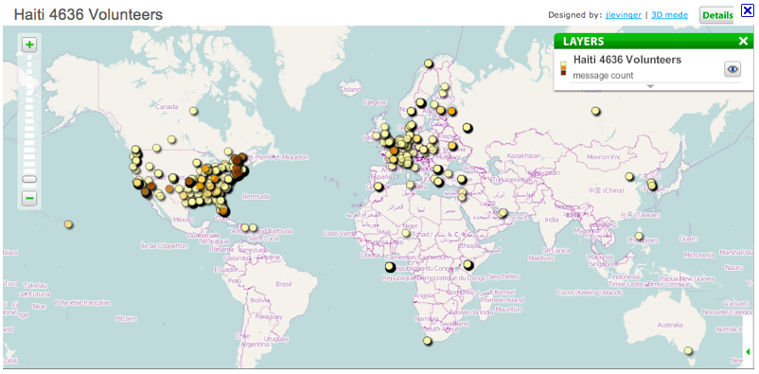
Need for
Kreyol-English
Translators
January 12, 2010
Notes:
Patrick Meier from Ushahidi talked about 4636 last year
Will it be reliable?
Can we really coordinate thousands of volunteers over the internet?
Seems hard, is hard

Slide 33
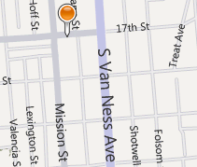
Contact me to learn more
  CrowdFlower
  2111 Mission Street, Suite 302
  San Francisco, CA 94110
  (415) 651-4485
  lukas@crowdflower.com
  Twitter: @CrowdFlower
  blog.crowdflower.com
CrowdFlower

