Slide 1
Computing Old and New: Labor Markets for Data
David Alan Grier
Center for International Science & Technology Policy
George Washington University

Slide 2
Crowdsourcing
Approach to Large Data
Assemble Workers
Divide Work
Organize Results
Frees from Discrete Finite Automata
Natural Extension of Standard Computing Model

Slide 3
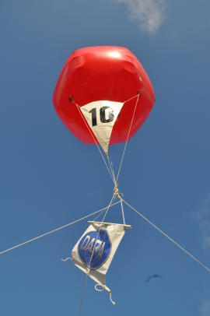
Current Uses of Crowds
Image Identification
Encyclopedia Production: Wiki
Translation
Editing
Data Collection: The Census
Search Enhancement
Graphic Design

Slide 4
Standard Computing Model
Data
Discrete Finite Automata
Data
Instructions
Output
1937 Turing
1945 John von Neumann
Instructions
Processor
Feedback
Output

Slide 5
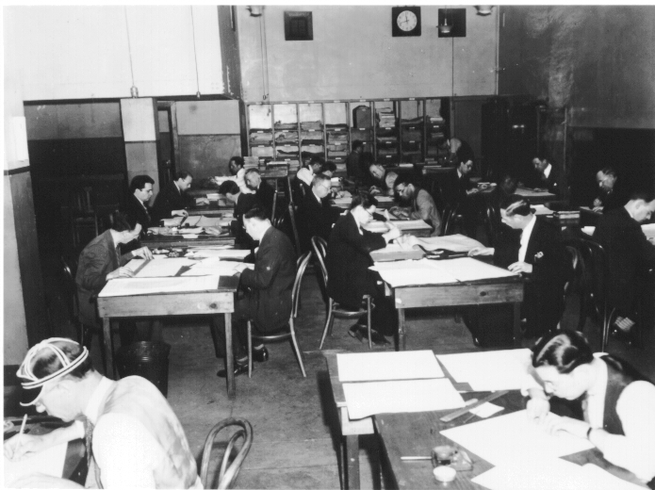
Humans Bring Judgment
Mechanical Discipline Hard
Pattern Recognition, Contextualization, Processing Ill-Defined Data
Judgment
Not Right or Wrong
But Better or Worse

Slide 6
Computing as Judgment
Valuation Activity
Valuation is Always Comparative
What Would You Give
In Comparison to Something Else
Market Activity
Extension of Mechanistic Computation

Slide 7
Calculation as Exchange
judgments
Processor
rewards
Calculation/Judgment Market

Slide 8
Full Combined Model
Every Step Expanded by Market
Data Input
Not Necessarily Gathered by Fixed Rule
Processing
Complicated Tasks Done Inexpensively
Data Output
Distribution by Judgment

Slide 9
What Markets Bring: Mathematical Tables Project
Jobs
Multiple Layers of Markets
Disciplining Function
Error Correction
Education
Problem Choice
Bethe’s Sun Model
Linear Programming
LORAN Tables
Workers
MTP
Distribution Market

Slide 10
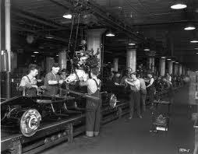
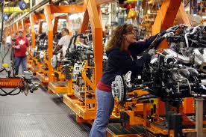
What Will it Do To Work?
Machine/Judgment Trade Off
Dynamic Division
Least Expensive Solution: Babbage(1832):
No Recovery of Fixed Investments
Rapid Prototyping

Slide 11
What will it do to Workers?
Potential to Educate
Global Engagement
Spread Opportunities
Advancement
Organization
New Forms of Parallelism

Slide 12
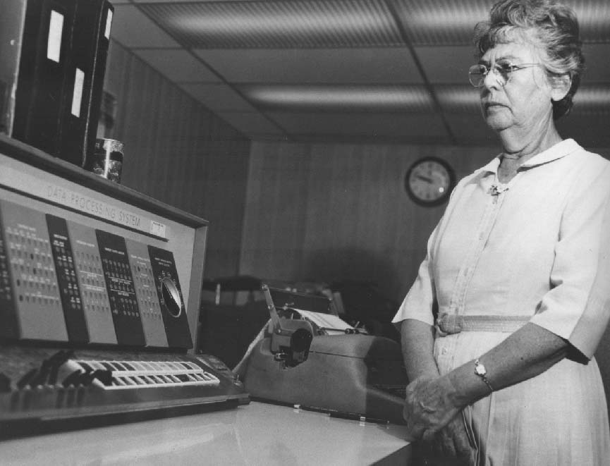
What will it do to Computation?
Expand capabilities
Change Quality
Change Quantity
A market activity
Machinery
Judgment

Slide 13
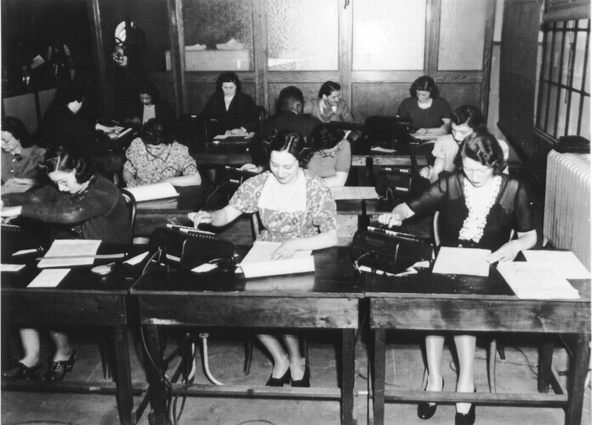
Finis
Powerful extension
Method of Future
Method of Past

