Slide 1
Commercial search engine developers and universities: a critical time for collaboration in the coming age of publicly accessible research data
Stefan Kramer & William C. Block
Cornell Institute for Social and Economic Research (CISER)

Slide 2
The past and the “recent present”:
  In universities, researchers have had fairly little incentive to preserve and share their research data with others in the long term, aside from altruism
    Not to be confused with temporary data collaboration during a project
  Data sharing and publishing largely not a recognized scholarly activity for the tenure process

Slide 3
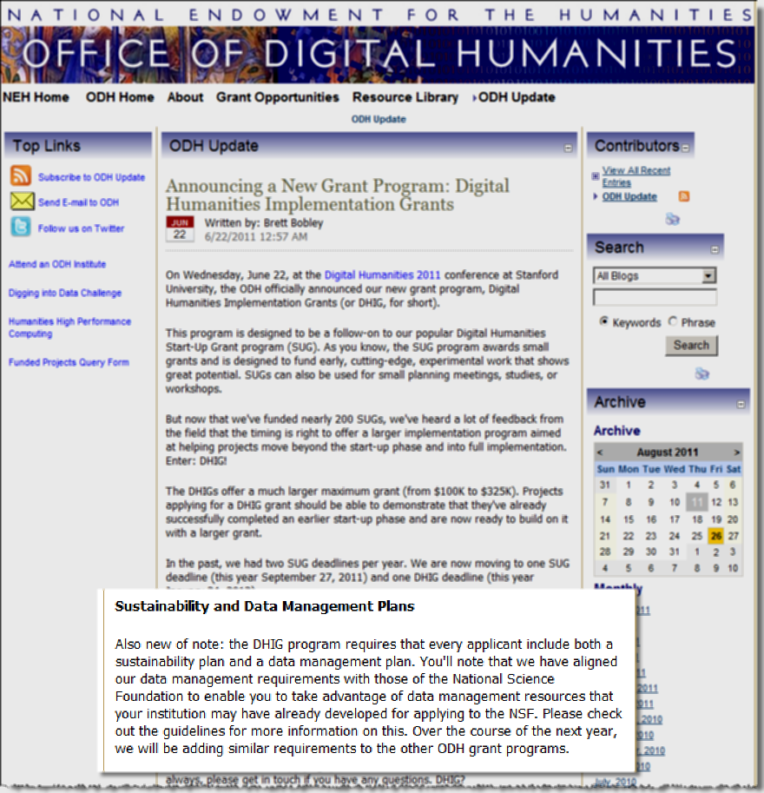
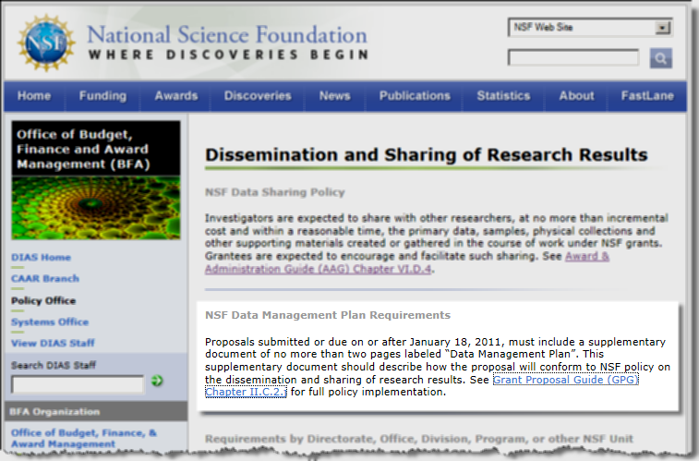
The potential game changer: requirements by research funding organizations
Now making research data available becomes non-optional

Slide 4
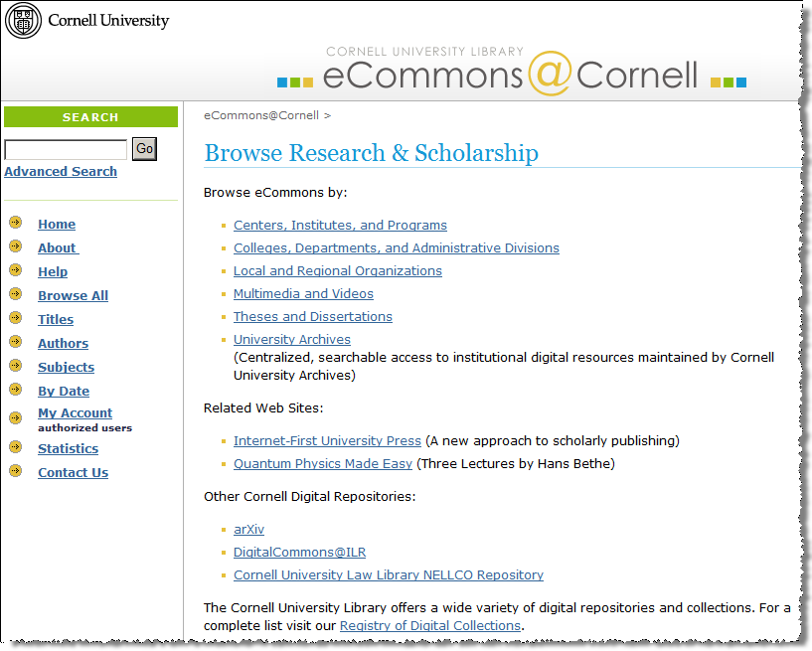
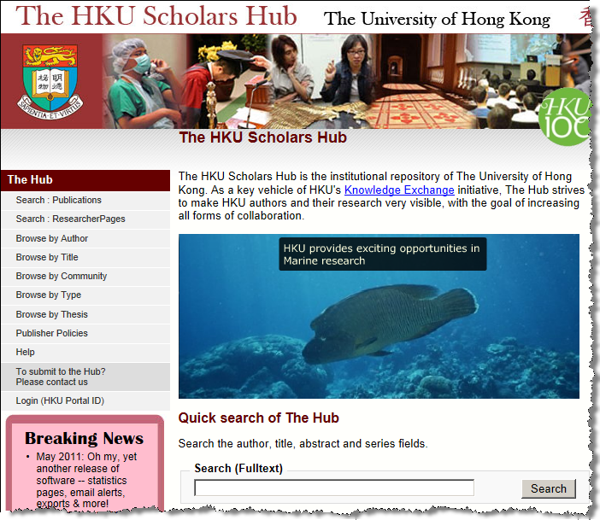
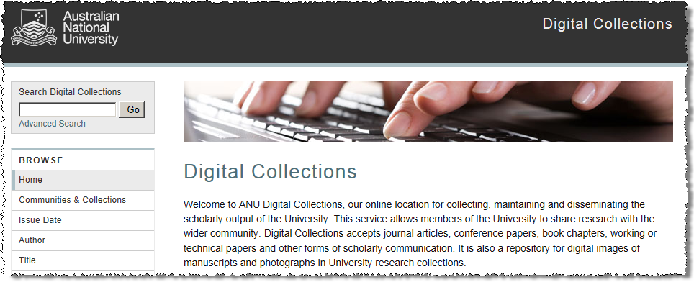
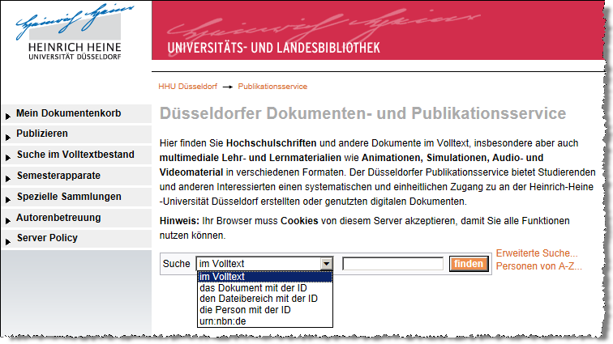
Many research universities have their institutional repositories, chiefly for texts, images, video, audio…
… which some now (want to) adapt to accommodate research data … or build separate repositories for that purpose

Slide 5
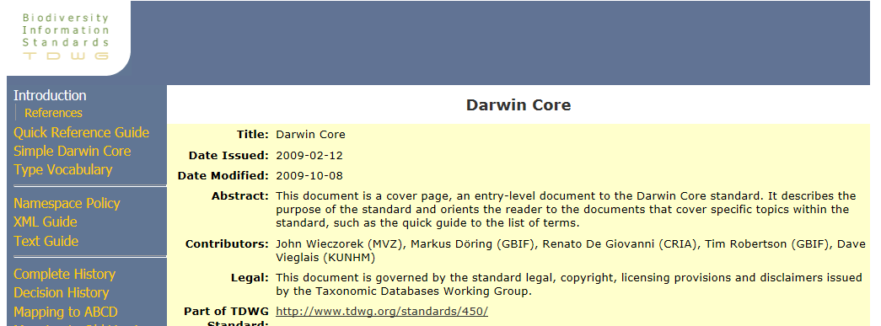
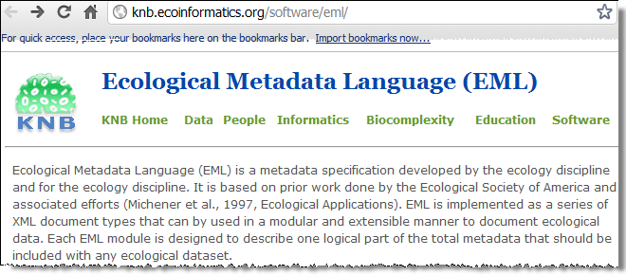
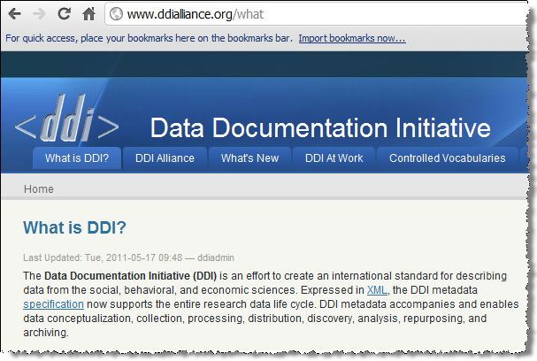
The good: metadata standards for specific domains of research data do exist, and research universities are increasingly promoting/supporting their use by scientists ...
Three examples, from ecological, life, and social sciences

Slide 6
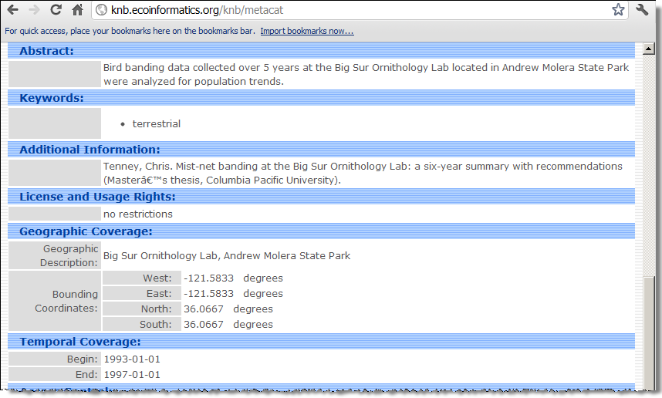

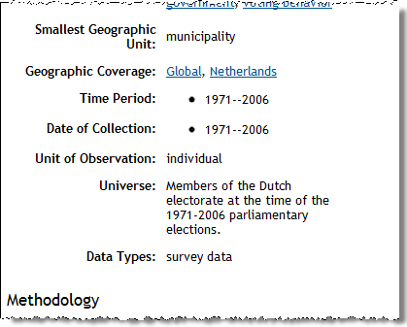
… so research data is (or at least can be) documented in ways that do (or at least could) allow for “search” in data-targeted ways:
Two examples, from ecological and from social sciences

Slide 7
The bad: as research data sharing becomes mandatory, university departments, libraries, research centers, associations, consortia, etc. will likely create more and more (different) information silos for more and more (diverse) data

Slide 8

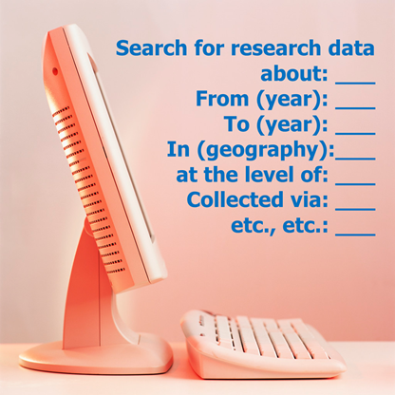
The ugly: the future researcher, looking for data for repurposing, replication, … won’t and shouldn’t have to know or care much about how this infrastructure came to be …
… but will want cross-data-repository searching to be easy, yet focusable

Slide 9
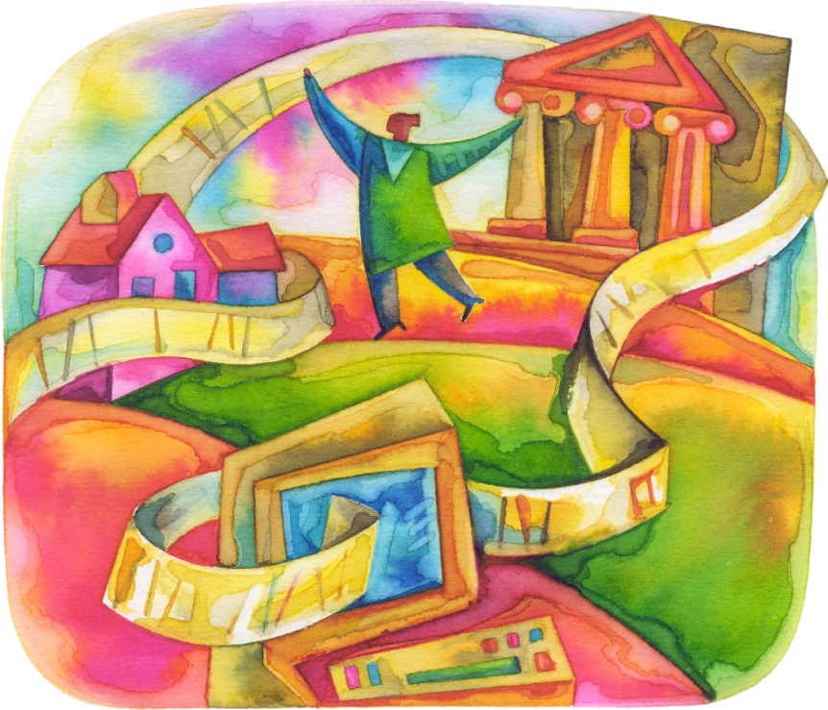

Who can create the solutions to these problems? Research-generating institutions (incl. universities) and search engine developers together
+
=

Slide 10
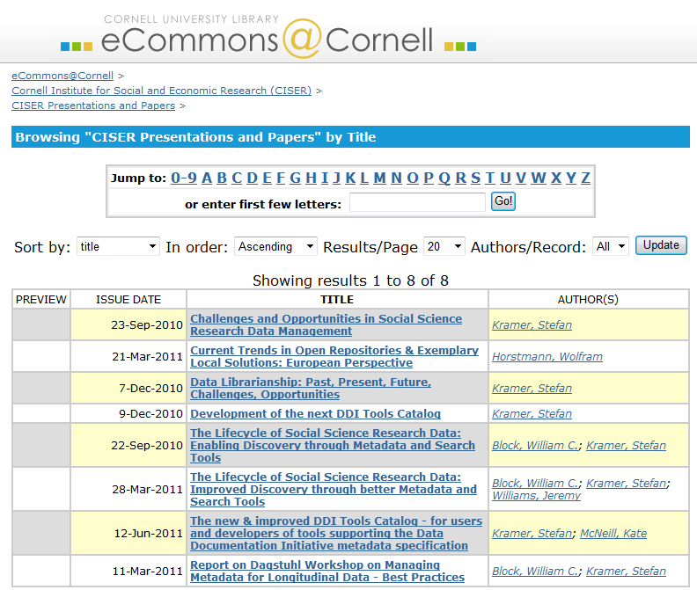
Thank you for your time & attention!
Stefan Kramer
stefan.kramer@cornell.edu
William C. Block
block@cornell.edu
Look for this presentation in: http://ecommons.library.cornell.edu/handle/1813/17391

