Slide 1
Experiences with Big Data and Learning What’s Worth Keeping
Roger Liew, CTO Orbitz Worldwide
Wolfram Data Summit 2011
Notes:
Good afternoon,
I’d like to talk about why we embraced big data
The benefits we’ve gained from the data
And lessons that we’ve learned from this
Apologies for the switch, but the original topic didn’t work with the additional context

Slide 2
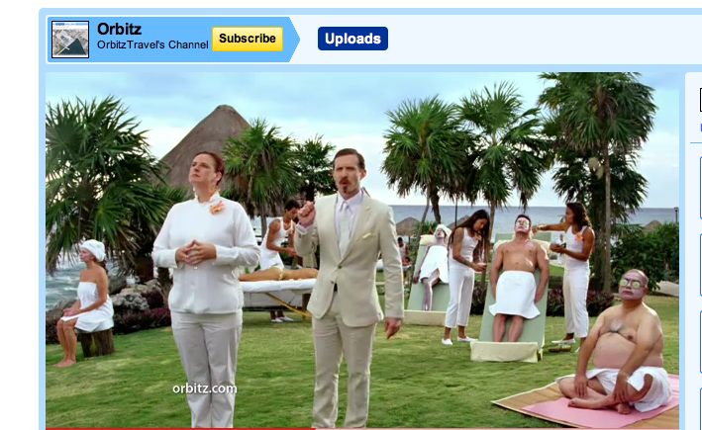
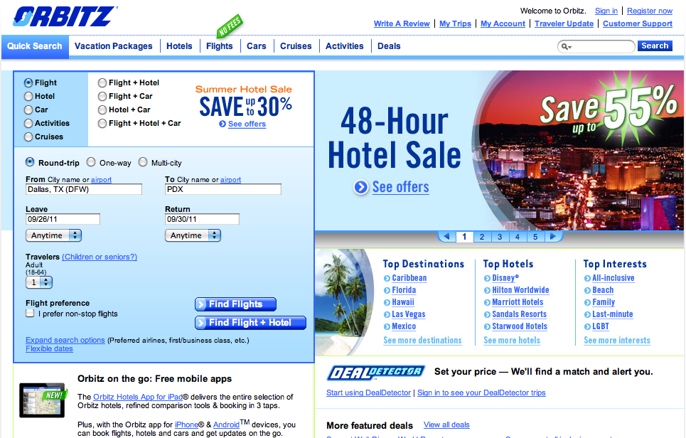
Launched in 2001
Over 160 million bookings
7th Largest seller of travel in the world
Notes:
Orbitz is a global travel company.
Lot’s of consolidation in travel over the last decade.
8 agencies 90% of the 3rd party travel market
>$11 billion in sales 2010
How do I get the best Deals?

Slide 3
How did Orbitz end up with big data?
Notes:
Other than public repositories of movies preferences and scraping amazon in violation of T&C’s there’s not a lot of freely available data on consumer preferences
Having lot’s of data is cool
But believe it or not we were not strictly motivated by technology

Slide 4
Optimizing Hotel Sorting
Notes:
Focus on the consumer data.
We started by trying to solve a particular business problem of ranking properties in hotel search results.
It’s challenging because availability and pricing are generally fluid and dynamic.
Availability tends to fluctuate as well.
this page is dynamically assembled.
What was reported was summarized information about transactions for each hotel as well as
When we looked at the data, we realized that what we recorded was user activity.

Slide 5
The Data We Collected Did Not Meet Our Research Needs
Transactions
Top clicked links
Top paths through site
Top referrers
Top bounce pages
Path conversion
Browser type
OS version
Geographic distribution
…
Aggregate
Consumer behavior
Notes:
Typical data is web analytics and marketing performance data
Stuff like campaign performance, but performance really measured by did they show up
Qualified traffic wars

Slide 6
We Have Two Distinct Databases Serving Different Constituents
Aggregated Non-Transactional Data (e.g. searches)
Transactional Data (e.g. bookings)
Data Warehouse
Data Warehouse
Notes:
Two distinct databases
Two distinct constituents

Slide 7
Hadoop technology and economics allow us to do things we couldn’t do before
Thousand $ per TB
Notes:
To solve this problem,
An open source technology inspired by google was created by a Yahoo employee Doug Cutting called Hadoop
Hadoop is software framework that allows us store and process large amounts of data
Web scale
It has proven to be scalable and reliable storage (but a bit bleeding edge)

Slide 8
Our New Infrastructure Allows Us to Record and Process User Activity at the Individual Level
Detailed Non-Transactional Data (What Each User Sees and Clicks)
Transactional Data (e.g. bookings)
Data Warehouse
Hadoop
Notes:
We started to record the raw analytics data
Click events
Actual page content
Ability to rerun queries.
When you think of a new attribute you would like to consider
Of people who left the site just before purchase, how many looked at more than one hotel and were on an iphone.

Slide 9
Transactions
Detailed events
Notes:
Not aggregations or samples but every single page view.
Records numbering the billions
It’s very important to note the distinction for us to have access to every individual record.

Slide 10
Recommendations For You
Notes:
Some of the things we can do now that we have the detailed information and the means to process the information.
Customers who’ve looked at hotels in your recent history etc are complicated problems to solve.

Slide 11
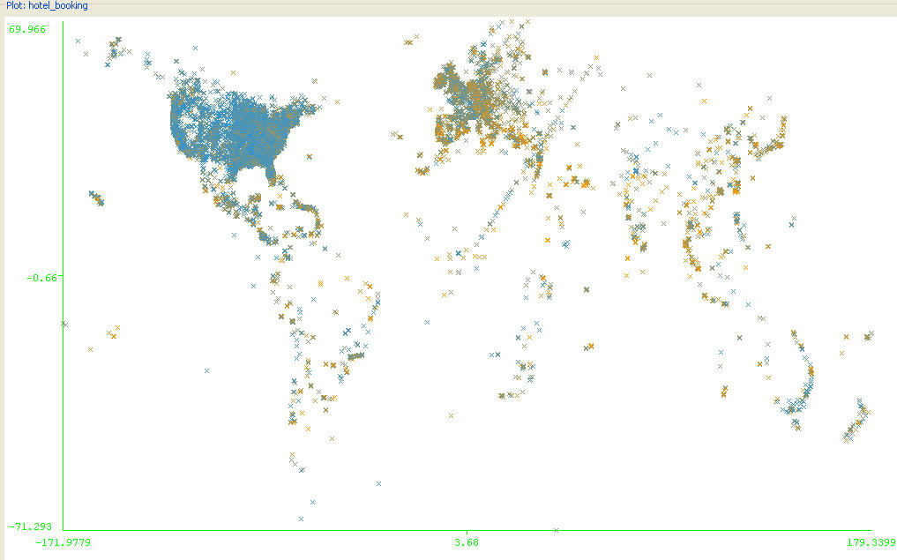
Orbitz World
Notes:
Fun chart that illustrates how global the business is.
We just plotted the lat/long of hotel bookings for the month

Slide 12
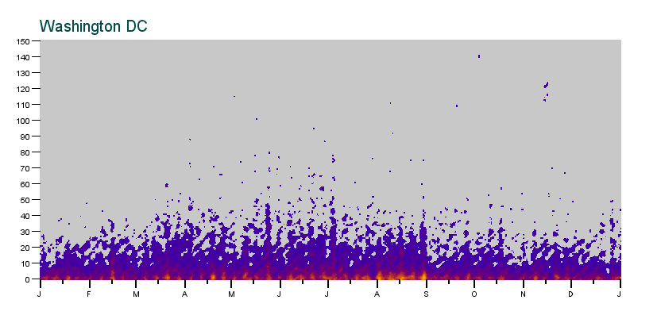
Advance hotel booking days
Notes:
Y axis = number of days before the booking
X axis = days stayed
Color = multiples of the x and y
Weekends big
More planning to visit NYC

Slide 13
Safari Users Seem to be Interested in More Expensive Hotels
Notes:
Data is used analysis of user segments, which can drive personalization.
This chart shows that Safari users click on hotels with higher mean and median prices as opposed to other users.

Slide 14
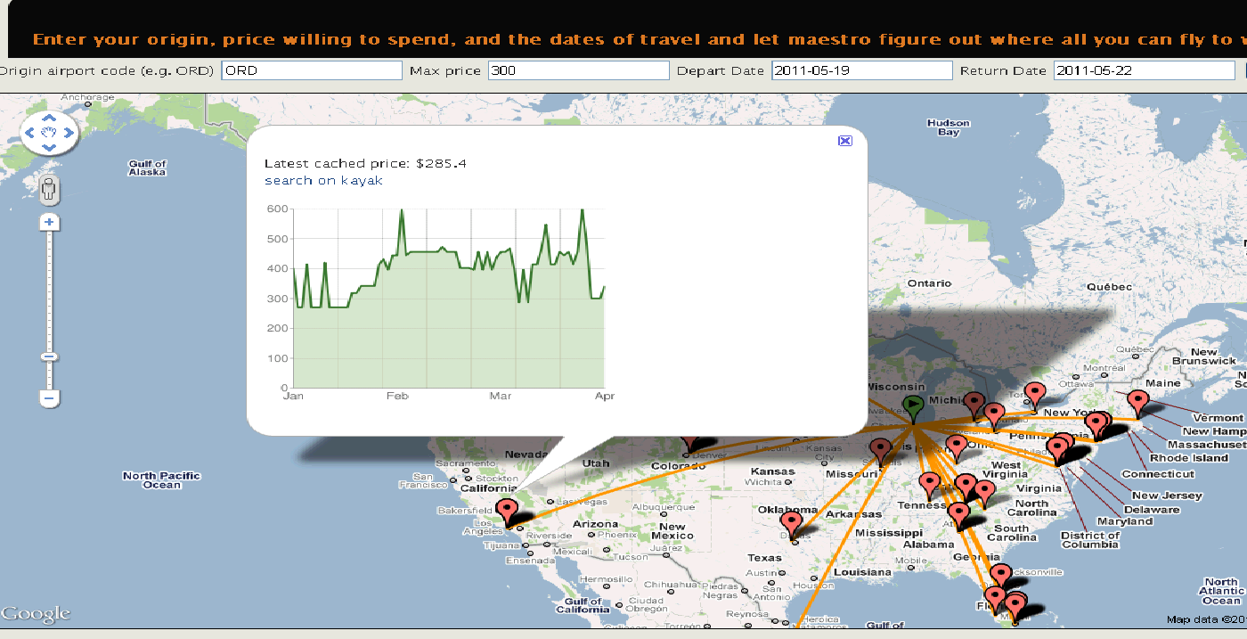
Historical Prices From a Given Origin
Notes:
Coming from our historical background of air
For a given origin city and travel days
How much would you pay?
This is all data recorded from users

Slide 15
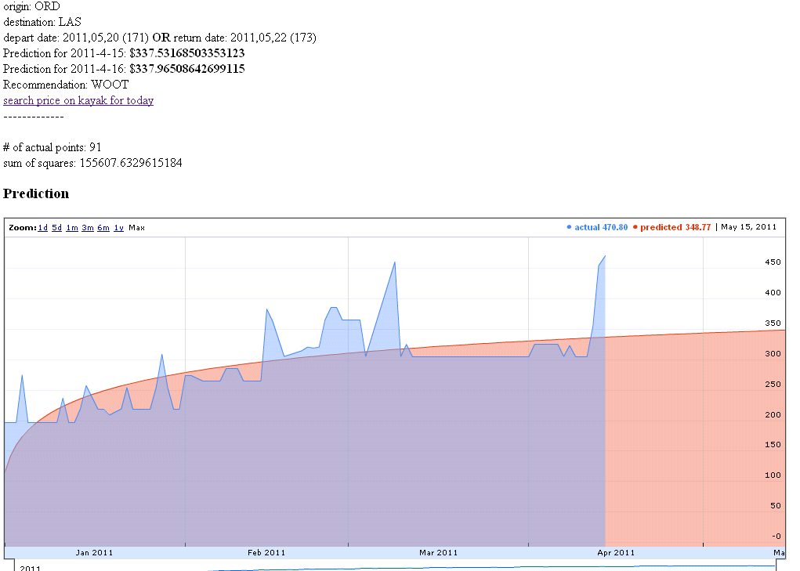
Simple Price Predictions
Notes:
Slightly different analysis
Overlaid a simple curve fit to guess future prices
This has evolved a bit into an internal game where we test different algorithm ability to predict future prices.

Slide 16
Our goal is a unified view of the data, allowing us to use the power of our existing tools for reporting and analysis
Notes:
Fun stuff, but there’s still a bit of disconnect. We can get much more granular about the activity, but it’s challenging to tie it with the fundamentals.
We’re trying to converge our worlds

Slide 17
We Can Begin to solve business questions
Answer how customers move between marketing channels
Identify transactions attributed to a marketing channel that are not truly incremental
Anticipate customer needs
Notes:
Self service questions like
Which marketing channels are the most effective and relevant
Business objective = show the most relevant content
If we track back from the purchase the Peel the onion and pull out
so we know what effect a change in one channel’s traffic will have on site traffic
We can understand the
so we can eventually make spending decisions based on incremental transactions

Slide 18
We’re Dealing With a Few Challenges
Most of these efforts are driven by technology
It’s batch oriented and simplistically controlled
The challenge now is to unlock the value in this data by making it more available to the rest of the organization
What is worth keeping
Notes:
Risk of Technology in Search of a problem
Very real resource contention issues. One query at a time and first come first served.
How do we make this accessible to the business analysts in the company. SQL of SQL-like interfaces.
Quantify of data is becoming overwhelming

Slide 19
The pace of data collection has outpaced growth curve of storage and processing
Notes:
I’m going to challenge your assumptions
We’ve actually run into a bit of a pickle
Kitchen sink
Storage density has doubled every 2-4 years.

Slide 20
What’s Worth Keeping
What’s Hot?
What’s Not
Raw data / source data
Intentional data
System metrics
(Most) Application logs
Incidental data
Notes:
Our Naïve view was never throw any data away
Seems to make sense
What matters is you record the data you want
Developers are very good a generating infinite amounts of logging and metrics
Logs should have an intended target to get a better signal to noise ratio and make the most of your storage.
or 7 million events per minute for only 35,000 signals
Use some sample logs and give a rough estimate of developer/system noise to signal ratio

Slide 21
Keep These Things in Mind When Dealing with Big Data
Create a universal key
Always keep source data
Data Scientists like SQL
Operationalize your bleeding edge infrastructure
It’s difficult to share data with third parties
Challenge assumptions and older lessons learned
Fast evolving technology space that’s challenging to keep up with
Notes:
A universal key will allow you to tie data together
The raw data allows you to derive new dimensions that you hadn’t though of ahead of time as well as go back in time to rerun queries.
Having common languages and well understood paradigms like SQL makes things much more accessible
The technology in all honesty is bleeding edge. Don’t be embarrassed about asking how to backup and deal with disaster recovery.
The data is proprietary and personal so how much needs to be anonymized before it’s shared?
Evolving application of data challenge what assumed everything was worth keeping.
It’s maturing fast. We have a pretty big ecosystem of technologies that aim to solve our problems.
==================
In spite of all this, we’re confident that our investment has been well-spent and that our future evolution will be built around this data

