Slide 1
Sports Analytics: Player Tracking

Slide 2
History of Sports Analytics
Initial attempts to quantify performance were rudimentary
Once established few new data points/analytics were added for each sport
In last 20-30 years, rapid expansion of new data points, with subsequent expansion of analytics
Major emphasis on economics analytics within sport in the last 10 years
Realization that all of today’s data capture still includes only a small fraction of what happens on the playing field has led to push for player/ball tracking

Slide 3
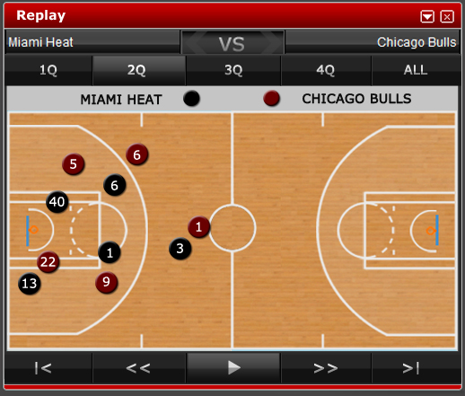
What is Player Tracking?
Simply put – player tracking measures the precise x,y,z location of each player on the field at all times
STATS uses a technology called SportVu that captures this information 25 times per second

Slide 4
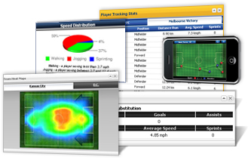
SportVU Player Tracking Technology
SportVU player tracking technology utilizes complex algorithms to extract X,Y,Z positioning data of the ball and participants
Data is captured by computer vision cameras and is used to calculate player and team statistics as well as provide graphic representations of live action
The soccer system is used by broadcasters, clubs, and leagues around the world
The basketball system is currently used in 6 NBA arenas
The football system is currently being tested in several NFL stadiums

Slide 5
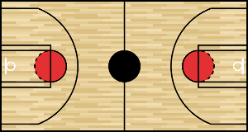
Basketball Setup
Computer vision cameras capture video and data
Complex algorithms extract X,Y,Z positioning data of all objects on the court, 25 times per second
6 cameras in 4-6 locations in the catwalk
Three cameras per half court allows for true 3D object tracking
Cameras wired together (coaxial, ethernet) and then connected back to command center

Slide 6
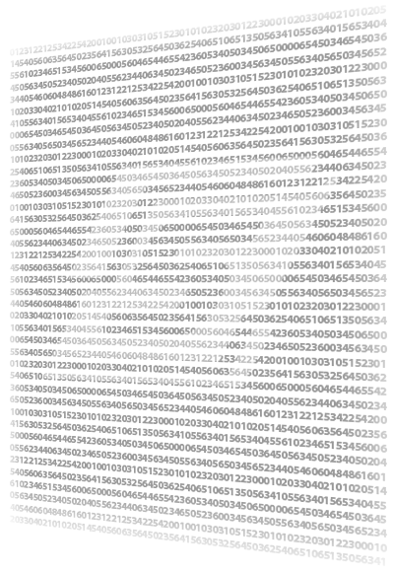
What to do with the Data?
For one game, depending on the sport, there are 1-2.5 million unique data records. (This is 5-10,000 times the number of records in traditional statistics)
In addition to needing a bigger database and a smart data design, the challenge is determining what the data really means.

Slide 7
Basketball

Slide 8
Initial Challenges
How do we define each movement on the court?
What constitutes a possession?
How do you define a pass?
What’s the definition of a dribble?
How do you determine the defender on a play?

Slide 9
Player Tracking Data Output
Player
Team
Ball
Speed / Distance Avg., max, instant speed Total, possession distance Shooting FG% by location Distance on shots Location tendencies TOP – shoot vs. pass Passing % of passes led to assists Total, avg. # of passes Defense FG% based on defender distance / location Exact defensive spacing Response to exact player tendencies
Speed / Distance Avg. speed True pace of play Shooting FG% by location Distance on shots Location tendencies TOP – shoot vs. pass Passing # of passes on play type Total, avg. # of passes Defense Tendencies / exact positions and results Closest defender
Trajectory Player arc comparison on makes vs. misses Goaltending accuracy Movement Automated pass, dribble, shot counter Connect # of passes, dribbles with play results FG% on shots off dribble Speed Avg., max, instant speed Shots, passes, blocks Time of Possession TOP breakdown by play and total game Connect TOP to results

Slide 10
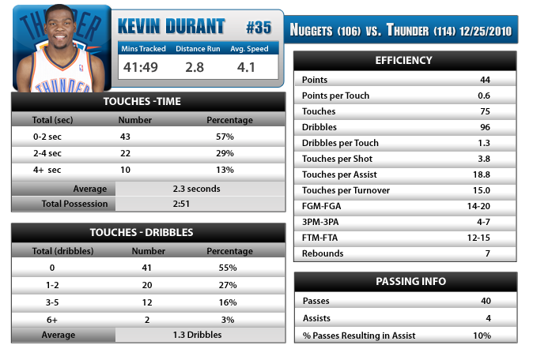
Single Game Breakdown

Slide 11
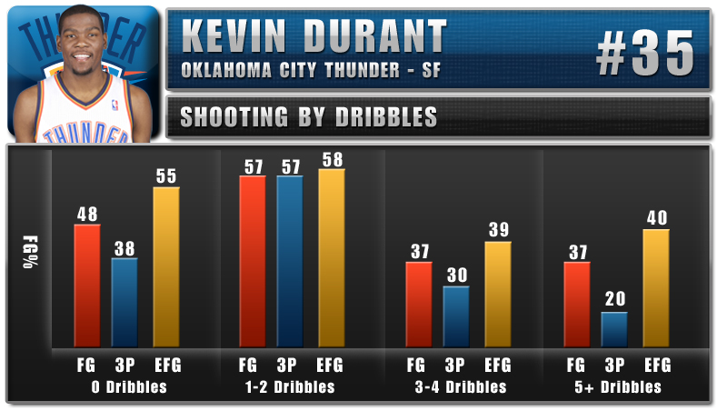
Cumulative Season Breakdown

Slide 12
Time of Possession

Slide 13
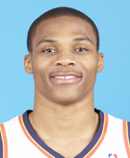
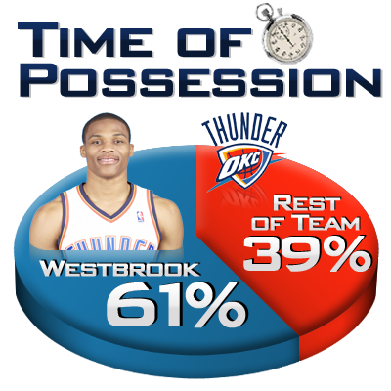
Westbrook Triple Double
Statistical Info
Points | 32
Pts/Touch | 0.3
Touches | 107
Dribbles | 680
Rebounds | 10
Assists | 12
TOP | 11:08
Distance Run | 3.2 miles
Avg. Speed | 4.6 mph

Slide 14
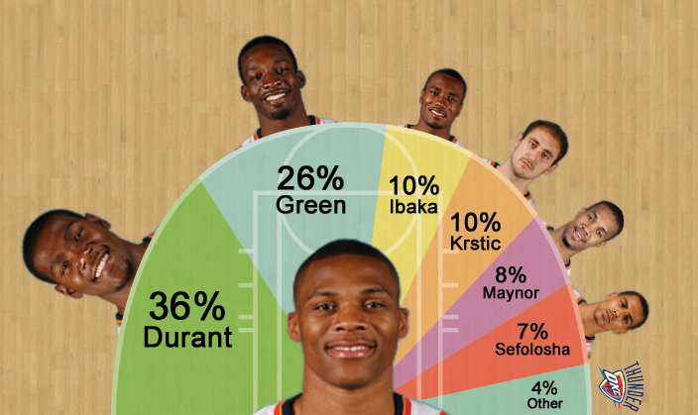
Westbrook Triple Double
Russell Westbrook Passing
Player | Assists | FGM-FGA | 3PM-3PA
K. Durant | 6 | 9-11 | 1-2
J. Green | 0 | 1-6 | 0-1
S. Ibaka | 0 | 0-3 | 0-0
N. Krstic | 3 | 3-4 | 0-0
E. Maynor | 0 | 0-1 | 0-1
T. Sefolosha | 3 | 3-3 | 0-0
J. Harden | 0 | 0-0 | 0-0
N. Collison | 0 | 0-0 | 0-0

Slide 15
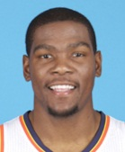
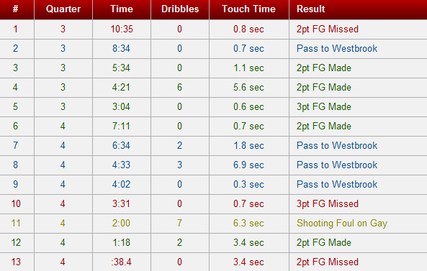
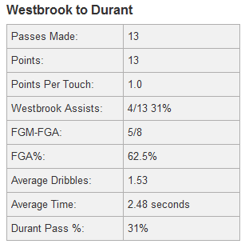
Westbrook to Durant

Slide 16
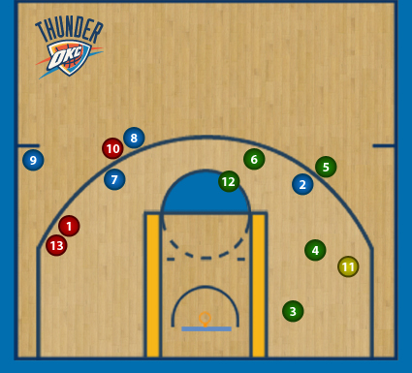
Westbrook to Durant
On January 8th, 2011 the Memphis Grizzlies matched up with the Oklahoma City Thunder.
Kevin Durant scored 28 of his 40 points in the 2nd half, leading the Thunder to 109 to 100 victory.
On 13 passes from Westbrook, Durant recorded a healthy one point per touch, well over his .6 points per touch average throughout the course of the game.
This level of efficiency was achieved while Durant attempted a field goal on 62.5% of touches where he received a pass from Westbrook.

Slide 17
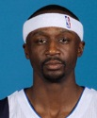
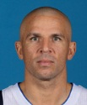
FG% by Passer
 | Tim Duncan | Monta Ellis | Kevin Love | Jason Terry | Jason Kidd | R. Westbrook
FGM | 92 | 78 | 15 | 153 | 271 | 266
FGA | 153 | 130 | 27 | 282 | 500 | .492
FG % | .601 | .600 | .556 | .543 | .542 | .541
Games Tracked | 27 | 15 | 6 | 32 | 32 | 30

Slide 18
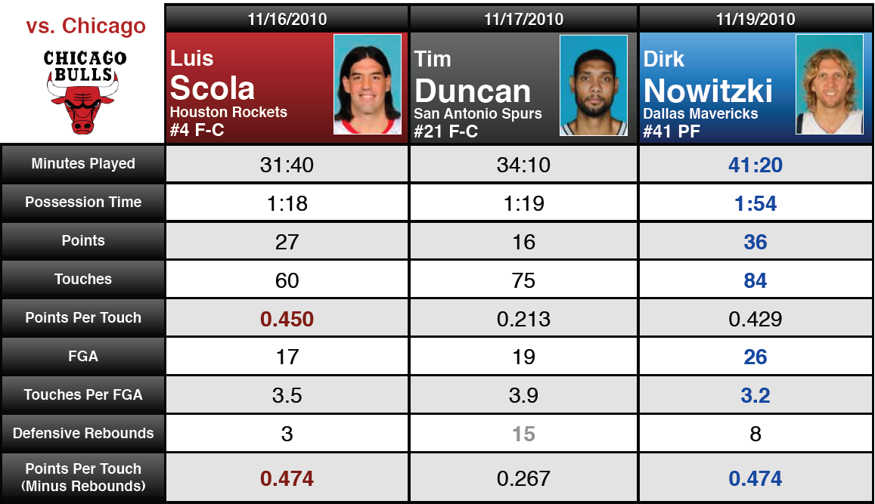
Player Comparison

Slide 19
Points Per Touch – SG/SF
 | Touches | Points | PPT | Games Tracked
Kevin Durant | 1624 | 904 | 0.557 | 30
Monta Ellis | 939 | 356 | 0.379 | 15
Luol Deng | 231 | 73 | 0.316 | 5
Shawn Marion | 1298 | 397 | 0.306 | 32
Trevor Ariza | 288 | 79 | 0.274 | 7
Jason Terry | 1913 | 507 | 0.265 | 32

Slide 20
Football

Slide 21
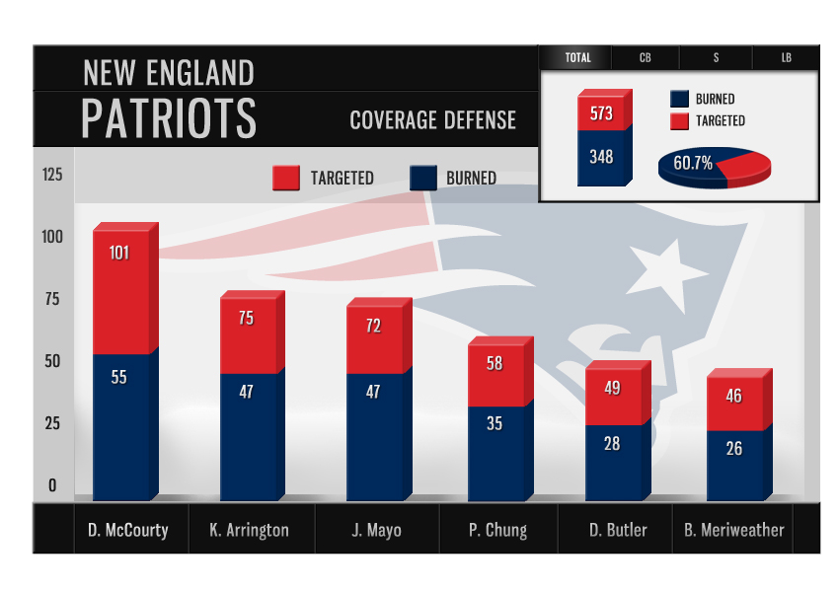
Inside the Numbers

Slide 22
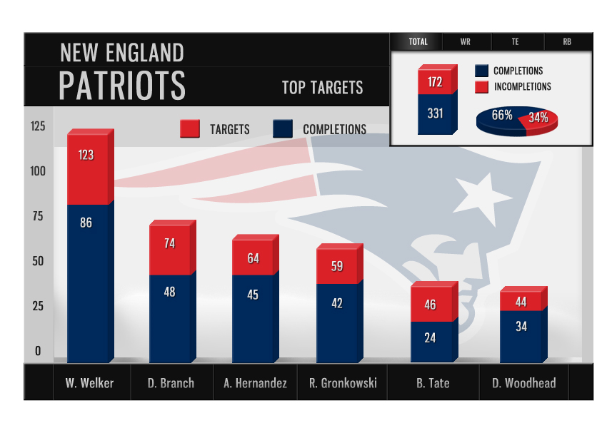
Inside the Numbers

Slide 23
Inside the Numbers

Slide 24
Soccer

Slide 25
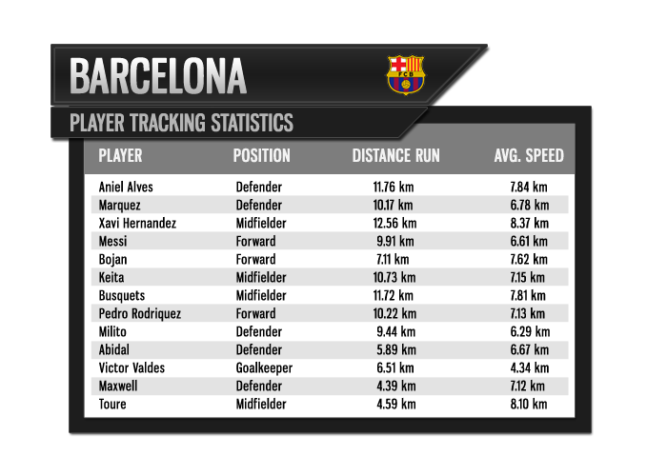
Statistical Content
Distance Travelled
Average Speed
Max Speed
Momentary Speed
Number of Sprints
Coverage Maps
Time of Possession
Player Possession
Ball Speed
Ball Distance
Zone Coverage
Team Formation

Slide 26
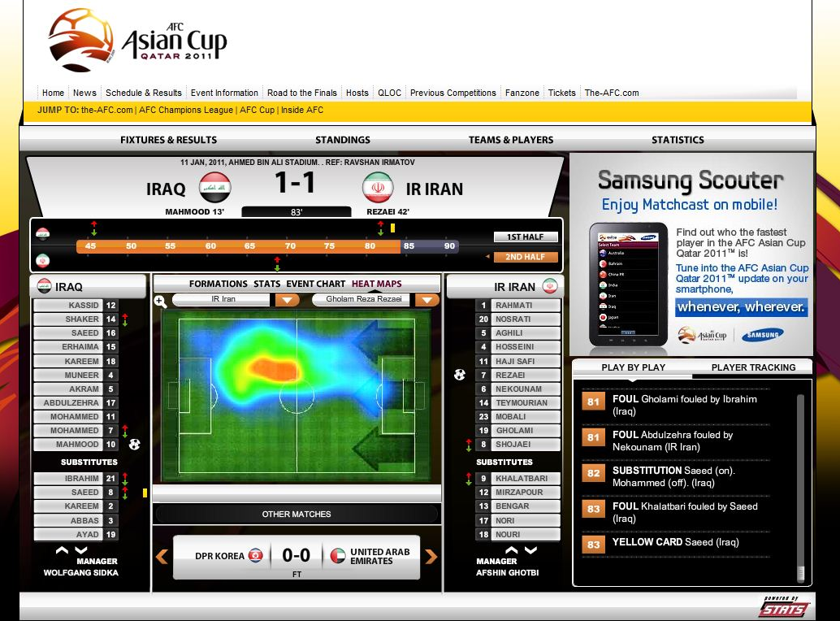
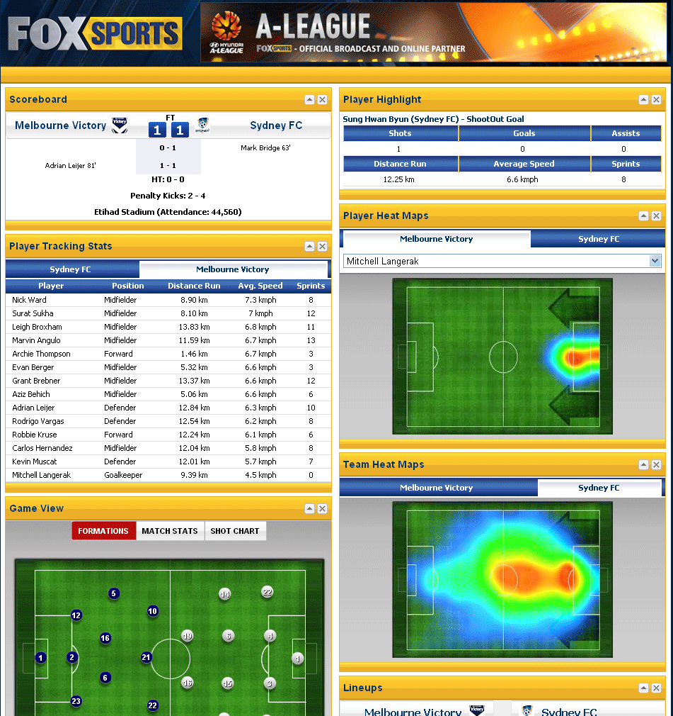
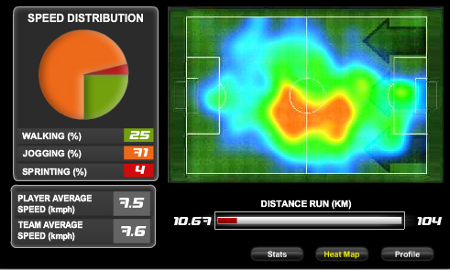
Fitness and Coverage

Slide 27
Future of Player Tracking
Continued development of sport-specific algorithms
Increased deployment
More complex analytics on the horizon

