Slide 1
Doing Business in the Face of the Information Explosion
Anthony J. Scriffignano 学術博士
Dun & Bradstreet 邓白氏
Vice President, Global Data Strategy
ヴァイスプレジデント
グローバルデータストラテジー
2011年9月9日

Slide 2
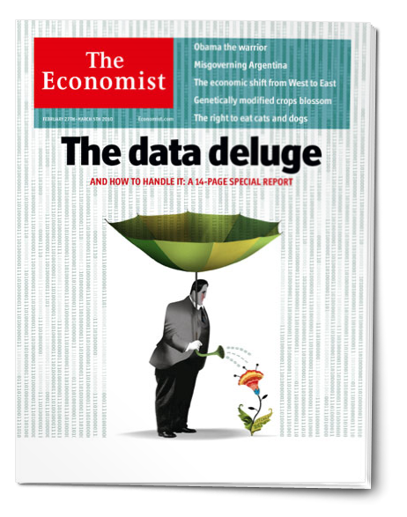
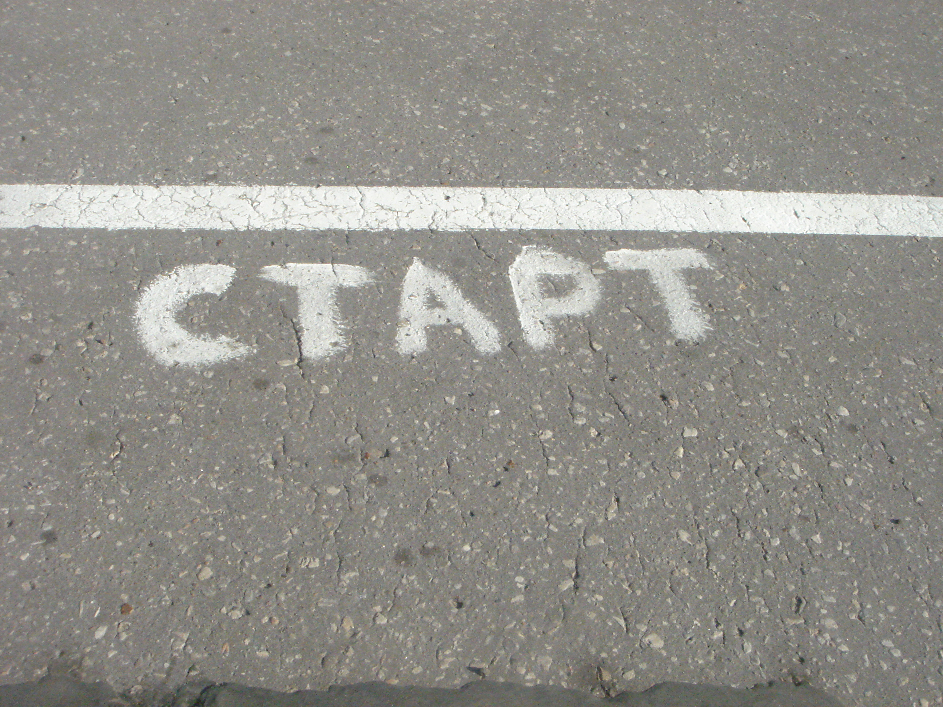
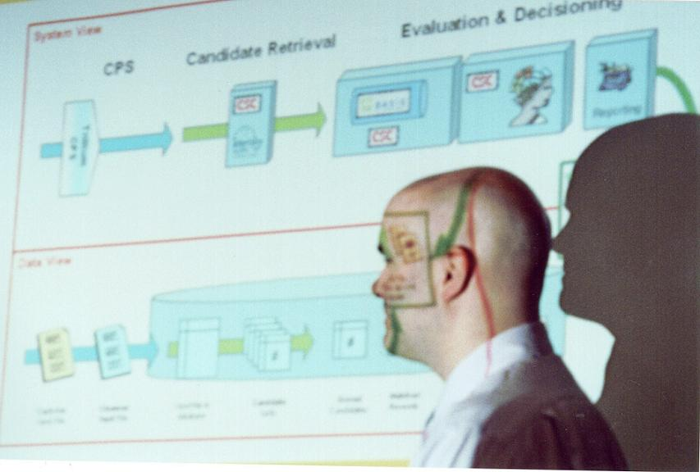
We’re starting to get the message…
“Last year, hard disk drive manufacturers shipped 5,127 petabytes of storage capacity, a 55.7% increase over 2009, according to a report released Friday by market research firm IDC.”
Lucas Mearian
Computerworld, March 4, 2011
“Just getting the data is only about 10% of the problem.”
Stephen Wolfram, Founder & CEO, Wolfram Research
Wolfram Data Summit, September 9, 2011, 9:09:11 AM
The Economist, Feb 25, 2010
“Data is widely available; what is scarce is the ability to extract wisdom from it.”
Where do we start?
Hal Varian, Chief Economist, Google
The Economist, Feb 25, 2010

Slide 3
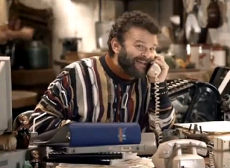
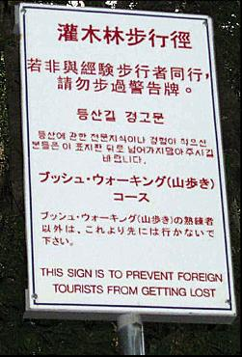

Is the Information Explosion a Good Thing for Business Identity Resolution?
It is easier than ever to start a new business – geographic location, existing infrastructure, and physical customer interaction are becoming irrelevant.
…However, ALL OF THESE ATTRIBUTES HELP RESOLVE BUSINESS IDENTITY.
As information is increasingly unstructured or imbedded in applications and private spaces, the lines between what is public and what is discernable are blurred.
As the ability to provide “helpful” information proliferates, the truth can get lost.

Slide 4
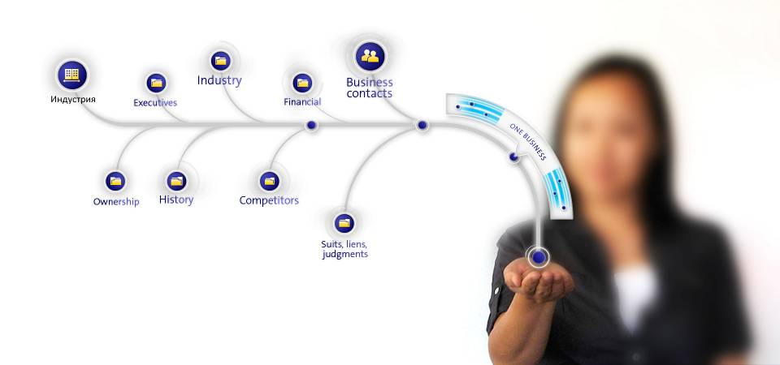
The Challenge: Find new businesses and attach relevant insight
Making new mistakes together:
Information is ubiquitous, truth is not… beware the madness of crowds
Inception of business starts with a single source… beware the single source
Consistently wrong is better than inconsistently right…
Having what the customer wants is only half the battle: People want to type like they think… we haven’t perfected the soul interface
The cost of data is often zero, selling data alone is a commodity position – we must continue to launch new insight from our data… there is no such thing as a free launch!

Slide 5
Some key strategies to extracting business insight
Multisourcing of information and mindful partnering
Recursive (“learning” ) entity extraction
Perpetual adjudication and segmentation of veracity
People in the process in the right places
No people in the process in the right places
Mindful segmentation of language treatments vis-à-vis business practice

Slide 6
The key to making associations is data
Multiple unlinked records
D&B Consolidated Record
ABC, Inc
220 Main St.
Bethlehem, PA 18025
Chuck Smith, Pres.
1
D-U-N-S Number : 123456789
ABC, Inc. (Legal Name)
+ Chuck’s Mini-Mart (Tradestyle)
+ APEX Real Estate (Tradestyle)
+ Smith Holding Co. (Former Name)
P.O. Box 111 (Mailing address)
+ P.O. Box 22 (Former Mailing address)
Bethlehem, PA 18055 (P.O. Box ZIP)
123 Elm St. (Physical Address)
+ 220 Main St. (Former Physical Address)
Bethlehem, PA 10825 (Physical ZIP)
610 882-7600 (Current Phone Number)
+ 610-882- 4545 (Former Phone Number)
Chuck Smith, President (Current CEO)
890 Eaton Ave. (Home address)
Chuck’s Mini-Mart
123 Elm St.
Bethlehem, PA 18025
Chuck Smith, Pres.
610 882-4545
2
APEX Real Estate
P.O. Box 22
Bethlehem, PA 18055
610 882-7600
3
Chuck Smith
890 Eaton Ave.
Bethlehem, PA 18055
610 882-7600
4
D&B Proprietary information

Slide 7
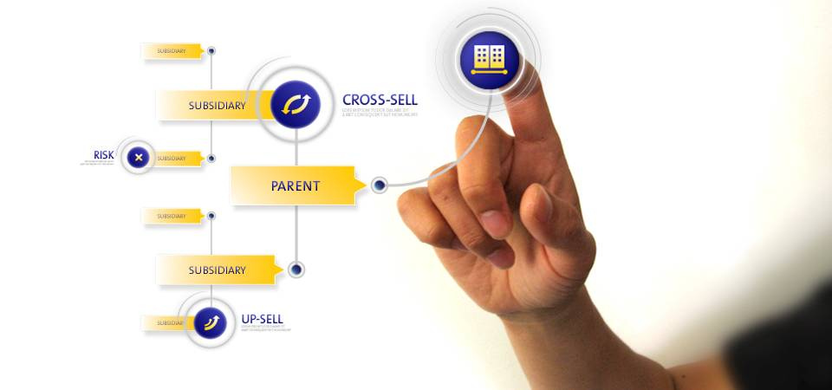
It is critical to expose relationships to understand total risk and opportunity
Often the relationships are not subject to public disclosure or are very difficult to understand
Family trees can also be very complex, involving ongoing merger, acquisition and divestiture
D&B Proprietary information

Slide 8
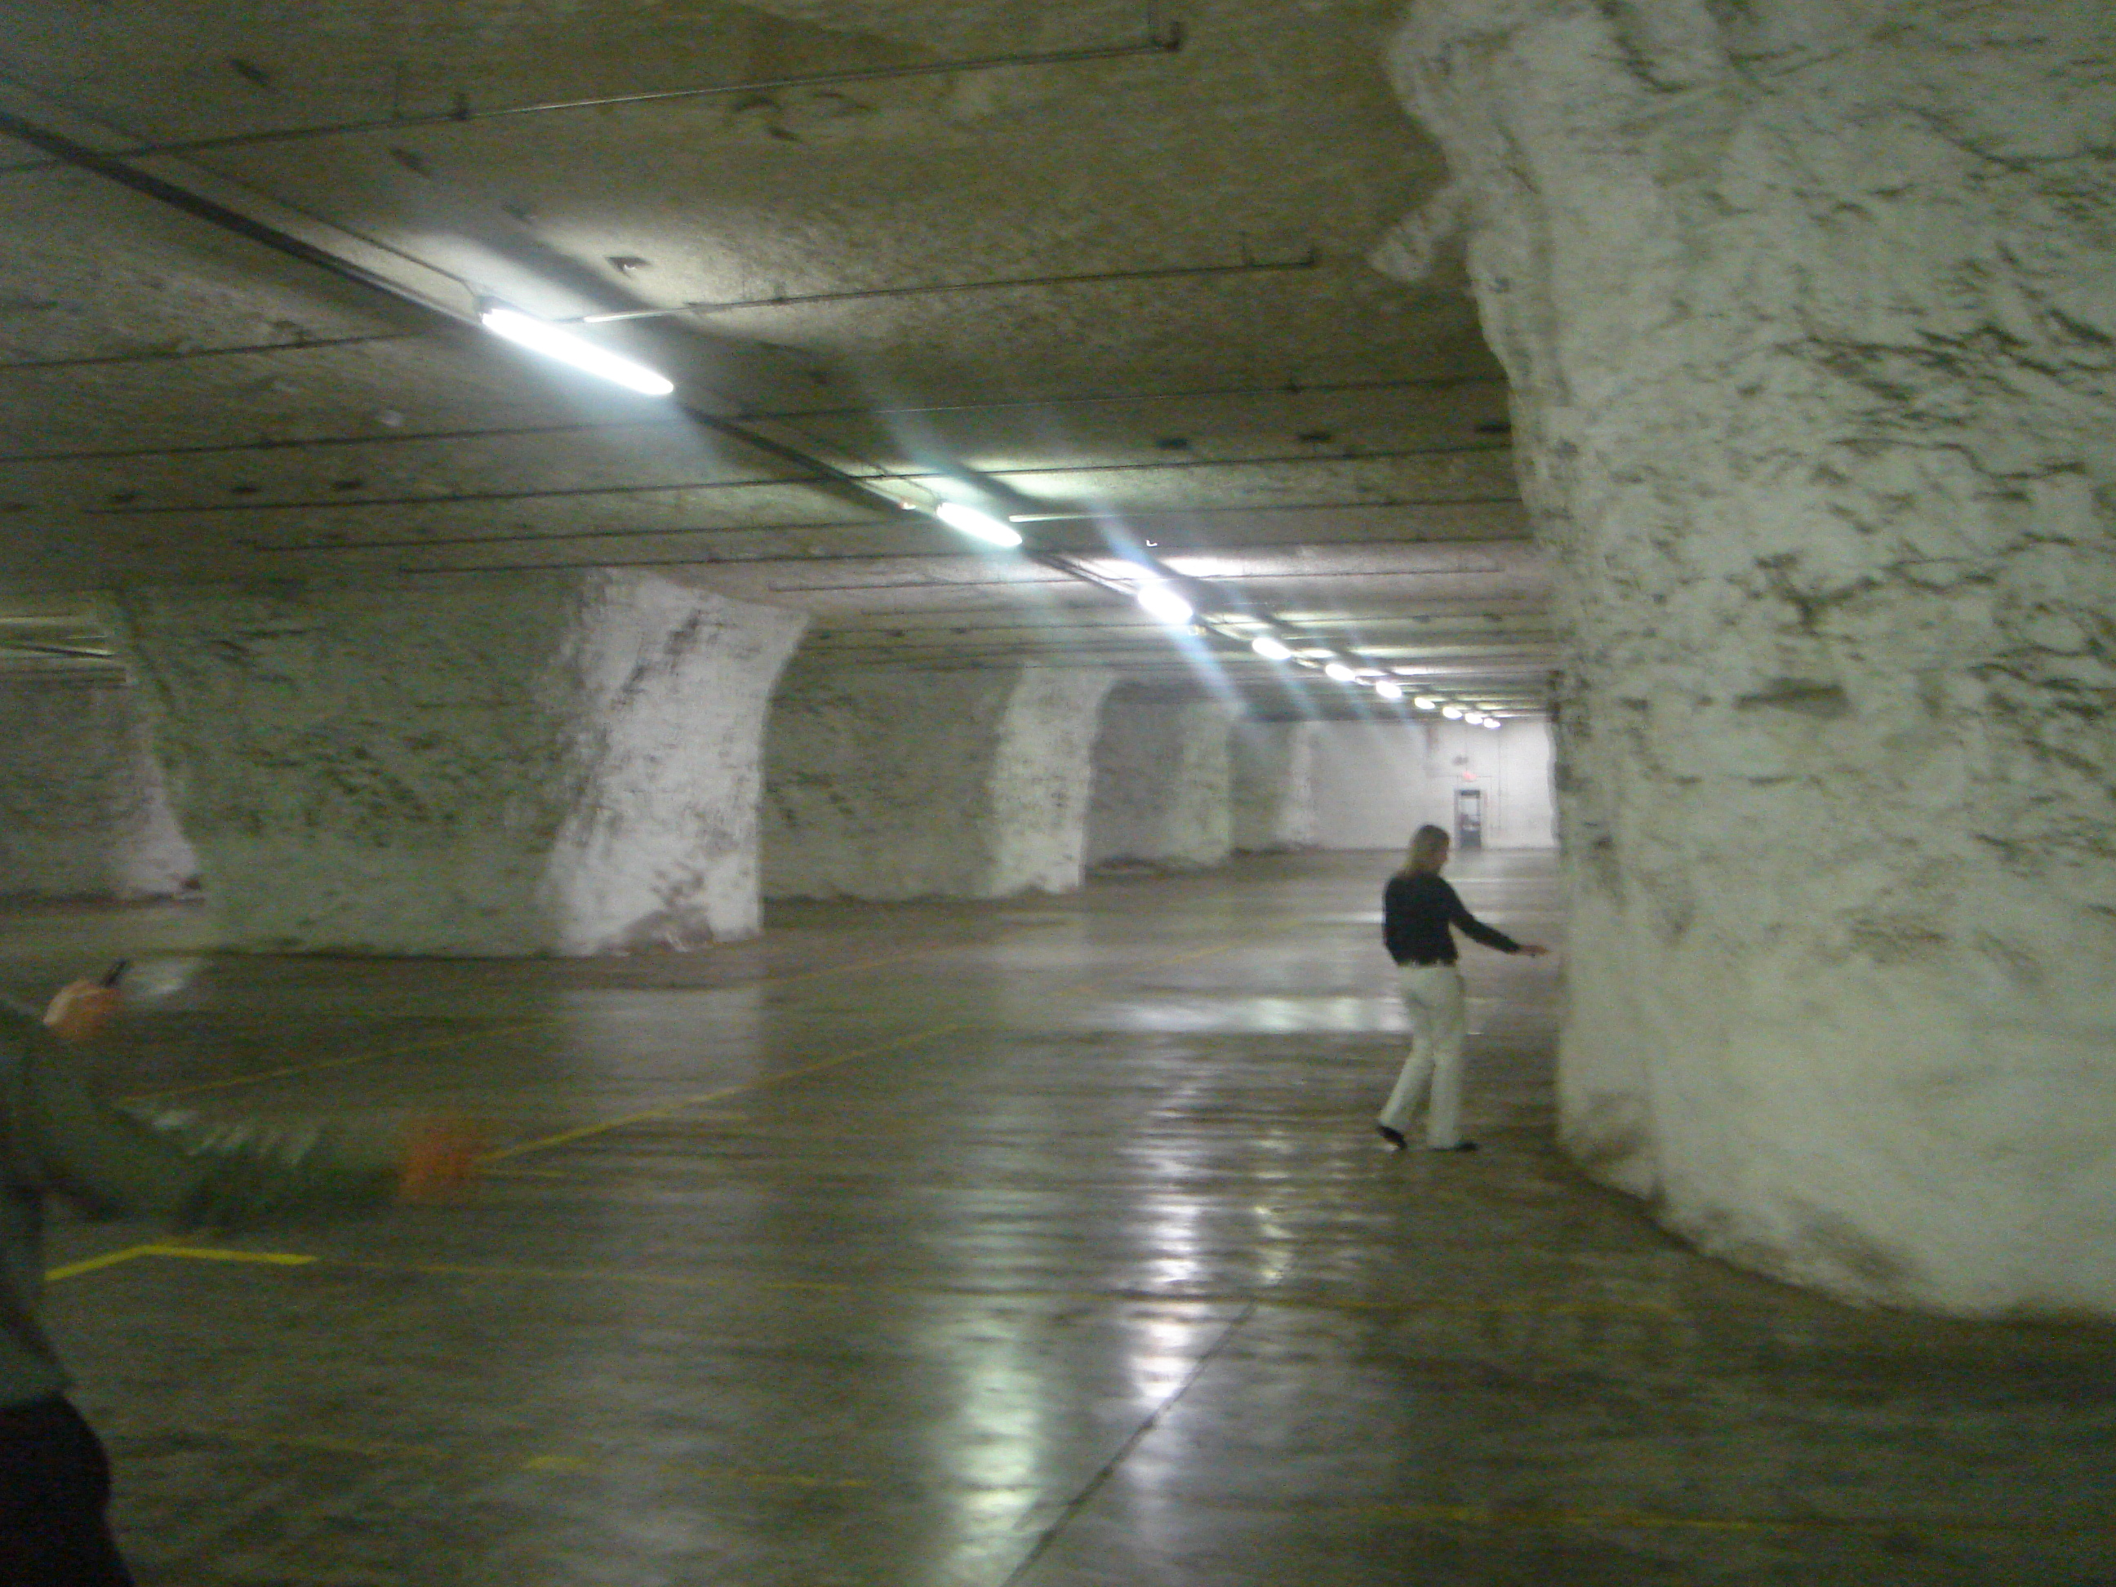
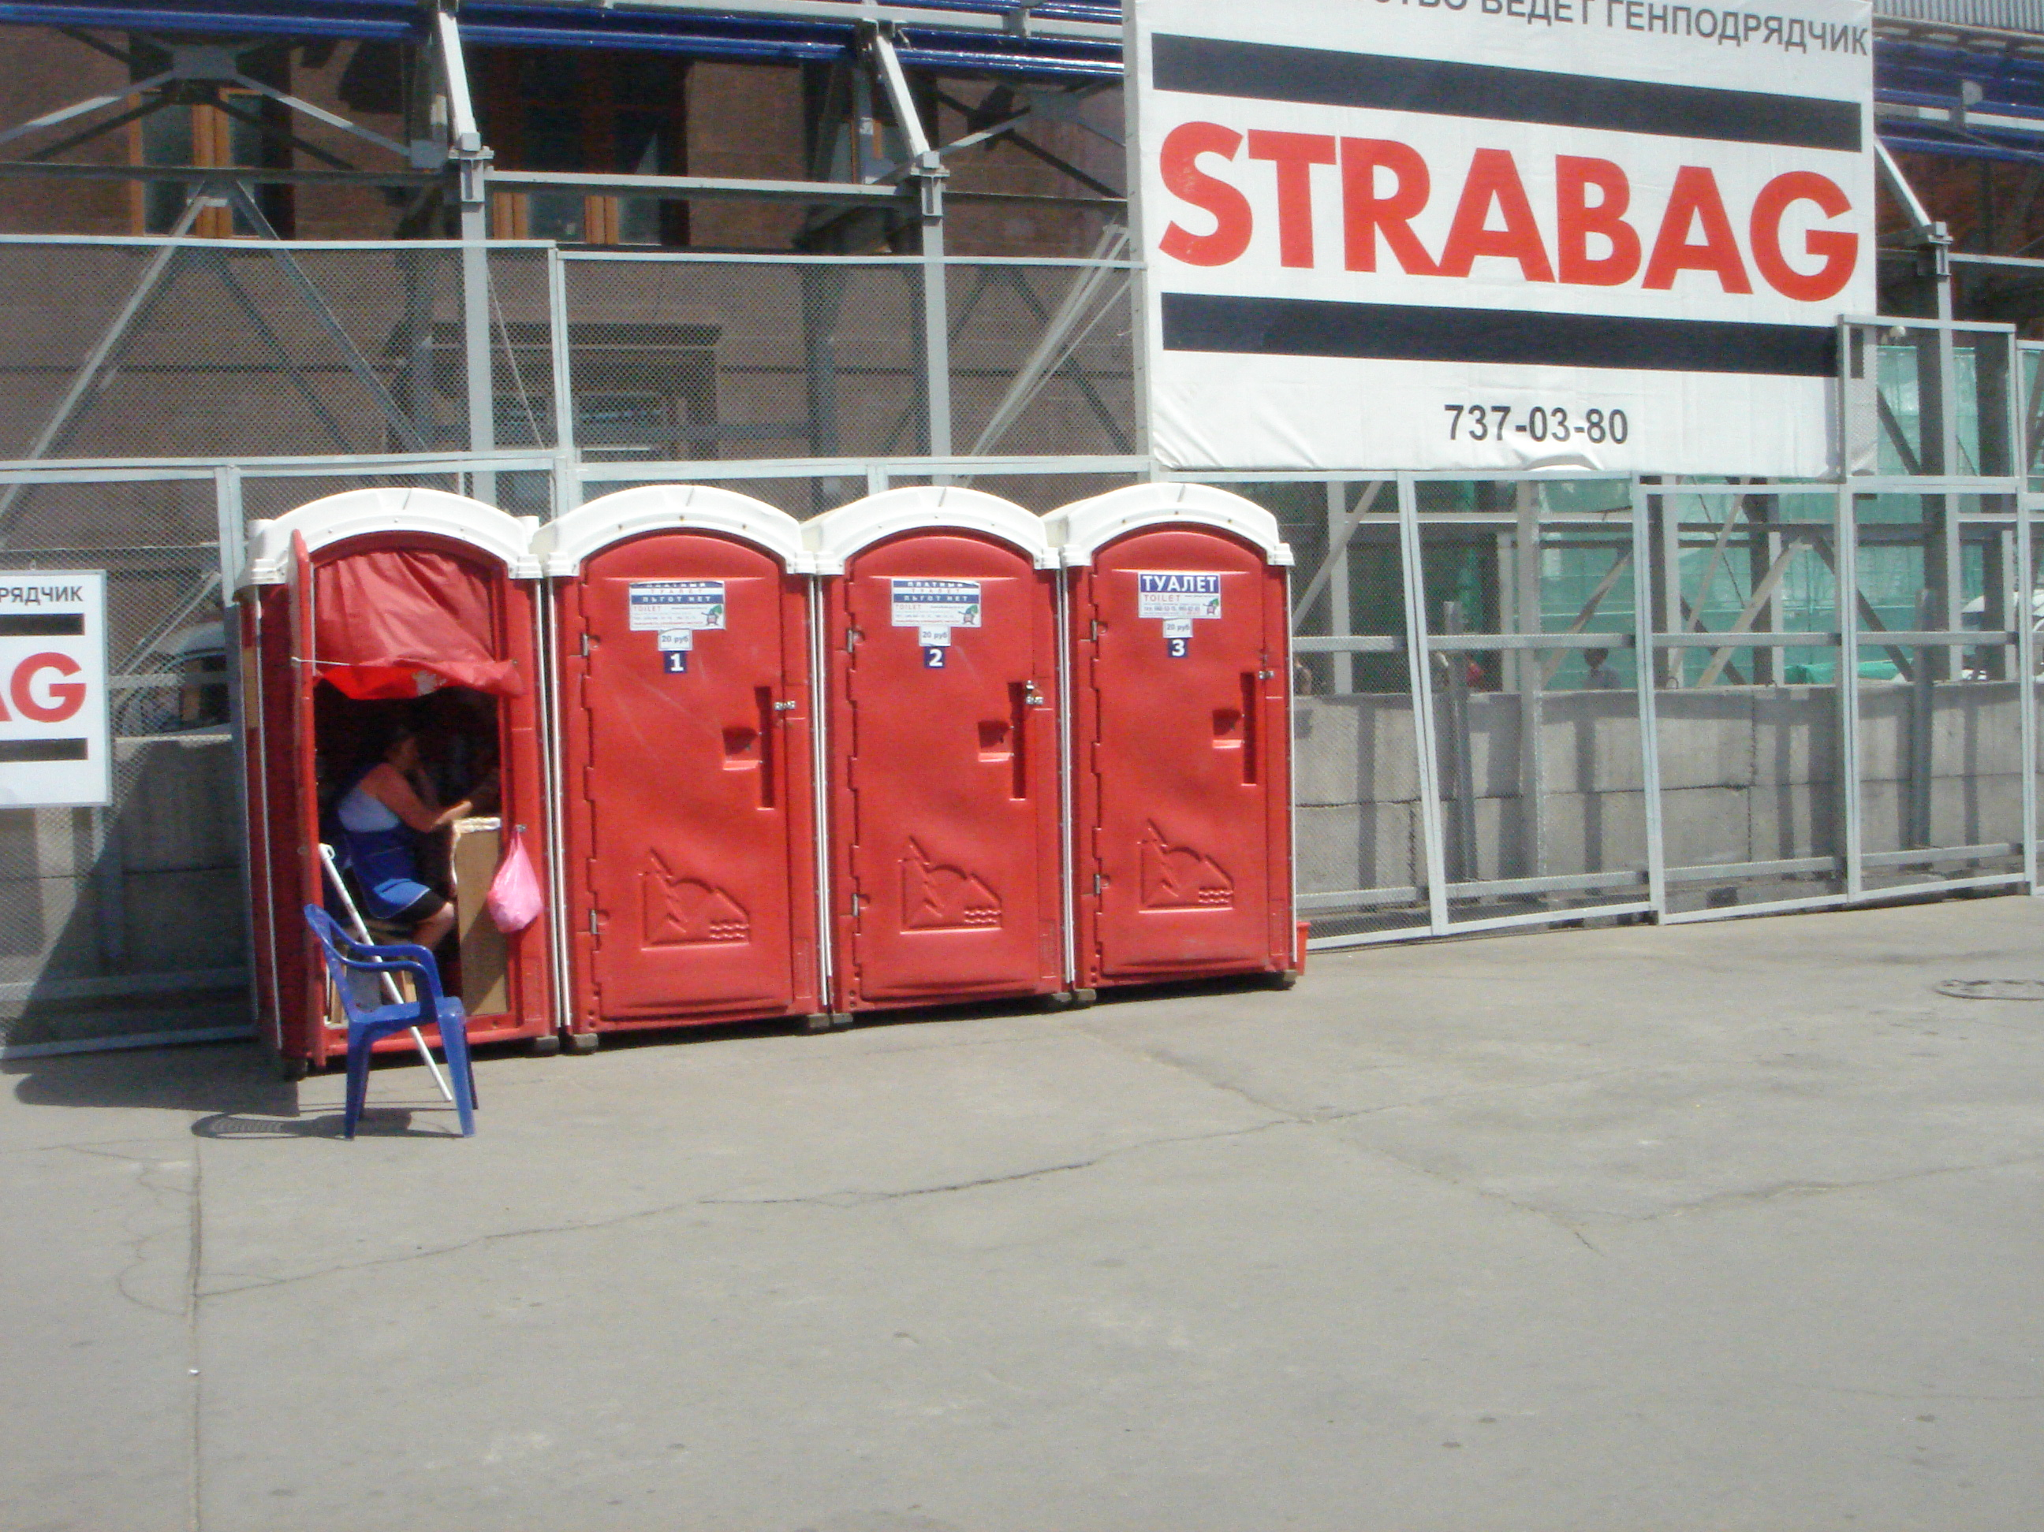

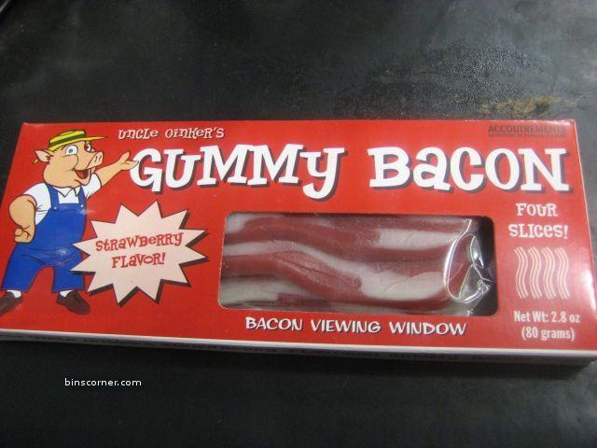
Customers want us to find businesses that are smaller and less traditional
Subtropolis facility outside Kansas City, MO
A small business that can literally move over night
A business with a digital presence
A bad idea?

Slide 9
As businesses become smaller and less traditional, understanding people is key
Γιάννης -- Common Greek name
Giannhs – “Standardized” transliteration
But…
Alternate transliterations could include
Yanni, Iannis and Yannakis
And…
Common names don’t follow patterns
Giannis Agouris - Greek writer and journalist
Yannis Bezos - Greek actor
Giannis Christou - Greek composer
Yanni Theodoridis - Greek trumpeter
Iannis Xenakis - Greek composer
Ioannis Amanatidis - Greek footballer
Yanni --- Greek New Age artist/composer
The big question – how much does this influence your situation?
D&B Proprietary information

Slide 10
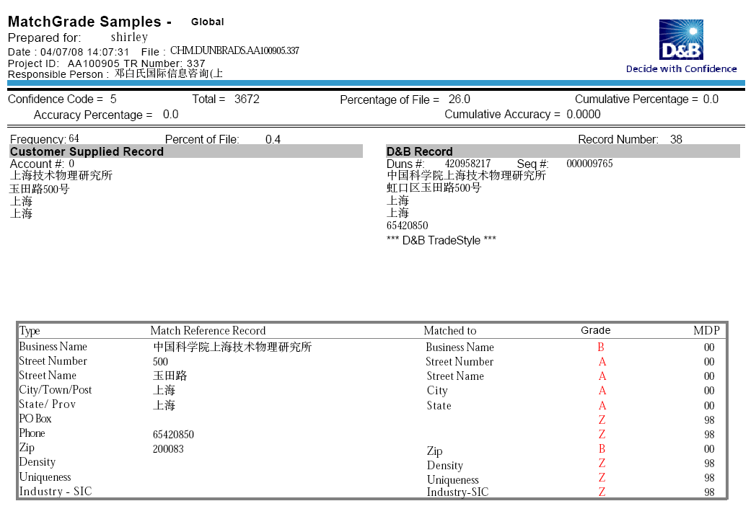
Enabling cross-border data curation and stewardship must also consider collaboration
D&B Proprietary information

Slide 11


Businesses also change how they represent themselves depending on audience
Xiamen Suo Fei Te Hotel ?
Xiamen Lake Side (Hu Bing Bei Lu) North Road #19
厦门索菲特大酒店
厦门湖滨北路19号
福建 厦门 湖滨北路 19号 Same address (Fujian province added at beginning)
索菲特
Xiamen Sofitel Hotel
Western business in asia
三菱汽车销售（中国）有限公司入场动画页面
The solution to this type of problem involves polylogogrammatic semantic disambiguation
三菱
Asian Business in the west
中国
D&B Proprietary information

Slide 12
Our challenge
Identity vs. Insight
Innovating on the Source vs. Innovating on the process
Maintaining the cohesiveness of the data
Proactively addressing fraud and volatility in data
Providing a consistent experience globally
“You cannot solve a problem from the same consciousness that created it. You must learn to see the world anew.”
Albert Einstein

Slide 13

One final note – Happy Mid-Autumn Festival!

