Slide 1
Empowering People with Data:
…What’s NOW, What’s NEXT!
Alan Vander Mallie
Data.Gov Program Manager
September 2011

Slide 2
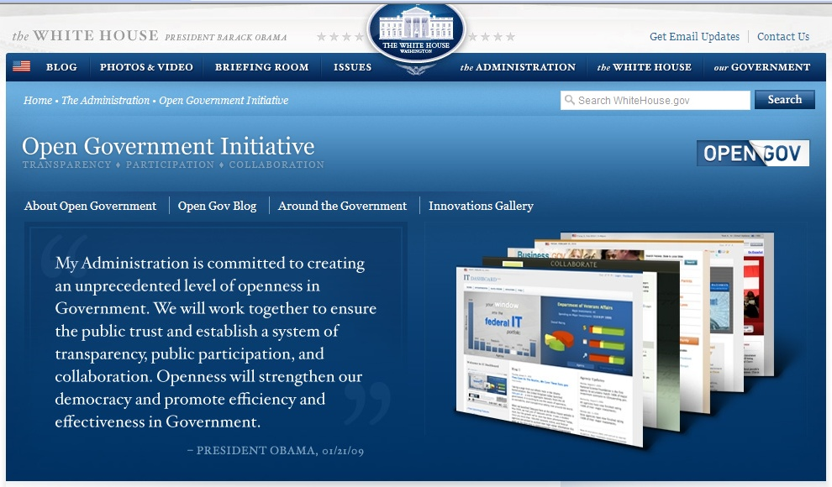
Data Sharing Now:
Open Government Initiative
Transparency promotes accountability
Participation allows people to contribute ideas
Collaboration encourages cooperation within government and with industry
Data sharing is key to empowering people

Slide 3
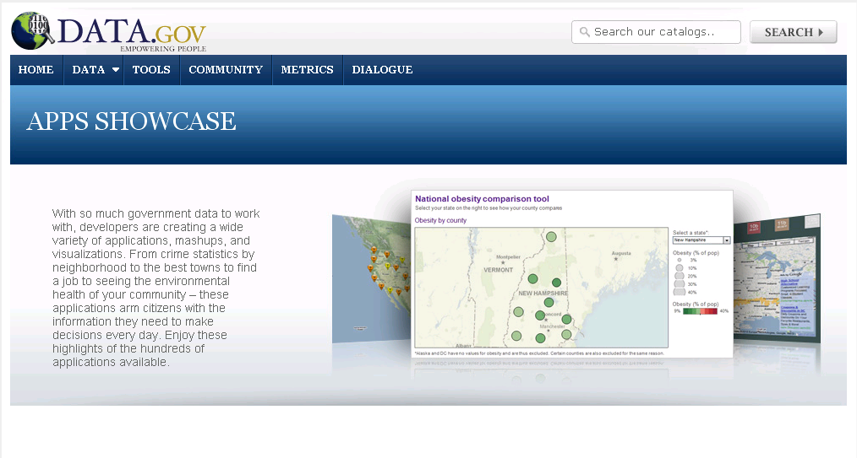
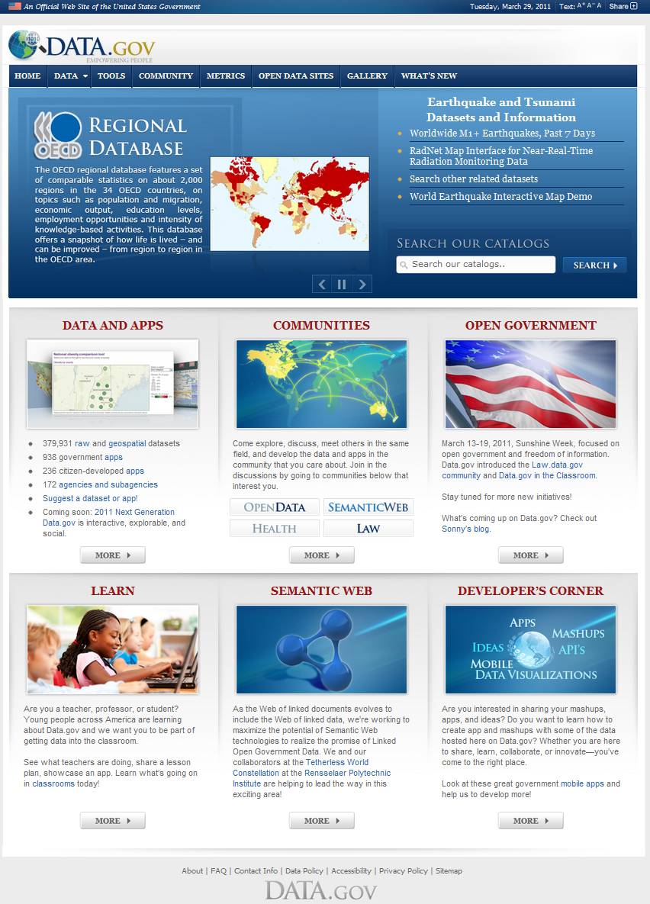
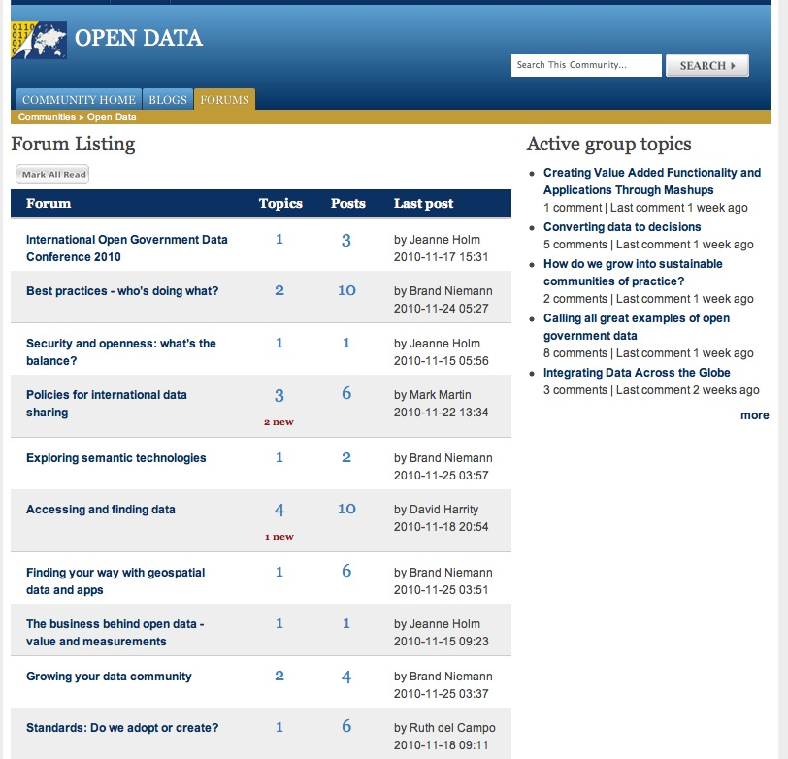

Slide 4

What’s NOW, What’s NEXT!
Empowering People
Sharing Government Data
“Discover, Visualize, Explore”
Citizens
Communities: health, law, ethics…
Developers
K-12 Education
Outreach to App Developers
Federated Catalog/ Search
Dataset Discovery
Community Space
Academia
State, local, tribal
Semantic and Ontologies
Geodata Mapping and Visualization
System: Site, DMS, hosting, security
Dataset Hosting in the Cloud
International
Industry
OMB, EOP
Cloud
Agencies

Slide 5















Data Sharing Now
Creates collaborative government
Agencies and Data.gov working together to create a knowledge management capability across the government at the data layer
  Data.gov-Visualizations
Improve government efficiency and drive innovation
Support decision making and understanding of data
Data…Information…Knowledge
More Analysis & Forecasting –looking at data & information

Slide 6
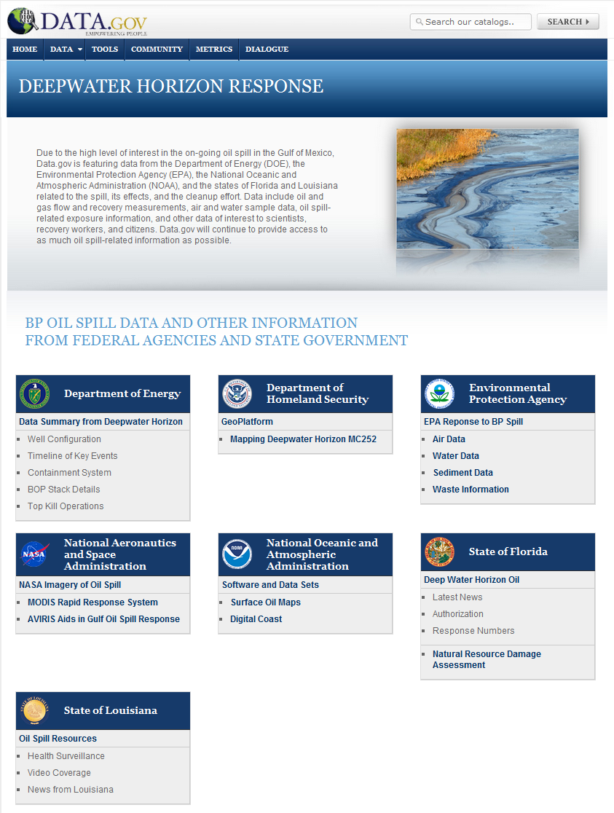
Data Sharing Now
Creates a more Transparent Government
  Data.gov provides a way for government agencies to share data on performance and their mission with the public.

Slide 7
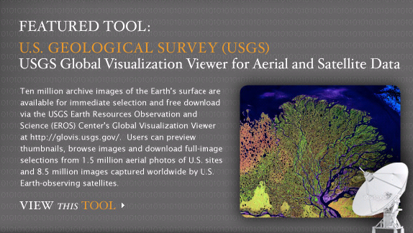
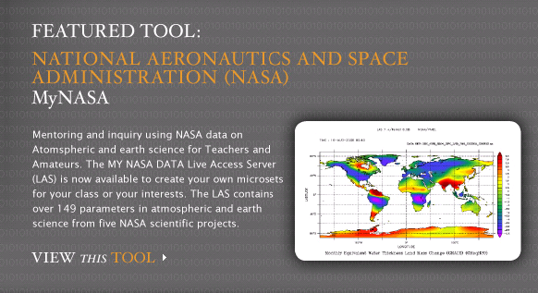
Data Sharing Now
Break s down stovepipes to increase access to data
Instant access: downloadable data only one click away
Data that can be manipulated and mashed up
Encourages development of innovative applications
Tools that provide access to complex data stores
Widgets

Slide 8

Participation Now
Creating a participatory government.
Data.gov makes it easier.
  Data.gov is a one-stop website for free access to data produced or held by agencies across the Federal Government, including:
  Data.gov makes it easy to find, download, and use Federal Government data, including databases, data feeds, and maps, graphics, and other data visualizations

Slide 9


Shared Dataset Hosting Now
  Richer metadata searching
  APIs
    Simplifies access for developers and publishers
    Provides feeds so developers can receive data directly from Data.gov
  Mobile Applications
    Facilitates mobile apps
  Data Discovery Services
    Available to agencies
    Allow agencies to discover datasets within their entire public space
  – Allows data visualization across agencies

Slide 10
GSA Data Sharing Now- FACA
GSA was first to Post Govt-wide Datasets
Federal Advisory Committee Act Datasets for last 10 years on DataGov in tools and raw csv datasets
  Federal agency activity for over 1,000 advisory committees government-wide
  Congress, the Public, the Media, and others use datasets to stay abreast of important activities
  True shared-system providing access to data

Slide 11
Data Sharing Now
Current & Evolving Data Environments
Current data activities focus/emphasis on collecting, cleansing, transforming, integrating, storing, and reporting
Evolving data activities focus/emphasis:
  Exploring, visualizing, analyzing, communicating, monitoring
  Used for forecasting/predicting future – explaining past events
  Used for decision making & understanding data

Slide 12
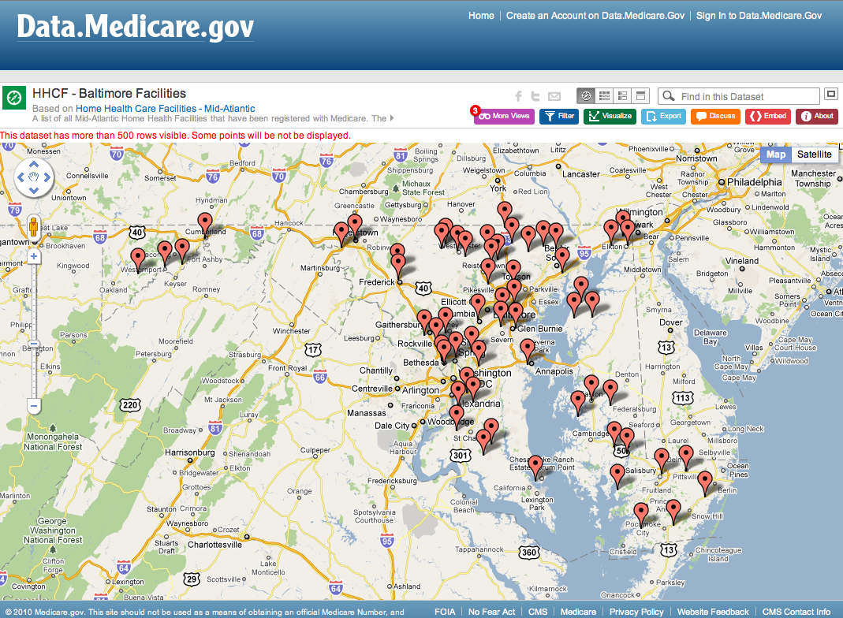
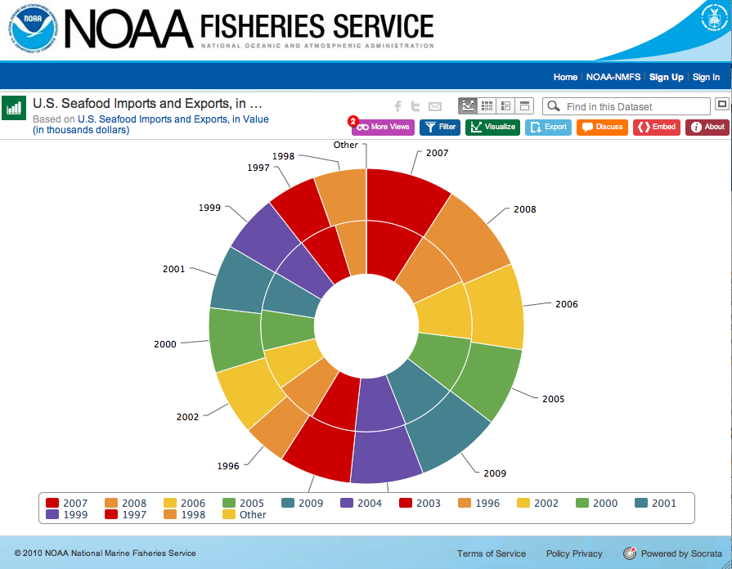
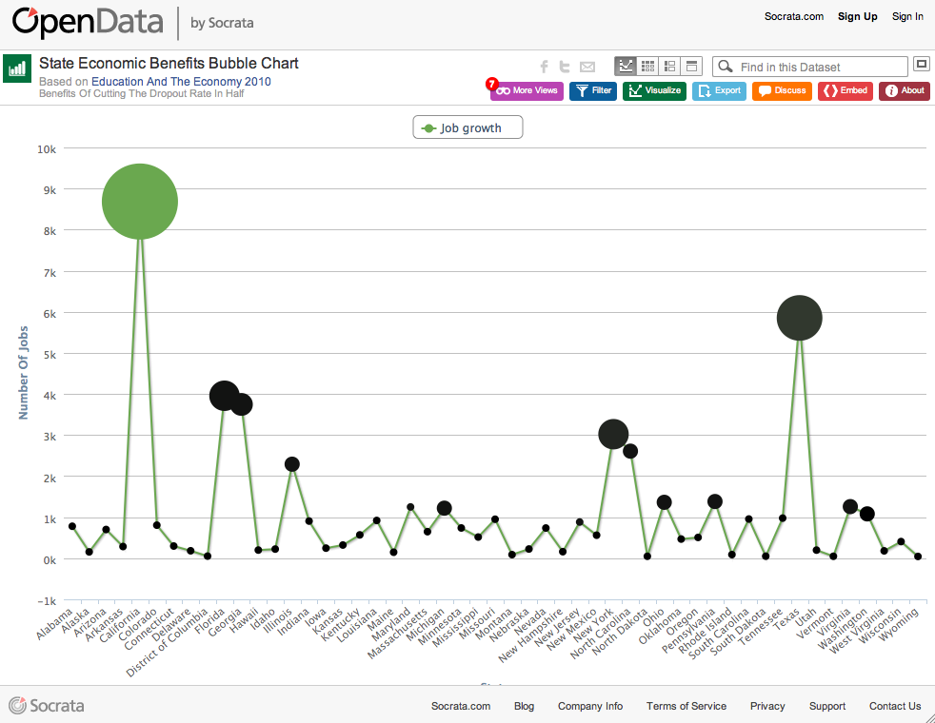
The Power of Visualizations
A rich visual experience that includes
  Mapping options from simple point maps to multi-dimensional maps using Google, Bing and Esri
  Charts such as Area, Bar, Column, Donut, Line, Pie, Time Line, Tree Map and Bubble
Notes:
Say it with a chart or a map.
The new Data.Gov is a great environment for communicating the meaning of the data. Often, the most powerful way to enhance comprehension is with visual data representations such as charts and maps. The next-generation platform provides a rich visual experience for constituents that includes:
A wide spectrum of mapping options ranging from simple point maps to multi-dimensional maps using Google, Bing and ESRI.
Various chart types such as Area, Bar, Column, Donut, Line, Pie, Time Line, Tree Map and Bubble charts.

Slide 13









Tapping the Ingenuity of the American Public
The Federal government does not have a monopoly on good ideas.
Access to information unleashes
creativity.
Innovation drives sustainability.

Slide 14

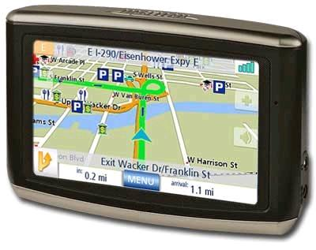
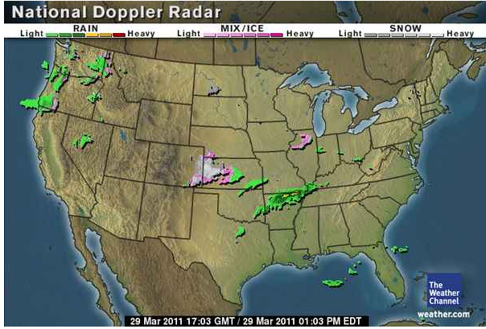
Data.gov for the Economy
NOAA’s data helped build weather-related business
    Weather forecasting
    The Weather Channel
    Weather.com
When the Department of Defense released satellite data…private industry created affordable GPS devices!
Opportunities for private sector are limitless

Slide 15
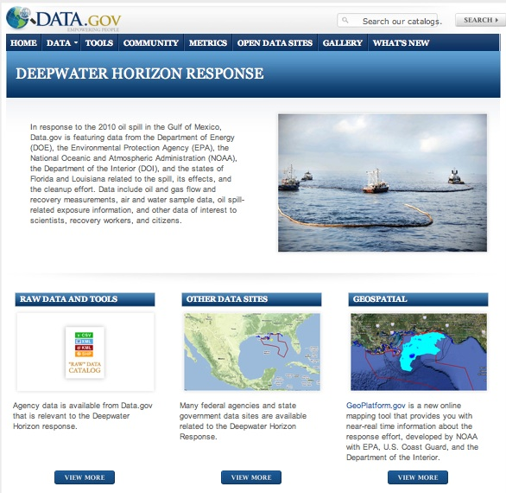
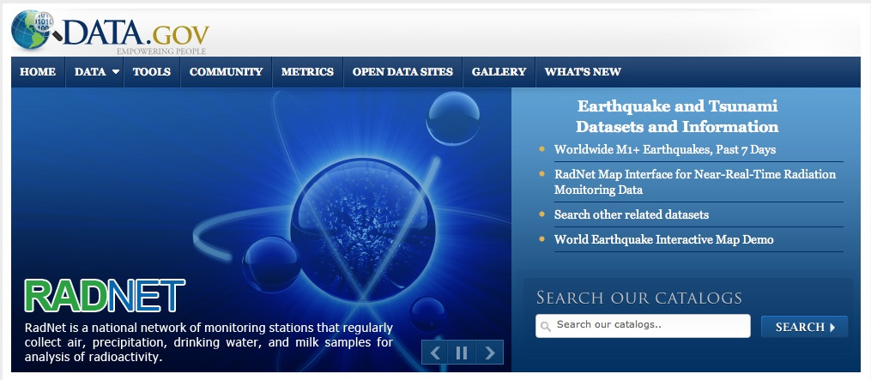
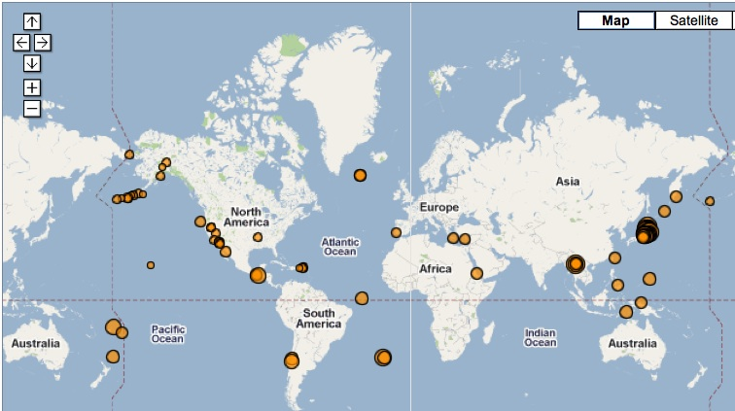
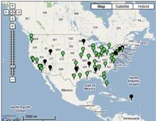
Supporting Global Events
Japanese tsunami, earthquake, and radiation monitoring
Restore the Gulf: Deepwater Horizon Response

Slide 16
Think Big, Start Small, Innovate
Data.gov Quick Facts | Launch: May 21, 2009 | September 2011
Total datasets available | 47 | 400,184
Apps and mash-ups by citizens and government | 0 | 236 + 1068
RDF triples for semantic applications | 0 | 6.4 billion
Nations establishing open data sites | 0 | 21
States offering open data sites | 0 | 29
Cities in North America with open data sites | 0 | 11
Open data contacts in Federal agencies | 24 | 396
Agencies and subagencies participating | 7 | 172
Communities (Energy, Health, Law, SemanticWeb, OpenData, Restore the Gulf) | 0 | 6

Slide 17
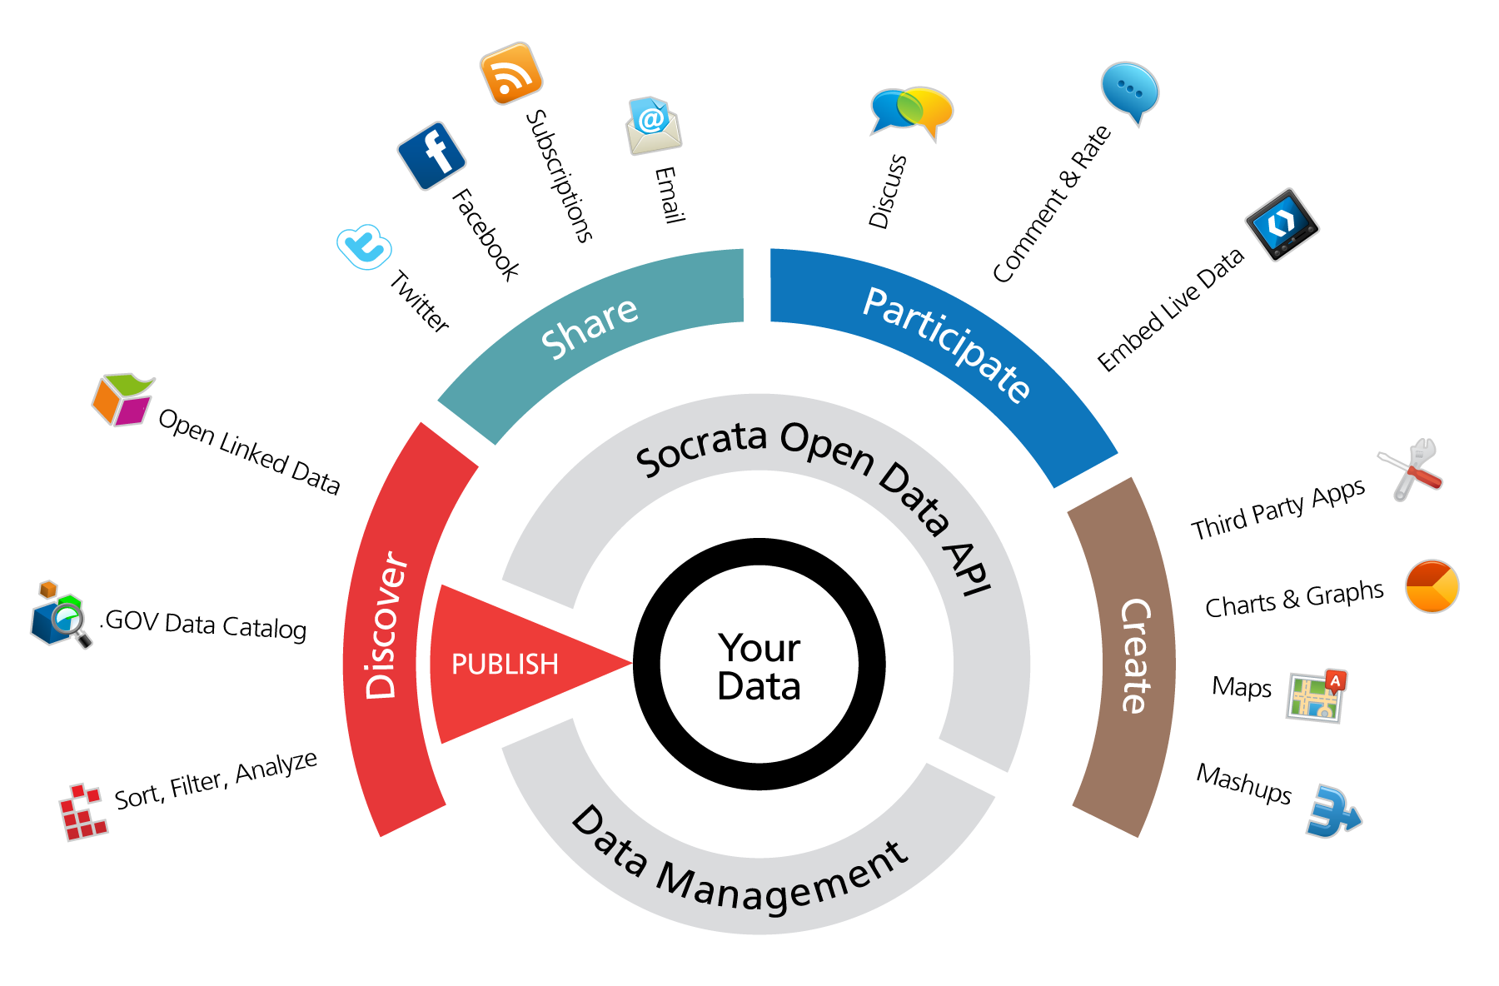
What’s NOW, What’s NEXT
Optimizing Data Use
Streamlining publishing, making it easier for agencies to contribute high-value data
Providing more and better data for analysts, journalists, and researchers
Leading to apps and reports for people to make better informed decisions

Slide 18
Data.gov Capabilities
Availability of data + frequency of release and updates
  Making data easier to publish
  Automating updates/maintenance
  Should result in more high-value data
Data that’s easy to find
Support for multiple formats
Ability to visualize data
Ability to embed live data on your site or blog
Using the API to populate other Apps
Notes:
Benchmark what the current state of Open Data is, at all levels of government.
To What extent are gov. orgs. adopting Open Data as part of how they deliver services to citizens
Is there a gap between goals and aspirations on one hand, and implementation on the ground on the other?
How are Open Data projects being initiated and delivered?
Are the underlying motivations and attitudes for initiating Open Data projects indicative of an enduring movement that will be a permanent dimension to a modern democracy?
Understand the perspectives, requirements and needs of the three key constituent groups in Open Data.
We often deal with the supply-side of the equation. For the first time in the Open Data movement, we wanted to give citizens an opportunity to express how they feel about Open Government, what they expect from their governments at all levels and what the best ways to facilitate their engagement and participation.
We also recognize that Open Data developers are playing a crucial role in transforming raw data into valuable services and products. So we set out to understand their motivations, their challenges and identify what they expect/need in order to make it easier for them to contribute.
Offer Government Organizations empirical-based evidence and insight in order to help them make better decisions and accelerate their adoption of Open Data. This includes practical insights into:
What data do citizens expect?
How do citizens prefer to access government data. What kind of experience is most conducive to engagement and participation?
How to make it easy for developers to work with the data and build on it?
What do their peers in government need in order to turn their Open Data goals into actionable projects that deliver value from day 1.

Slide 19
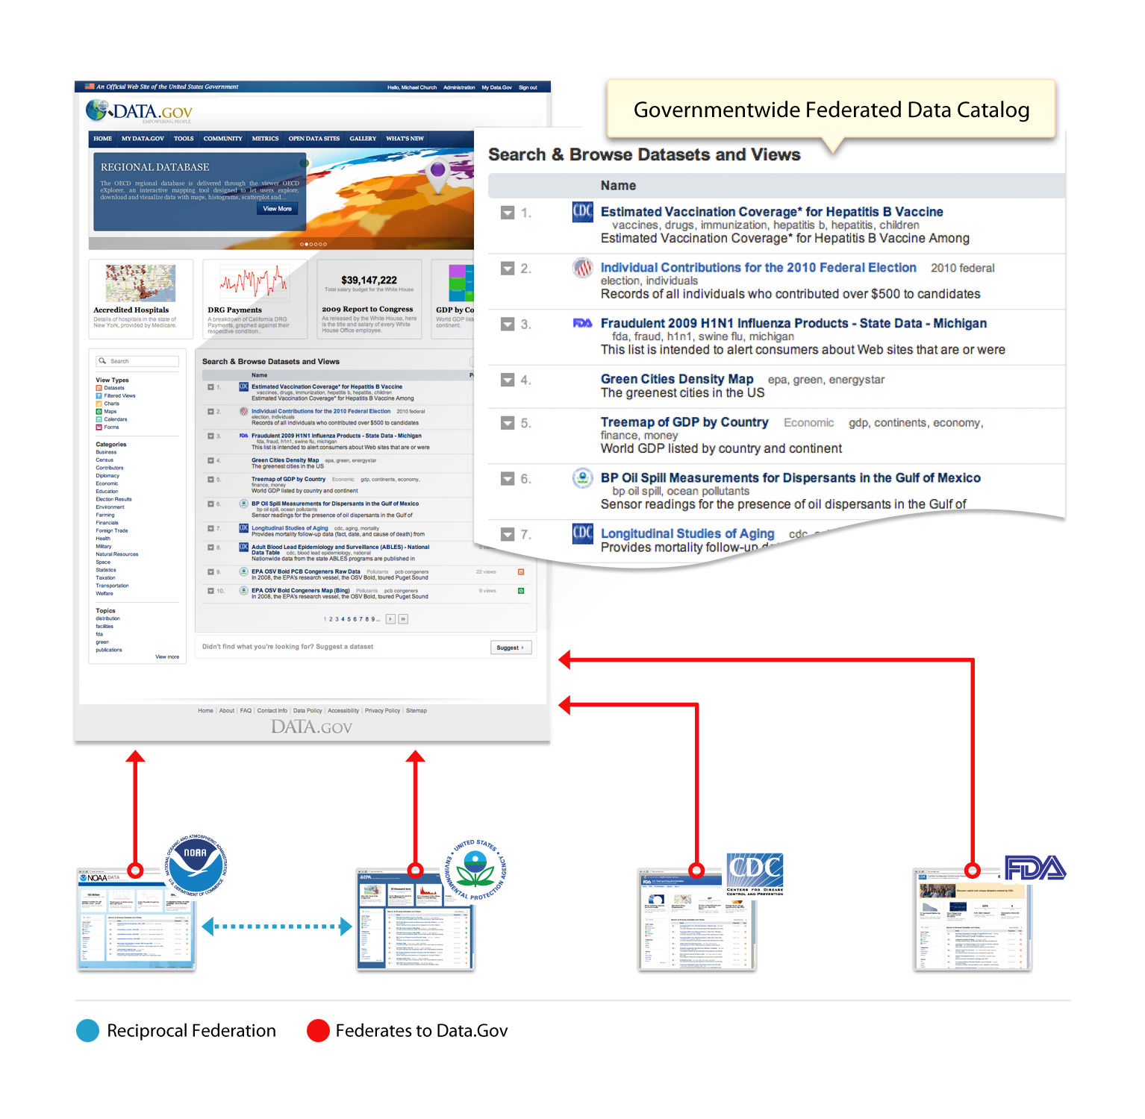
Agency Data in Data.gov
Agencies can
  Upload data directly to Data.gov, sharing its cloud-based data hosting environment
  Or upload data into their own datasite, which federates agency datasets into Data.gov
Either way, data will automatically appear on the Data.gov government-wide virtual catalog
Notes:
Contributing to Data.Gov is now effortless.
Agency stakeholders have two options to participate in the Data.Gov program. In the first option, agencies upload data directly to Data.Gov, sharing its cloud-based data hosting environment.
In the second option, agencies upload their data into their own agency-branded datasite, which automatically federates agency datasets into Data.Gov, as shown in the conceptual diagram on the left.
Either way, your data will automatically appear on the Data.Gov government-wide virtual catalog.

Slide 20
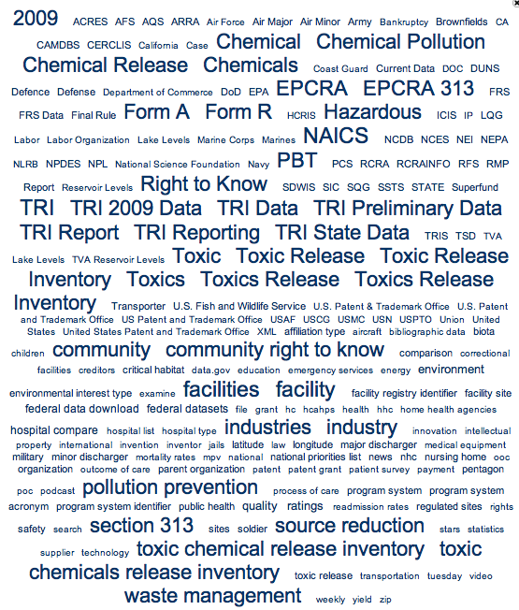
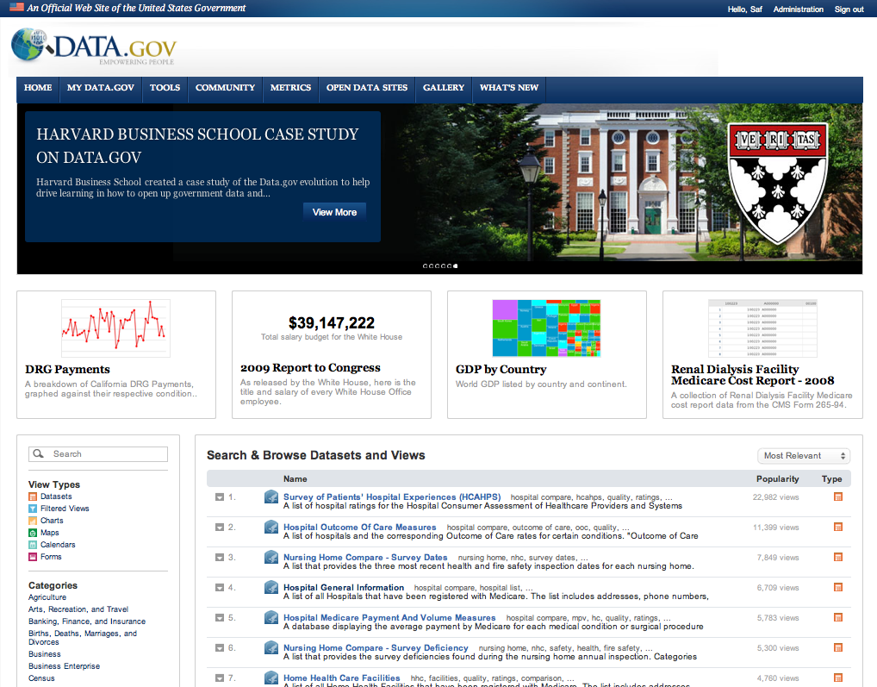
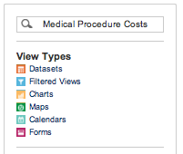
Easy to Find Data
Topics tag cloud
Data.Gov Virtual Catalog
Keyword search
Notes:
How do constituents find relevant data?
For government data to be useful, constituents must first find it. The new Data.Gov public data catalog gives a non-technical user a multitude of ways to find relevant and useful data quickly.
Constituents search using keywords to find relevant datasets or specific data within a dataset. A robust, weighted index that combines metadata as well as row-, column- and cell-level data ensures maximum relevance of search results.
Constituents browse categories and topics in the data catalog and benefit from community tags and ratings to find the most useful and relevant data.

Slide 21
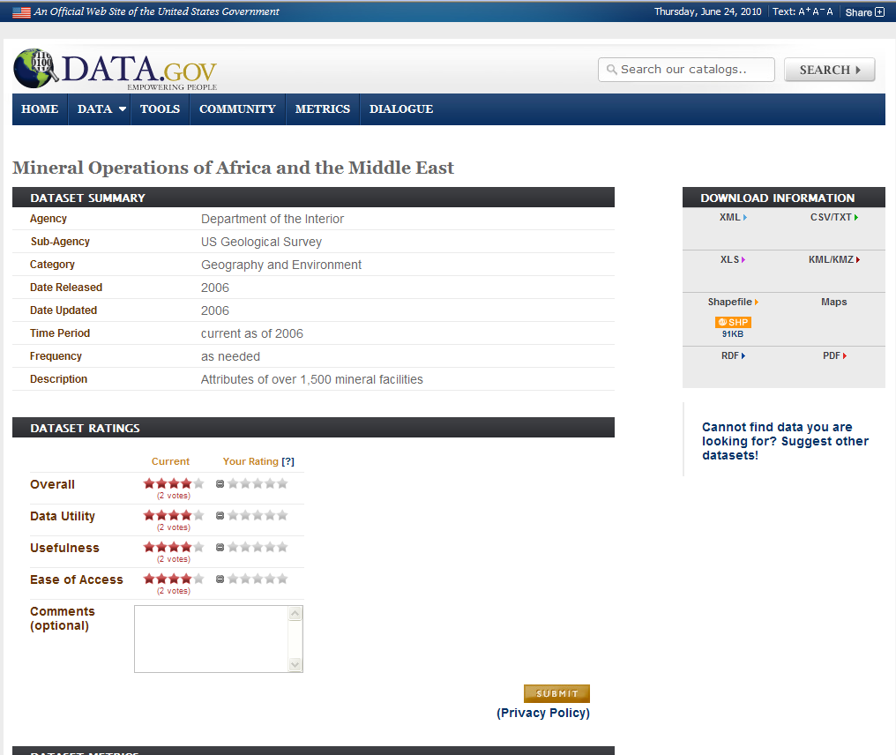
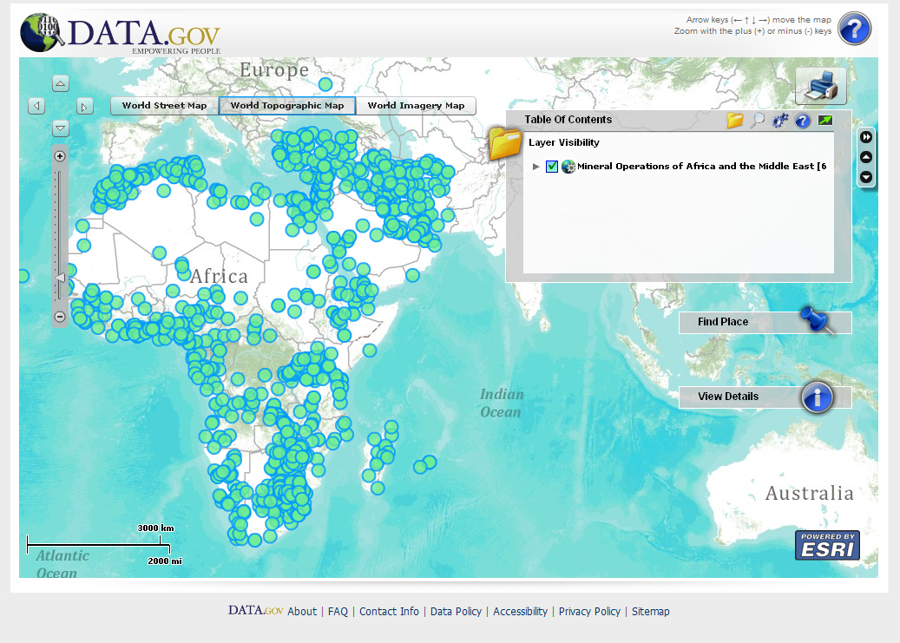
Geospatial preview allows on-the-fly visualizations…

Slide 22
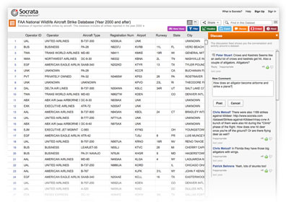
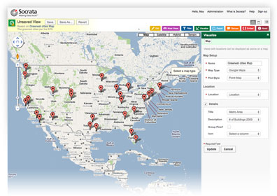
People Make Data Valuable
A platform for engagement
  A rich social experience around data that promotes participation and gives people a voice
  Provide ratings and comments that can be shared over social media
  Recommend datasets and participate in communities
  Powerful visualizations
  Create a filtered view, a map, or a chart that represents what they’re interested in
Notes:
A platform for engagement.
Promoting civic engagement is one of the primary goals of Data.Gov. The next-generation platform gives constituents a rich social experience around data that promotes their participation and gives them a voice.
Constituents contribute to creating a rich experience around data by providing ratings and comments. The social feedback loop in turn drives more adoption
Constituents help propagate interesting data on social networks, creating a new data distribution channel
Constituents can recommend datasets and participate in communities of interest
Millions of contributors.
The same powerful visualization capabilities that Publishers enjoy are available to all users on Data.Gov.
Every reporter can create a filtered view, a map, or a chart that best represents what they’re interested in. The data becomes organically more valuable to everyone, with each interaction.

Slide 23
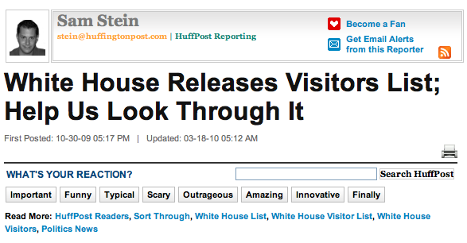
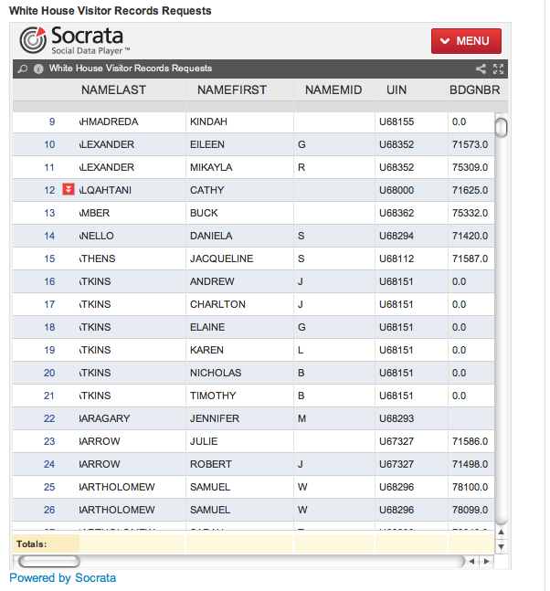
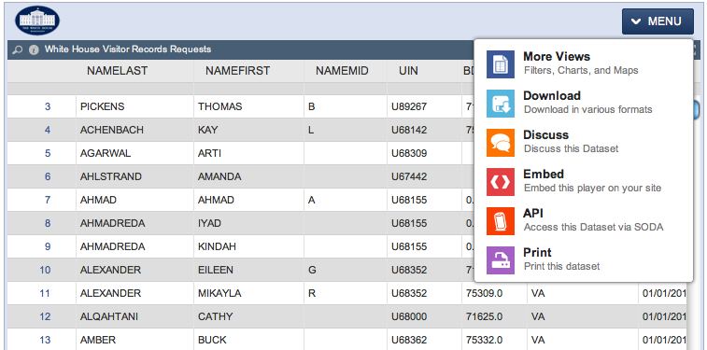
Sharing Data on Blogs and Social Networks
Data tells stories that people care about
Embed data on blogs and web sites
Embed a dataset or view of a dataset on any webpage
Bring data to where people are having conversations
Notes:
Interesting government data often tells stories that engaged constituents care about.
Citizen journalists, bloggers and professional reporters are not content to just consume data. They want to use it to publish informed articles and opinion pieces. The Socrata Social Data Player™ makes embedding data on blogs and web sites a snap.
Anyone can easily embed a dataset or user-created representation (view) of a dataset on any webpage
Helps propagate data on blogs and media sites, beyond the government’s datasite, increasing its reach and exposure with constituents
Provides a fully interactive experience that maintains the integrity and freshness of the source data

Slide 24
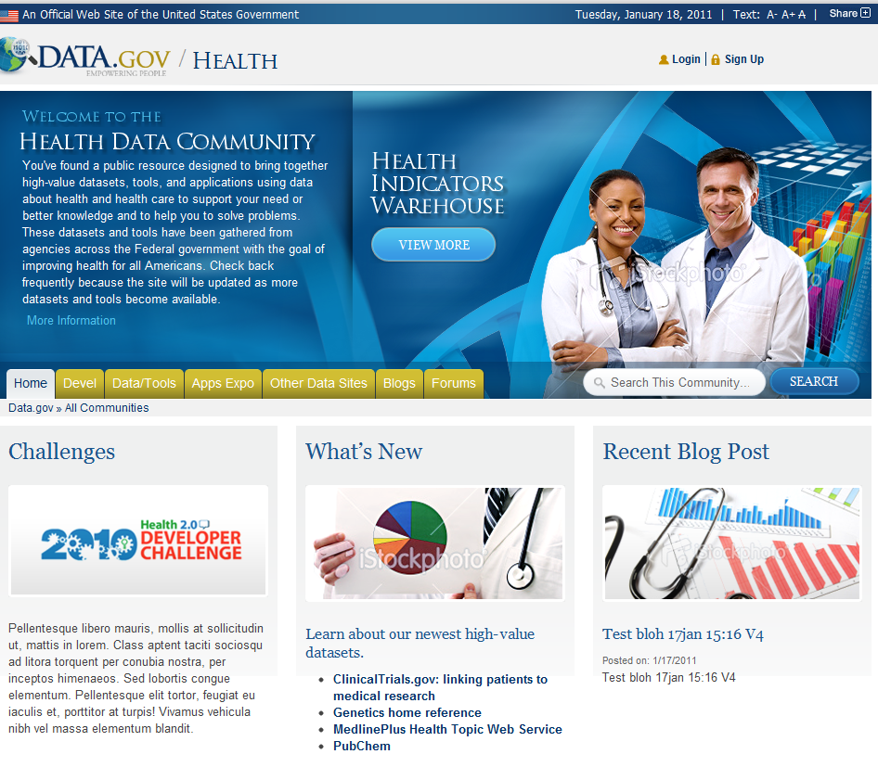
Open Communities for Discussing Trends and Topics
Join in the community discussions about open data and semantic technologies at http://www.data.gov/opendata
  Twitter at @usdatagov
If you are interested in a specific type of data let us know!

Slide 25
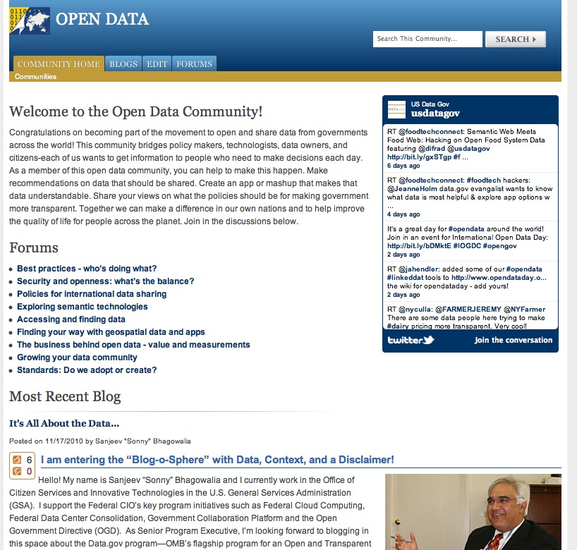
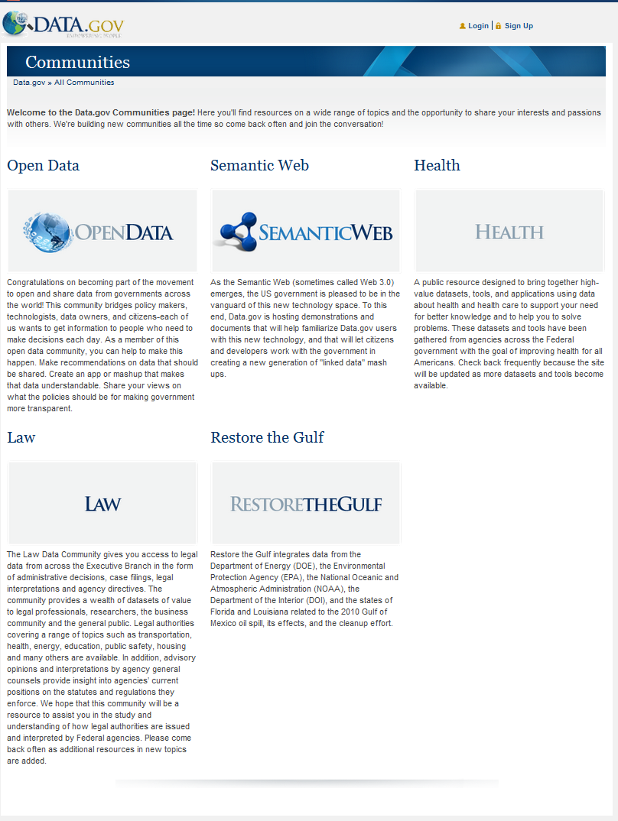
Community Sites…Stay Tuned
Community
Restore the Gulf | ✓
Open Data | ✓
Semantic Web | ✓
Health | ✓
Law | ✓
Education
Energy | ✓
Developers
Foreign trade products
Human rights
Climate
Marine and coastal
OECD
Open data research

Slide 26
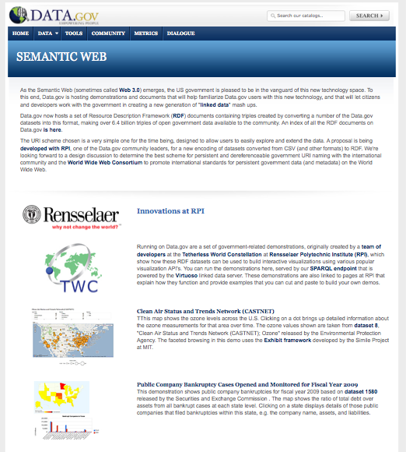

Semantic Technologies
Provides developers the tools and raw data formats to develop new capabilities
Close partnership with Rensselaer Polytechnic Institute
Connected to other open data efforts across the world

Slide 27

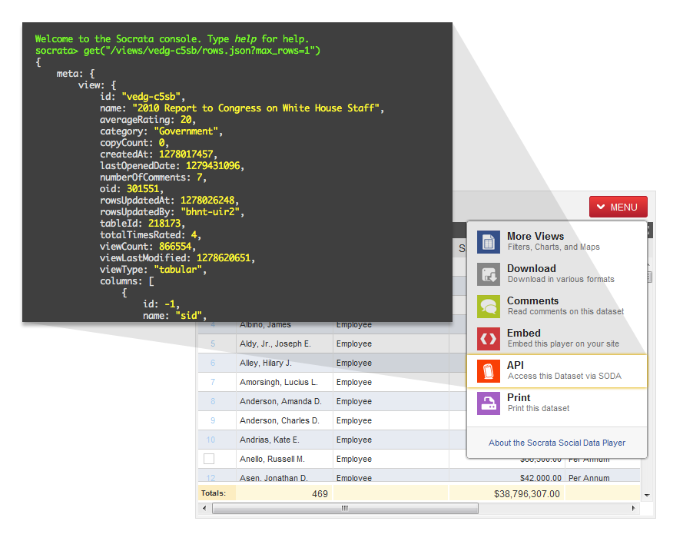
API for Advanced Applications
Offers a common API for all datasets and Agency datasites (data catalogs)
Offers an open, standards-based, non-proprietary API implementation built on web-based RESTful architecture
Provides consistent high-performance throughput of up to 500,000 requests per hour
Provides support for advanced operations such as filtering and sorting
27
Notes:
Lowering the bar for programmatic access and applications
The next-generation Data.Gov platform is API-enabled with an open, standards-based API, so that every dataset is readily and uniformly accessible for developers. This is a new capability with far reaching implications.
Data.Gov offers a common API for all datasets and Agency datasites (data catalogs). This ensures uniform programmatic access to data and metadata in any dataset or datasite regardless of originating agency. It dramatically reduces the cost of application development using government data.
Data.Gov offers an open, standards-based, non-proprietary API implementation built on web-based RESTful architecture. As a result, there is no lock-in effect of other proprietary systems and the likelihood developers will invest in developing applications greatly increases.
Data.Gov API provides consistent high-performance throughput of up to 500,000 requests per hour. This ensures site availability under the heaviest of loads and peak periods of interest.
The API provides support for advanced operations such as filtering and sorting. These capabilities reduce program complexity and improve performance.

Slide 28
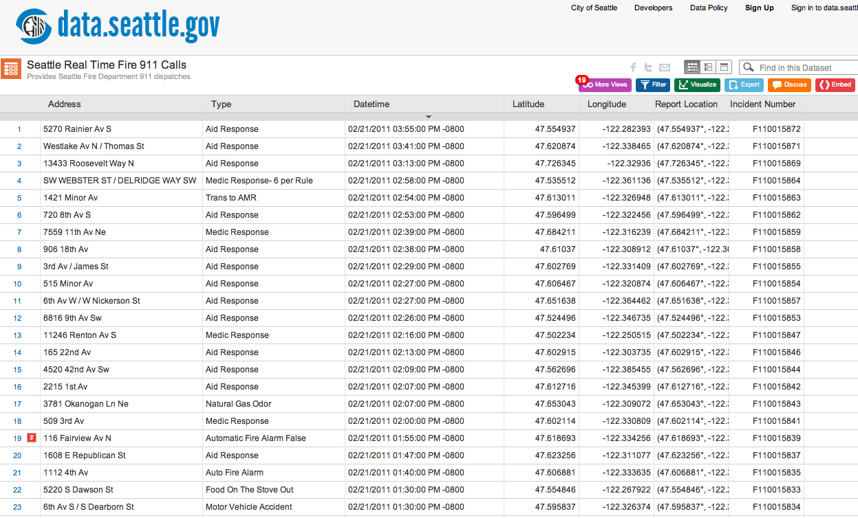
Advanced Features for Publishers
Publisher API provides a programmatic way to automate publishing and updates from the source data onto Data.Gov or your Agency’s own datasite.
All of the interactive capabilities available to data publishers can be automated
  Import and create datasets.
  Update dataset metadata.
  Append to and replace dataset rows.
  The Publisher API boosts efficiency and provides a robust a mechanism for automating recurring data maintenance or publishing data in real-time.
Example: City of Seattle uses the Publisher API to update the Fire 911 Calls dataset in real-time
Notes:
Automating publishing and maintenance.
The Publisher API provides a programmatic way to automate publishing and updates from the source data onto Data.Gov or your Agency’s own datasite.
All of the interactive capabilities available to data publishers can be automated
Import and create datasets.
Update dataset metadata.
Append to and replace dataset rows.
The Publisher API boosts efficiency and provides a robust a mechanism for automating recurring data maintenance or publishing data in real-time.

Slide 29
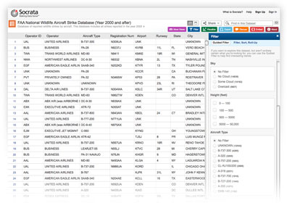
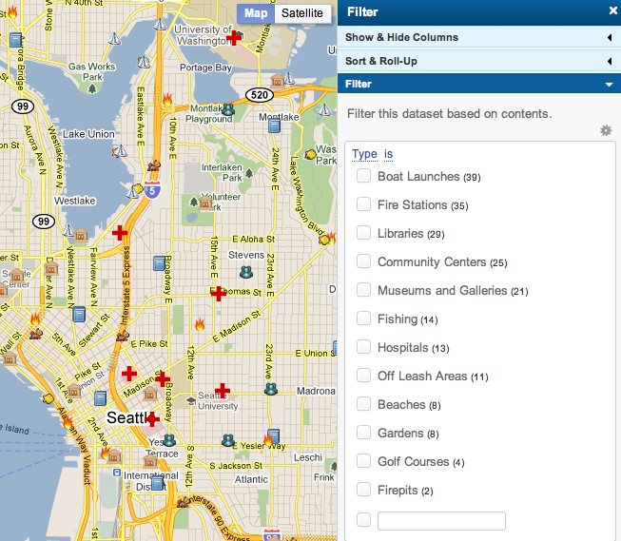
Easy to Find Answers
Can exploring government data be as easy as shopping online?
Yes. E-commerce sites have written the book on easy, intuitive navigation of complex data. Now the same power of intuitive web browsing using guided filters is available on Data.Gov and Socrata-powered agency sites.
Constituents can make sense of data using intuitive, step-by-step, contextual exploration.
Even the most complex dataset is reduced to a few clicks, eliminating the intimidation factor.
Guided Filters are familiar intuitive interfaces that publishers can add to any dataset or visualization. Finding answers is a few clicks away.
Notes:
Can exploring government data be as easy as shopping online?
Yes. E-commerce sites have written the book on easy, intuitive navigation of complex data. Now the same power of intuitive web browsing using guided filters is available on Data.Gov and Socrata-powered agency sites.
Constituents can make sense of data using intuitive, step-by-step, contextual exploration.
Even the most complex dataset is reduced to a few clicks, eliminating the intimidation factor.

Slide 30
Geospatial Data
Geo-data Integration: Combine capabilities of Geodata.gov and Data.gov
Enhanced visualization and data-mashing capabilities
“Human knowledge is expected to be doubling by the year 2012”
  Alvin Toffler
Geo-aware applications are key
  How to realize the promise of geospatial information systems (GIS) for the nation
  Geo-data “architected and built-in”
  Lightweight geo-applications and mash-ups for Web 2.0 and Gov 2.0
  Incremental, agile, actionable and affordable delivery

Slide 31
What’s NOW, What’s NEXT!
Questions, Comments or Feedback
Visit – Data.Gov
Help US Empower the People through Open Data Sharing!
  Contact the Data.Gov Program Management Office
    Marion Royal, Program Director – marion.royal@gsa.gov
    Hyon Kim, Deputy Director – hyon.kim@gsa.gov
    Alan VanderMallie, Program Manager- alan.vandermallie@gsa.gov

