Slide 1

Drug Efficacy in the Wild
Tim Vaughan
8-Sep-2011

Slide 2


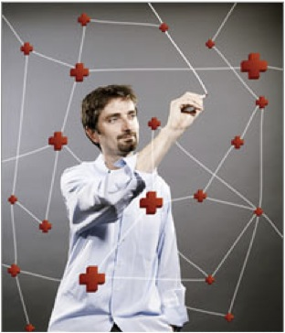

PatientsLikeMe – Three brothers’ story

Slide 3
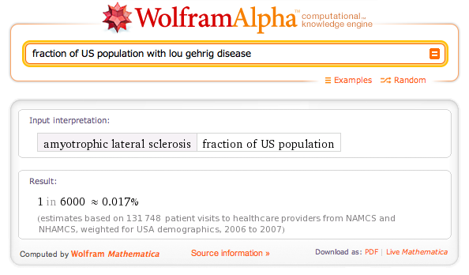
ALS − Rare neurologic disease

Slide 4
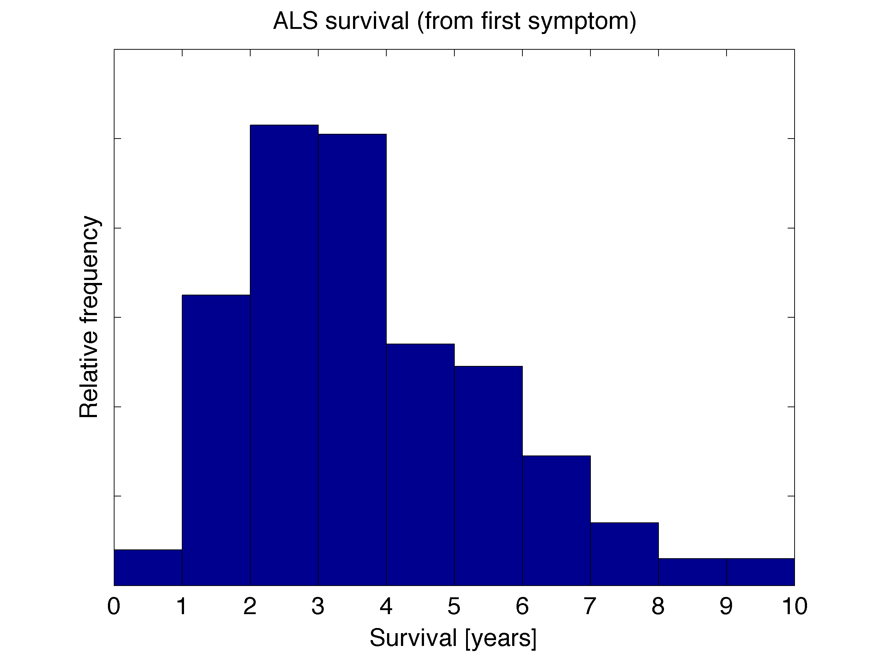
ALS − Time is of the essence

Slide 5
Contents
PatientsLikeMe
Why is MikeFromFinland taking lithium?
Lithium delays progression of ALS?!
PatientsLikeMe’s observational study
Finding patients like me
Results
Predictive modeling / What is my outcome?
Concluding remarks

Slide 6
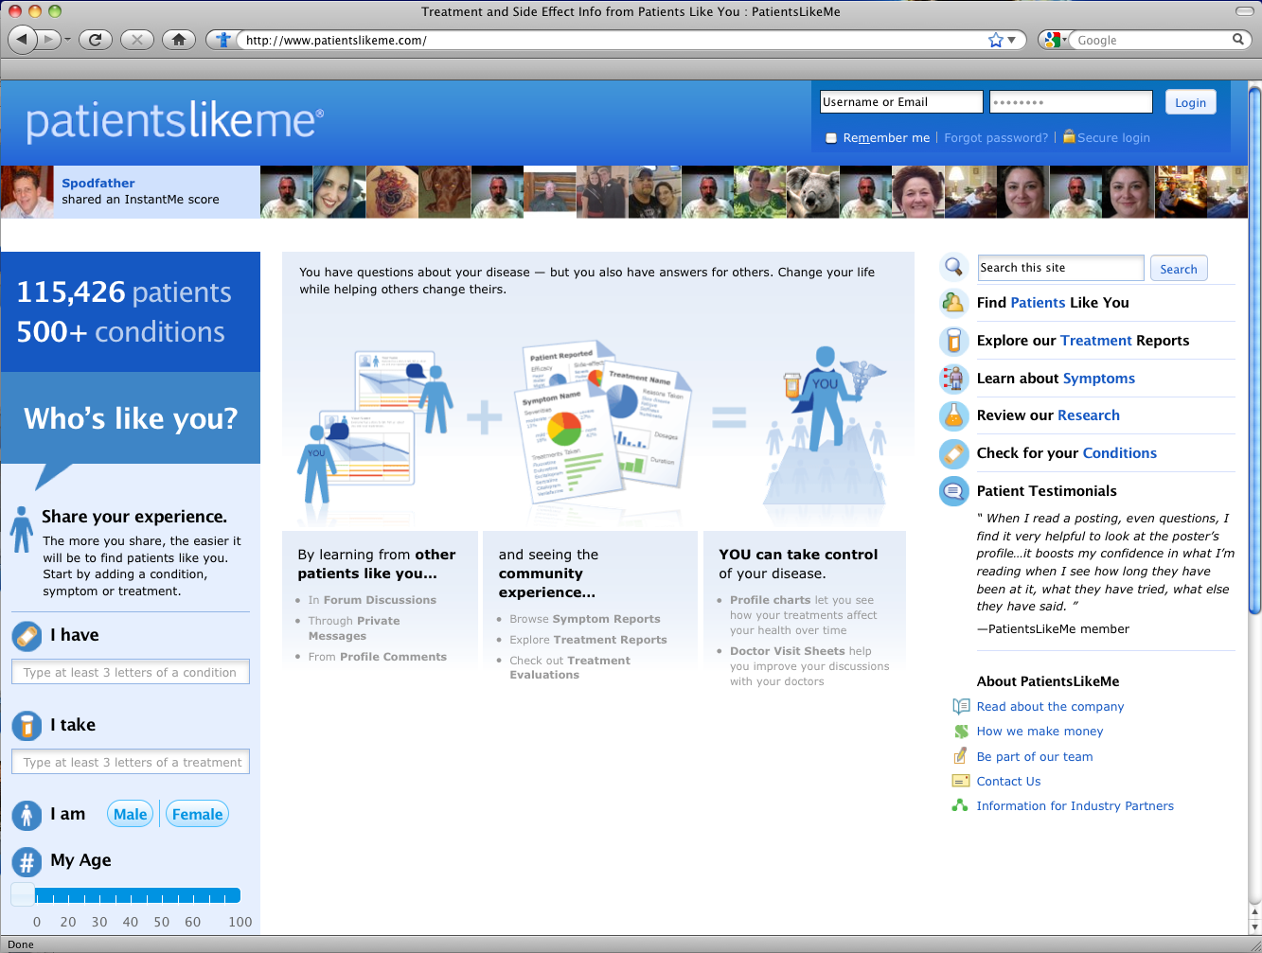
PatientsLikeMe web site

Slide 7
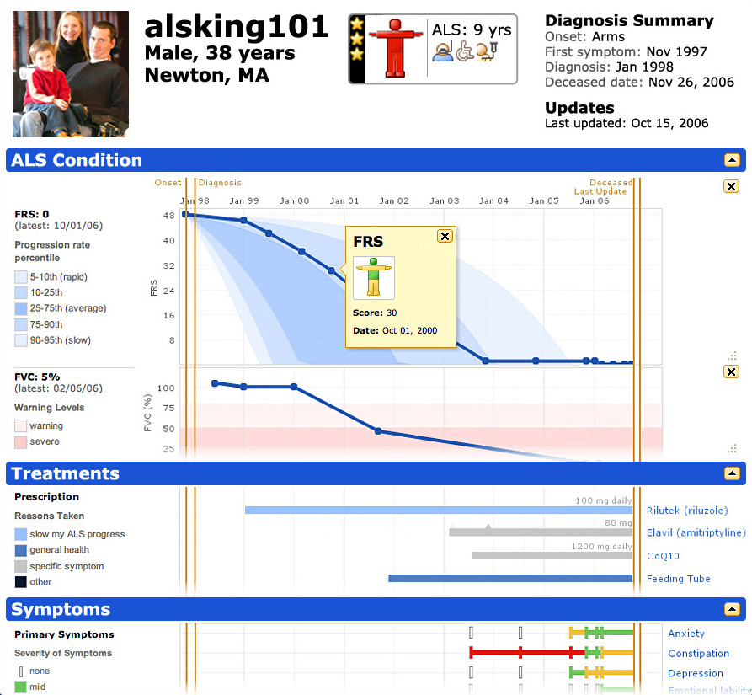
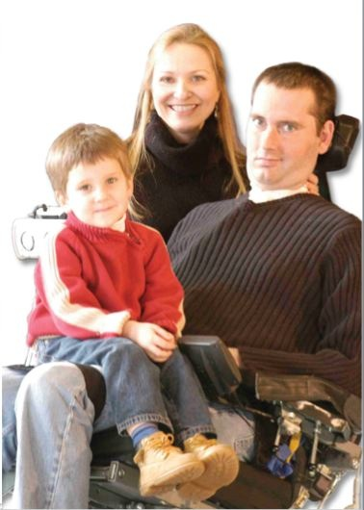
Stephen Heywood (alsking101)
Notes:
7

Slide 8
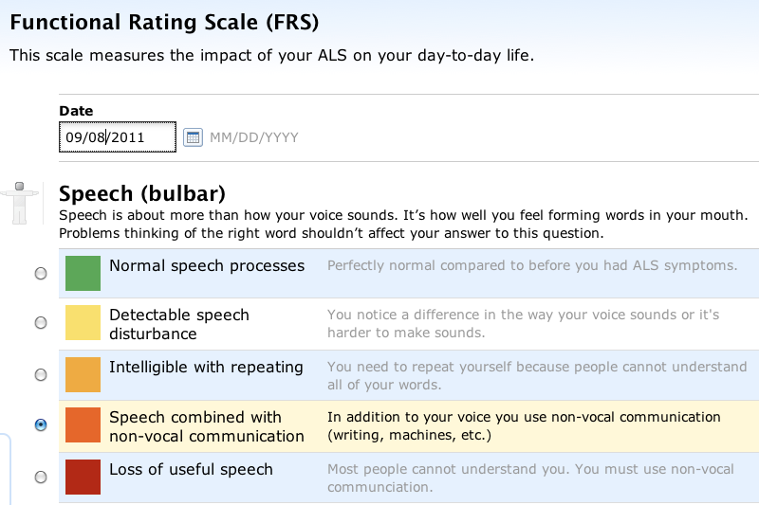
Data collection
Notes:
8

Slide 9
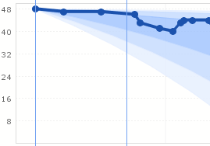
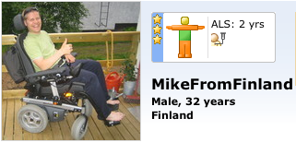
Why is Mike taking lithium?
Lithium

Slide 10
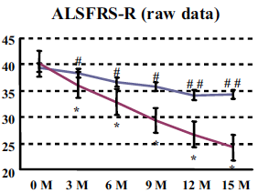
Lithium delays progression of ALS?!
Fornai et al., PNAS 105:2052-2057 (2008)

Slide 11
The observational study germinates

Slide 12
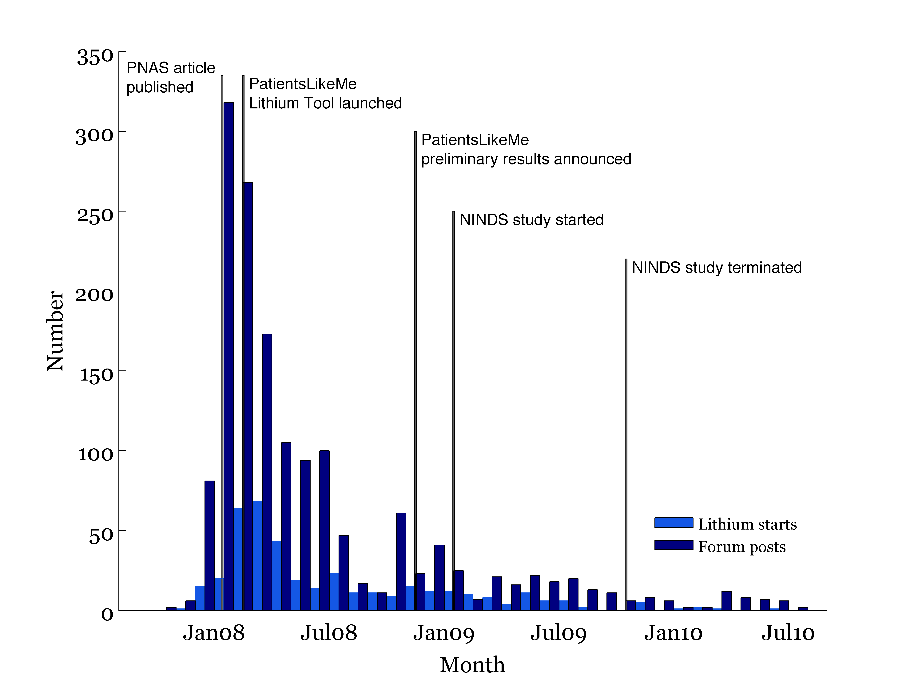
Timeline

Slide 13
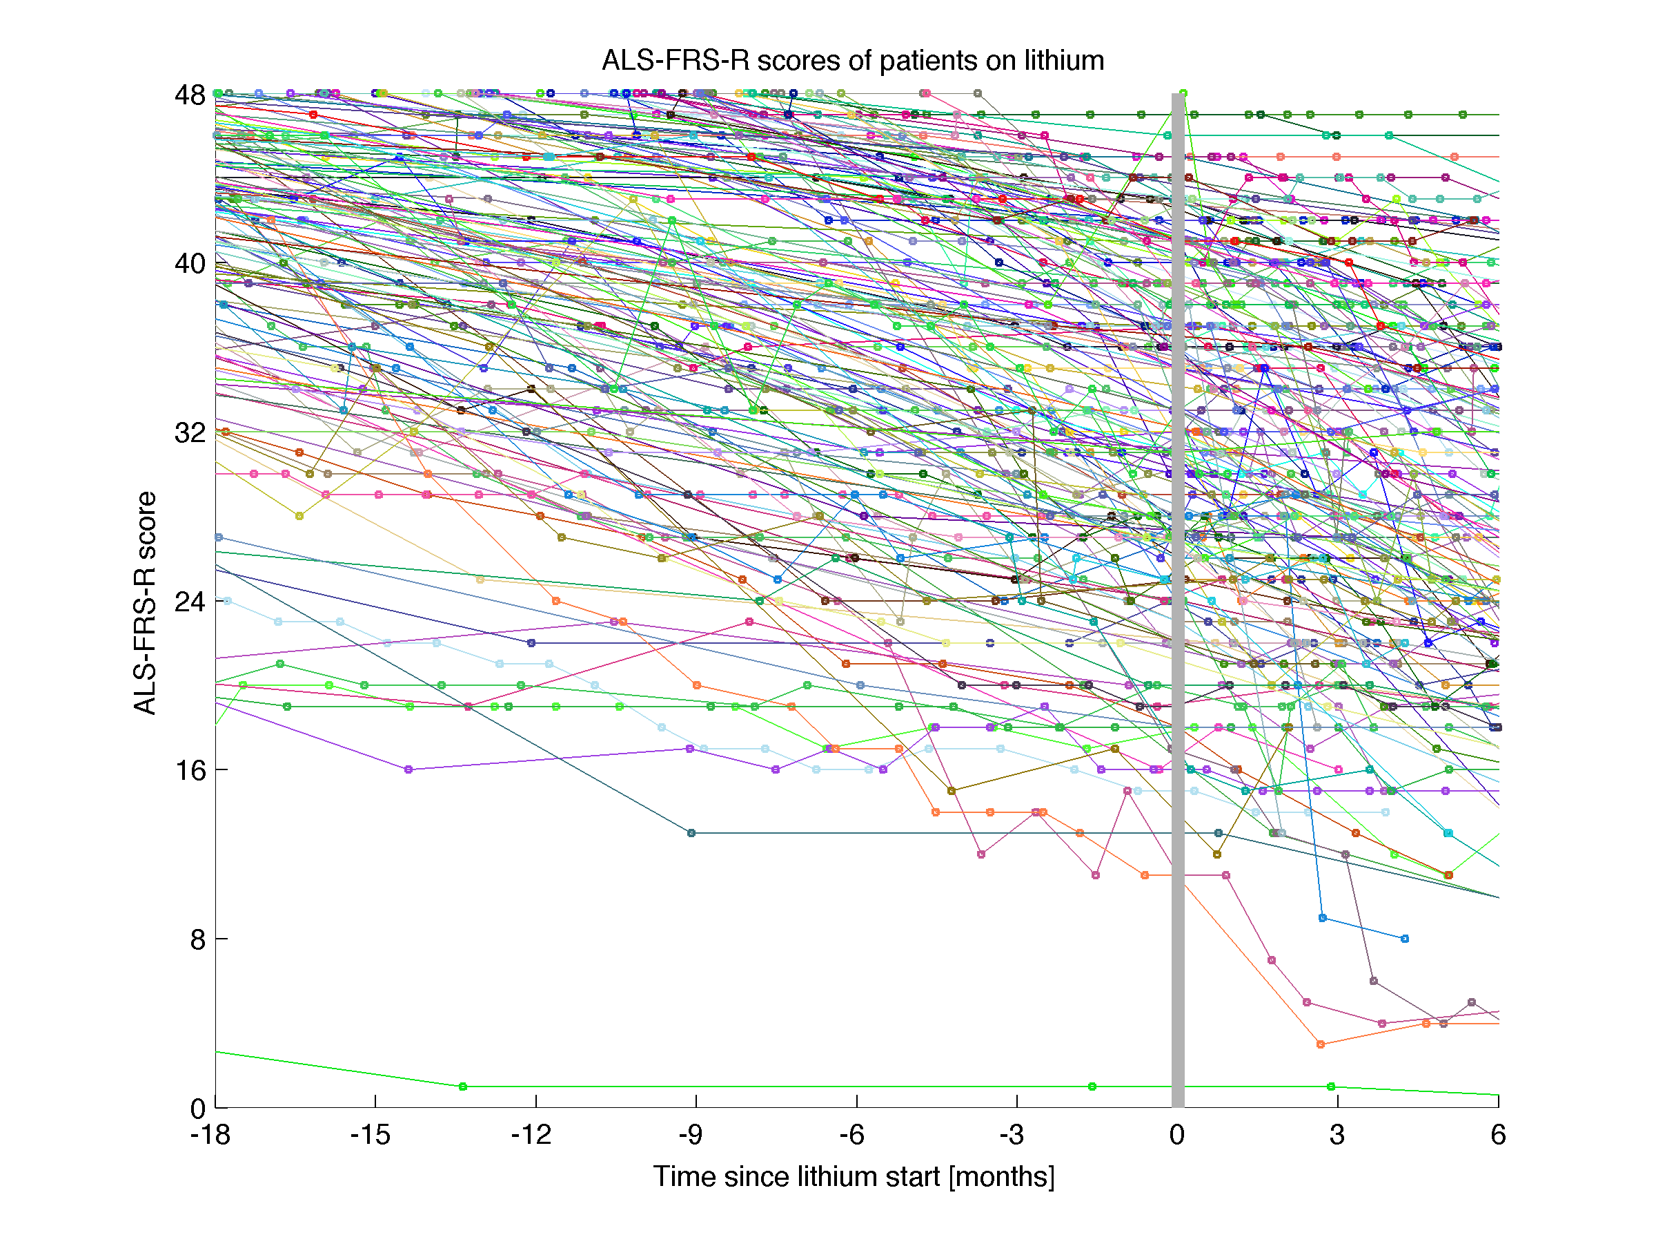
Patients track their progress

Slide 14
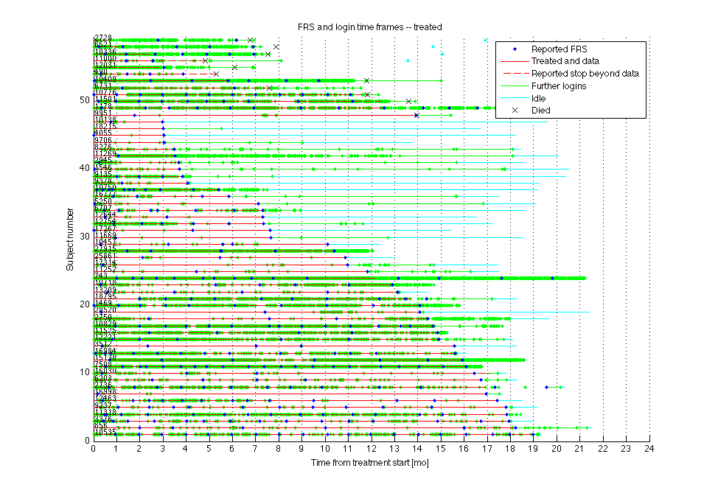
The “kitchen sink” plot

Slide 15
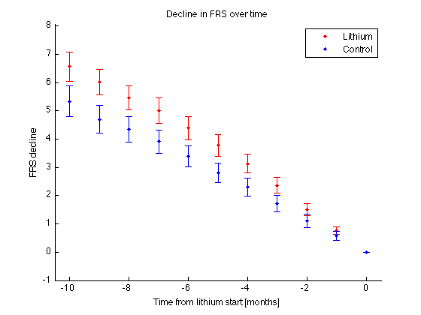
Random control may not be a “patient like me”

Slide 16
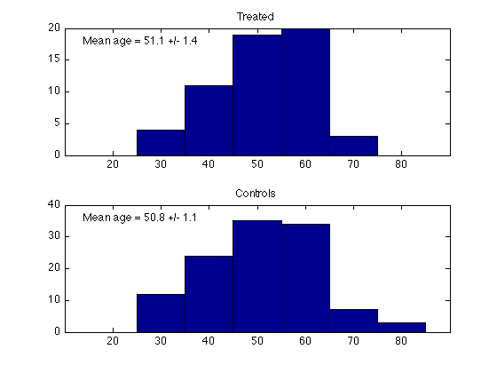
Demographics – age

Slide 17
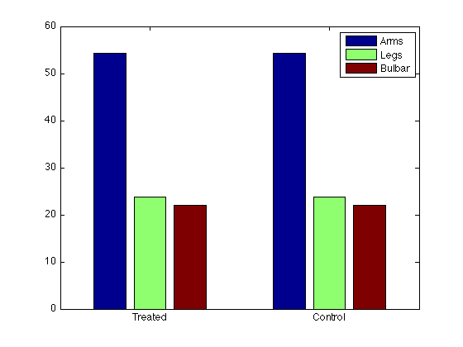
Demographics – onset site

Slide 18
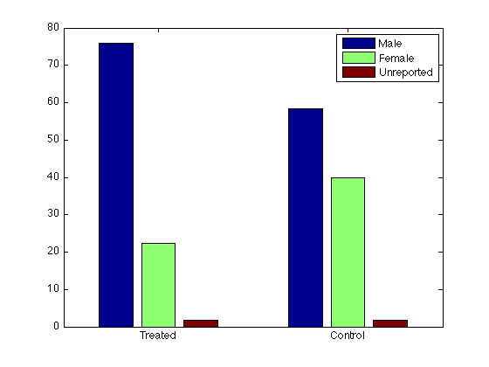
Demographics – sex

Slide 19
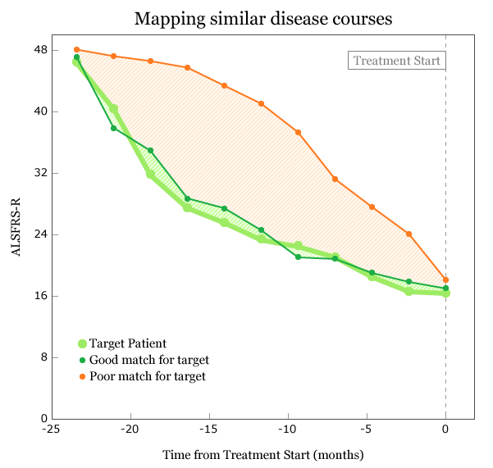
Matching algorithm

Slide 20
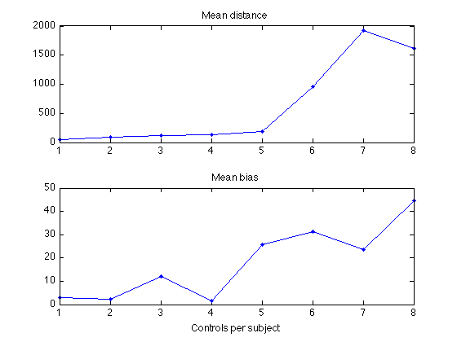
Matching across the entire sample

Slide 21
Pre-treatment progression bias reduced

Slide 22
Results of lithium treatment

Slide 23
Kaplan-Meier for patients & data

Slide 24
Biases and other stuff that worried us
Self-selection for treatment
“Recruitment bias”
Data reported (vs. data opportunity)
Outliers (e.g. PMA and PLS)
“Optimism bias” at treatment start

Slide 25
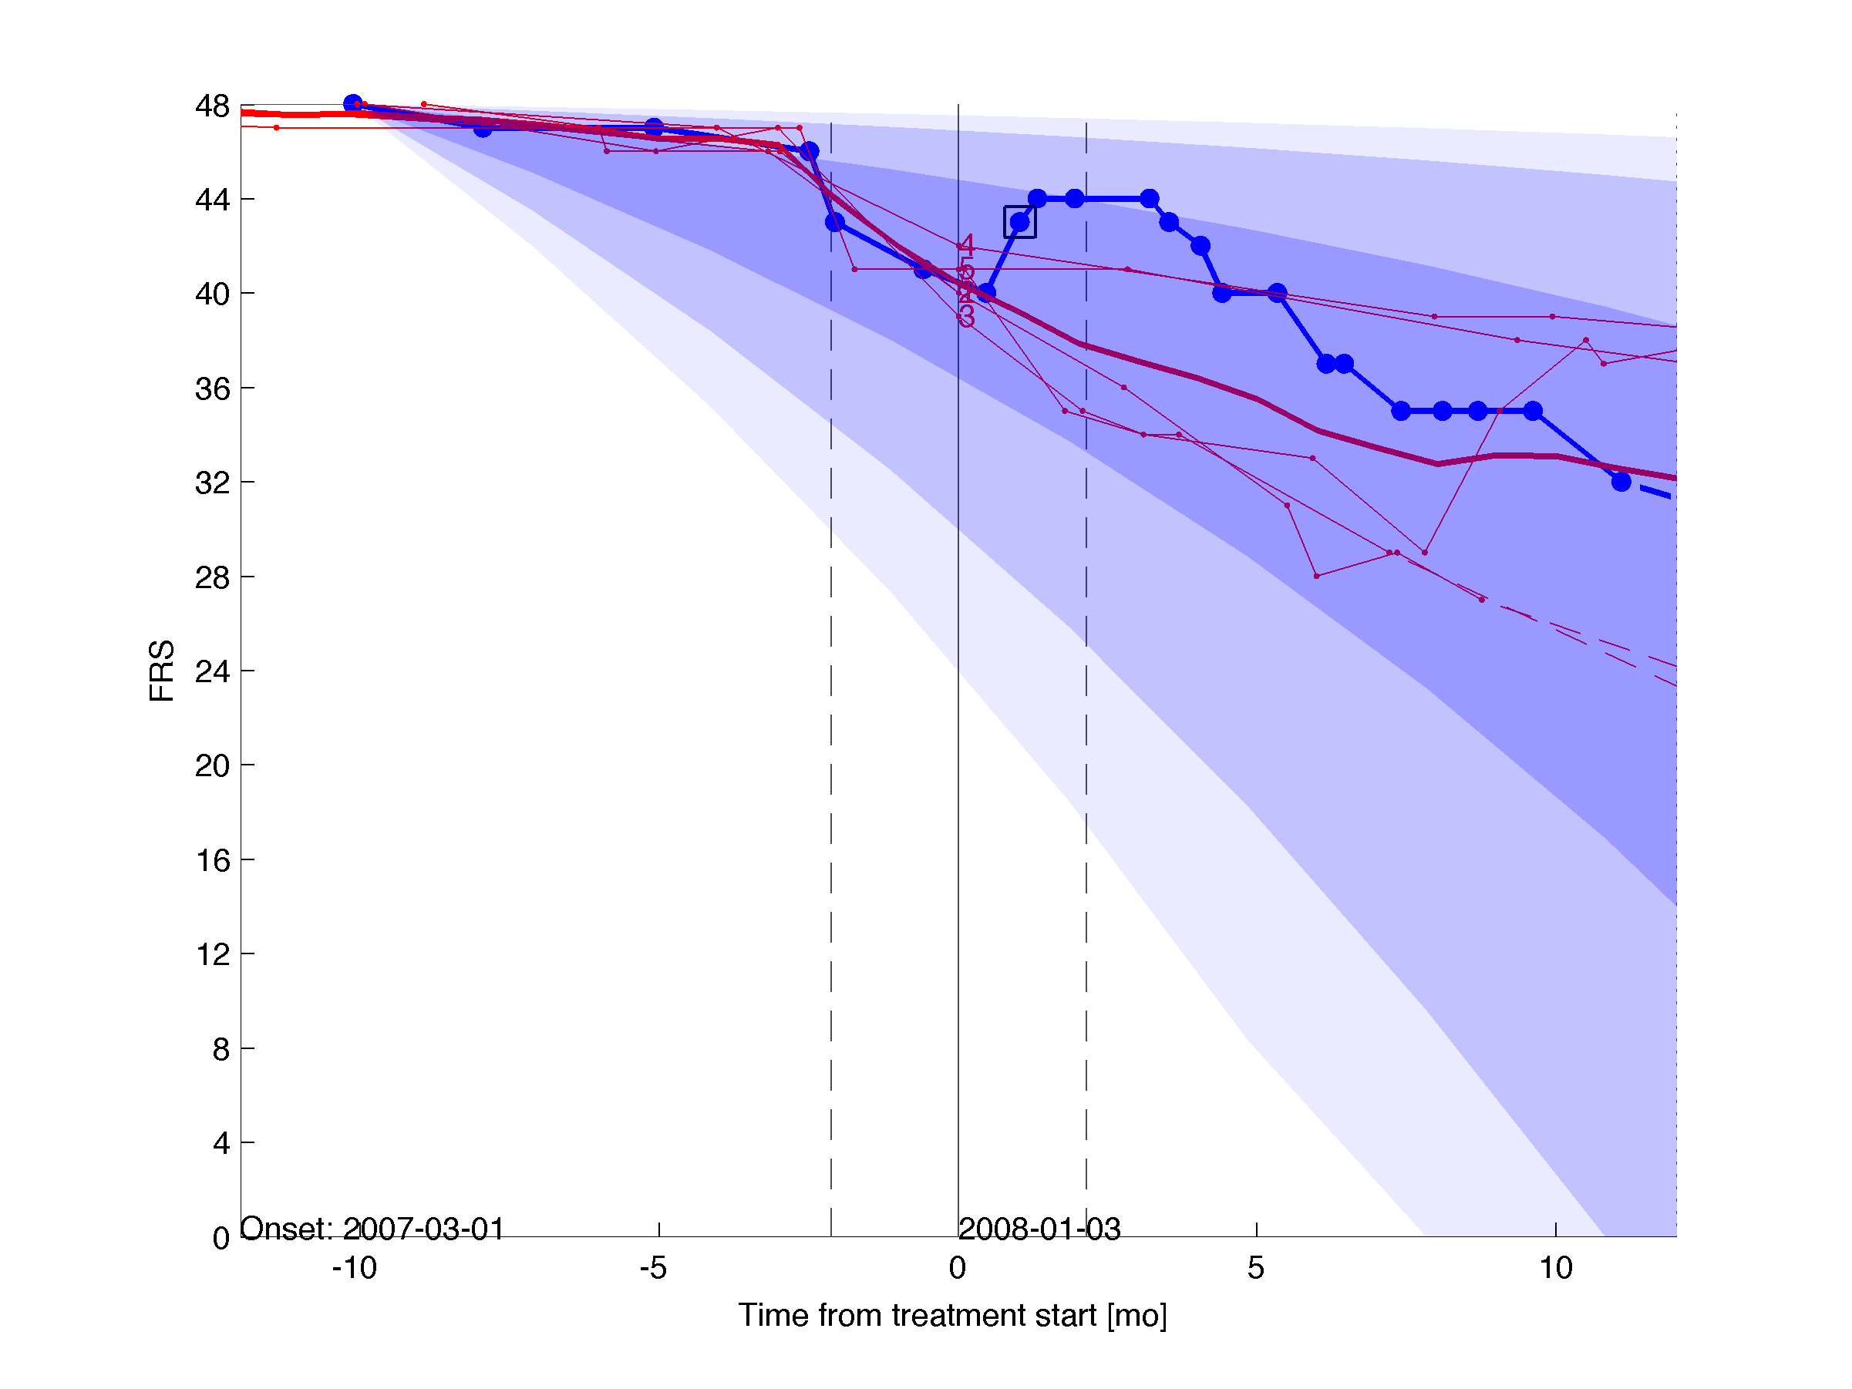
What Mike (and PatientsLikeMe) can learn

Slide 26
Conclusions
Savvy patients are using the internet in creative ways to understand and improve their health
Structured, self-reported patient data has profound value, despite being subject to bias (like all patient data!)

