Slide 1
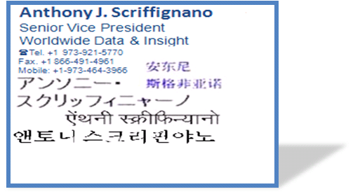

Moving from
Information to Insight
2012年9月7日

Slide 2

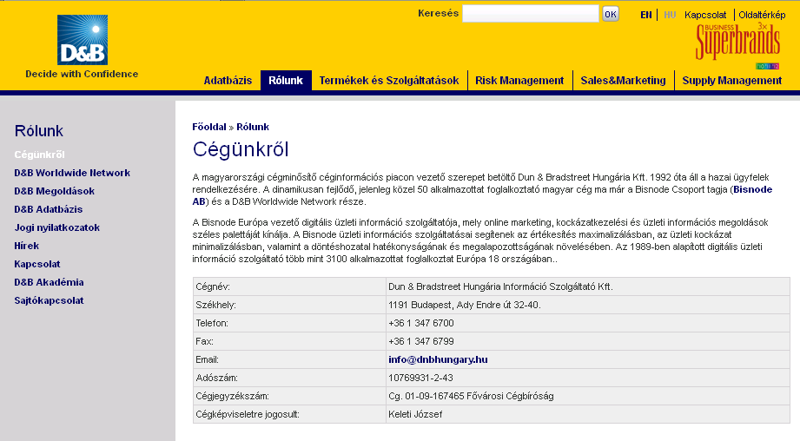
The Challenge:
Understand the basic identity and inter-relationship among commercial entities globally
Who are they?
Where are they?
How are they related?
How do they behave?
What is my total risk?
What is my total opportunity?
Global, US HQ
Est. 1841
“Dun & Bradstreet”
访问邓白氏其他国家和区域站点
ダンアンドブラッドストリートTSR株式会社

Slide 3
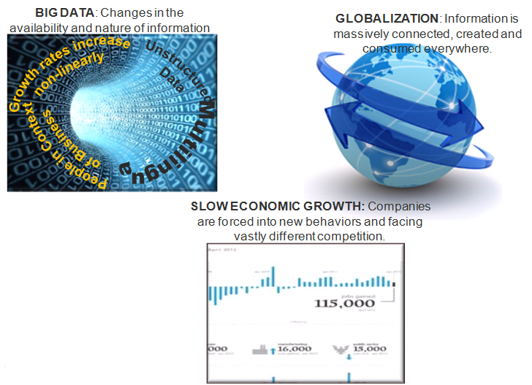
Setting the stage: What are we thinking about?
3 Major Trends Impacting Commercial Activity

Slide 4

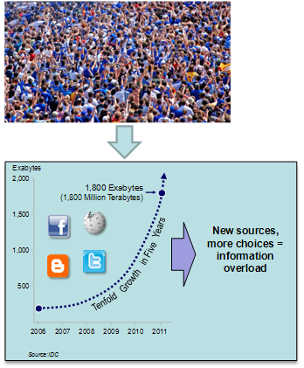

The challenge and opportunity starts with the current data deluge
BIG DATA: Changes in the availability and nature of information
That problem is made much more complex when the “crowd” is doubling and doubling in size.
“Internet-related consumption and expenditure, if measured as a sector, is now bigger than agriculture or energy. On average, the Internet contributes 3.4 percent to GDP in the G-8 countries, China, India, Brazil, South Korea, and Sweden—equal to the GDP of Spain and Canada.
The fundamental problem of identifying and understanding a business is something we do well.
McKinsey & Company
40 Million Jobs Needed, 2012
Notes:
4
Over the past several years, the types and volume of data available online has dramatically expanded
We will see a 10 fold growth of information in just 5 years and all expectations are that the pace of growth will accelerate
Today, customers tell us they do not have the capacity to process the sheer volume of information available to them
We have a choice to be more relevant or less relevant in this environment
Our choice is to be more relevant by helping customers organize the information into insight to create much more customer value and a far better customer experience
by connecting disparate sources of online information
by integrating this information with customer workflows
by enabling customers to use the information for more jobs—jobs that they cannot easily perform today
There is a tsunami of data coming at us which we can get crush by or ride — the cost to ride is $110-130M

Slide 5
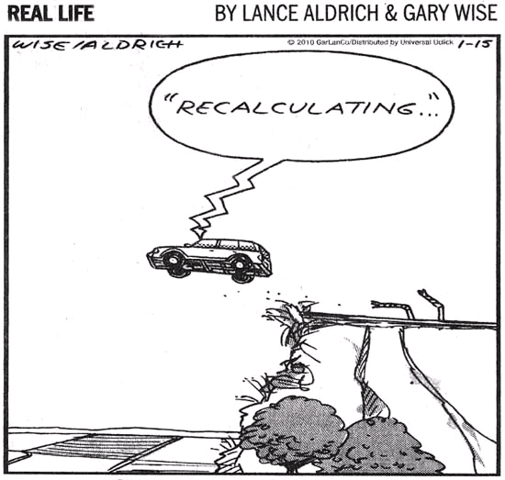
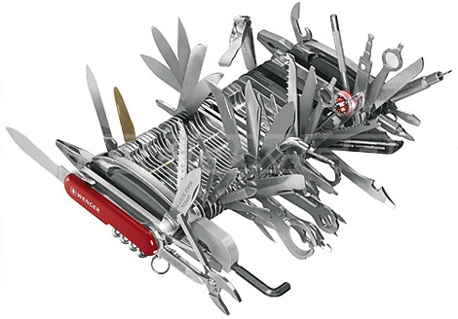
BIG DATA: Changes in the availability and nature of information
Some hard, cold facts:
The Internet
  Just because it’s on the Internet doesn’t make it true…
  Everything isn’t on the internet!
  You can’t use everything you find on the Internet for commercial (or maybe any other) purpose
Veracity
  Repetition doesn’t necessarily mean truth
  Repetition doesn’t necessarily mean truth
  Bad news travels fast
  Bad guys are often “smarter” than good guys
Latency
  Everything is not simultaneously true
  There is no such thing as real time
Correlation is not causation
Data is not insight
We have lots more data – more is better, right?!?

Slide 6
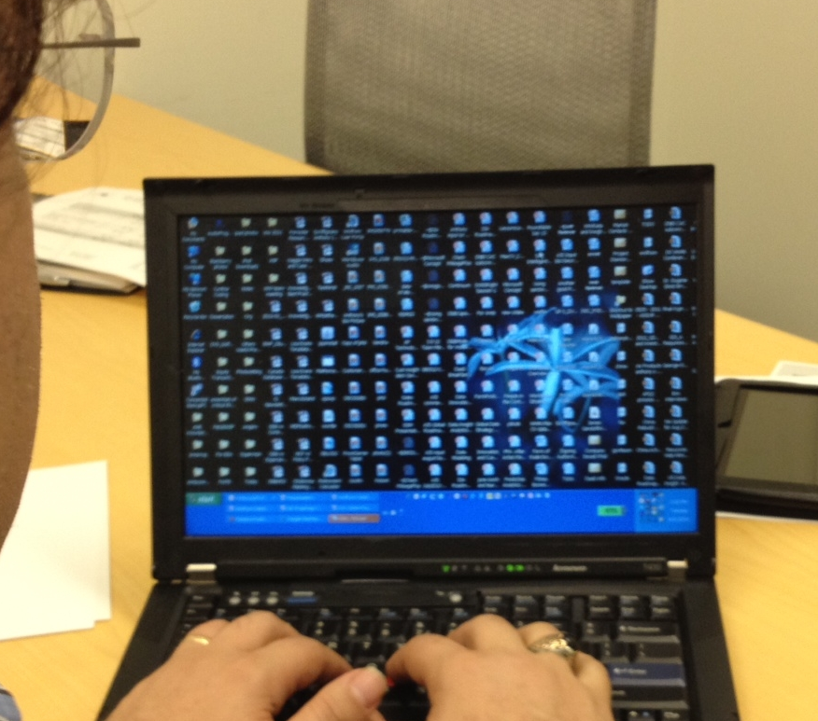
And then there is my own personal big data challenge…

Slide 7

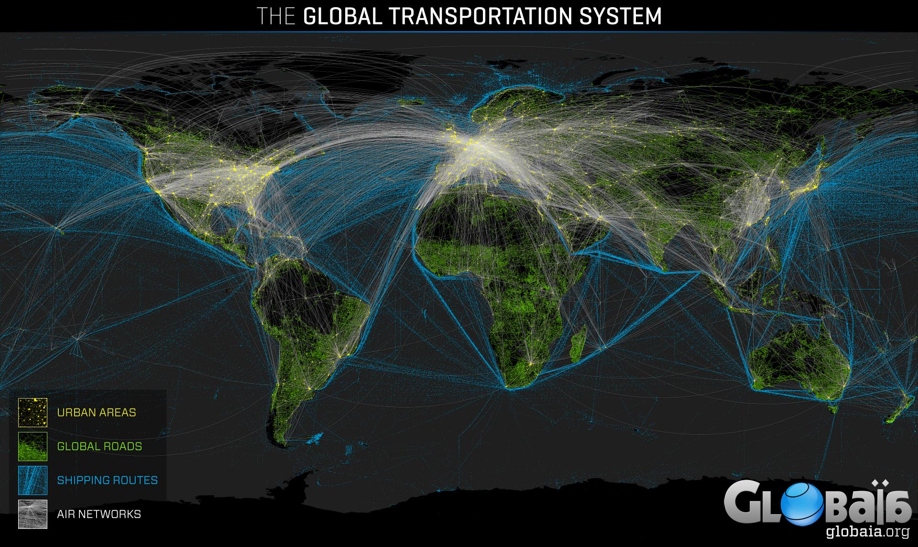
Tremendous shifts occurring in the global marketplace are also driving our thinking.
GLOBALIZATION: Information is massively connected, created and consumed everywhere.
Globalization is making it increasingly unlikely for companies to operate at scale without some degree of cross-border activity. For our major customers, this effect is driving significant growth outside the US.
Source: globaia.org by Felix Pharand Deschenes

Slide 8

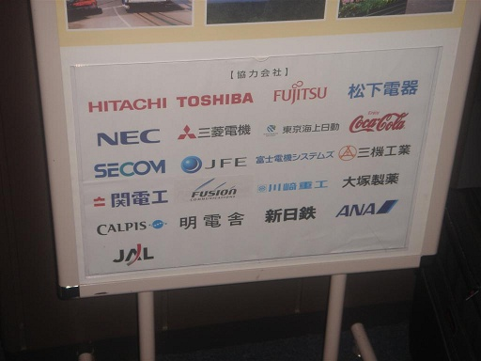
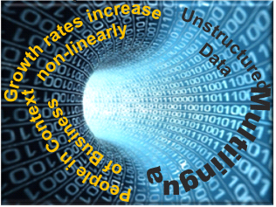
GLOBALIZATION: Information is massively connected, created and consumed everywhere.
Korean Business Name | (주)유니슨어드바이저리코리아
Romanized Name | Unison Advisory Korea Co., Ltd.
Korean address | 서울특별시 서초구 반포동66-1
Romanized Address | Banpo-dong, Seocho-gu, Seoul 66-1 KOREA
Korean CEO Name | 김수민
Romanized CEO Name | Si Min KIM
A local presence that is pronounceable, but not meaningful
?
“electronics”
A very different message locally, but less meaning globally
Korean Business Name | 삼성전자(주)
Romanized Name | Samsung Electronics Co.,Ltd
Korean address | 경기도 수원시 영통구 매탄3동 416
Romanized Address | 416, Maetan 3-dong, Yeongtong-gu, Suwon-si, Kyeonggi-do KOREA
Korean CEO Name | 김수민
Romanized CEO Name | O Hyeon Kwon

Slide 9

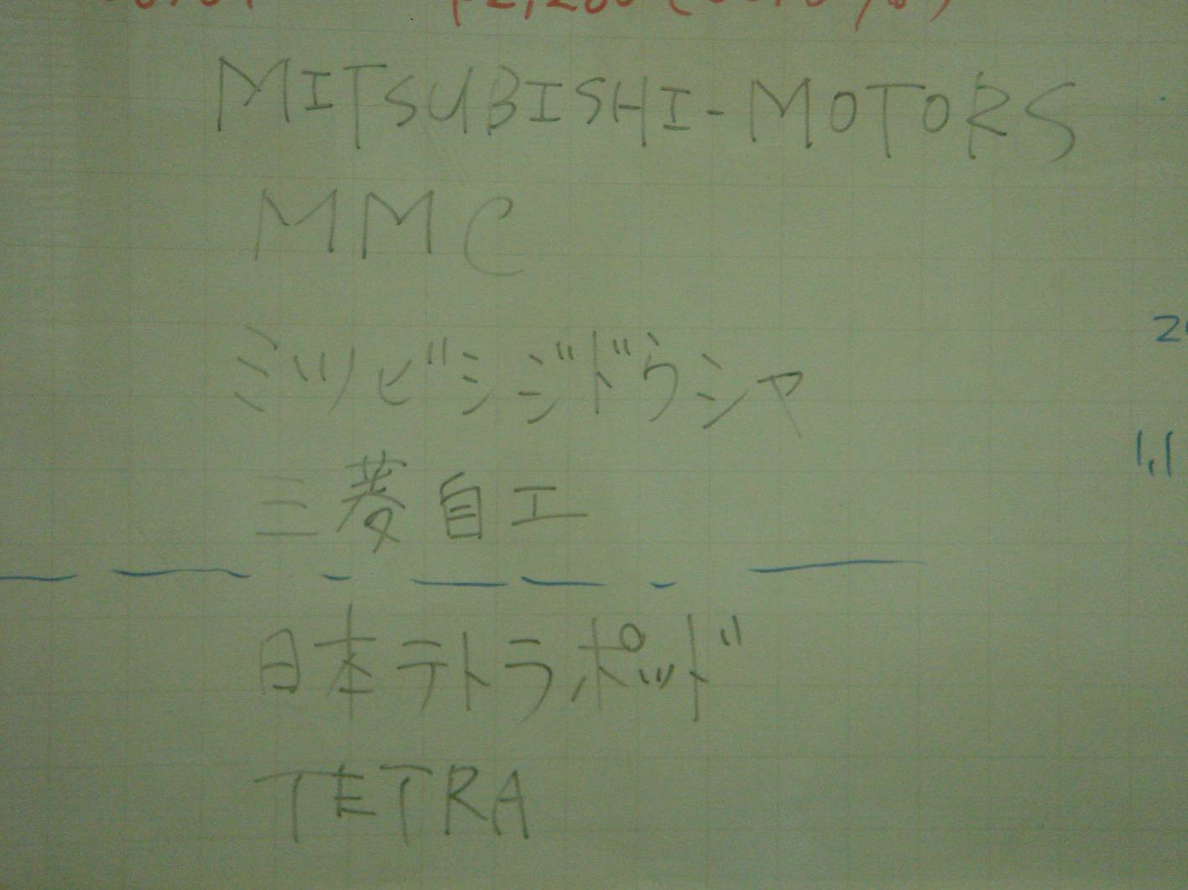
GLOBALIZATION: Information is massively connected, created and consumed everywhere.
三菱汽车销售（中国）有限公司入场动画页面
三菱
Chinese company?
中国
Western: 3 Water Chestnuts?
Asian: San Leng
Other Country that uses this script… Japan?
3 Rhombuses, 3 Diamonds?
San Bishi?

Slide 10
The current economic cycle is the most unique event of our lifetimes, adding to the need to address opportunity and risk with agility and precision.
SLOW ECONOMIC GROWTH: Companies are forced into new behaviors and facing vastly different competition.

Slide 11




Innovation
"The unit within the system with the most behavioral responses available to it controls the system."
“The squeaky wheel gets the oil.”
“The quacking duck gets shot…”

Slide 12


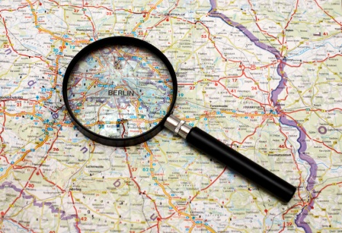

Our approach to move from “big data” to “big insight” is to innovate in different ways around the world, dictated by the various ways in which data is discovered, curated and synthesized.
20K+
Sources
Commercial Data Sources
Intelligence Engine
Rules
Single Source Records
Multi
Source Records
Commercial Data Sources
In mature markets, where many sources of data are available, we use a rules-based engine, which can build and monitor millions of records.
In other parts of the world, where laws, business practice, or availability of information is different, our hybrid strategies, include recursive web mining/triangulation and other traditional processes.
In some countries, we rely on a combination of published sources, call centers, traditional interviews, and rich understanding of the local region.

Slide 13
Mature Markets Example: The innovation challenge is to discover business relationships based on people.

Slide 14
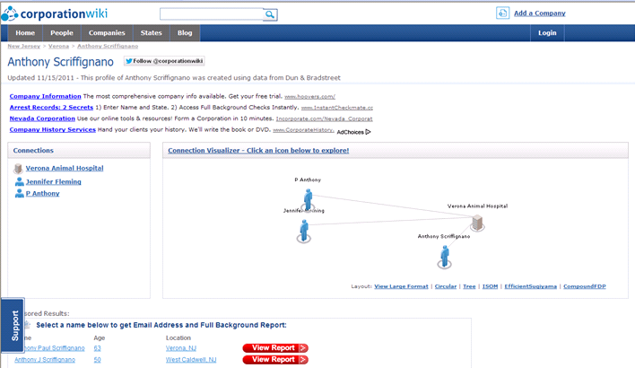
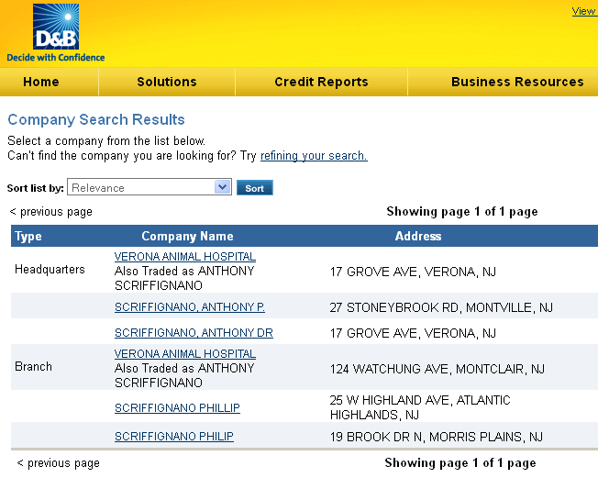
There are many commercial solutions which are limited in the ability to discriminate people in the context of business (in the context of permissible use)
Solutions are highly focused on name and simple relationships
D&B has a similar approach today

Slide 15

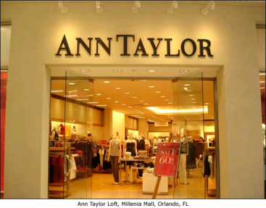
Critical to Solving the Challenge of People in the Context of Business is having data to address 3 core phenomena.
#1 – the “John Smith” problem – multiple people with the same name
#2 – the “Ann Taylor” problem – data about businesses named after people
#3 – the “Sybil” problem – One person with multiple persona or names

Slide 16
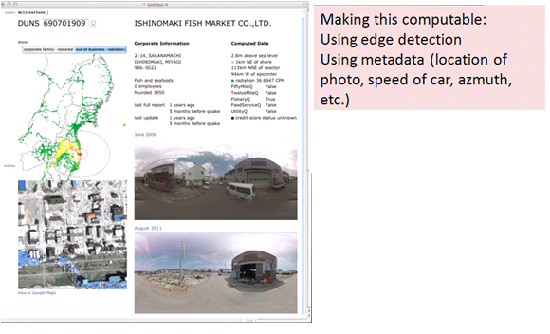
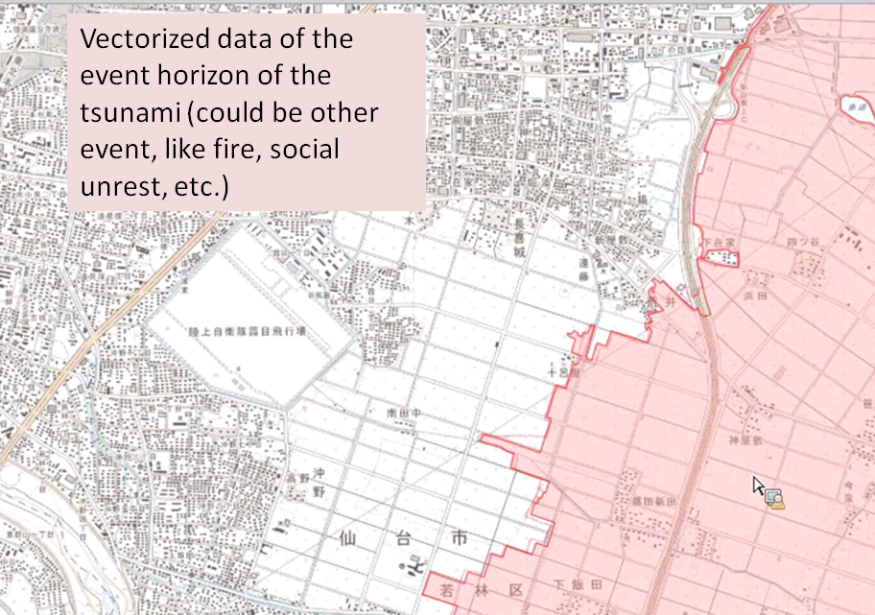
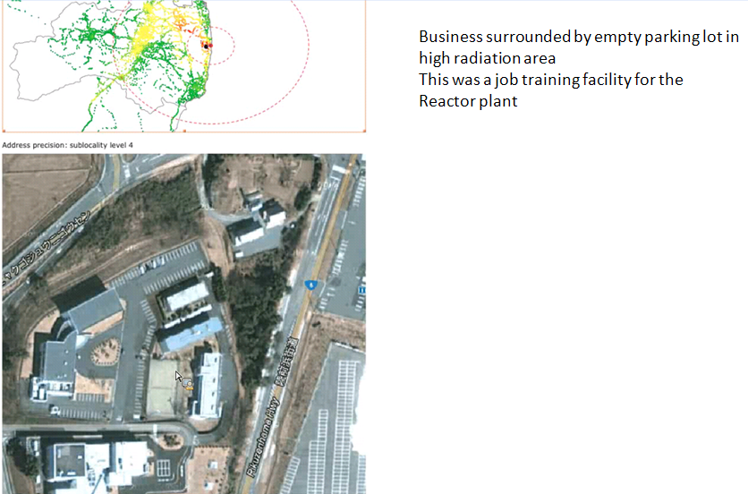
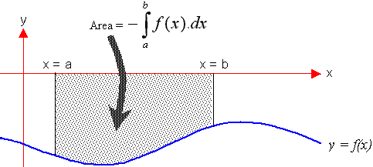

Global example: Use known and discoverable data to infer the impact of an event on a large group of businesses in a consistent way.
Looking at known and derived data
Inspecting the flood footprint
Making data “computable”
Using existing and derived data
Assessing multiple hypotheses
Strict empirical process
Modular, reusable tools
“Training”
Detecting cars…
Detecting radiation…
Spatial
inference
Detecting
“non-” cars…
Detecting Roads
Contains D&B Proprietary information. Do not share without permission.

Slide 17
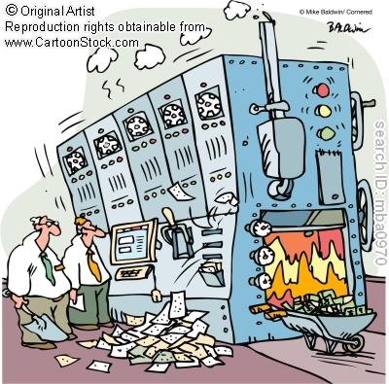
It would be nice to have a “big data machine” to give us the answers
PURCHASING
Social
Web
People
Hey Nate, we’re getting a lot more “Maybe not” than “Maybe”. Pull the lever.
Language

Slide 18
Our thinking about Innovation must be continuously challenged and enriched.
Innovation can take on many forms:
  new sources of data
  new processes
  new insight from existing and discoverable data
We are at a critical time in the history of business information
  Rate of change is itself increasing
  New challenges mount on existing business cases
  The availability of data is both a blessing and a curse
We must work together to share best practices
  Our competition may not come from traditional sources
  We are making increasing use of collaboration and multi-partner development

Slide 19

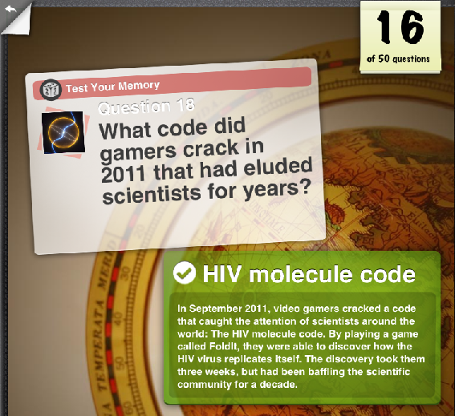
The next destabilizing evolution?
Who is working on the problem?
Do they realize it?

