Slide 1
The Analytic Potential of Long-Tail Data:
Sharable Data and Re-use Value
Carole L. Palmer
Center for Informatics Research in Science & Scholarship
Graduate School of Library & Information Science
University of Illinois at Urbana-Champaign
Wolfram Data Summit
6 September 2012

Slide 2





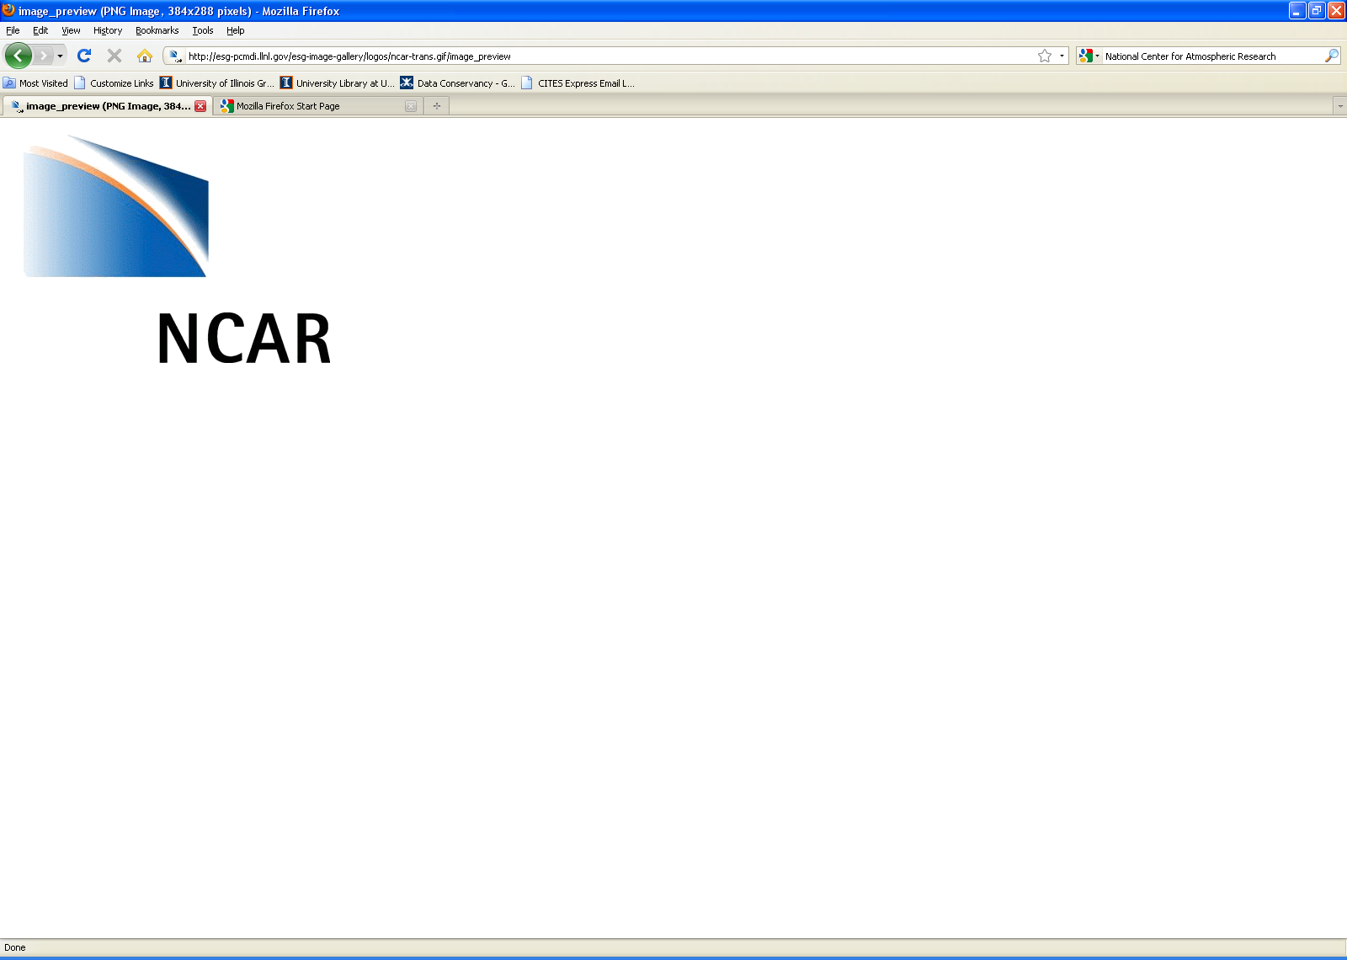


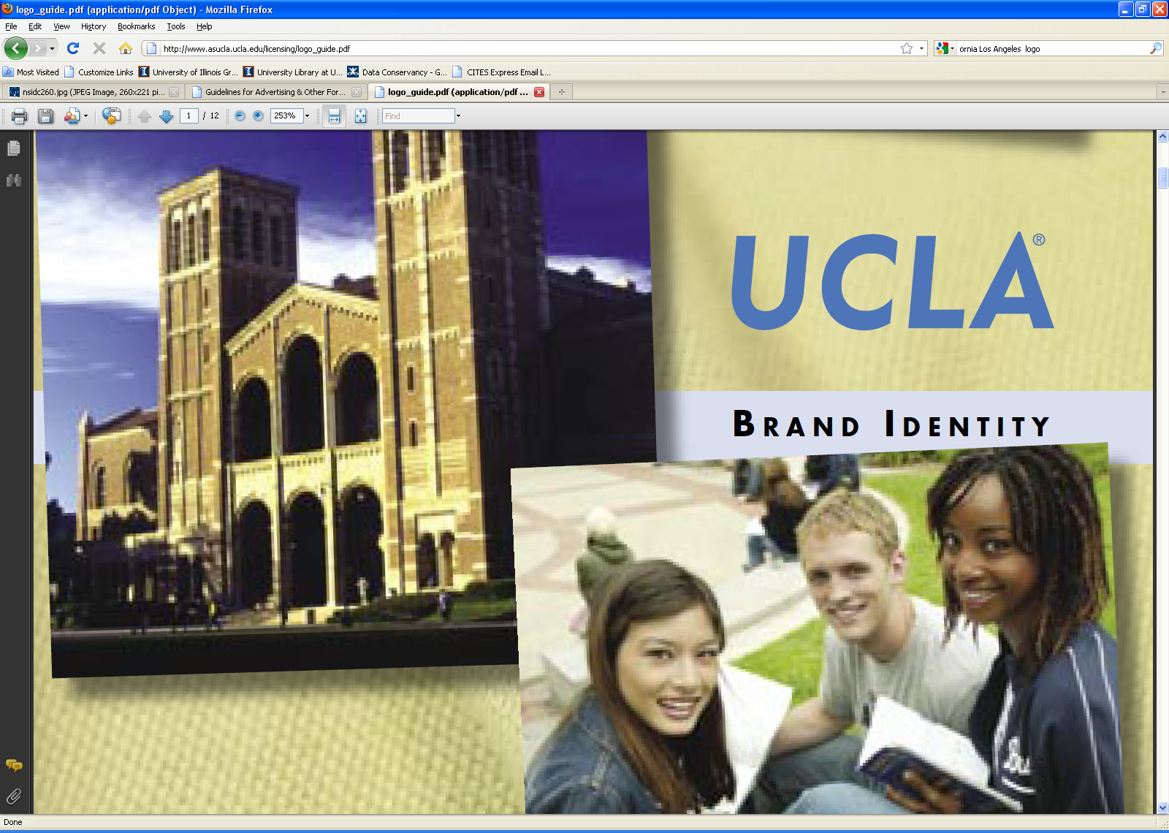

Preserve * Share * Discover
PI – Sayeed Choudhury
Promoting data preservation and
re-use across disciplines.
Illinois – Data Practices team
Collaborator:
  Melissa Cragin
Doctoral students:
  Nic Weber
  Tiffany Chao
  Karen Baker
  Andrea Thomer
Qualitative studies of data production and use
long tail - complex, heterogeneous data
re-use value across disciplines
implications for curation of research data
Notes:
Socio-cultural, behavioral studies of
Data production and use / Cultures of sharing and / norms of re-using data
Inform Data Conservancy systems and service development
Specialization in Data Curation
Data concepts team – Data Concepts team
Renar, Dubin, Wickett, Sacchiformal data modeling group
Basic Representation Model and the Systematic Assertion Model.
bridge the gap between preservation models that identify and describe entities and processes involved in preservation (like OAIS and PLANETS)
and scientific data models that describe entities and processes in a particular scientific domain of study.
Consistent identification and characterization of digitally-encoded scientific data,
(ii) fine-grained description of scientific equivalence relationships,
(iii) better integration of data provenance tracking with the larger stewardship enterprise.

Slide 3
The “big tail”
12,025 NSF grants awarded in 2007 = $2,865,388,605
Range | $300,000 - $38,131,952 | $579 - $300,000
 | 20% | 80%
Number of Grants | 2405 | 9621
Total dollars | $1,747,957,451 | $1,117,431,154
(Heidorn, 2009)
(Heidorn, 2009)
Notes:
Understand that the recent - Big Data and Long Tails workshop in Park City, the phrase became “big tail”
Ethnographic studies we like to use what we call “in vivo” quotes – things participants say that express the concept better than we can in new words
One of our favorites, although never made it into publication yet, has been our geobiologists talking about their “big ass” spreadsheets
So now on my more animated days, I like to say, mostly to myself, the big ass tail

Slide 4



Earth & life sciences
Oceanography
Climate science - modern
Climate science - paleo
Soil ecology
Volcanology
Stratigraphy
Mineralogy
Microbiology
Sensor network science
Environmental engineering
Photonics
Curation Profiles Project
2007-2009
  Anthropology
  Plant sciences
  Kinesiology
  Speech and Hearing
  Earth and Atmospheric
earth and life science intersection - systems geobiology as exemplar
Notes:
Domains seen as important constituencies

Slide 5
Methods
Talking shop about data
  efficient exchange with right researchers about right dimensions
Lead scientists - research context, sharing, access, discovery, re-use
      1) Pre-interview worksheets
      2) Semi-structured interviews
      3) Follow-up sessions with selected participants
  Researchers managing data - stages, versions, standards, tools
      4) Data deposit & sharing worksheet
      5) Data samples, related documentation

Slide 6
Interpreting perspectives and practices
  “My data will never be of use to anyone else.”
  “Of course I'm willing to share my data publicly.”
  “There are no standards in my field.”
    Forms most easily or willingly shared may not have most re-use value.
  as raw materials of research
  for application in other fields
  in aggregation or integration with other data

Slide 7
Sharing variations across fields
Field | Research Area | Form to be shared | Formats | Type | Size | Shared when?
Agronomy | water quality, drainage, and plant growth | cleaned, reviewed sensor; hand-collected samples | .xls | approx. 100 files | ~1MB each, up to 20 Mb | After publication
Geology | rock, water and microbes | averaged sensor; hand-collected samples; photographs | .xls; jpg | 1 file; images | < 1 Mb | After publication
Civil Eng | traffic movement | cleaned, normalized sensor data | MySQL (postgre SQL) | 1 data- base | approx. 1000 K/day | 1 month to 1 year embargo

Slide 8
Analytic potential
Value beyond original intended use
    Long-term
    utility
    user
    communities
preservation ready
representation information, context, metadata, fixity, etc.
that someone -- or some machine -- other than the
original data producer can use and interpret the data.
  fit for purpose
  for new applications
High AP – applicable and functional
  to multiple communities / high priority problems
Notes:
What do we want to share?
Preservation readiness as mentioned previously – is of course a basic, fundamental requirement
Assuming this condition is met
fit for purpose and appropriate use – prominent concern
Mention that AP is high based on applicability to multiple communities; fill important gap; reveal something important as accumulated over time

Slide 9
Utility for producers – compound units
 | Geobiology | Volcanology | Soil ecology | Sensor science
Data unit | Site-specific time series: spreadsheets averaged rock, water chemistry measures microscopy images annotated field photos microbial genomic data | Rock profile: physical rock thin section chemical analysis photographs field notes | Database: multiple abiotic soil measures associated metadata | Database: soil data sensor data
Sharing conventions | by request no repository | by request no repository | public resource collection | Reference data Limits – customization “vertical” dev.

Slide 10
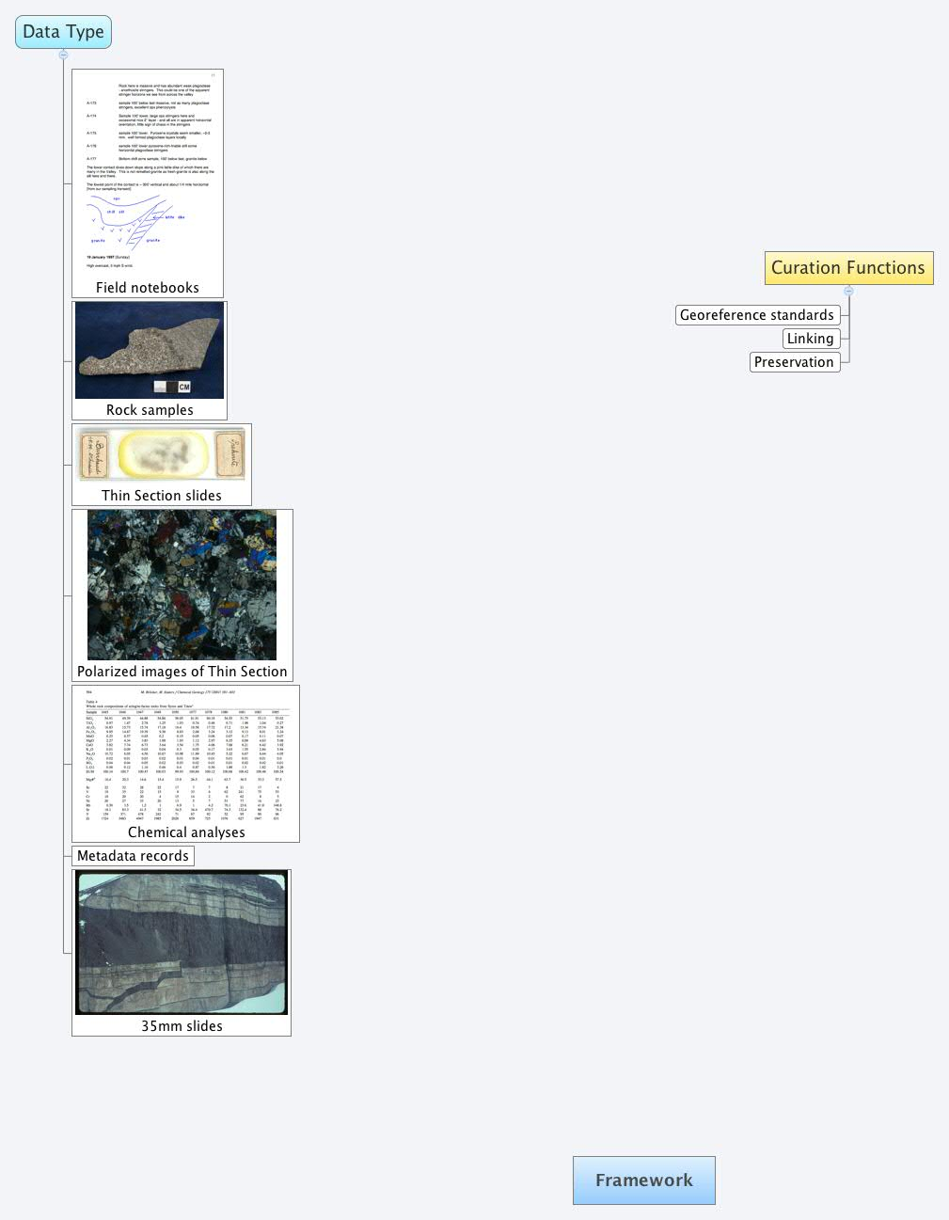
Utility for reuse – components of compound units
…somebody more knowledgeable about isotopes can take the data that I produced and do a whole different series of investigations.
… there are people who might work on little iron and titanium oxides which I don’t really care about.
…there’s a lot of geochemical work that’s
done that relies less on field context.
Notes:
Data producers – require compound data sets organized around vertical “profiles” in rock face
Case for processing chemistry data first across the set – while work to capture all done at a slower rate perhaps further exploring reuse potential

Slide 11
Curation of functional units
  Scholarly record of data collected / analyzed
  Preservation of research assets
  Raw materials for research
  Searching, browsing, chaining, filtering, retrieving…
    __________
  Optimal organizational groupings
  especially beyond data associated with papers.
    – collections, sites, producers
Notes:
Misinterp - Agronomy – want strict control of data and interaction around how interpreted, secondary users can’t understand all conditions at play in the field site
Misapprop - Geology - Data had been shared but did not expect it to be used – prior to his own publication –
Good faith use – cherry picking by industry to show efficacy of certain products in marketing materials; breach of scientific protocol, and also a lack of enforcement of the formal agreement between the institution and industry organizations.
Anthropology - saw poster, scrutinizing discovered base on his data, though not obvious; another case their data downloaded & used but reference made to some earlier associated work not directly tied to the particular data set.

Slide 12
User communities
 | Geobiology | Volcanology
 | Time series | Rock profile
Designated community | Microbiology Geobiology Geology | Igneous petrology Geophysics Geochemistry
Potential communities | Chemistry, Evolutionary biology Bioprospecting U.S. Park Service Public Health | Glaciology
Reuse applications (parts of unit) | Microbial data - assess presence and extent of disease | Field photos – assess spacio-temporal glacier change over time
Notes:
Open Archival Information System

Slide 13
Value and use – ecosystem or data economy
What data do we invest in?
“A classic example is the NSIDC glacier photo collection, which 10 years
ago no one had heard of, and no one thought was worth digitization.
It is now NSIDC's 2nd most popular data set.”
(Ruth Duerr, National Snow & Ice Data Center)
    How do we predict what data will become highly valuable?
“The value of data increases with their use.” (Uhlir, 2010)
How do data gain in value through use?

Slide 14
General Popularity Curve for Earth Science Data
(Ruth Duerr, NSIDC, personal
communication, 4 September 2012)
Popularity
Time
Public
release
End of data collection
Old enough for comparison studies
Useful for long-term
trends
Notes:
Looks like Gartner Hype cycle – but not trough of disillusionment
At some point they release it publicly and usage starts to rise. The amount and timing of rise depends on the breadth of the community that finds that kind of data useful. In the the science community the rise will generally continue as folks become familiar with the data and its utility until sometime after the data stops (i.e., the mission ends or the data stream is defunded or whatever). At that point, their attention will go to whatever new data products exist that sort of do similar things, so usage will drop for some period of time.
The problem is that funding for archives generally drops off just about when the interest is lowest so lots of data never make it across that "trough of disillusion" as the Gartner folks term it, which of course makes any data that does survive the gap even more popular and important. I would say that at least in the Earth sciences this sort of curve is considered "the norm".

Slide 15
Value indicators
Climate / Ocean modeling
Soil Ecology
Volcanology
Stratigraphy
Sensor and Network Engineering
Reputation of data collector
Spatial coverage
Longitudinal coverage
Site factors:
  unique conditions, rarely studied,
  politically volatile, permitting requirements
Multiple sources for triangluation and context
Documentation of workflows and provenance
Notes:
Linkages to field notes, photographs, physical specimens, processing scripts, simulations

Slide 16
Value gains with shared data
Ocean modelers with field campaign data
Gathering complementary evidence richness & verification
(Weather during plane flight pattern, satellite serial numbers,
irregularities in open sea mooring)
Sensor engineers reworking water measurements to share
Transforming for multiple audiences refinement & fit
(For search and rescue, triathlon organizer, fishermen,
industry ship maneuvering)
Rainforest researchers with sensor block temperatures
Recalibration and feedback accuracy
(improved instrument level calibrations and original
climate science group’s measurements)
Notes:
Importance of capturing and representing work with shared data

Slide 17
Implications
Recruit data with multiple value indicators
Preservation imperative for long re-use cycles
Promote sharing for value gains
Support capture and representation of work with shared data
Notes:
enough representation information, context, metadata, fixity, etc. such
that someone -- or some machine -- other than the original data producer can use and interpret the data.

Slide 18

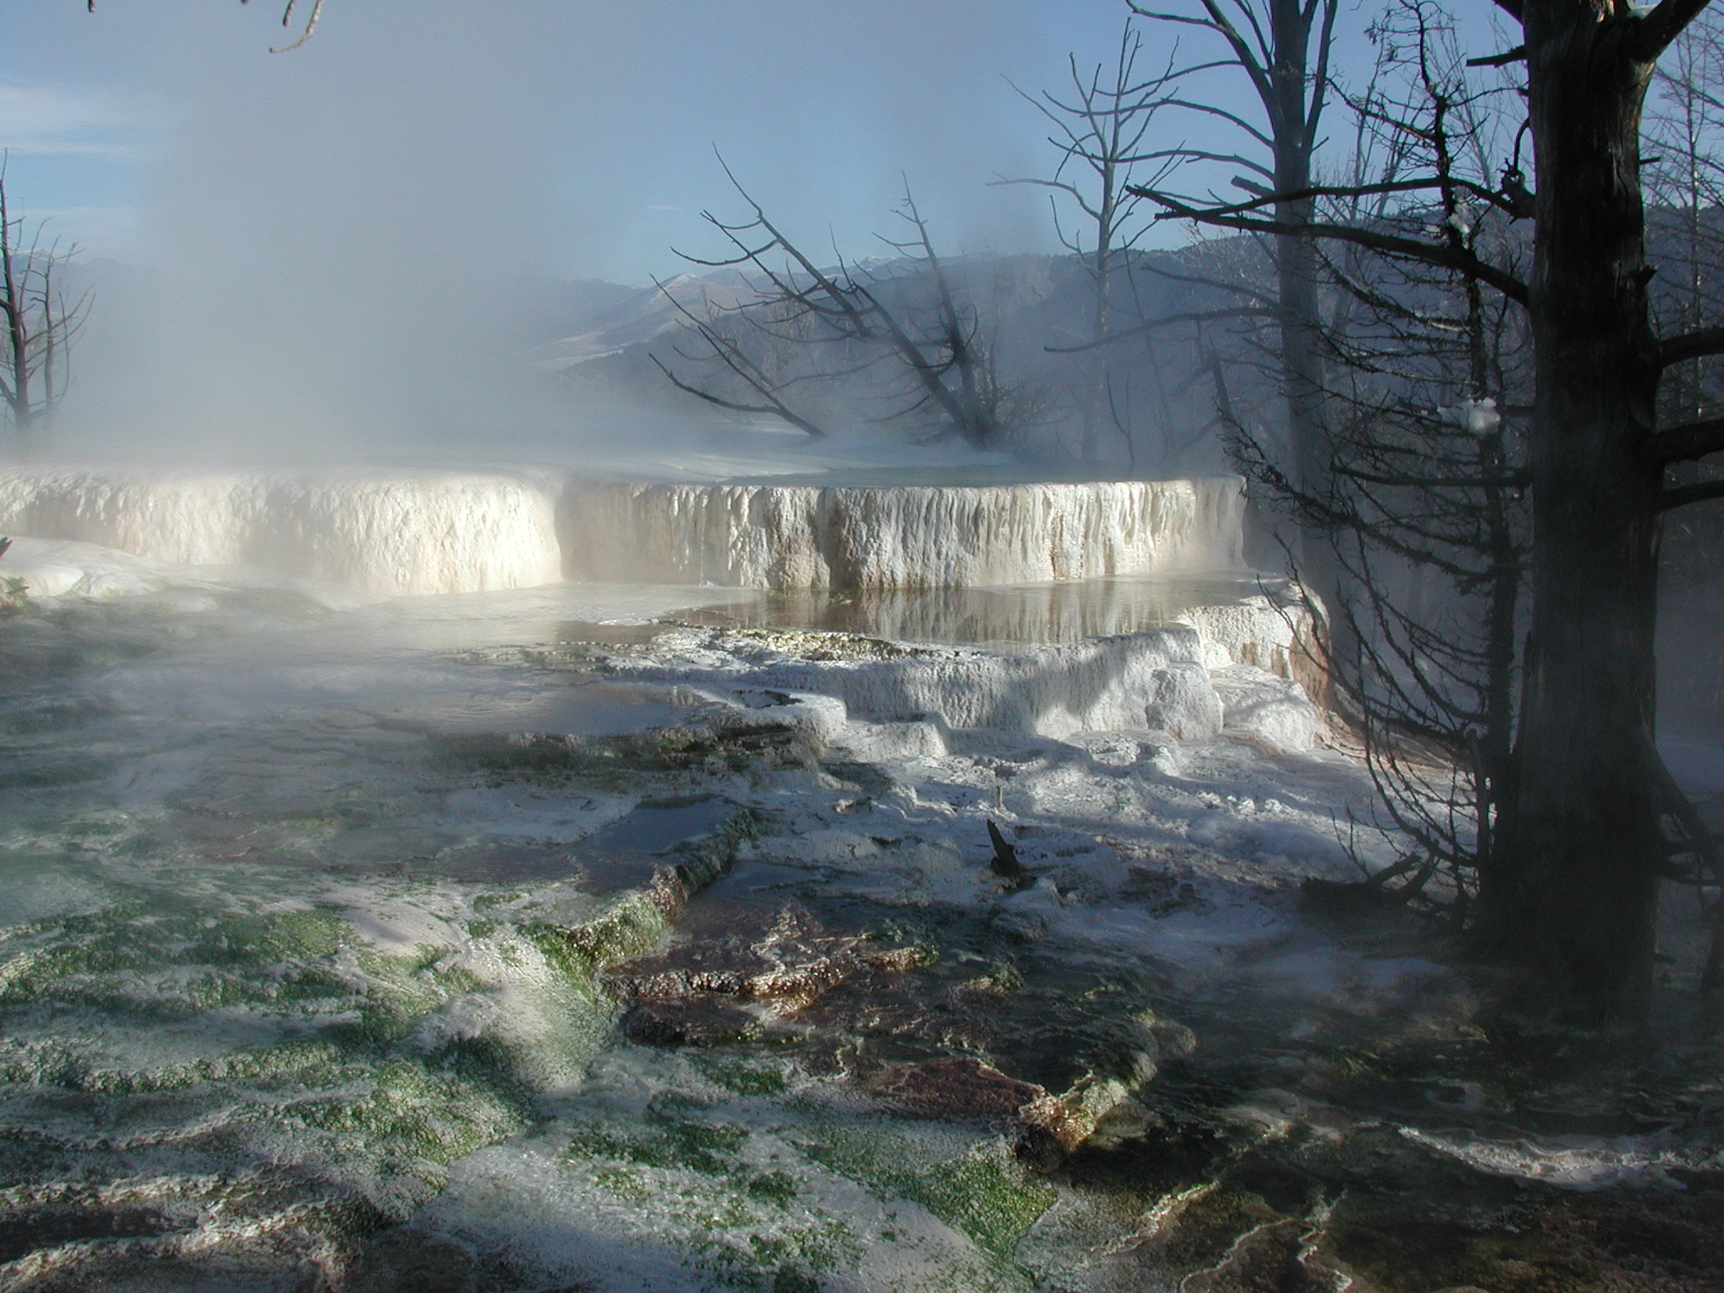
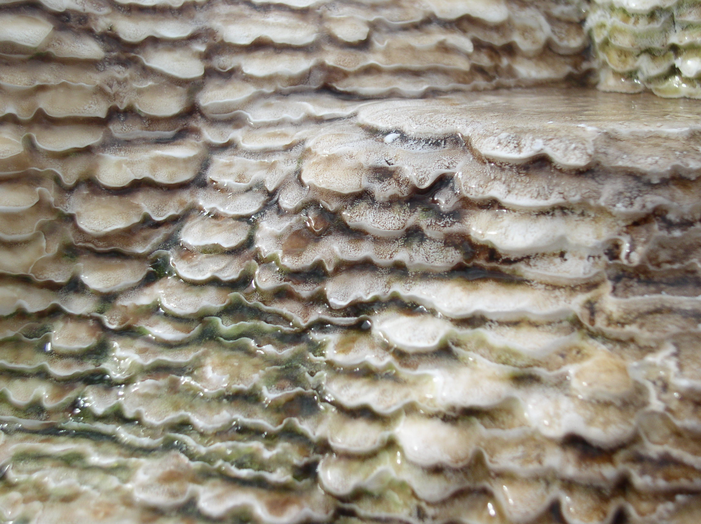
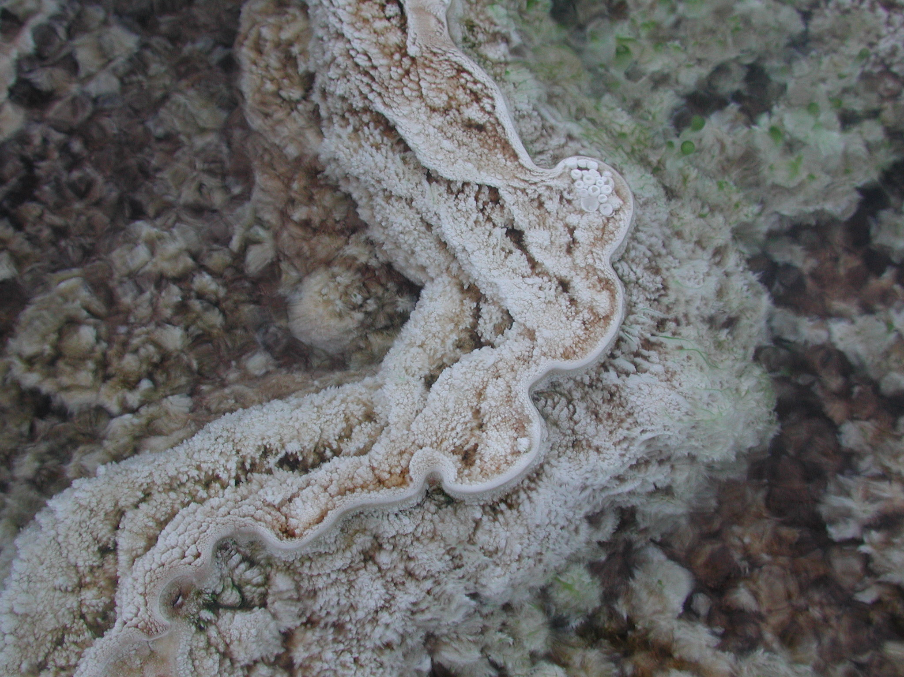
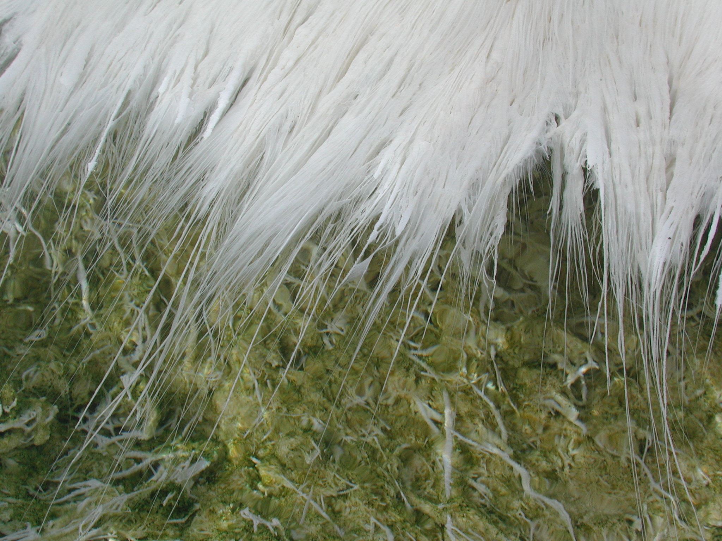
Future work: Site-based curation for Geobiology
Yellowstone National Park - mecca for data collection
Key to research questions ranging from
origin of life on Earth to the search for life on other planets.
Value indicators:
special permitting, site uniqueness, longitudinal coverage,
politically volatile (bioprospecting), multiple sources for triangulation
Collaboration with
- Bruce Fouke, U of I, Geology, Microbiology, Genomic Biology
- Ann Rodman, National Park Service
Used with permission from B. Fouke
Notes:
Bioprospecting – commercial profit

Slide 19
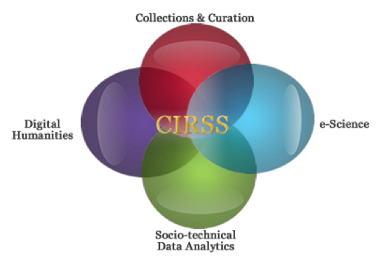
Thank you
-- Dataconservancy.org
clpalmer@illinois.edu
Center for Informatics Research in Science and Scholarship

