Slide 1

An Initiative to Improve Academic and Commercial Data Sharing in Cancer Research
Wolfram Data Summit
Washington DC, September 6th 2012
Charles Hugh-Jones MD MRCP
North America Medical Unit
Sanofi Oncology
Disclaimer: Views expressed are personal and not necessarily those of Sanofi Oncology

Slide 2
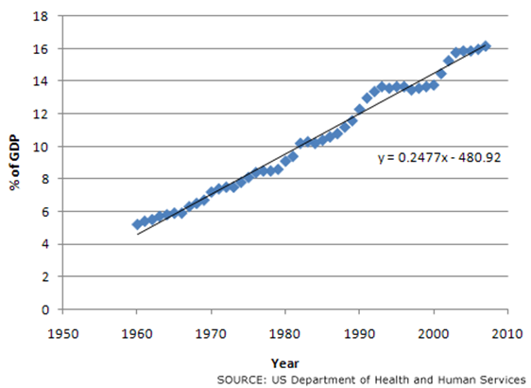
Healthcare is getting expensive…

Slide 3
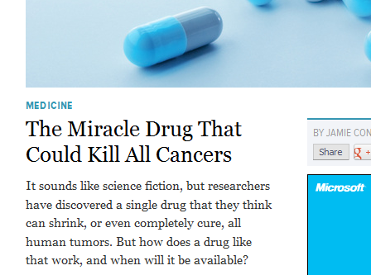
Cancer Research 2012
www.gizmodo.com March 27th 2012

Slide 4
Oncology Drug Development is Inefficient..
success rates (%)
Kola et al Nature 2004: First-in-human to registration, ten large pharma.

Slide 5
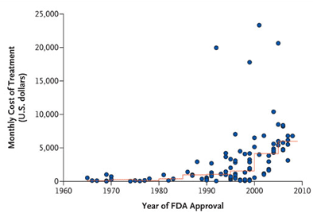
Rising cost of Cancer Drugs
Source: Bach, NEJM 2008
Notes:
5
April 17, 2009
Why Medicare Has Not Been Able Rein In the Cost of Cancer Drugs
If you want to understand why U.S. health care is so expensive, take a look at the chart below. It illustrates how the price of cancer drugs has levitated in recent years, revealing how, in our largely unregulated for-profit health care industry, the seller is the price-maker and the patient is the price-taker. In other advanced countries, the government intervenes with an eye to protecting desperate patients from being gouged. In the U.S. the law specifically prohibits Medicare from trying to negotiate for discounts.
In an article titled “Limits on Medicare’s Ability to Control Rising Spending on Cancer Drugs,” published in a recent issue of the New England Journal of Medicine Dr. Peter B. Bach, a physician and epidemiologist at Memorial Sloan-Kettering Cancer Center, uses this chart to demonstrate the steep rise in Medicare spending on cancer drugs in just the past ten years.
Figure 1. Monthly and Median Costs of Cancer Drugs at the Time of Approval by the Food and Drug Administration (FDA), from 1965 through 2008.
Note that the chart tracks the monthly cost of cancer drugs (vertical axis) from 1960 to 2009 (horizontal axis). What is extraordinary is how the price of the most expensive bleeding edge treatments has jumped, since 1990, from $2,000 a month to $5,000, $10,000 and finally $25,000 a month. Meanwhile, the fine red line traces the rise in the median price of cancer drugs—from well under $1,000 a month in the late 1960s to $6,000 to $7,000 a month today.
Note that the chart tracks the monthly cost of cancer drugs (vertical axis) from 1960 to 2009 (horizontal axis). What is extraordinary is how the price of the most expensive bleeding edge treatments has jumped, since 1990, from $2,000 a month to $5,000, $10,000 and finally $25,000 a month. Meanwhile, the fine red line traces the rise in the median price of cancer drugs—from well under $1,000 a month in the late 1960s to $6,000 to $7,000 a month today.
Overall, the amount that Medicare shells out for drugs administered in a doctor’s office--— a category dominated by drugs used to treat cancer —has spiraled from $3 billion in 1997 to $11 billion in 2004 (an increase of 267%),” Bach notes. Over the same span, total Medicare spending rose from $210 billion to $309 billion (an increase of 47%).
Meanwhile, even patients who have prescription coverage under Medicare Part D face high co-pays. More Part D insurers have put brand-name drugs, including Gleevec ­(imatinib), Sutent (sunitinib), Tarceva (erlotinib), Thalomid, and Tykerb (lapatinib), on specialty tiers that require cost sharing of 26 to 35 percent for each prescription. Insurers begin picking up 95 percent of the drug’s cost, only after a patient’s annual out of pocket spending reaches $4,350. And many patients don’t even have Part D.
As a result, “Patients who face life-threatening illnesses are also facing out-of-pocket costs for cancer therapies that can threaten their family's financial security,” Bach observes.
“Health economists are concerned, too . . . .because the prices of cancer drugs appear to be rising faster than the health benefits associated with them, at least in some cases,” writes Bach, pointing to studies published here and here.
Big Pharma’s Eureka! Moment
How and why did this happen? In 2006 the New York Times made an announcement: “Big Pharma has discovered cancer.”
That was the first sentence of a story headlined: “New Drugs for Cancer Could Soon Flood Market.” In the past, large, traditional pharmaceutical companies such as Glaxo, Pfizer and Wyeth had shown relatively little interest in selling potions for cancer patients,, the Times explained, preferring to “make drugs for chronic diseases” rather than “treatments for cancer, where patients often die within months.” (There is a saying in the pharmaceutical industry: “a pill that cures is good; a pill that you have to take every day is better.”
Moreover, the Times pointed out: “while cancer as a whole affects many people, the market is divided into different types of cancer.” In other words, a drug that targets a particular type of cancer is limited to a small niche market made up of patients who often don’t have long to live. From a drug-maker’s perspective, this is not an enticing group of customers.
But then, a year or so before the Times article appeared, the pharmaceutical industry’s marketeers had an Eureka! moment. Looking around, they realized that Gleevec, which had been developed by Novartis. to treat two obscure cancers — chronic myelogenous leukemia and gastrointestinal stromal tumor —enjoyed sales year of $2.2 billion in 2005.
Had the pool of patients suffering from these diseases expanded? No, But companies like Novartis were beginning to discover that there is virtually no limit to how much you can charge when you are peddling pills to dying patients. “Some patients will tolerate prices of tens of thousands of dollars a year, making drugs for even rare cancers into big moneymakers,” the Times observed.
By 2006, the Pharmaceutical Research and Manufacturers Association reported that about 400 cancer drugs from 178 companies were in clinical trials. “Competition could also bring down prices, which are now reaching $100,000 a year for some cancer drugs,” the Times speculated.
But, of course, as the chart above reveals, that didn’t happen. As I have explained in earlier posts, while competition brings down the cost of new technologies in most sectors of the economy, the rule doesn’t hold for healthcare. Unlike most consumers, seriously ill patients are not looking for bargains. They don’t want the cheapest product; they want the best. And they are quite easily persuaded that what is newest and most expensive must be top-of-the-line. In addition, a patient cannot wait until “prices come down.” He needs the medication immediately. (Keep in mind: 80 percent of our health care dollars are spent when the patient is very ill.) Thus, when it comes to healthcare, consumers have very little power over pricing.
A year after the Times announced that Pharma had finally figured out that cancer drugs could be blockbusters, the Wall Street Journal picked up the story. In a piece headlined “From Wall Street, a Warning About Cancer-Drug Prices,” the Journal focused on Dr. Steve Harr, an analyst at Morgan Stanley who was cautioning drug-makers that greed could lead to price controls. Congress “will get involved when its constituents can’t get drugs,” Harr told Genentech, which was charging $47,000 for ten months of Avastin, a drug used to treat colorectal cancer.
Is the Drug Worth the Price?
Avastin does not “cure” cancer; it slows the progress of the disease. It won approval from the FDA following a trial showing that the patients who both took the drug and followed a chemotherapy regimen lived an average of 20.3 months, versus 15.6 months for patients treated with chemotherapy alone. Genentech hailed the extra 5 months as a leap forward: “This is one of the largest improvements in survival ever reported in a randomized, Phase III study of patients with metastatic colorectal cancer.”
At the same time, the company acknowledged that patients might experience numerous side effects including Gastrointestinal (GI) perforation--which can be fatal. Researchers also have discovered that use of Avastin can lead to deep vein blood clots, increasing the risk of heart attack or stroke.
Just last October, the Scottish Medicines Consortium (SMC) advised the National Health Services (NHS) that Avastin “is not recommended for use within NHS Scotland for the treatment of patients with metastatic carcinoma of the colon or rectum” because “the manufacturer did not present a sufficiently robust economic analysis to gain acceptance.”
But in the U.S. we do not take “cost-effectiveness” into account when deciding whether to approve or cover a drug.
Harr Warns that Washington Will Begin Regulating Drug Prices
In its 2006 story the Wall Street Journal reported that Dr. Harr had been “shocked” as he saw cancer-drug prices “moving to a new level of the stratosphere in 2004. That year Erbitux, made by ImClone Systems Inc. and partner Bristol-Myers Squibb Co. was introduced at $10,000 a month, or about $40,000 for a course of treatment “Biotech drugs, which are produced by live cells, were generally more expensive than pills that are a mixture of chemicals.” the Journal explained. “But this was twice the price of other new cancer drugs on the market, and many times the cost of older drugs.”
When Genentech introduced Avastin, Harr, who covered Genetech for Morgan Stanley, buttonholed oncologists and Genentech officials” at a conference, “pressing them about how patients could afford even the co-payment. He raised this concern with Genentech Chief Financial Officer David Ebersman. "Many plans have a 20% co-payment -- that's $8,000. That's a big bite," he recalled saying
By 2007 Harr was “stunned” to discover that cancer drugs were projected to account for almost a quarter of the nation's drug spending. He acknowledged that market forces would not bring down prices the "market structure effectively provides no mechanism for price control in oncology other than companies' goodwill and tolerance for adverse publicity.”
Meanwhile, he remained convinced that soaring prices could trigger government controls. Indeed, as the Wall Street Journal noted when it published Harr’s story in March of 2007: “In November, when Democrats took control of Congress, Nancy Pelosi, the incoming Speaker of the House, put controlling drug prices at the top of the Democratic agenda. Soon after, the House passed a bill that would amend the Medicare prescription-drug benefit, to allow the government to negotiate prices with the pharmaceutical industry. The bill is pending in the Senate.”
Of course we now know that Pelosi lost that battle. Instead of allowing Medicare to use its clout to bargain for more reasonable prices, the Medicare Modernization Act specifically forbids the federal agency from trying to negotiate with drug makers.
Today--Will Medicare Reformers Be Able to Cap Prices?
Maybe not. “A unique legislative and regulatory framework shields cancer drugs (as well as a few other specialty drugs) from the strategies that health care payers such as Medicare typically use to hold down prices,” observes Dr. Bach in his recent NEJM article.
He goes on to outline ways that Medicare usually holds down spending. Often, Medicare limits coverage by specifying the types of patients who will benefit from a treatment “For instance, in 2007, Medicare narrowed the coverage of erythropoiesis-stimulating agents (ESAs) for cancer patients”. Amgen then informed investors that changes in coverage would reduce annual sales of the company's ESA, Aranesp to Medicare patients from approximately $1 billion to $200 million.
In other cases, Medicare concludes that several drugs are clinically interchangeable and encourage prices competition. One way to do this, Bach explains, is by “blending” reimbursement. “Under this approach, Medicare reimburses for the use of a particular drug on the basis of a weighted average of prices for that drug and other similar drugs, with the weighting linked to the sales volume of each drug. . . . , lower-priced drugs garner market share because their price is below the blended-reimbursement rate. As the sales of the lower-priced drugs increase and sales of the higher-priced drugs decrease, the blended-reimbursement rate declines. In July 2007, Medicare implemented blended-price reimbursement for two nebulized beta-agonist drugs that were not identical but that Medicare, through one of its contractors, deemed were clinically equivalent in their effect] and thus interchangeable.”
Medicare sometimes uses a “ least-costly-alternative (LCA) strategy, reimbursing at the price of the least costly drug among all those that are interchangeable, no matter which drug is actually used. Manufacturers respond to LCA reimbursement by lowering prices so that they are not higher than the amount of reimbursement a provider can receive after administering the drug.
“Many of the local contractors to the Medicare program have instituted LCA reimbursement for the clinically interchangeable prostate-cancer drugs leuprolide acetate (Lupron, Abbott) and goserelin acetate (Zoladex, AstraZeneca),” Bach reports. “The Office of the Inspector General estimated that in 2002, full use of LCA reimbursement for the two drugs would have saved Medicare $40 million, because the reimbursement rate for the least costly drug (goserelin acetate) was 27% lower than the alternative drug (leuprolide acetate).”
Finally , in the past Medicare has engage a third-party intermediary to obtain competitive bids when clinically interchangeable drugs are available. Under this scenario, Medicare puts out an offer to various intermediaries to bid for goods. These intermediaries negotiate with various competing manufacturers, using their purchasing leverage and the intrinsic competition among the manufacturers to obtain low prices. They then present to Medicare bids that reflect the cost savings they have achieved. Medicare recently completed a pilot program of competitive bidding for durable medical equipment and other supplies (such as home hospital beds, wheelchairs, and home oxygen-delivery machines). Through the bidding process, the Government Accountability Office estimated that Medicare saw a 26% reduction in price.
Legal Barriers to Reducing Costs
No surprise, lobbyists are adamantly opposed to any strategy that might limit their profits. And last year, they manage to persuade Congress to pass the Medicare Improvements for Patients and Providers Act which stopped Medicare’s successful pilot program dead in its tracks: Medicare will not be allowed to implement competitive bidding nationwide.
Meanwhile, the “least-costly-alternative” strategy also suffered a set back. Last year a U.S. District Court ruled that Medicare is required to reimburse for the combination brand-name inhaled drug (Duoneb a.k.a. Dey) “on the basis of the price the company charged for the drug, rather than on the basis of the cost of the drug's two components, albuterol and ipratropium, which are both available as generics.” Medicare was willing to reimburse for what it would cost to buy the two generics separately; the judge ruled it must pay the full cost of the combined brand-name drug. Judge Henry H. Kennedy declared that the policy of paying for only “the least costly alternative” was not permitted under the Medicare law. In a friend of the court brief, another drug company argued that “Congress consciously chose to entrust the amount of reimbursement to the market, not to a government agency or its contractors.” (Of course, as Morgan Stanley’s Harr observes—and as history demonstrates-- when it comes to cancer drugs neither “the market” nor the consumer has the power to bring prices down. )
As for Medicare’s “blended reimbursement “strategy, Bach notes that Congress shot it down with a a complex set of laws that make it impossible for Medicare to declare that cancer drugs are interchangeable. A related law “undid a previous attempt at competitive bidding for Part B drugs, Bach notes, “stripping the bidders of any real negotiating leverage that could have come from an ability to designate clinical compounds as interchangeable.”
Manufacturers who sell cancer drugs won yet another victory in Congress when legislators first created Medicare Part D. “Under the law the private insurers that contract with Medicare to offer part D are required to include on their formularies virtually all cancer drugs that were available at the time the program was implemented in 2006,” Bach explains. “ In 2008, Congress added oral cancer drugs that came on the market after 2006: as of 2010, Part D plans must include all drugs in certain categories in which the treated condition is ‘major’ or ‘life-threatening.’ The prototypical example listed in the law is ‘drugs used in the treatment of cancer.’"
This virtually eliminates any leverage insurers might have when trying to negotiate for better prices; drug-makers know that insurers cannot threaten to leave any cancr drug out of their offerings.
Such laws underline not only the power of the lobbyists, but the general hysteria surrounding the very idea of cancer in this country. Many cancer advocates believe that cancer patients have a right to any treatment that might conceivably help them—whatever the price. The fact there is no medical evidence that the drug will help that particular patient is considered unimportant.
Looking Ahead
“Policymakers are now in a quandary,” Bach observes. “ To be sure, they are worried both by the increased total costs of cancer care and by the fact that high prices are leading to higher out-of-pocket expenses for patients. Yet, it is difficult for them to discount the progress that has been made overall in the treatment of cancer and to wholly disassociate that from the high prices that innovative cancer treatments are able to capture . . ..Some health economists argue for a causal link between high prices and the pace of innovation, which would suggest that efforts to reduce spending on cancer drugs would retard the pace of innovation.”
Yet innovation will do us little good if it produces only more more expensive drugs that neither taxpayers nor patients can afford. This is especially true when so many of these treatments offer neither comfort nor cure, but merely expose patients to the risk of extreme side effects while giving them a few more months of poor quality life.
Moreover, as in so many other areas of healthcare, we have reached a point of diminishing returns. As Back notes, while prices soar, new products are usually only minimally more effective than older, less expensive alternatives. We don’t want to encourage drug-makers to continue in this direction.
As a solution, Bach suggests that Congress consider “judiciously amending or reversinig the laws that limit Medicare's flexibility with respect to cancer drugs, while moving rapidly toward the creation of a center for comparative effectiveness that could guide Medicare's actions. Such a center could help Medicare ensure that cancer drugs are covered when their use is reasonable and necessary but are not covered when it is not. This center could also create a robust framework for classifying cancer drugs and other specialty drugs as interchangeable when they are, basing the judgment on clinical rather than pharmacologic criteria. This would achieve two ends. Manufacturers would seek to prove through clinical research that their products are not interchangeable with other compounds on the market but, rather, are superior to their competitors. Meanwhile, Medicare and other payers could apply formulas for reimbursement that would encourage lower prices when products are in fact clinically interchangeable.”
In addition, Bach notes, Medicare might consider "reference pricing," a version of LCA reimbursement in which the payer covers only the cost of the lowest-priced alternative, and patients pay the difference if they want a higher-priced item. "Payment for results" is a somewhat new idea that involves reimbursement for a drug by the payer only when it "works." One prominent example: under a preliminary agreement, Britain's National Health Service (NHS) will reimburse for doses of bortezomib (Velcade, Johnson & Johnson) when it has a therapeutic effect but not reimburse for the drug when it does not.
All of these are sensible solutions. What is certain is that decisions about how much to pay for cancer drugs, and which ones actually benefit patients, should not be made by legislators who are all-to-likely to be swayed by generous lobbyists and/or tearful advocates. Nor should they be made by judges who may let ideology cloud their thinking. Guidelines for coverage and payment must be made by scientists— unbiased physicians and medical researchers who are capable of taking a clear-eyed look at the wide array products that promise cancer patients so much, and too often, deliver so little.

Slide 6
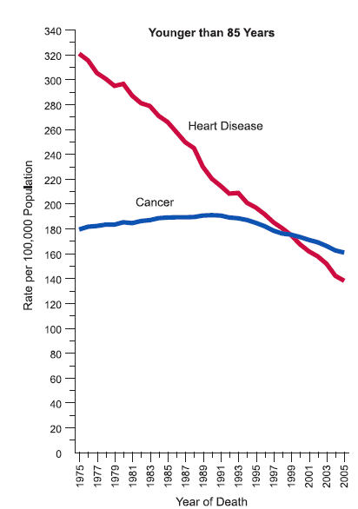
Cardiovascular and Cancer Mortality
1:Jemal A: CA J Clin 2009
Notes:
7.6 million caner deaths per year globally
Many reasons for the discrepancy
Tumor heterogeneity
Fact that cancer is essentially a biological process gone wrong so any attack on the tumor is essentially an attack on self

Slide 7
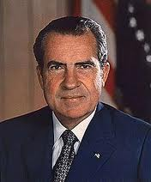
The 41 year “War on Cancer”¹
Poor clinical outcomes
Unsustainable costs
7.6 million deaths every year worldwide
Massive quantities of clinical trial data
No systematic sharing of these data
1: National Cancer Act of 1971

Slide 8
Data Sharing in Medicine: why do it?¹
7.6 M lives lost each year worldwide
Faster, more efficient research
  Improved trial design and statistical methodology
  Secondary hypotheses
  Epidemiology
  Collaborative model development
  Smaller trials sizing (esp. with molecular subtyping)
  Reproducibility and reduced duplication
Transparency, and prevention of selective reporting
Real World Data corroboration with Trial Data
Unknowns ²
Data Standards & Meta-analysis
1: Vickers 2006
2: www.cardia.dopm.uab.edu: 475 publications from a single large dataset

Slide 9



Data Standards in Clinical Research

Slide 10
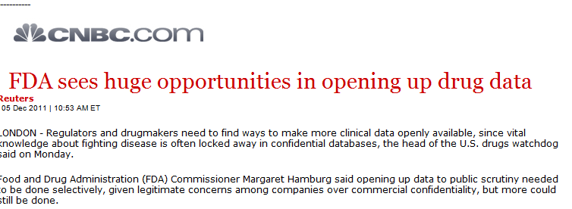

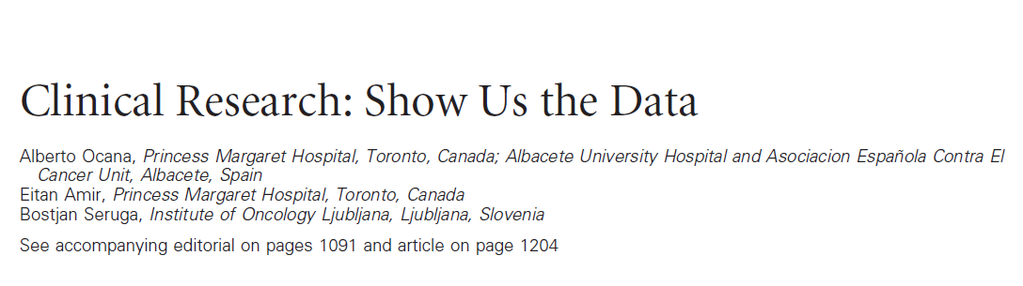
A need exists
1: Peggy Hamburg, FDA Dec 2011
2: Ocana et al, JCO 2011
Notes:
10

Slide 11



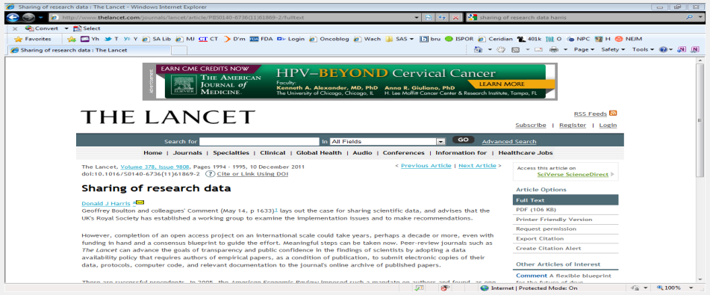




So why hasn’t it happened? (1)
Publication
Network
Policy
1
Active attempts generate less that 10% sharing
2
1: Grants >$500k in one year. Grants.nih.gov
2: Savage & Vickers, 2009. PLoS One

Slide 12
So why hasn’t it happened? (2)
Unique challenges to Big-Data in Healthcare
  But attitude is “don’t share unless I can prove no harm occurs”⁴
Academic Disincentives
  Academic tenure system driven by data hoarding¹ ²
Patient
  Privacy, Confidentiality, Consent & Ethics concerns
Corporate
  IP & Competition Law concerns
  Resources for data preparation
  Suitable IT environment
But: data sharing success in many other disciplines
1: Kaye et al 2009
2: Tucker 2009
3: Westin, IOM 2007
4: Vickers 2006

Slide 13












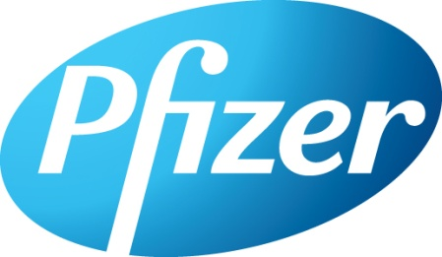







  CEO Roundtable on Cancer
  “Life Sciences Consortium” working team
  Address issues in cancer research
  Accomplish together what no single company might consider alone
Engages 3rd parties
as “Safe Harbors”
  www.ceo-lsc.org

Slide 14
What is Project DataSphere?
Challenging oncology research and therapy environment
Huge quantities of archived & unused clinical data
Plan: Broadly share oncology data to enhance research & health
  Both industry & academia, positive & negative data
  Comparator arm data, protocols, case-report forms and data descriptors
  “Publically” accessible, simple file-sharing web-library for crowd sourcing
  Respecting appropriate privacy and security issues
Goal
  Prime with 2 Sanofi-donated Phase III datasets and CRFs on-line by Q1 2013
  30 high-quality datasets by key LSC members end 2013

Slide 15

A Data “Library”

Slide 16
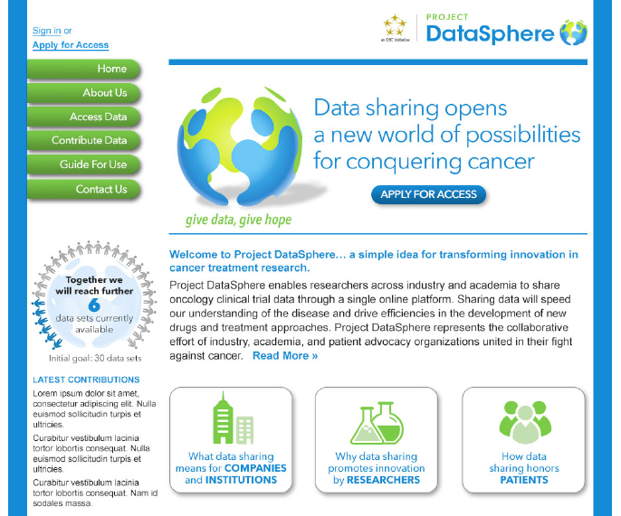
DataSphere web-library¹
Facilitated network only
External aggregation partners
Broad access criteria²
Minimal curation
  Different with other disease models projects
1: Public access projected as April 2013
2: Access criteria include recognized research institution, data use agreement, and use consistent with data sharing goals

Slide 17
Major challenge: How to make it happen?
Incentivize Donors
  Financial¹
  Increased citation rate²
  Collaborative Development model
  Assist with de-identification procedure
Incentivize Patients
  Define a reasonably safe, de-identified and secure data environment
  Faster, cheaper, better medicines
  Patient Advocacy and community driven.
Incentivize Researchers
  Access to high quality data & data competitions
1: Paul et al, Nature Rev Drug Disc, March 2010
2: Piwowar et al PLoS One March 2007

Slide 18
Donors: $261 Million worth of reduced costs¹
Trade off for all parties: donors, researchers, patients
WIP * p(TS) * V
Productivity =
C*CT
WIP: Work in progress, how many compounds are being tested?
p(TS): Probability of technical success
V: Value
C: Cost
CT: Cycle time
Paul et al, Nature Rev Drug Disc, March 2010
1: DataSphere project team internal calculations

Slide 19

Patients & Donors: De-identification (1)
HIPAA, Common Rule, and EU Data Protection Directive
  De-identification permits sharing absent explicit consent for secondary research
  De-identification is relative²
  0.00013% re-id on HIPAA safe harbor data
De-identification strip explicit identifying information from disclosed health records
  Name, SS number, address, dates etc
  Full 18 point, or <=17point limited data sets
  31% data loss on average ¹ Criticality of date for cancer research
1: Clause et al, 2004
2: Emam et al. PLoS One 2011
3: Benitez and Malin, J Am Med info Assoc 2007

Slide 20
Patients & Donors: De-identification (2)
Re-identification risks
  Limited v full knowledge attacker
  Dependency on population from which health data is drawn.
  “Uniqueness” v “Distinctiveness”.
  Prosecutor, journalist and marketer attacks³ and associated costs
Close discussion with Patient Advocacy and Privacy groups
  (What is possible v what is likely) v unmet need in cancer
DataSphere adopting a Technical/Social Model of protection
  Custom (how much?) de-identified “limited datasets”
  Hardened and secure hosting environment.
  DUAs, IRB and applying a “Trust Differential”³ through restricted enrollment
  Recognizing Cancer population is somewhat unique
  Project limited to Cancer only
3: Benitez and Malin, J Am Med info Assoc 2007

Slide 21




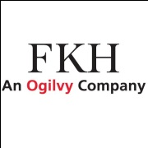
































Donors & Patients: Change the social paradigm

Slide 22

Long term implementation plan
Patient partners
Development of use cases
Oversight & funding
Pilot
Release de-identified comparator arm data “as is”
(file share)
Full
Launch
Data Partners
Disease standards
Integrated Database or 3rd Party Warehouse (?)
(Meta Analysis and disease models, etc.)
IT Framework
Research ad-hoc analysis
2011
2012
2013
2014
2015
2016

Slide 23
Critique
Proof of concept project initially
  Complex issues
  No active arm nor genomic data facility yet – unique challenges
  De-identification can never be complete, nor data full
  Resource challenges and ongoing business model
  Accurately defining ongoing social-media and advocacy-driven components
  Defining micro-attribution component
KPIs:
  Quantity and Quality of Datasets donated
  Dataset Specific Use Cases
  Security

Slide 24
Data Sharing in Medicine:
7.6 M lives lost each year worldwide. Negligible data sharing
Faster, more efficient research
  Improved trial design and statistical methodology
  Secondary hypotheses
  Epidemiology
  Smaller trials
  Collaborative model development
  Reproducibility and reduced duplication
Transparency, and prevention of selective reporting
Real World Data corroboration with Trial Data
Unknowns ²
Data Standards & Meta-analysis
1: Vickers 2006
2: www.cardia.dopm.uab.edu: 475 publications from a single large dataset

Slide 25
1:Jemal A: CA J Clin 2009
Notes:
7.6 million caner deaths per year globally
Many reasons for the discrepancy
Tumor heterogeneity
Fact that cancer is essentially a biological process gone wrong so any attack on the tumor is essentially an attack on self

Slide 26
Thank you
Acknowledgement
Project Office: Robin Jenkins, Michael Curnyn, John Dornan
Legal: John O’Reilly, Anne Vickery
Biostatistics: Zhenming Shun, Jeff Cortez, Brad Malin
Clinical: Leonardo Nicacio, Ronit Simantov, Stephen Friend, Amy Abernethy
IT: Mark Kwiatek, Jeff Cullerton, Angela Lightfoot, Janice Neyens,
Advocacy: Joel Beetsch, Deb Sittig, James Shubinski, Nicole Johnson
Sponsors: CEO Roundtable on Cancer

