Slide 1
Neuroscience Data: Past, Present, and Future
September 7, 2012
Chinh Dang
Chief Technology Officer

Slide 2
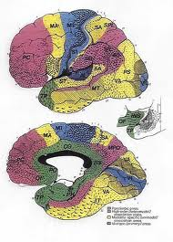
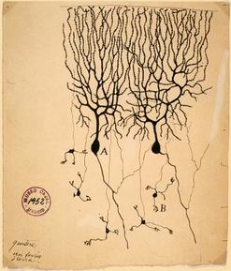
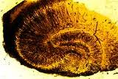
Neuroscience—the last 100 years
Korbinian Brodmann
(1868-1918)
Camillo Golgi
(1843-1956)
Ramon Y Cajal
(1852-1934)

Slide 3
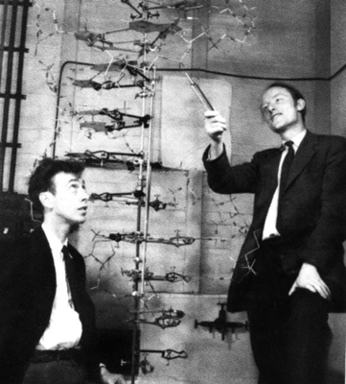
Genomic Revolution

Slide 4
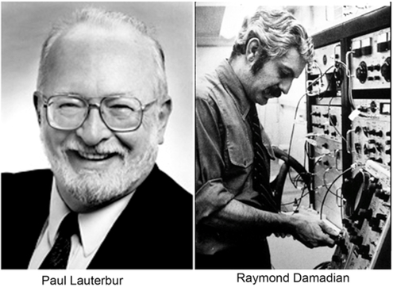
Imaging

Slide 5
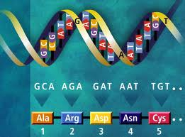

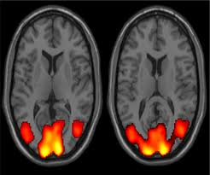
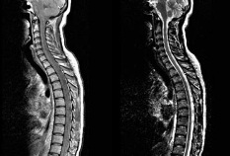
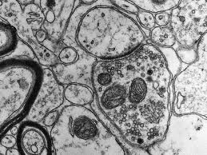
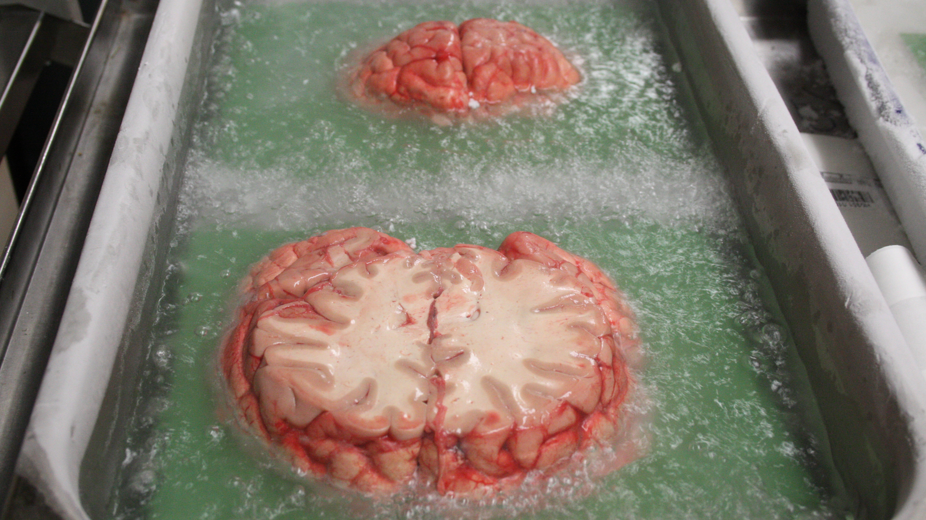
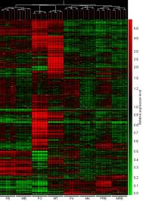
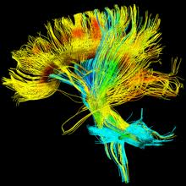
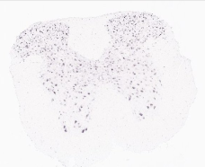
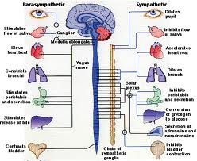
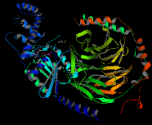
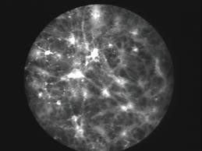
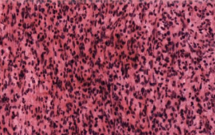
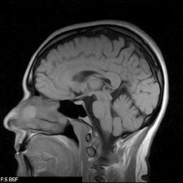
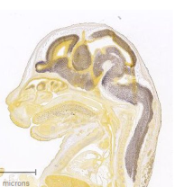
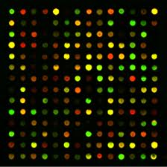
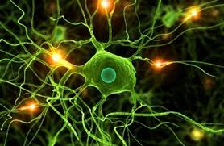
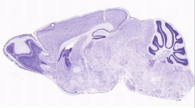
Problem of Scale and Defragmentation
Subcellular Cellular Tissue Whole Brain CNS Peripheral(?)

Slide 6
Allen Institute for Brain Science
Accelerating understanding of the human brain in health and disease.
Who we are
An independent nonprofit medical research organization
Advancing understanding of the brain in health and disease
Project-focused, milestone-driven

Slide 7
Our Overarching Goal:
Moving Systematically from Left to Right
Consciousness
Electrophysiology
Computation
Memory
Genes
Cell types
Dynamics
Brain
Biochemistry
Synapses
Behavior
Connections
Circuits
Thought
Language

Slide 8
Mission
The goal of the Allen Institute for Brain Science is to accelerate the understanding of how the human brain works in health and disease.
Using a team science approach, we generate useful public resources, drive technological and analytical advances, and discover fundamental brain properties through integration of experiments, modeling, and theory.

Slide 9
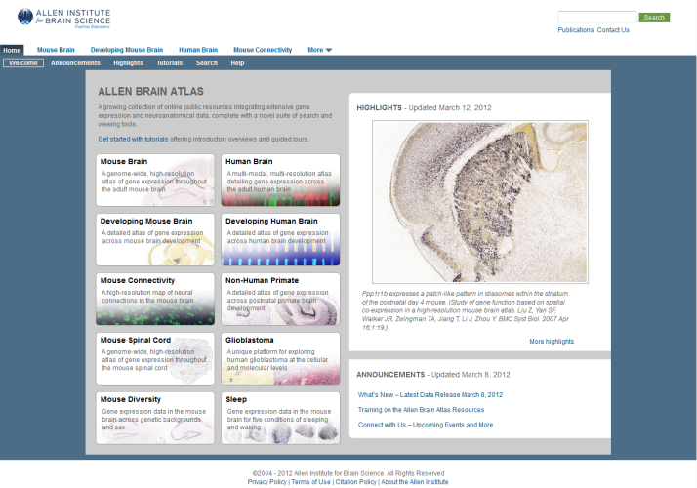
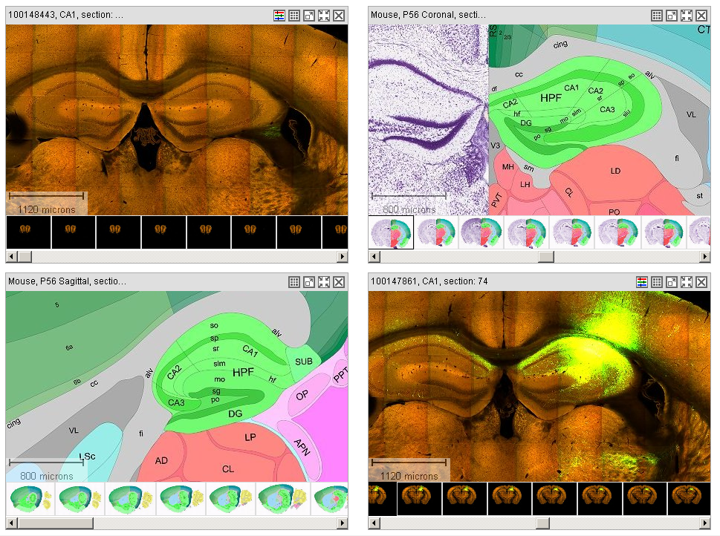
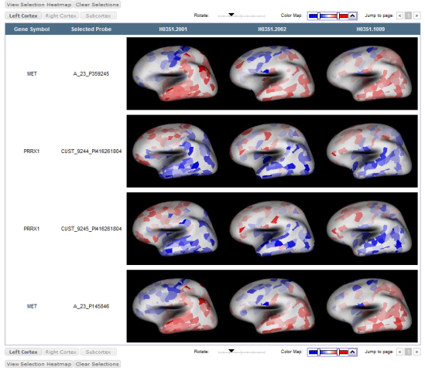
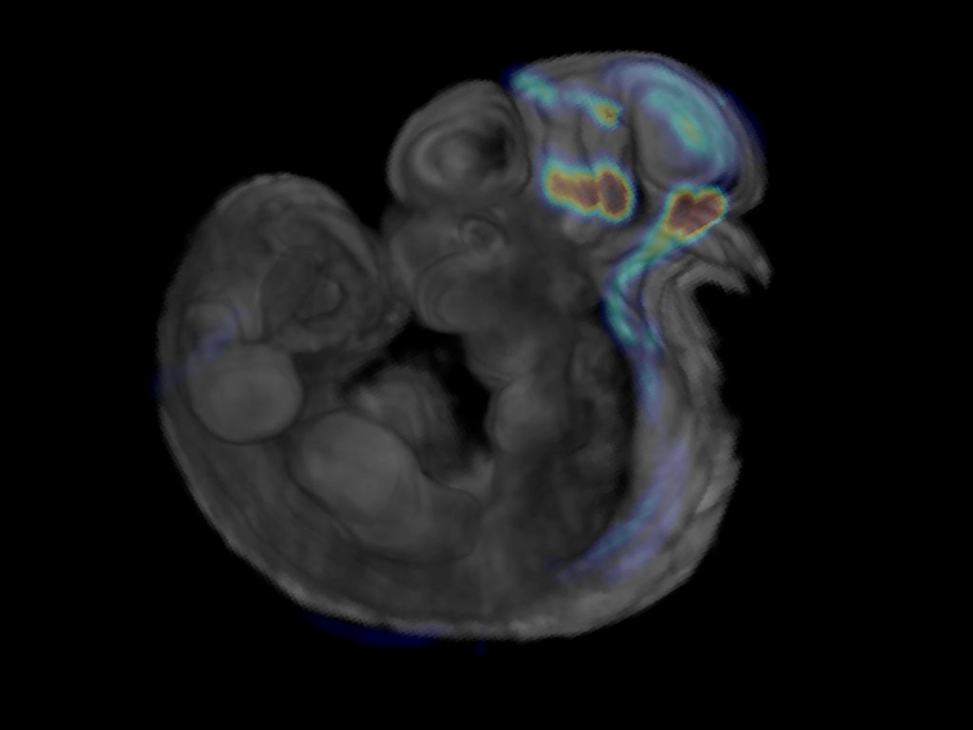
Progress so far…..
ALLEN BRAIN ATLAS Online Public Resources
Institute atlas initiatives
ALLEN Mouse Brain Atlas
ALLEN Developing Mouse Brain Atlas
ALLEN Spinal Cord Atlas
ALLEN Mouse Brain Connectivity Atlas
ALLEN Human Brain Atlas
Sponsored atlases
BrainSpan Atlas of the Developing Human Brain
NIH Blueprint Non-Human Primate (NHP) Atlas
Ivy Glioblastoma Atlas Project
Focused studies
Sleep Study
Mouse Diversity Study

Slide 10
ALLEN Mouse Brain Atlas

Slide 11
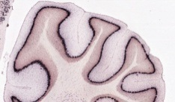
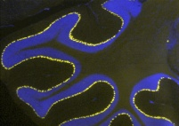
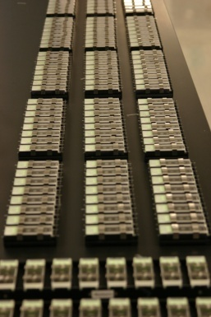
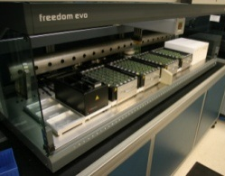
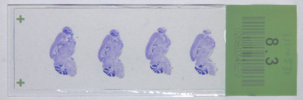
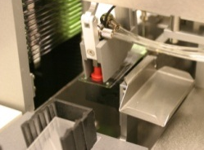
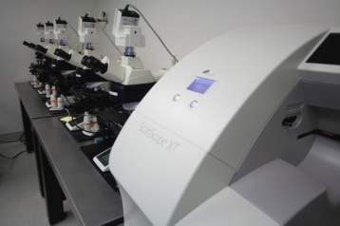
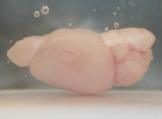
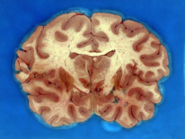
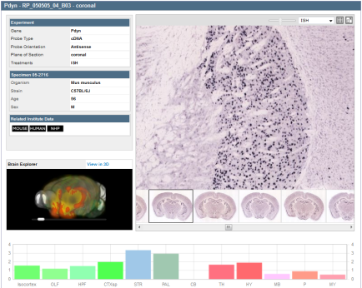
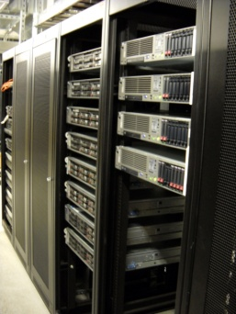
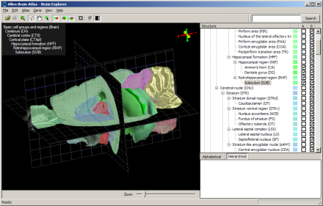
High-throughput in situ hybridization (ISH) platform
High-throughput microscopy
Tissue
Web Application
Automated image processing & data storage
Web-based data viewer
Downloadable Brain Explorer® 3-D viewer

Slide 12
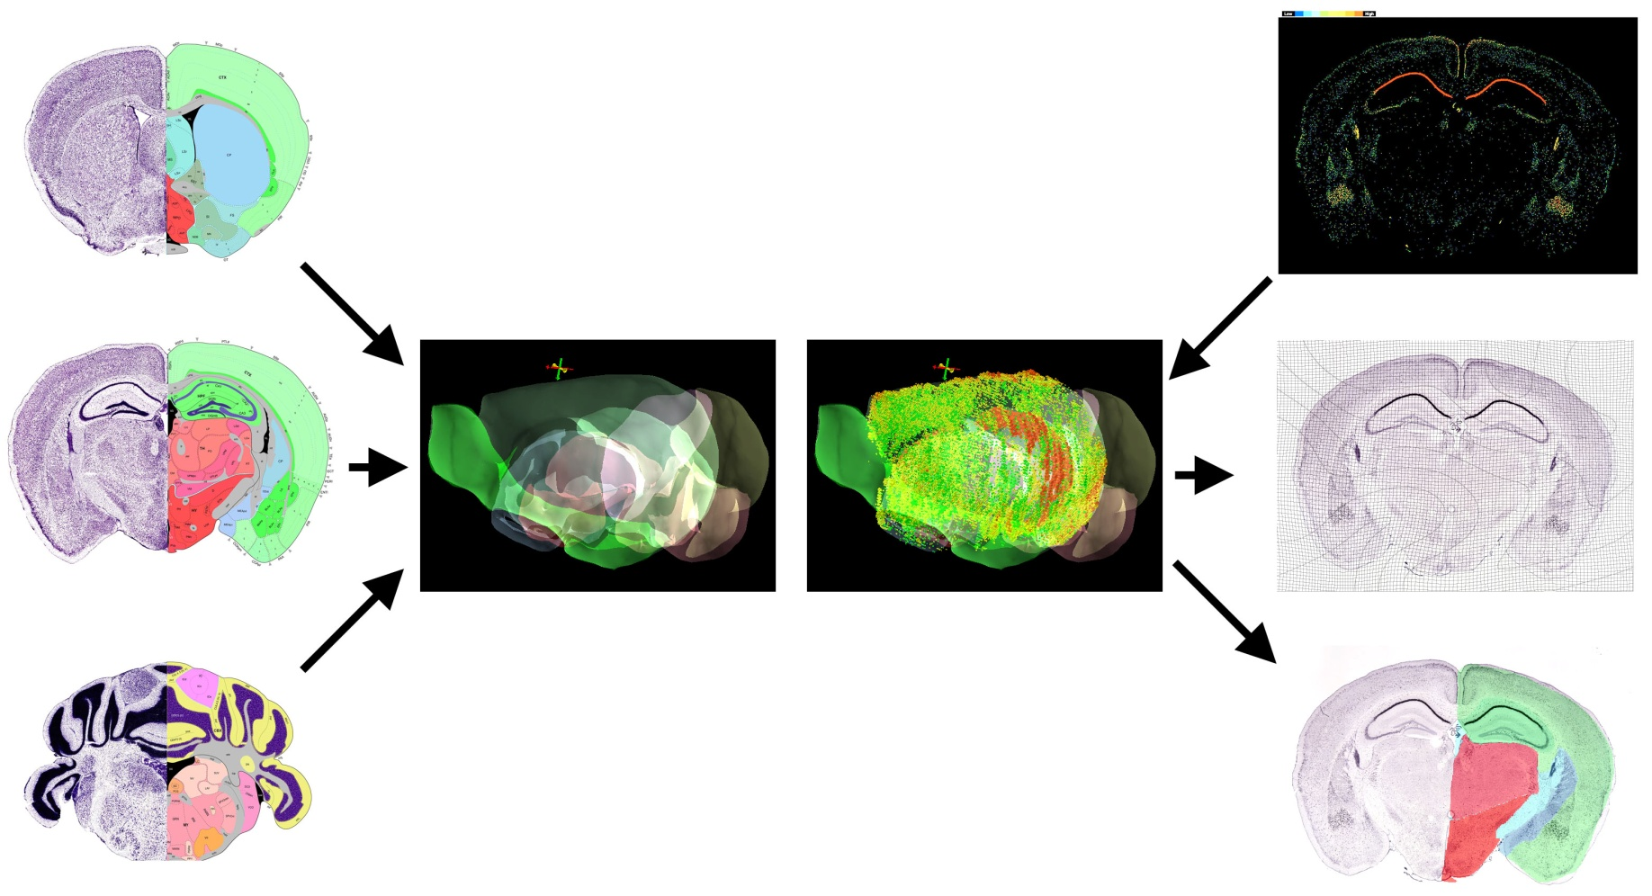
Establishing a Common Coordinate Framework for Analysis: Registration of Gene Expression Data with a Matching Reference Atlas
Automated
Signal Detection
Annotated Reference Atlas
Gene Expression
Registered with
3D Reference
Volume
Annotated 3D
Reference Volume
Grid Overlay
Structural Overlay
Nature 445, 168-176 (11 January 2007)

Slide 13
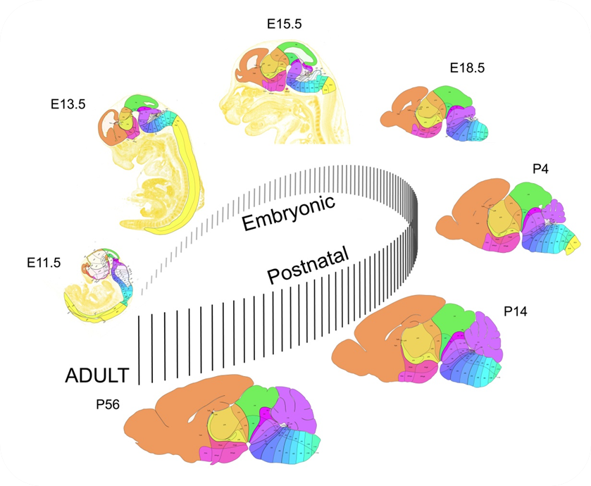
ALLEN Developing Mouse Atlas
7 developmental stages
Developed by Luis Puelles
Consistent ontology to compare across time

Slide 14
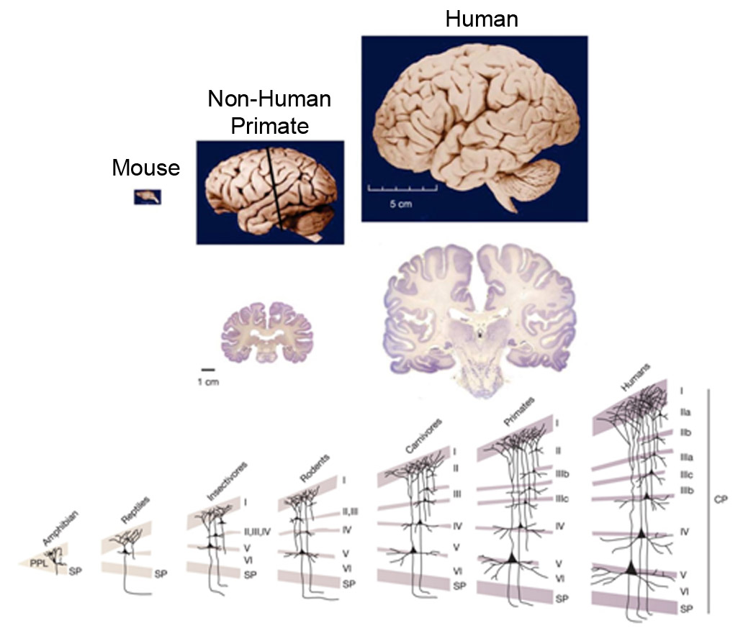
From Mouse to Man: Problem of Scale
Hill and Walsh, 2005

Slide 15
ALLEN Human Brain Atlas

Slide 16
A multi-modal atlas of gene expression in adult human brain
Microarray – “All genes, all structures” survey
Spatially mapped microarray data (3 full adult control brains)
  ~1,000 distinct anatomic samples/brain for comprehensive anatomic coverage
  Custom Agilent microarray chip
Histology
MRI & DTI
In situ hybridization – High-resolution, selected genes in specific regions
Subcortex Study: 55 genes across subcortical regions (1 male, 1 female donor)
1,000 Gene Survey: visual and temporal cortex in multiple adult control brains
Schizophrenia Study: 60 genes in DLPFC of over 50 control and schizophrenia cases
* Available data as of March 2012 data release

Slide 17
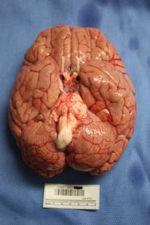
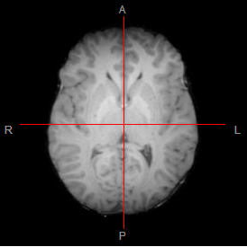
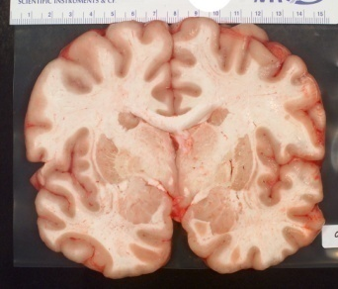
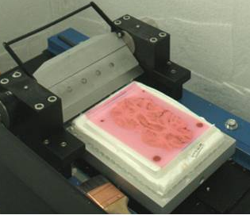
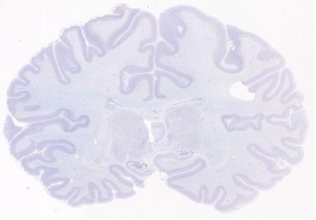
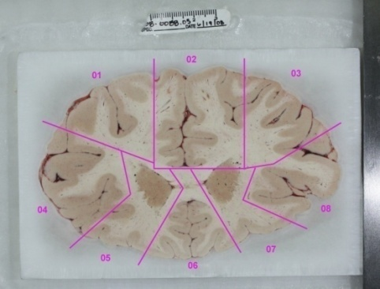
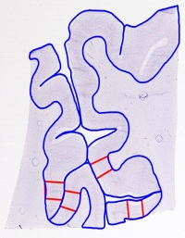
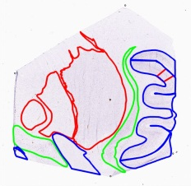
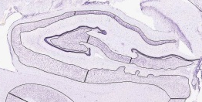

Whole brain to microarray
Whole brain
MRI
5 – 10 mm slabs
Section 1 mm of slab
(image courtesy Mark Vawter
and Preston Cartagena)
Block into 2x3
Cryosection 2x3 block
Final 1 mm of block
Microarray
cortex
lf
IHC
Nissl
IHC
SFG-L
IHC
Nissl
IHC
SFG-R
ISH
Nissl
IHC
CgGf-R
cgs
subcortex
cgs
CgGf-L
Macrodissection
Nissl
IHC
IHC
IHC
Nissl
IHC
IHC
IHC
IHC
PEN
ISH
Nissl
PoG
ic
crs
ec
LIG
Laser Capture Microdissection
GPi
GPe
Pu
exc
SO
SI
ac
Cl
PLP
opt
crs

Slide 18

Allen Brain Atlas Data

Slide 19

Beyond Gene Expression: Connectivity Atlas
Three dimensional map of axonal projections covering 300 anatomical regionsng
~100 Transgenic Cre driver lines targeting diverse neuronal populations
Integrated and leverages the same Allen Reference Atlas of the Adult Mouse

Slide 20




The Allen Institute for Brain Science: Impact
Since inception, the Allen Institute has:
Generated data on over 3.2 million tissue sections on ~850,000 microscope slides (if laid end to end, would stretch 50 miles)
Produced petabytes of image data; currently at ~2PB per year
Produced >200 million gene expression measurements
  HBA: >150M (~1000 structures on 3 donors)
www.brain-map.org provides web-based tools and access to extensive data resources generated by the Allen Institute for free to researchers around the world.
Researchers from academic, biotech, government, and pharmaceutical companies from around the world.
Researchers studying every facet of normal and disease brain function regularly use and cite the Allen Institute resources (stroke, Alzheimer’s, obesity, schizophrenia, autism, cognition, hearing, etc)

Slide 21








Understanding the visual system
Identification and classification of cell types in cortico-thalamic system
Neural Coding: understanding how cells are encoded/decoded
Erbb4
Pvalb-Ctx
Pvalb-Cre; Ai14
Sst-Ctx
Sst-Cre; Ai14
Tac1
Tac2

Slide 22





Cell Types: Connections, Morphology, and Transcriptome
Cell count via stereology and other methods
Single neuron characterization from Electrophysiology
Hooks, … Shepherd 2011
Reconstruct populations of neurons from Electrophysiology
Taxonomy of Cell Types
Kuramoto, … Kaneko, 2009
Via, QPCR, RNA sequencing

Slide 23







Functional Studies
Stimuli / Behavior
Optical physiology
Electrophysiology
Circuit Anatomy

Slide 24

Single Neuron Models
A linear model allows easy tuning (analytically proven concave error function) using either:
  log maximum likelihood
  specially designed spike-distance metrices
Training
stimulus
Measured
spikes
Predicted spikes
Test
stimulus
Measured
spikes
Predicted spikes
Kim, Mihalas, Russell, Dong, Bensmaia, IEEE TNSRE, 2011

Slide 25



Synaptic Models
Short term synaptic plasticity plays a crucial role in firing rate homeostasis; a canonical model has been described (Tsodyks and Markram, PNAS 1997)
Large number of models different mechanisms for different types of synapses ranging from generic (Clopath and Gerstner, 2010, Vogels et al 2011, Naud 2012 etc.) to more biochemically accurate but still analytically tractable (Mihalas 2011).

Slide 26

Acknowledgements
We wish to thank the Allen Institute founders, Paul G. Allen and Jody Allen, for their vision, encouragement, and support.

