Slide 1
A new, searchable SDMX registry of country-level health, education, and financial data
Chris Dickey
DevInfo Support Group
cdickey@devinfo.info
917-484-1133
Notes:
DevInfo is a UN-sponsored and endorsed data management and visualization application currently utilized by nearly 130 countries to monitor socioeconomic and financial data. The newest version, DevInfo 7.0, is web-based and contains many features that increase the accessibility and value of the data, particularly because of its powerful graphing and mapping functionality. One feature potentially of interest to the Wolfram Alpha community is DevInfo 7.0's new SDMX registry, which permits national statistical offices (NSO) to register databases that share the DevInfo data structure definition (DSD) so that they are searchable by any application that recognizes that DSD. The NSO can either upload the database to a central registry via a secure URL or it can host its own URL to be searchable through the registry. In addition to maintaining the conditional database structure, the NSO would only ensure that its database is continually visible to analysis tools.
Coincident with the release of DevInfo 7.0, a number of NSOs are currently developing the necessary skills to register the country-level data, which will increase the available data through the registry with each passing month. The benefits of this increased transparency will no doubt encourage other country statistical offices to join the registry, increasing access to this important information to anyone that wishes to use it.

Slide 2
SDMX
S
D
M
X
Statistical
Data &
Metadata
Exchange
Notes:
What - “Statistical Data and Metadata Exchange”¹ refers to an international cooperation initiative aimed at developing and employing more efficient processes for exchange and sharing of statistical data and metadata among international organizations and their member countries. The initiative, started in 2001, is sponsored by 7 international organizations: BIS, ECB, Eurostat, IMF, OECD, UN, World Bank. It is a global standard, currently in three backwardly compatible versions: 1.0, 2.0 and 2.1. Version 2.1 is at the end of its public review stage as of April 2011. The standard is published at SDMX.org. Aim of SDMX was to develop and use more efficient processes for exchange and sharing of statistical data and metadata among international organizations and their member countries.
Why - Exchange has often taken place in an ad hoc manner using all kinds of formats and non-standard concepts. This creates the need for common standards and guidelines to enable more efficient processes for exchange and sharing of statistical data and metadata.
Discuss Issues / Challenges in normal data collection (Heterogeneous format, Excel / Binary / database – not Platform neutral, csv – lack of structural knowledge - parsing logic, Content variation – Indicator name GUIds, metadata content and structure, Manual interpretation vs automation)
The objective is to establish a set of commonly recognised standards, adhered to by all players, making it possible not only to have easy access to statistical data, wherever these data may be, but also access to metadata that makes the data more meaningful and usable. The standards will allow national organisations to fulfil their responsibilities towards users and partners, including international organisations, in a very efficient way, among other things by using their general online databases to give access as soon as the data are released.
How -. To achieve this goal, SDMX provides standard formats for data and metadata, together with content guidelines and an IT architecture for exchange of data and metadata. SDMX aims to ensure that metadata always come along with the data, making the information immediately understandable and useful. For this reason, the SDMX standards and guidelines deal with both data and metadata.

Slide 3


Translator
SDMX
1. Indicator: Enrolment ratio primary education (Net)
2. Unit: Percent
1. Unit: Percent
2. Series: Primary Education Net Enrolment
Different Terms
Different Order

Slide 4
Translator
SDMX
1. Indicator: Enrolment ratio primary education (Net)
2. Unit: Percent
1. Unit: Percent
2. Series: Primary Education Net Enrolment
Harmonization
1. Indicator = Series
2. Unit = Unit

Slide 5
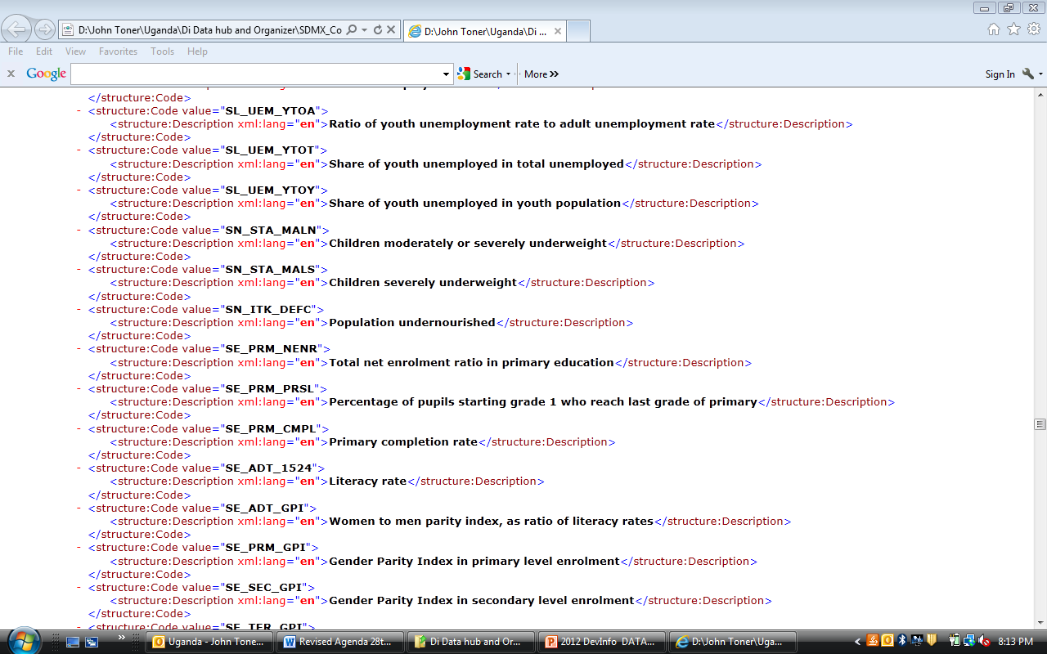
1. Indicator: Enrolment ratio primary education (Net)
2. Unit: Percent
1. Unit: Percent
2. Series: Primary Education Net Enrolment
1. Indicator = Series
2. Unit = Unit
Notes:
----- Meeting Notes (9/6/12 13:40) -----
This is just scratching the surface - there is much more to harmonization - this is a simple illustration

Slide 6
SDMX
Information Model
(Schemas)
Content Oriented
Guidelines
(Common Codelists
And Concepts etc.)
IT Architecture for Data Exchange
(Registry &
Web Services)
Notes:
SDMX is more than a data transmission format since it answers to several questions:
• What is the information model underlying the data and metadata exchanged between the partners?
• How to increase the interoperability and statistical harmonisation?
• How to exchange the data?

Slide 7

SDMX – Users
SDMX Registry
Maintenance Agency
(UNSD)
Data Consumer
Define rules:
DSD
Codelists
Schemas
Subcribe:
Email
Http Post
Register data
Data Provider
Notes:
Maintenance Agency
Define / Maintain rules for data in DSD, DFD, Constraints, Codelists, Concept Scheme, Data Provider Scheme, Data Consumer Scheme etc.
Define / Maintain rules for data discovery in Category Schemes, Categorizations etc.
Data Provider
Produces data, in a standard format compliant to SDMX schemas (Simple Data source, Queryable Data source), Confirming to rules compliant to a Database Structure Definition (DSD)
Registers Data Source
Data are available for key combinations (combinations of mandatory dimensions)
Location of the data source (URL of web service)
Serves data
As SDMX-ML schemas compliant to a DSD
Via a SDMX compliant web service.
Against registered key combinations only
Discover / Consumes data and metadata
Available in a standard format i.e. compliant to SDMX schemas.
Confirming to some rules i.e. compliant to a DSD.
Subscribers are notified
When new data are made available
When the rules defining the data change
----- Meeting Notes (9/6/12 13:40) -----
automatically get notified that the data is updated

Slide 8


Slide 9




strategy
mission
facts. you decide
data for all
values
vision
innovation for development
public good
Notes:
Mission
To enable the UN system and its national development
partners to realize this vision as an effective and relevant
common database system used for the accumulation,
dissemination, presentation and advocacy of human
development indicators.
To add value to national statistics systems by
complementing existing databases and bridging data
dissemination gaps.
To be used as an advocacy platform by UN agencies to
engage both government and civil society in policy choices
for human development that yield measurable results.

Slide 10












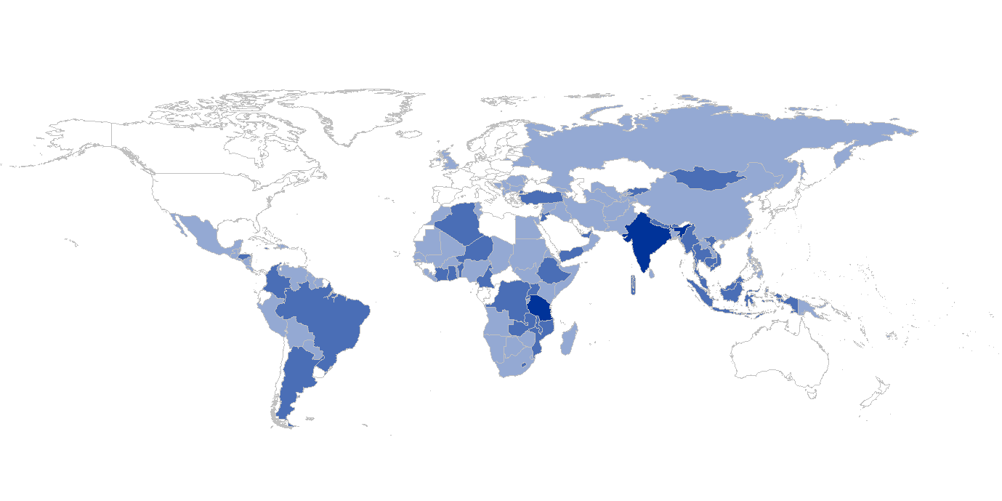
130+ countries and regions
404 adaptations
2011

Slide 11
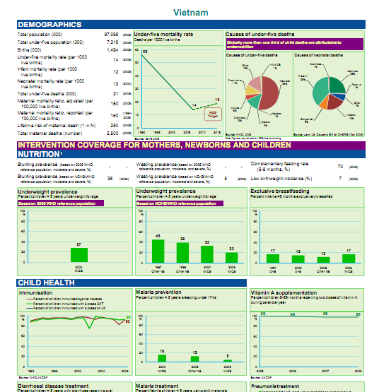
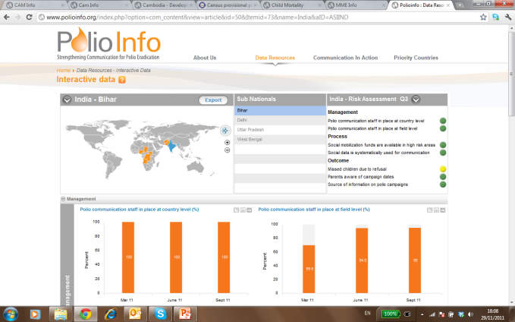
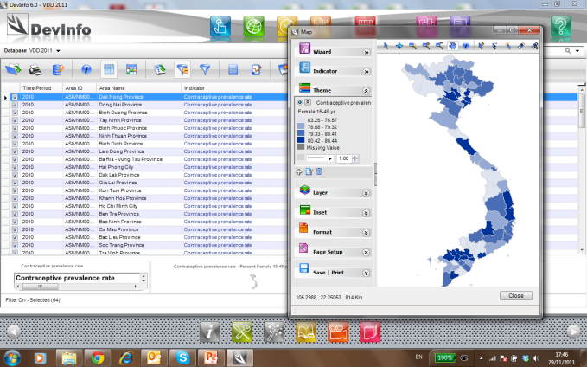

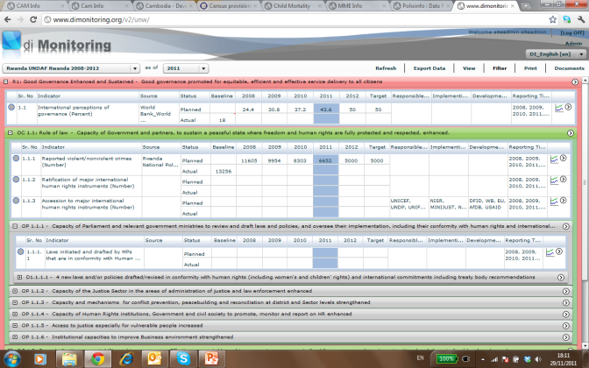

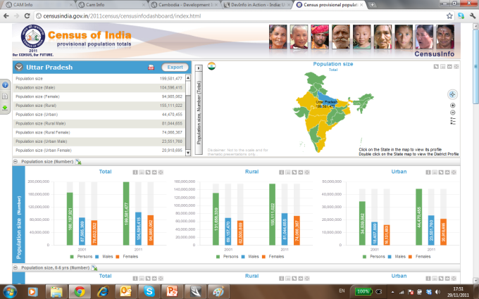
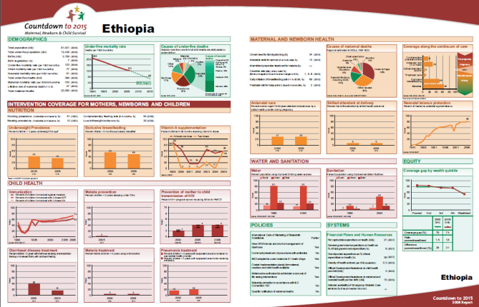
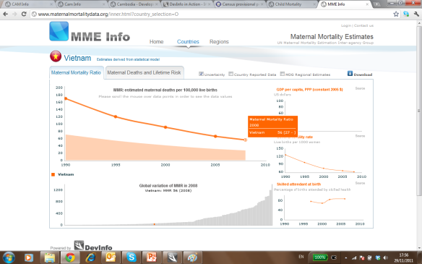

Slide 12


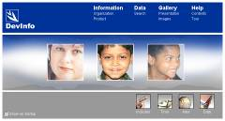
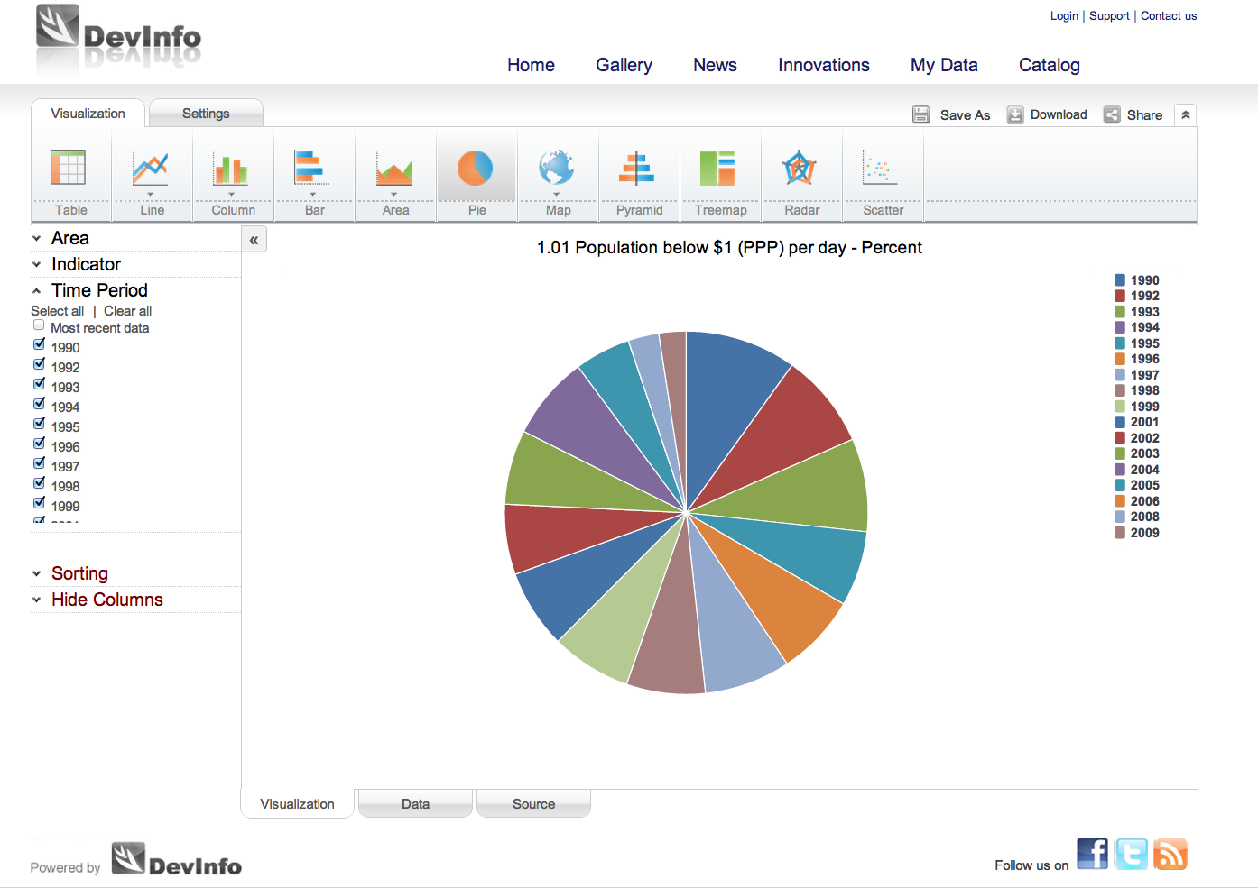



from ChildInfo to
DevInfo
ChildInfo 1995 - 2003
UNICEF developed a database to monitor the World Summit for Children offered to the UN system
DevInfo 7.0 2012
Interactive, state-of-the-art visualizations, SDMX registry, increased flexibility
DevInfo 4.0 2004
ChildInfo upgraded and launched with UNDG endorsement in April 2004
UN Endorsement
Endorsed by the United Nations to assist Member States in monitoring human development
DevInfo 5.0 2005
New web-enabled version developed and launched with broad government and UN support in May 2006
DevInfo 6.0 2008
New features with Web 2.0 social networking launched in Apr 2009
Notes:
DevInfo database technology was adapted from UNICEF’s ChildInfo database system.

Slide 13
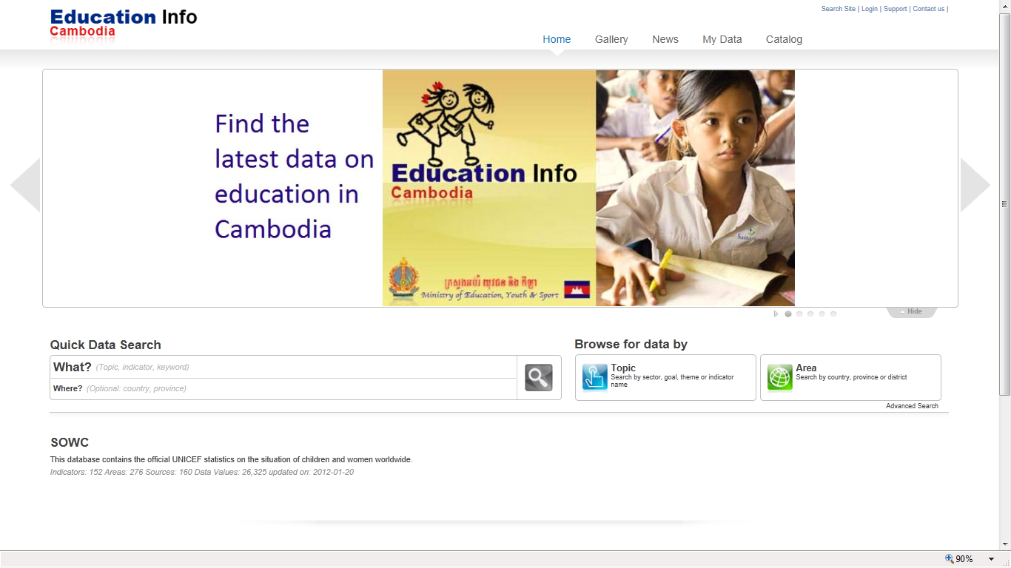
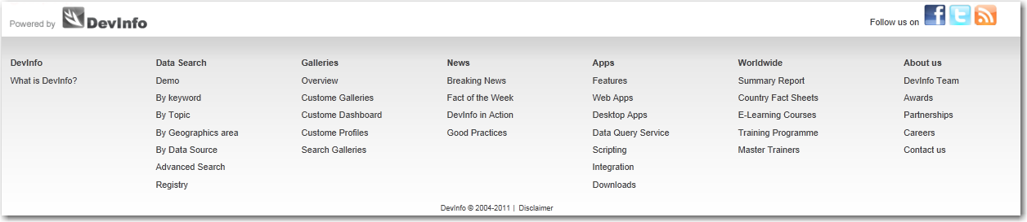
Thematic Banners
Search by Text
Search by Topic
Extensive Links by category
Share Results
Notes:
http compression
Client caching
Database stored procedures

Slide 14
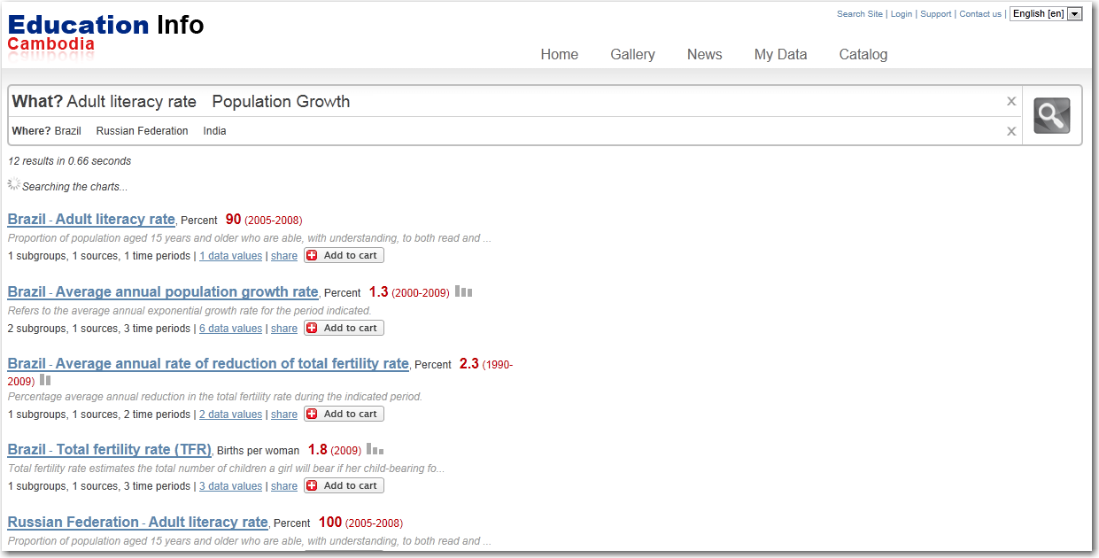
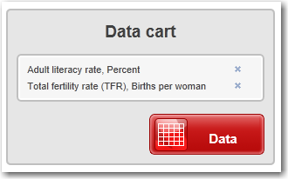
Quick Results
Notes:
http compression
Client caching
Database stored procedures

Slide 15
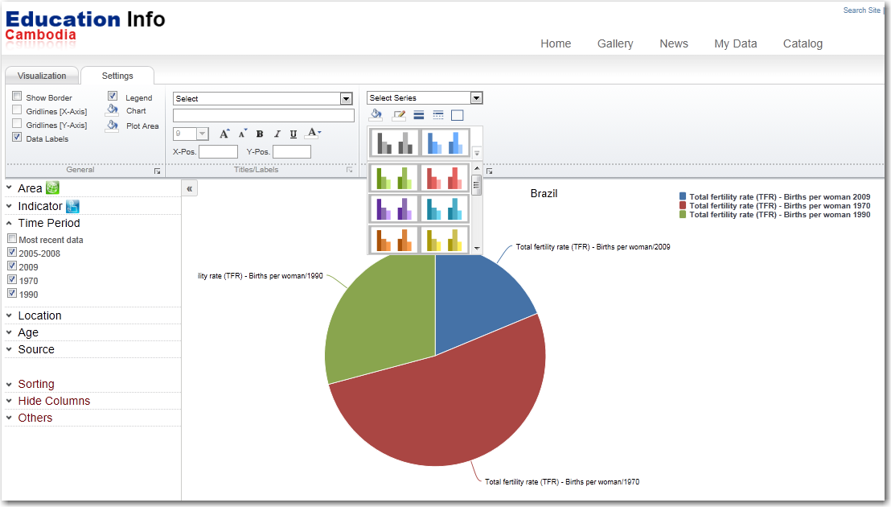
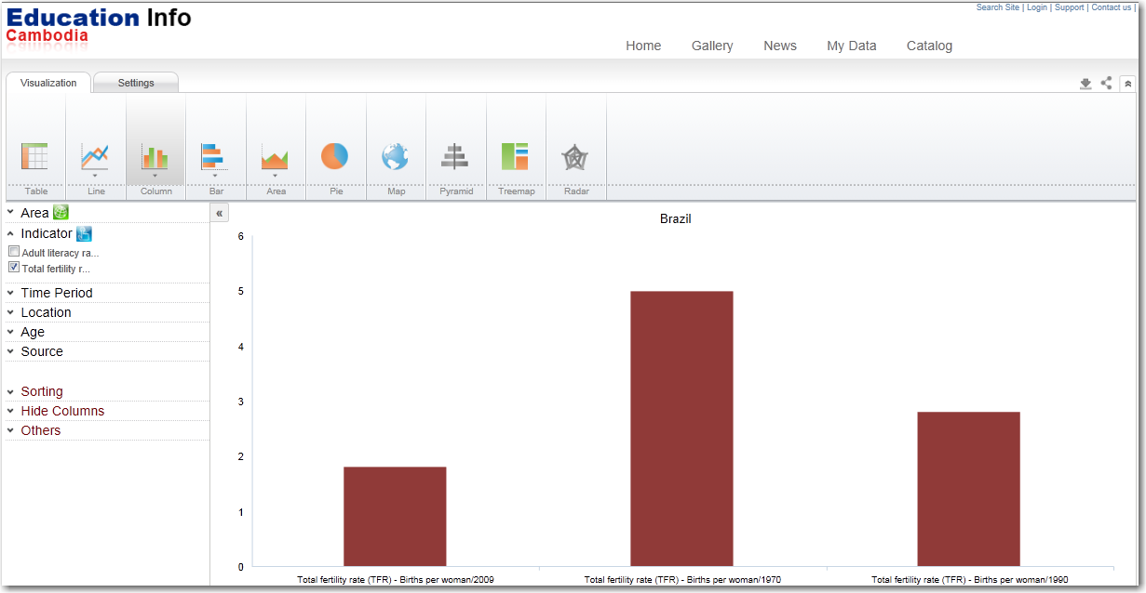
Change Settings
Data Filters
Notes:
http compression
Client caching
Database stored procedures

Slide 16
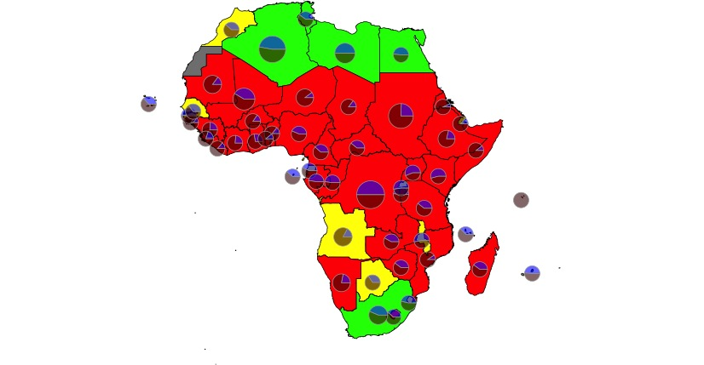
Improved sanitation facilities
Percent population using improved sanitation facility, Africa
Source: UNSD MDG Estimated, 2010

Slide 17
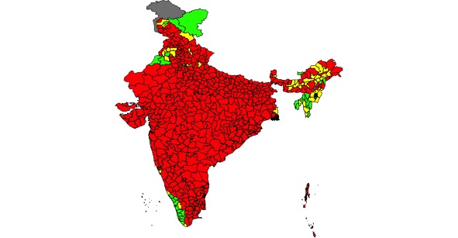
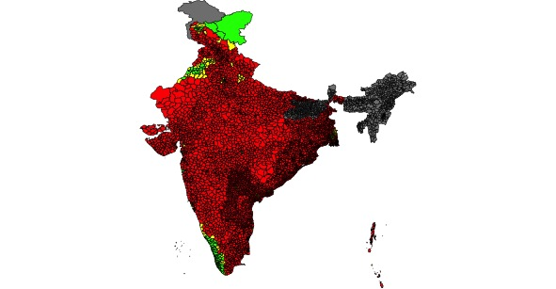
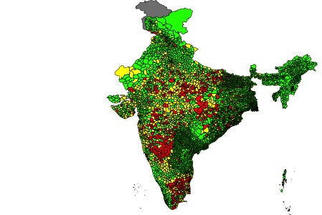
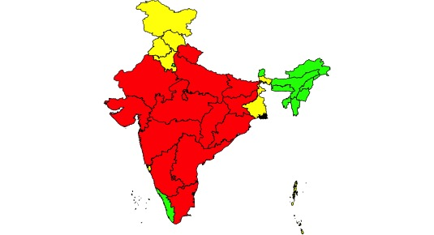
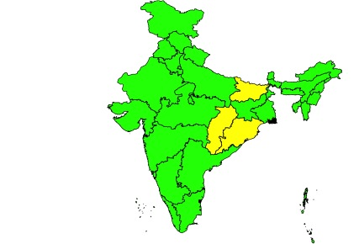
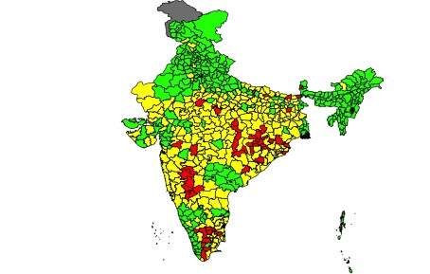
Drill Down Maps
Proportion of households by type of toilet
No latrine, India – most recent data
Source: Census India 2001

Slide 18










Enhanced Visualization
Column
line
Pie
Tree map
Scatter
Stack
Bar
Pyramid
Wedge
Google map
Radar
Map
Notes:
http compression
Client caching
Database stored procedures

Slide 19







Data Exchange
DevInfo
Notes:
DevInfo
Facts. You decide.

Slide 20
Data Exchange and SDMX
Data Exchange and DevInfo

Slide 21
DevInfo DSD
Dimensions
Attributes
Area
Periodicity
Time Period
Start Date
Indicator
End Date
Unit
Source
Observation
Total
Nature
Age
Denominator
Sex
Footnote
Location
Confidence Interval Upper
Wealth Quintile
(user defined)
Confidence Interval Lower
Notes:
Mandatory Dimensions

Slide 22
Data Exchange Flow
National Statistics Organization
Global
Line Ministries
Global Development Indicator Registry (MDGs)
National Development Indicator Registry
(MDGs + National Development Indicators)
Line Ministry 1
(Education)
Data Verification
SDMX-ML files
(for selected Development Indicators)
SDMX Consumer
National Development Indicators
Line Ministry 2
(Health)
National
Data Repository
Line Ministry 3

Slide 23
Consume data
National Registries
UN data
Cambodia
National SDMX Registry
data.un.org
Uganda
National SDMX Registry
DSD
Burundi
SDMX-ML
National SDMX Registry

Slide 24




Line Min to National Data Repository
Education Ministry
EMIS
National
Data Repository
Health Ministry
DHIS
Line Ministry
HIS
Utility Tool (LM)

Slide 25
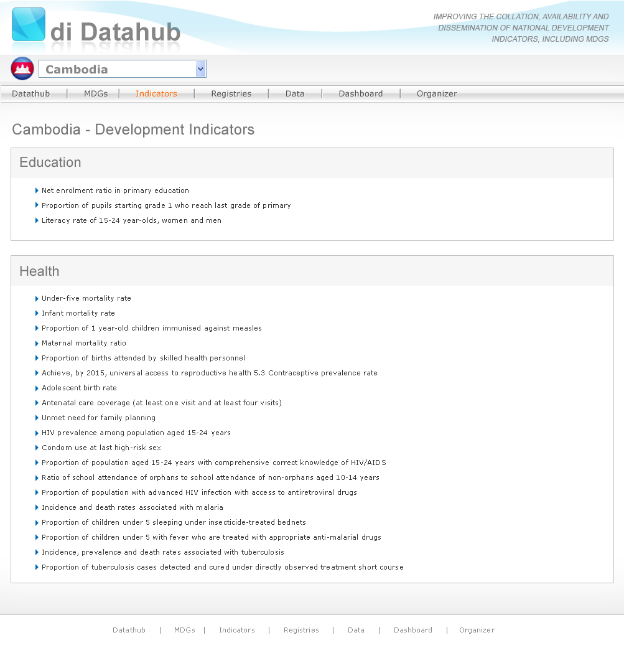

Slide 26
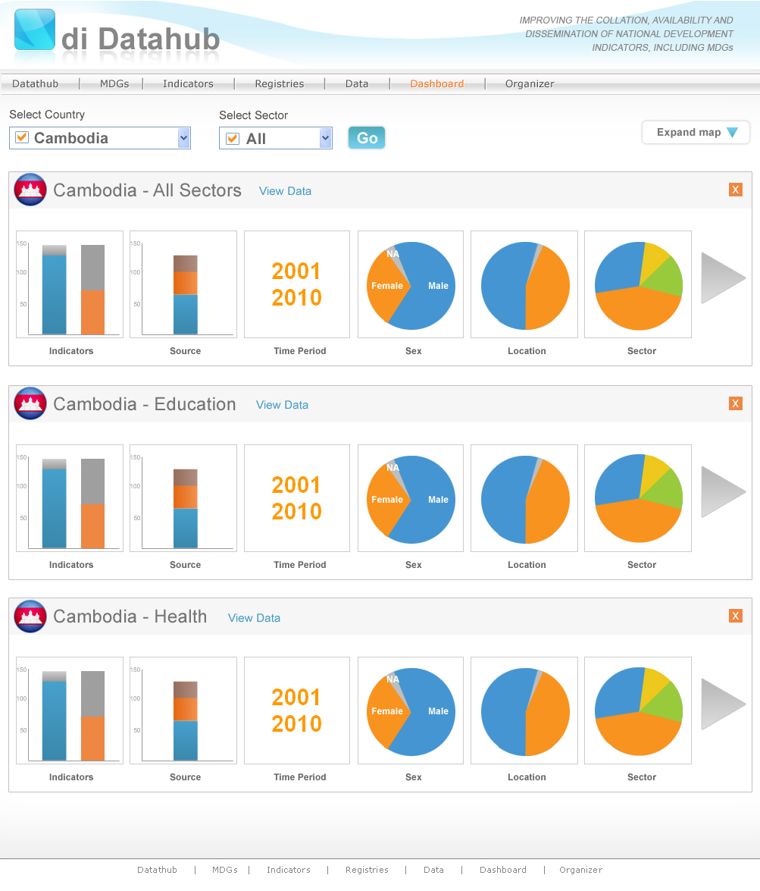

Slide 27
Uganda Data Flow
UNSD
International Actors
Public
SDMX
UBOS
SDMX
SDMX
MOES
MOH
UgandaInfo National Repository
EMIS
DHIS 2.0

Slide 28
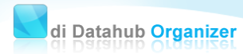
Uganda Data Flow (LM)
Upload Data
Upload SDMX-ML data file at FTP location
Upload data to national data repository (online)
UBOS
MOH
UgandaInfo National Repository
  DI Data Entry Spread Sheet
2. Manage DSD Import
Manage data to share with NSO
3. Convert Data
Export DES into SDMX-ML
DHIS 2.0

Slide 29
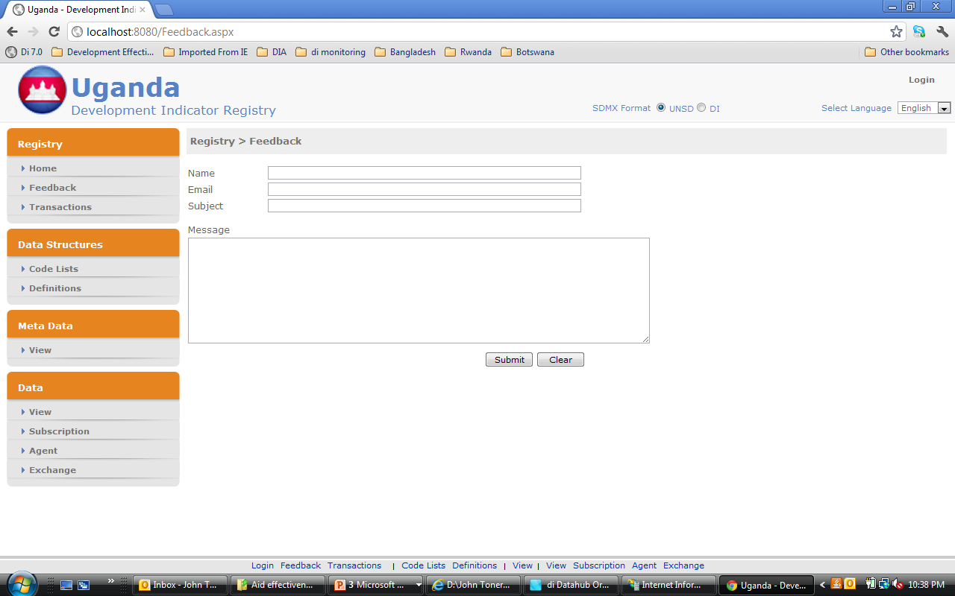

Slide 30
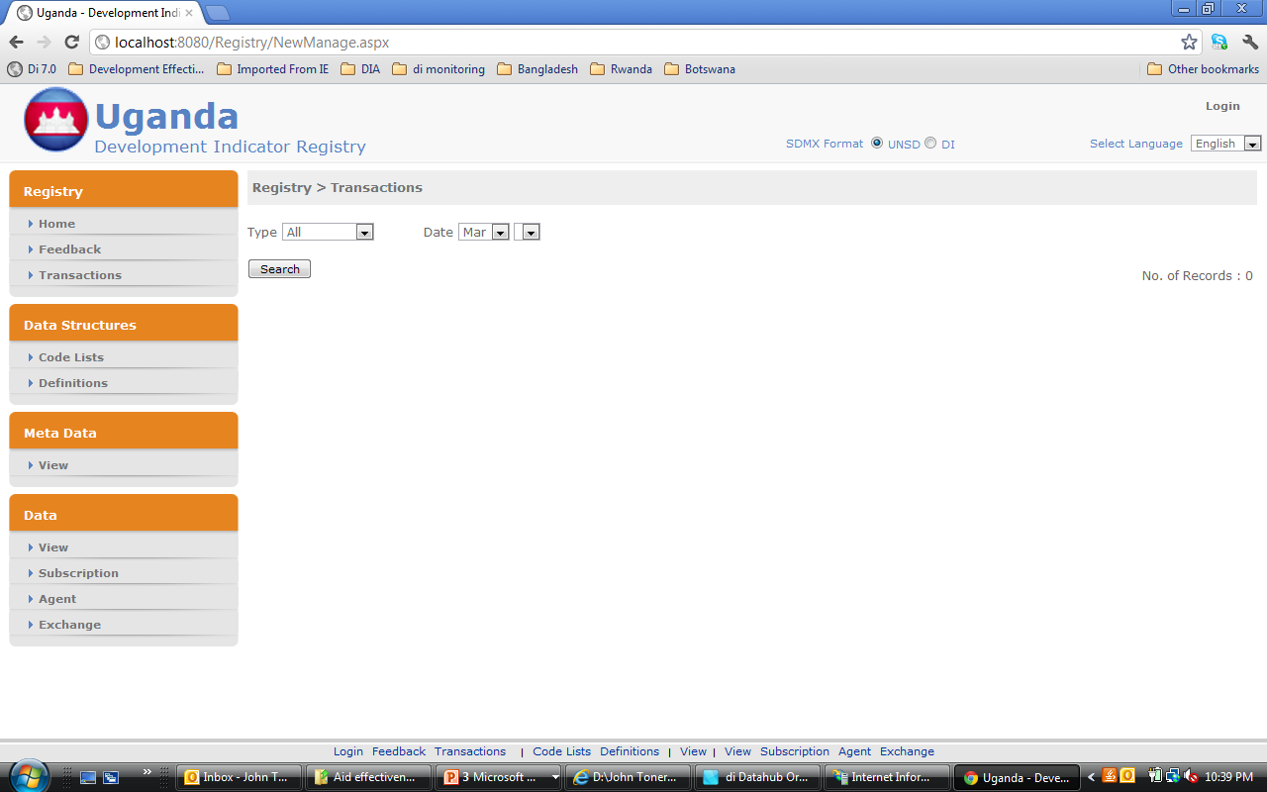

Slide 31
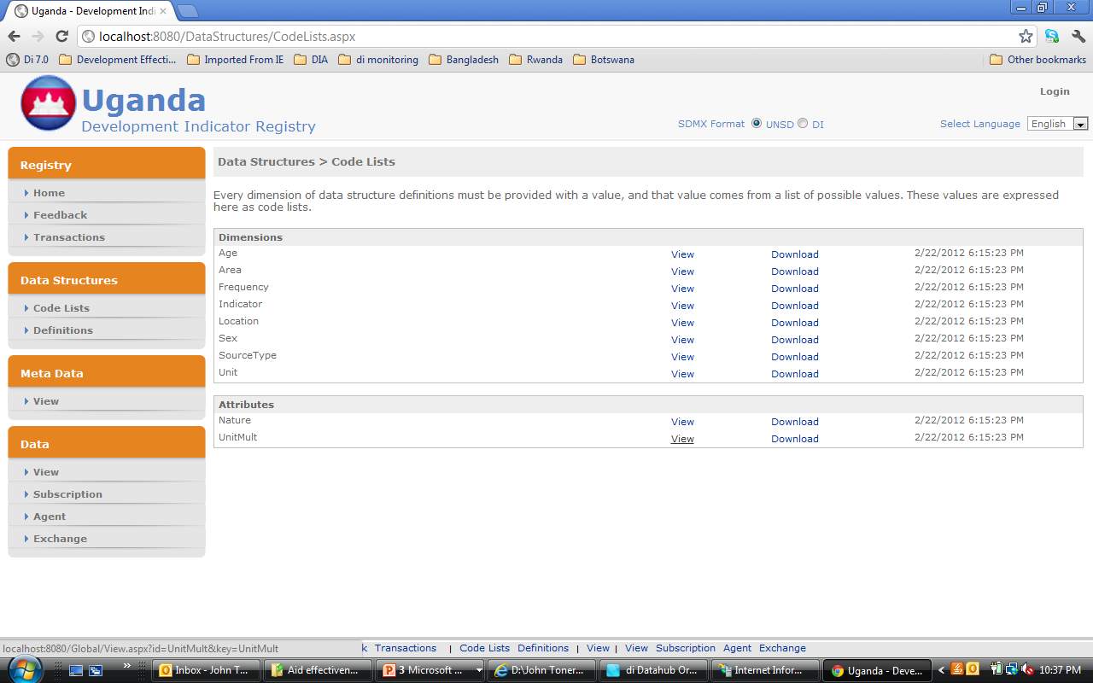

Slide 32
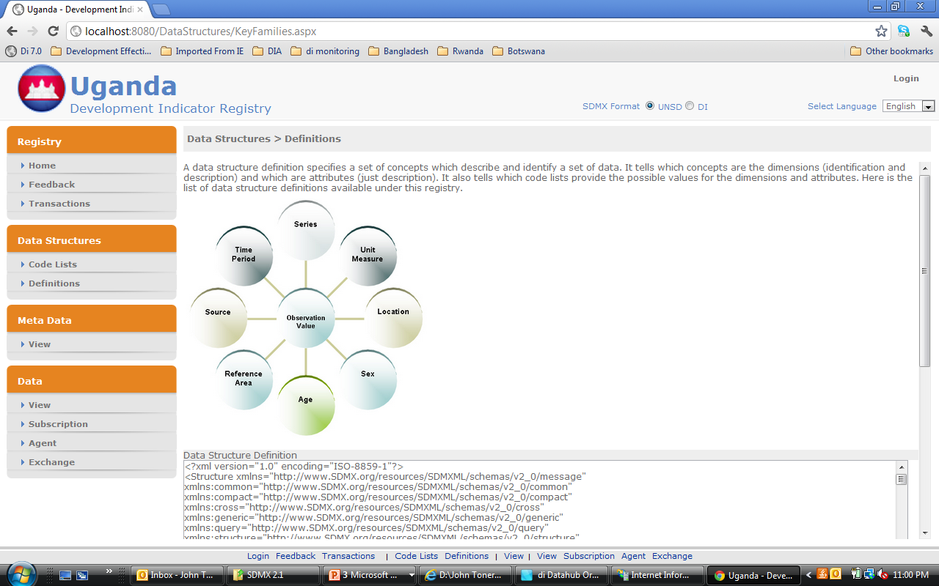

Slide 33


Slide 34
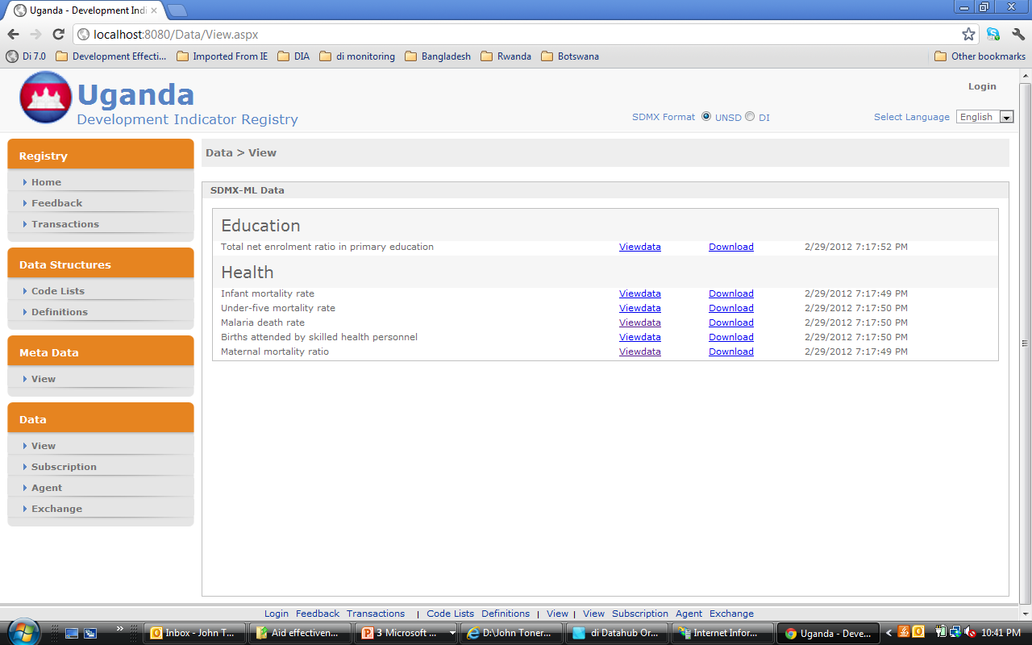

Slide 35
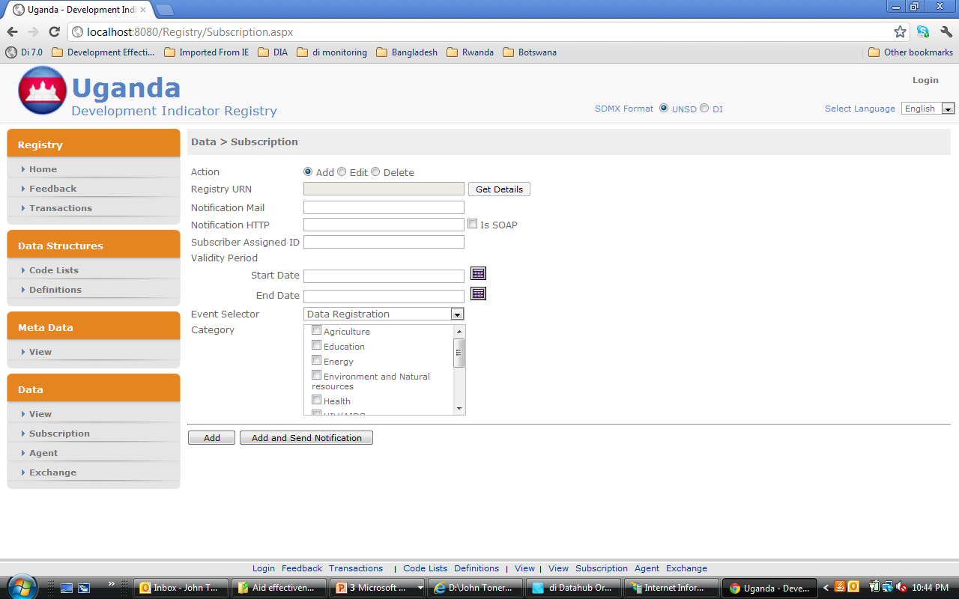

Slide 36


Slide 37
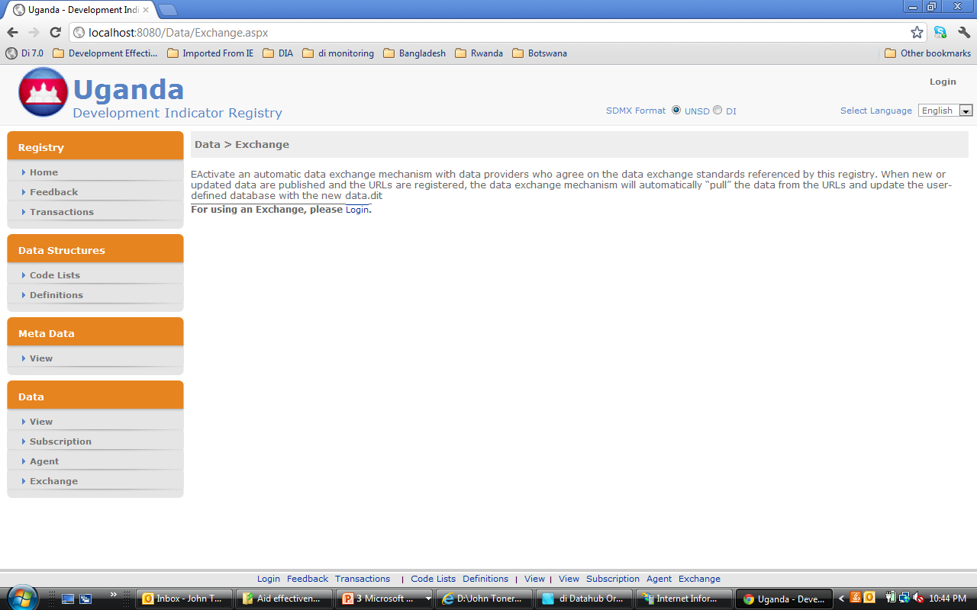

Slide 38
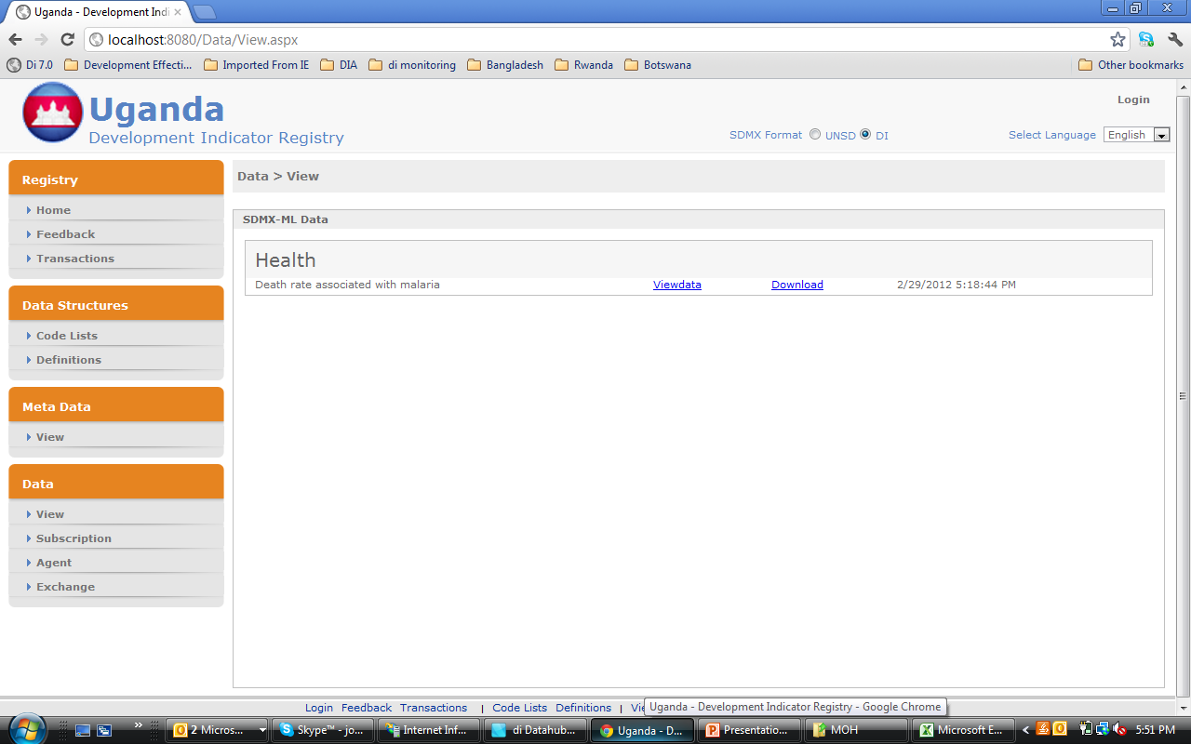

Slide 39
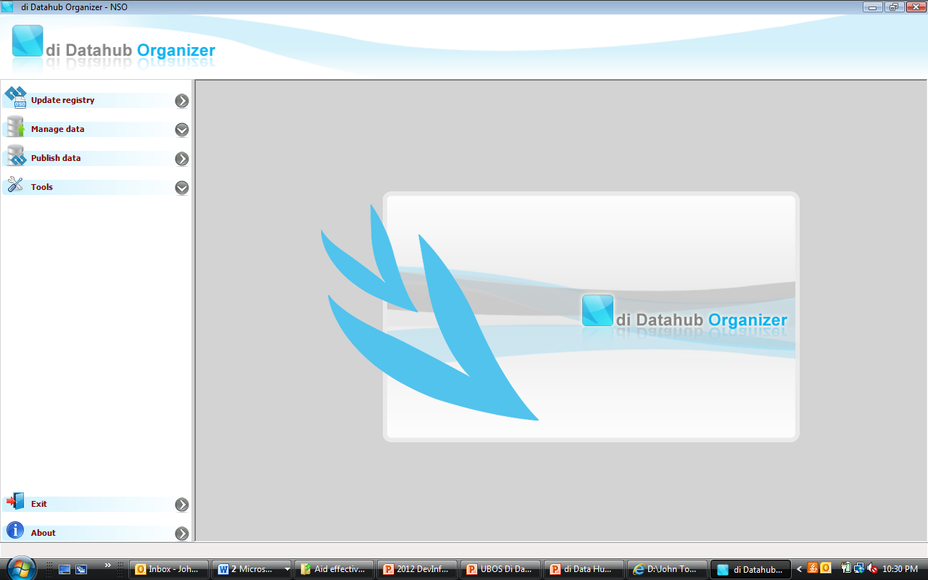

Slide 40
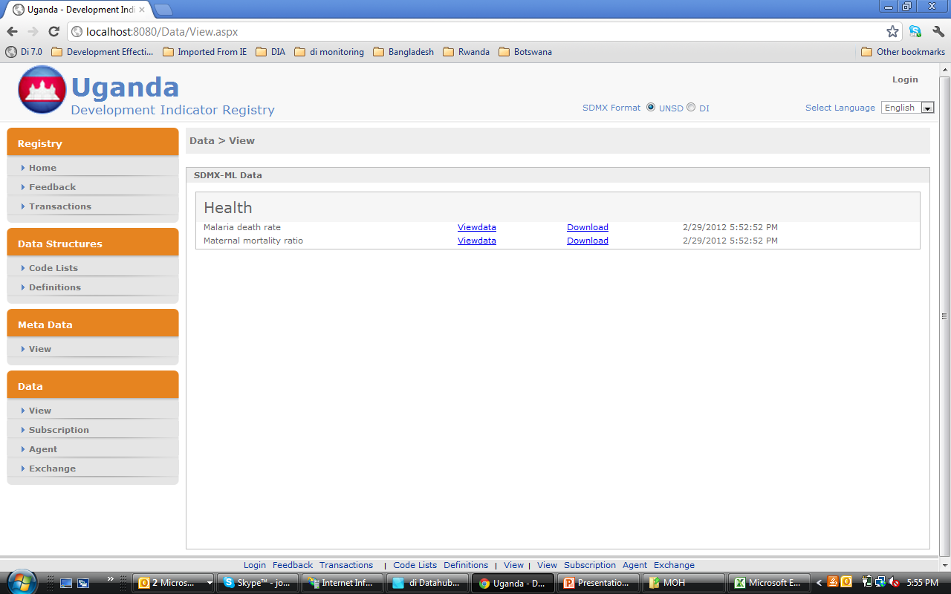

Slide 41
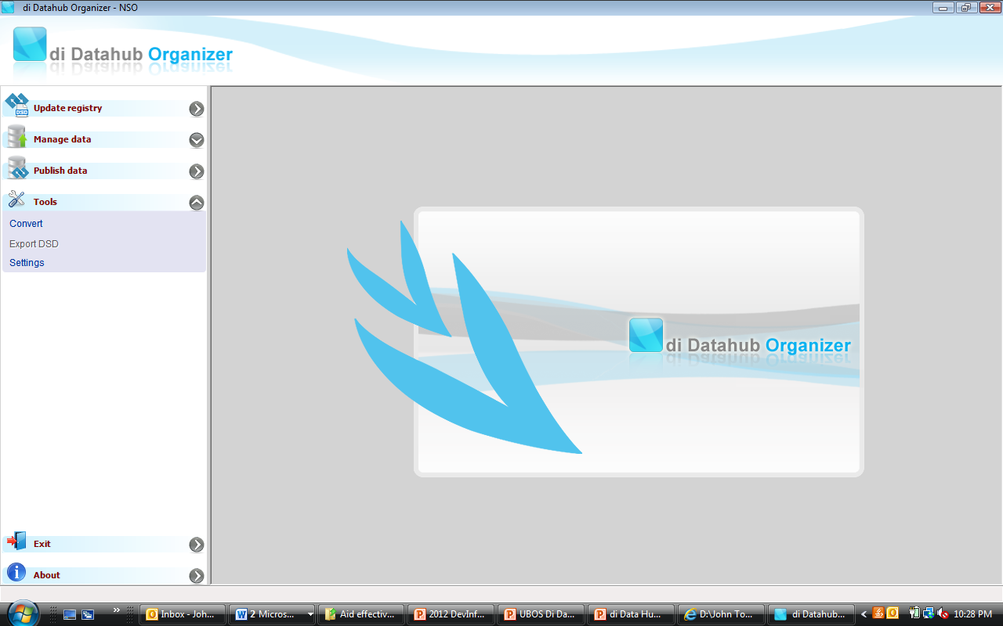

Slide 42
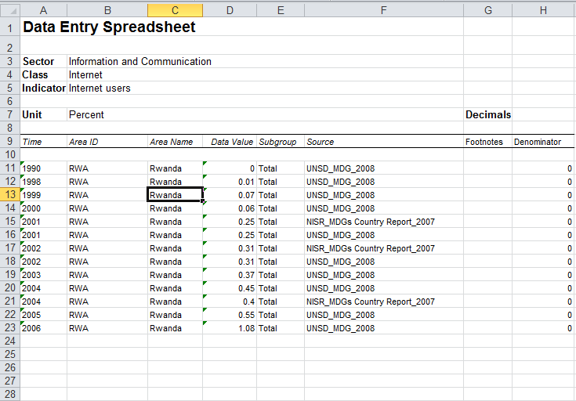
Data Entry

Slide 43
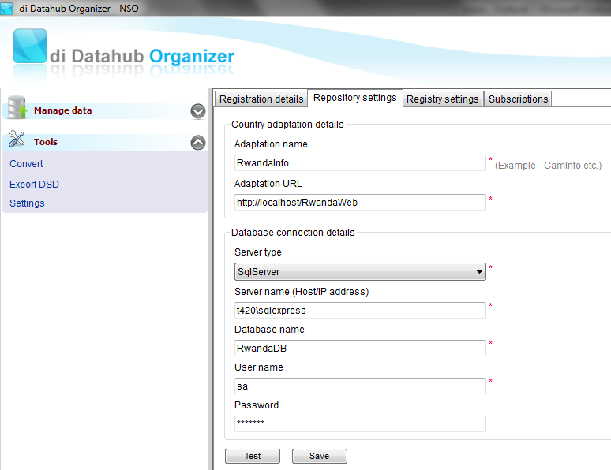
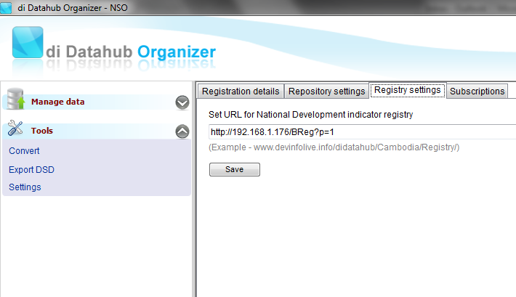
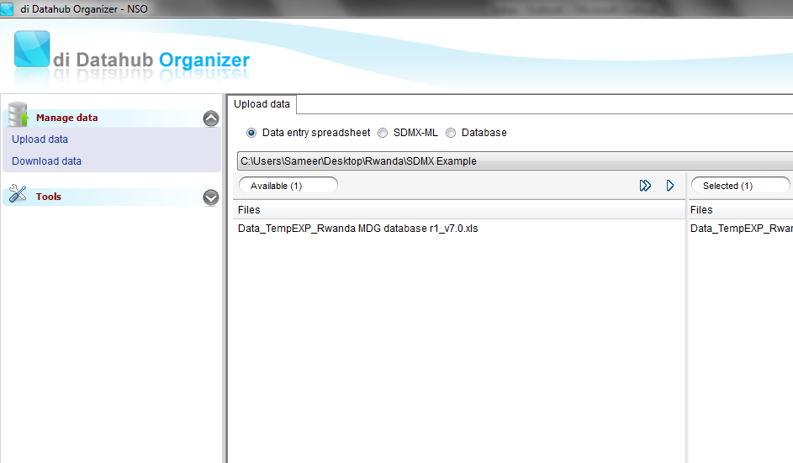
Upload Data

Slide 44
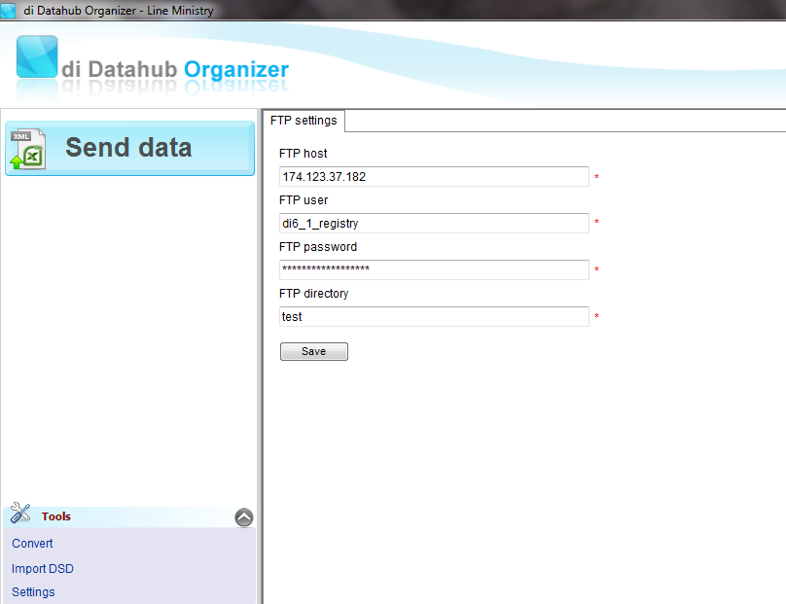
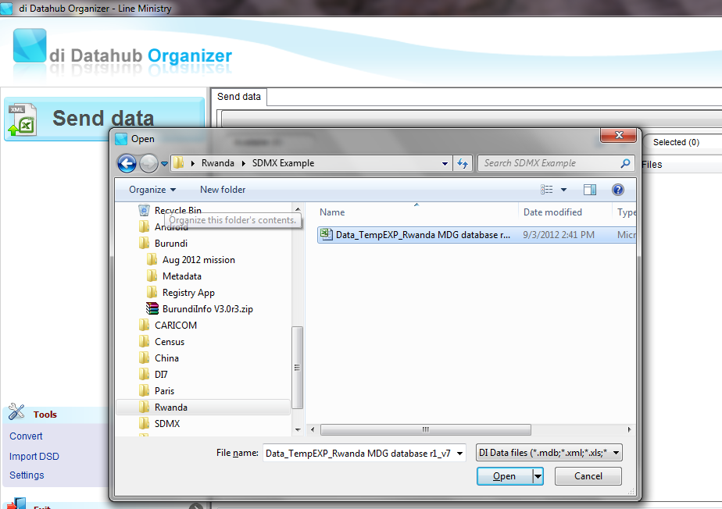
Send Data

Slide 45
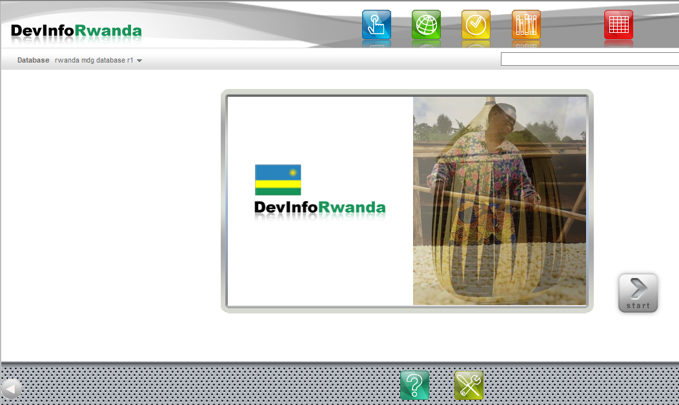
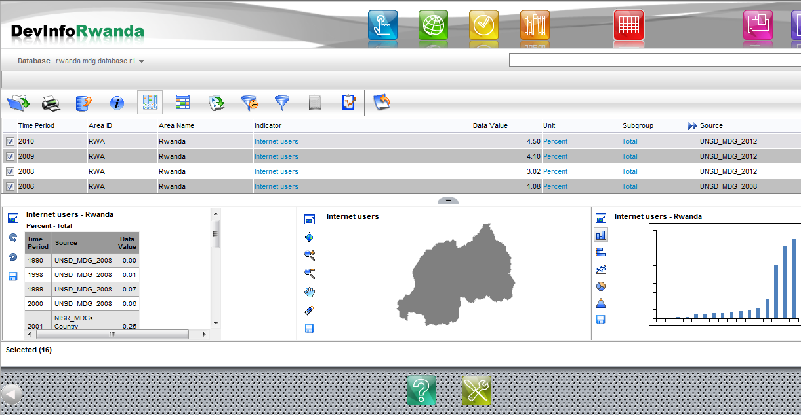
View Data

Slide 46

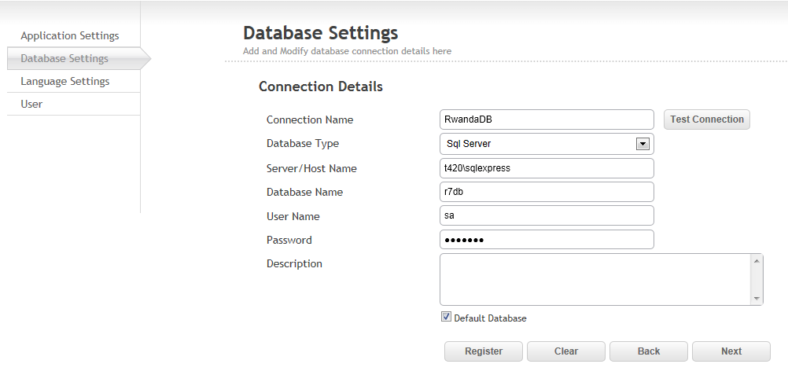
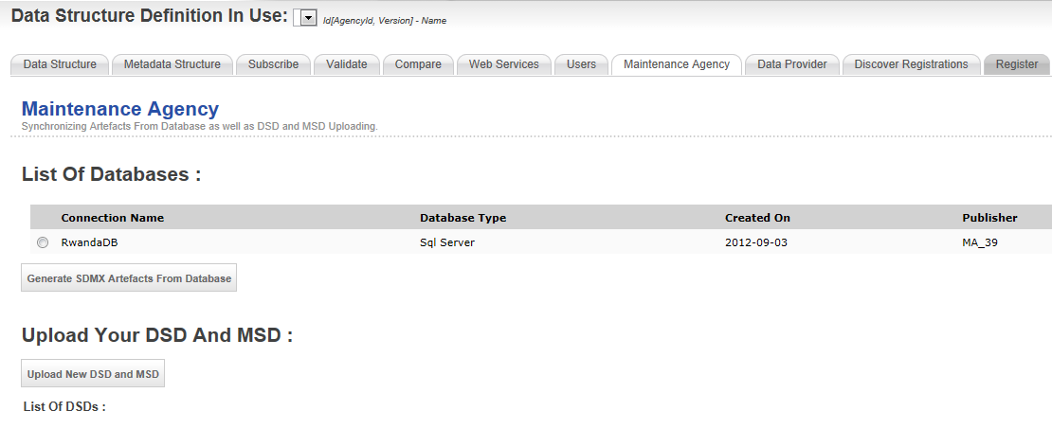
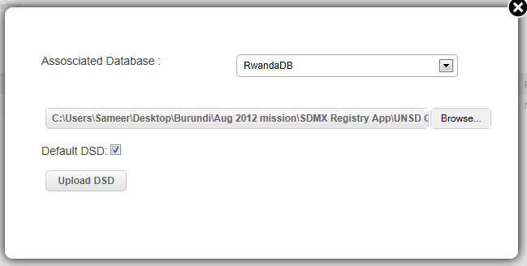
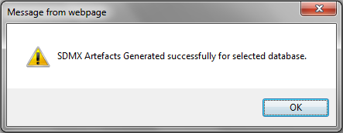
Upload DSD

Slide 47


View Artifacts

Slide 48



Subscribe for Data

Slide 49



Map Codes

Slide 50




Publish Data

Slide 51


Get Notifications

Slide 52
www.devinfo.org
support@devinfo.info

