Slide 1
Evolution of the Storage Brain
Using history to predict the future
Larry Freeman
Senior Technologist
NetApp, Inc.
September 6, 2012

Slide 2
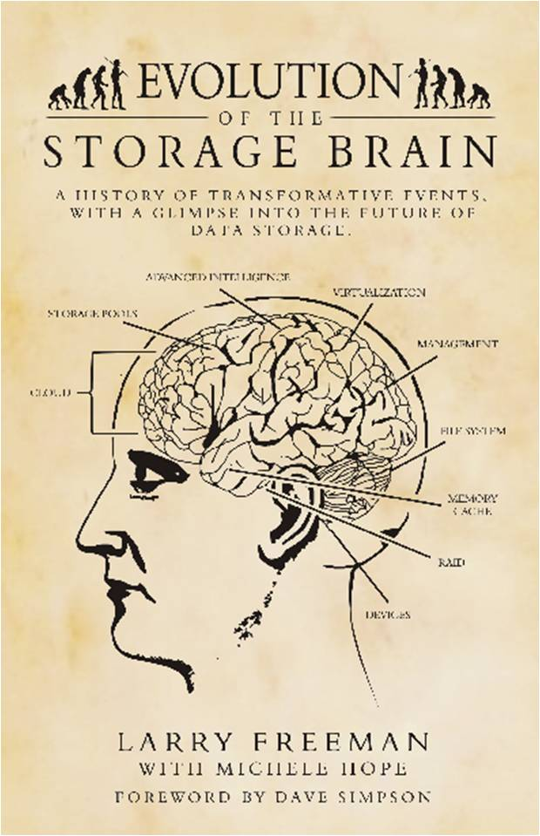
Introduction
30-year view of data storage from an industry observer
The storage brain has evolved much like the human brain
Increasingly complex and sophisticated
Many functions have become autonomic:
  Self-governing
  Self-learning
  Self-healing
This book discusses the reasons behind technologies that succeeded, any many that failed

Slide 3
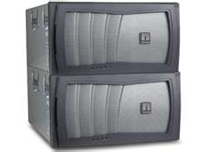
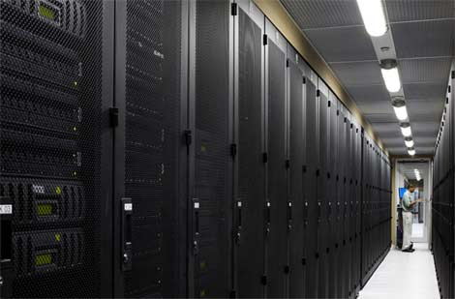
Today’s Data Center
No longer a “Computer Room”
Highly virtualized
  A pool of shared resources
  Nothing is “real”
Three infrastructures are emerging:
  Compute
  Storage
  Networking
Storing data in the cloud makes things easier, and harder

Slide 4
Data Growth 1980-2010 (Observed)
1980 – 10GB
1988 – 100GB
1995 – 1TB
2003 – 10TB
2008 – 50TB
2010– 100TB

Slide 5
Data Growth Projection 2010-2040 (Historic)
2010 – 100TB
2018– 1PB
2025– 10PB
2031– 50PB
2035 – 100PB
2040– 1,000PB (1 Exabyte)

Slide 6
Data Growth Projection 2010-2040 (Current)
2040 – 19 Exabytes Online??

Slide 7
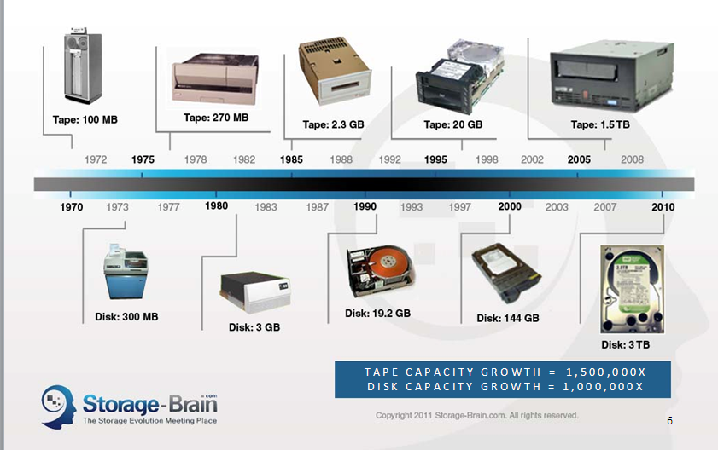
The Evolution of Storage Devices

Slide 8
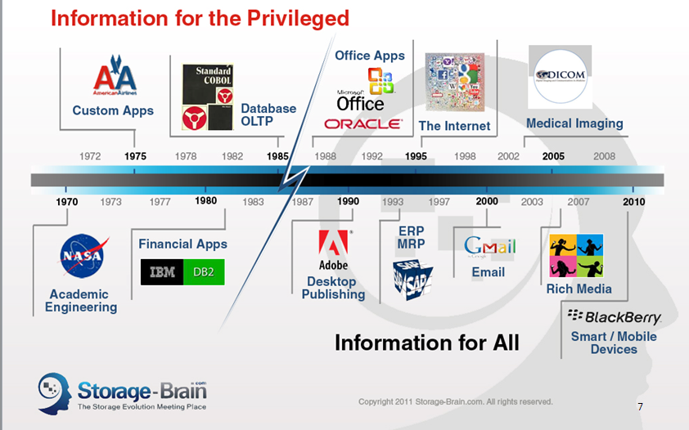
The Evolution of Data Applications

Slide 9
Top Ten Storage Innovations (1980-2010)
Year | Innovation
1980 | Small Form Factor Magnetic Disk Drive. Small, inexpensive, disk drives allowed the formation of storage arrays.
1986 | Small Computer Systems Interface (SCSI). SCSI gave us the common framework to tie all those drives together.
1987 | Redundant Array of Independent Disk (RAID). RAID protected us against drive failures that might have otherwise brought down an entire storage system.
1988 | System-Managed Storage (SMS). SMS provided the foundation for today’s cloud-enabled storage.
1988 1990 | Network-Attached Storage (NAS). Storage Area Networks (SAN). | Both NAS and SAN gave us the ability to cut the umbilical cord of storage, thereby creating infinitely expandable shared networks.
1992 | Intelligent Caching Storage Controller. Intelligent caching brought memory into the forefront of storage systems.
1995 | Virtualized Storage Array. The virtualized storage array taught us that storage need not be bound by physical disk properties.
1999 | Application Service Providers (ASP). ASPs proved that open systems applications could be shared broadly and stored centrally.
2002 | Storage Resource Management (SRM). SRM software brought sanity to the management of constant data growth.
The golden age
of innovation

Slide 10
A Quote From the Book
Looking back, I am sure if I tried to convince anyone in Raytheon’s 1980 [10GB] data center that they might someday be responsible for managing 100TB, they would have revoked my access badge. After all, this was 10,000 times more storage than they were used to seeing. But, here we are in 2010 and 100TB is a reality. Reasonable discussions are being held today as to whether or not we will see data grow again by a factor of 10,000 over the next 30 years.
The questions I, therefore, leave you with are:
How long will this data growth continue?
What will drive data growth over the next 30 years?
At what rate will it grow?

Slide 11
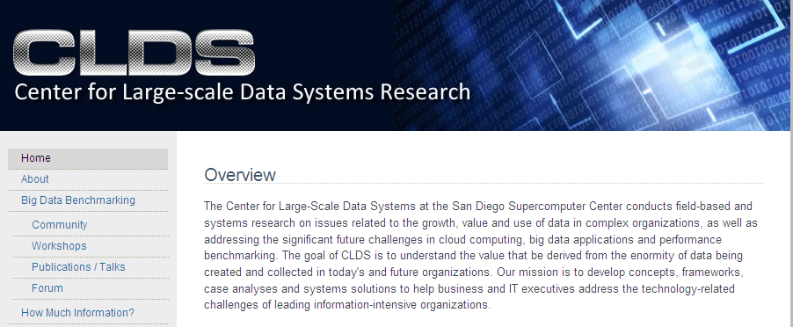


UC San Diego Data Growth Research
“Our motivation in researching data and data growth are several: first, we appear to be at a critical inflection point in our understanding of how Moore’s Law improvements in compute, network and storage capacities are ushering in new paradigms in data intensive computing.
Secondly, we need more and better use case analyses of how companies are leveraging the opportunities in data growth – where is the value in all of this data? More and better recording and analysis of emerging, successful practices is important.”
James Short, PhD
Principal Investigator
Chaitan Baru, PhD
Distinguished Scientist
http://clds.ucsd.edu/

Slide 12
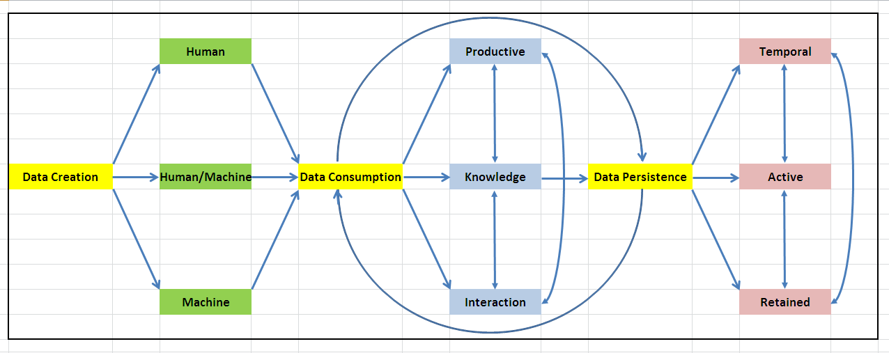
Data Taxonomy Model
Data exists in 3 states:
  Creation, Consumption, Persistence
Clues in determining the value of data:
  The creation point
  The time spent in consumptive state
  The time spent transiting in consumptive and persistence states

Slide 13
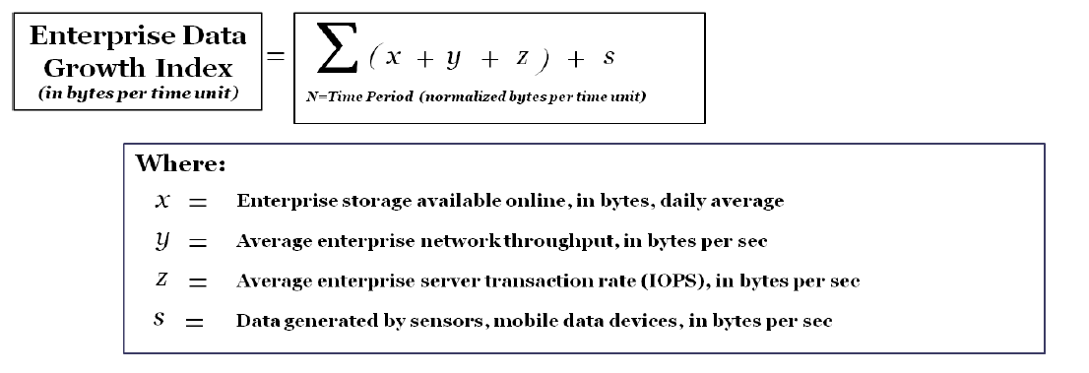
The Enterprise Data Growth Index (DGI)
Examines data value from multiple perspectives:
  Large datasets that are never accessed?
  Small datasets that are continuously computed?
  Very active traffic on a small amount of data?
Tools do not currently exist that place relative value on data
The DGI could be of great use as a business investment tool

Slide 14
Next Steps
Taxonomy refinement
Sponsor review
Use case studies
Published findings
Further research:
  Industry-specific
  Workload-specific

Slide 15
Questions/Comments? larry.freeman@netapp.com jshort@ucsd.edu

