Slide 1
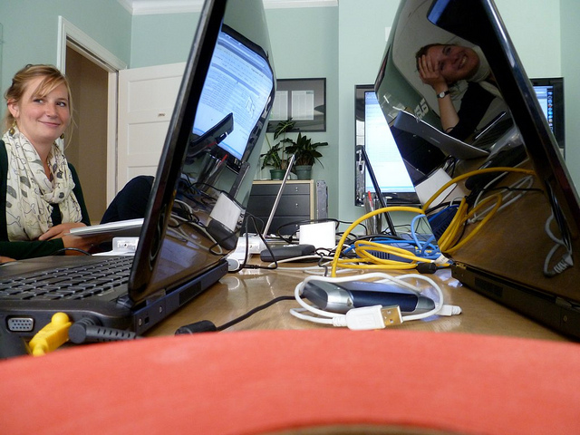
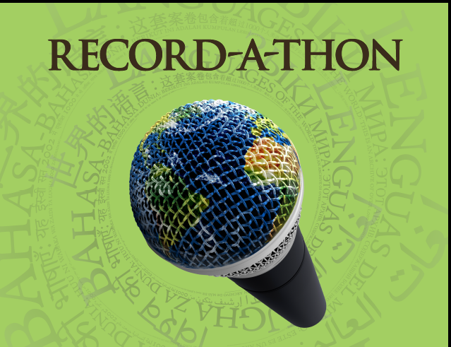
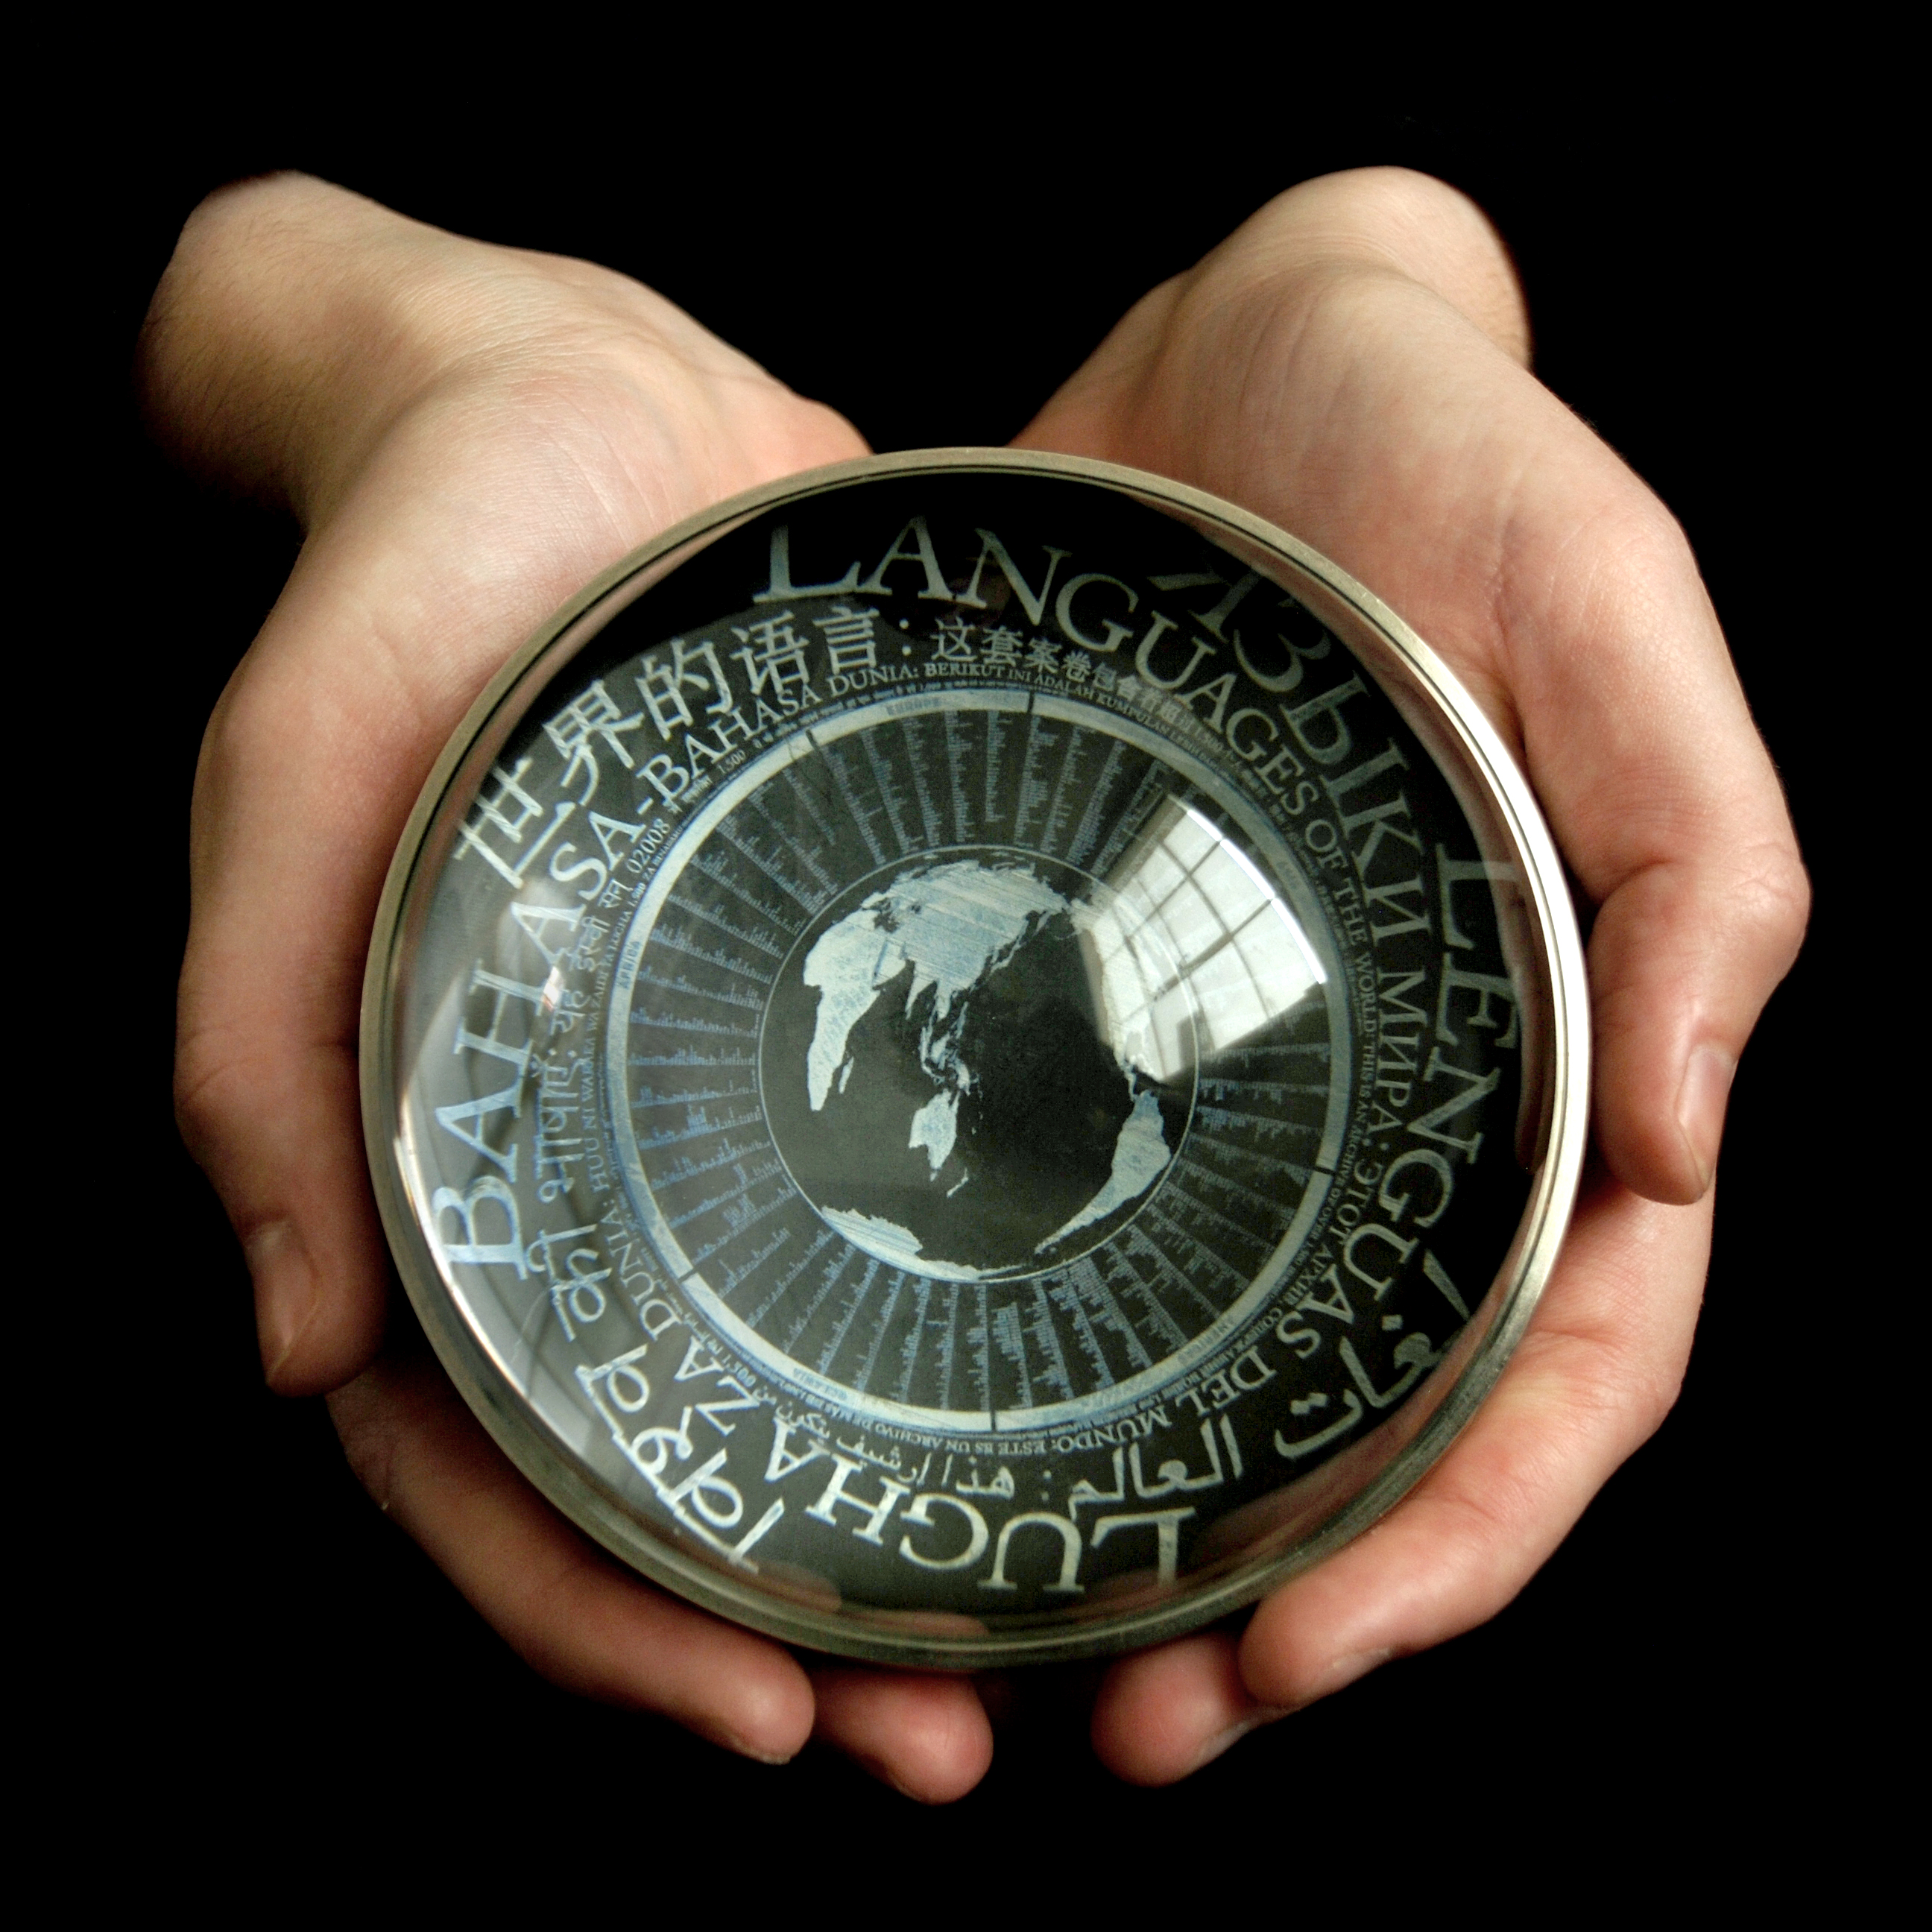
Big Data for Small Languages
Laura Welcher
The Long Now Foundation / Rosetta Project

Slide 2
Top ten languages by native speakers (millions)
Data from The Ethnologue. (2009). Retrieved at www.ethnologue.com

Slide 3
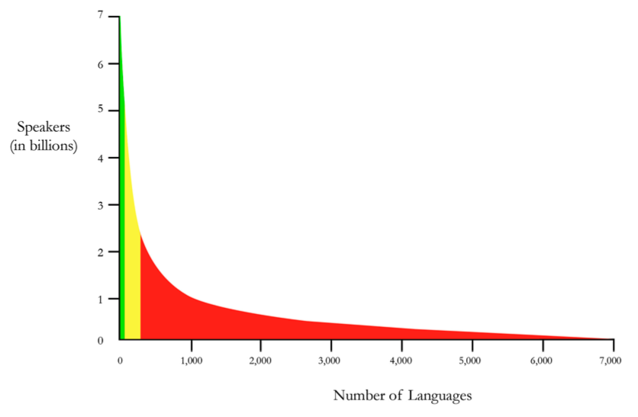
The “Long Tail” of Human Language
1 Billion
100 Million
10 Thousand
Half the world population speaks one of 10 languages (>1%)
Most everyone else speaks one of 300 languages (4%)
5% of the world speaks one of 6,500 languages (95%)
Number of Languages
Data visualization by Laura Welcher – laura@longnow.org

Slide 4
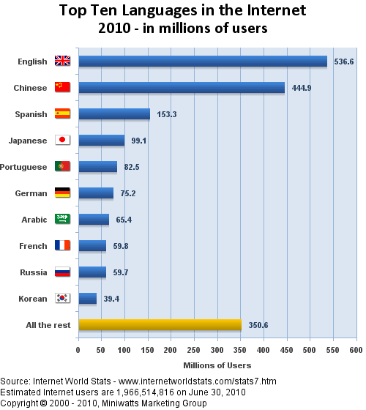
Top 10 Languages in the Internet
50%
32%
18%

Slide 5
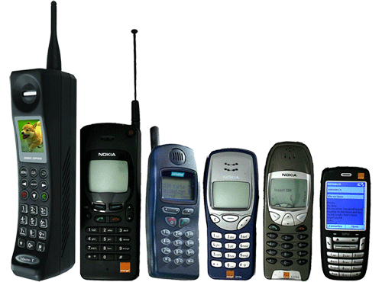
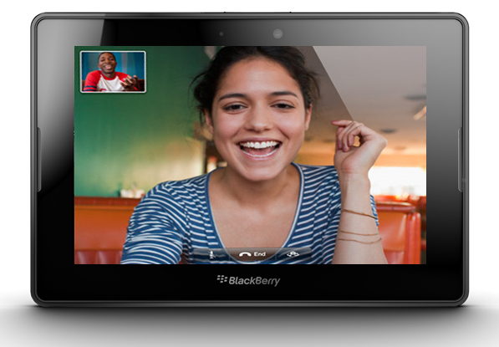
Why does the long tail matter?
There is commercial interest in enabling the ~300 most widely spoken languages in the digital domain – if digital technologies work for this group of languages, that represents 95% of humanity.
As mobile phones are nearly ubiquitous (87% penetration worldwide) and global internet access is approaching 1/3 of the human population, enabling the long tail of languages in the digital domain increasingly matters.
The other ~6,500 languages are not of commercial interest, but there are other reasons to enable them if possible – to provide access to information, to provide a critical new domain of use for endangered languages, for better linguistic knowledge of them, for response in a crisis (“surge languages”).

Slide 6
Language use in the digital domain – basic needs
Written form of the language is important – but probably not essential
Most languages of the world do not have a written form
Any language can be transcribed
Interaction in the digital domain is still very text-heavy
Multilingual infrastructure
ISO 639-3 or later, Unicode, locale data
A “BLARK” - Basic Language Resource Kit (Krauwer, 2003)
Less than 100 languages “have managed to assemble the basic resources needed as a foundation for advanced end-user technologies: monolingual and bilingual corpora, machine-readable dictionaries, thesauri, part-of-speech taggers, morphological analyzers, parsers, etc.” (Scannell, 2007).
Only about 20-30 of the world’s languages have advanced language technologies like speech recognition, and machine translation (Hughes and Maxwell, 2006).

Slide 7
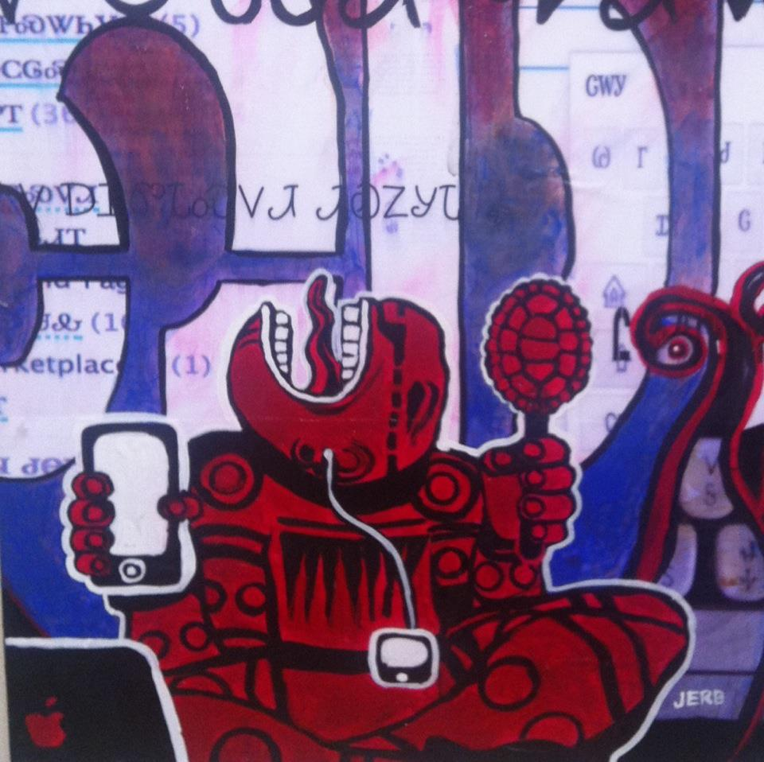
Long-tail languages need corpora
Most (98%) of long-tail languages have very few of these tools
As a precursor to the development of these tools they need corpora.
Machine Translation: several million words of parallel text, plus tens of millions of words of monolingual text in the target language.
Speech recognition: Tens of hours of transcribed speech to build acoustic models, and millions of words of text as a basis for a model of word-sequence probabilities.
Speech synthesis: Tens of hours of phonetically transcribed speech from individual speakers.
Painting by Joseph Erb

Slide 8
How do we build corpora for small languages?
How do we build these corpora?
Do we purpose create them?
Discover and aggregate them?
Do these strategies scale to address the size of the long-tail?
Do any of them address the rate of global language shift and language loss?
How do we make what we build usable as a speech corpus?
Speech must be transcribed
Scanned manuscripts must be transliterated and / or OCR’d
Texts must be translated
There are significant challenges in all of these areas!
What other strategies might be employed?
Can what we develop for larger languages work for the small ones?
Or can we create new mechanisms that work with less data?

Slide 9
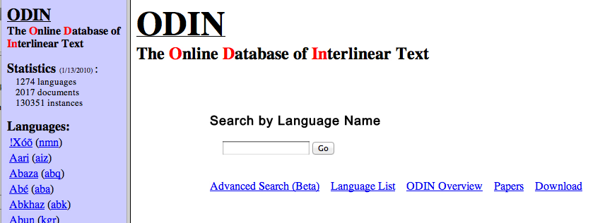
Discover and aggregate – ODIN (Lewis 2006)
ODIN Online Database of Interlinear Text
Web crawler that identifies linguistically analyzed text
Over 130,000 instances in 2,000 PDF documents
Rectified (by discovery or hand-editing) to 1,274 language codes
Used as the basis for building grammatical profiles for each language
http://odin.linguistlist.org/

Slide 10
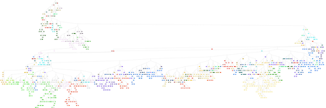
Discover and aggregate - An Crúbadán (Scannell, 2007)
Set of crawlers that calculate probability of 3-character sequences
Provides a unique “fingerprint” for a written form of a language
Maps them onto language codes (ISO 639-3)
Has identified over 1,000 different languages in use online
Tool bootstrapping: has created wordlists, spell-checkers, simple morphological analyzers, and part-of speech taggers
http://borel.slu.edu/crubadan/index.html

Slide 11
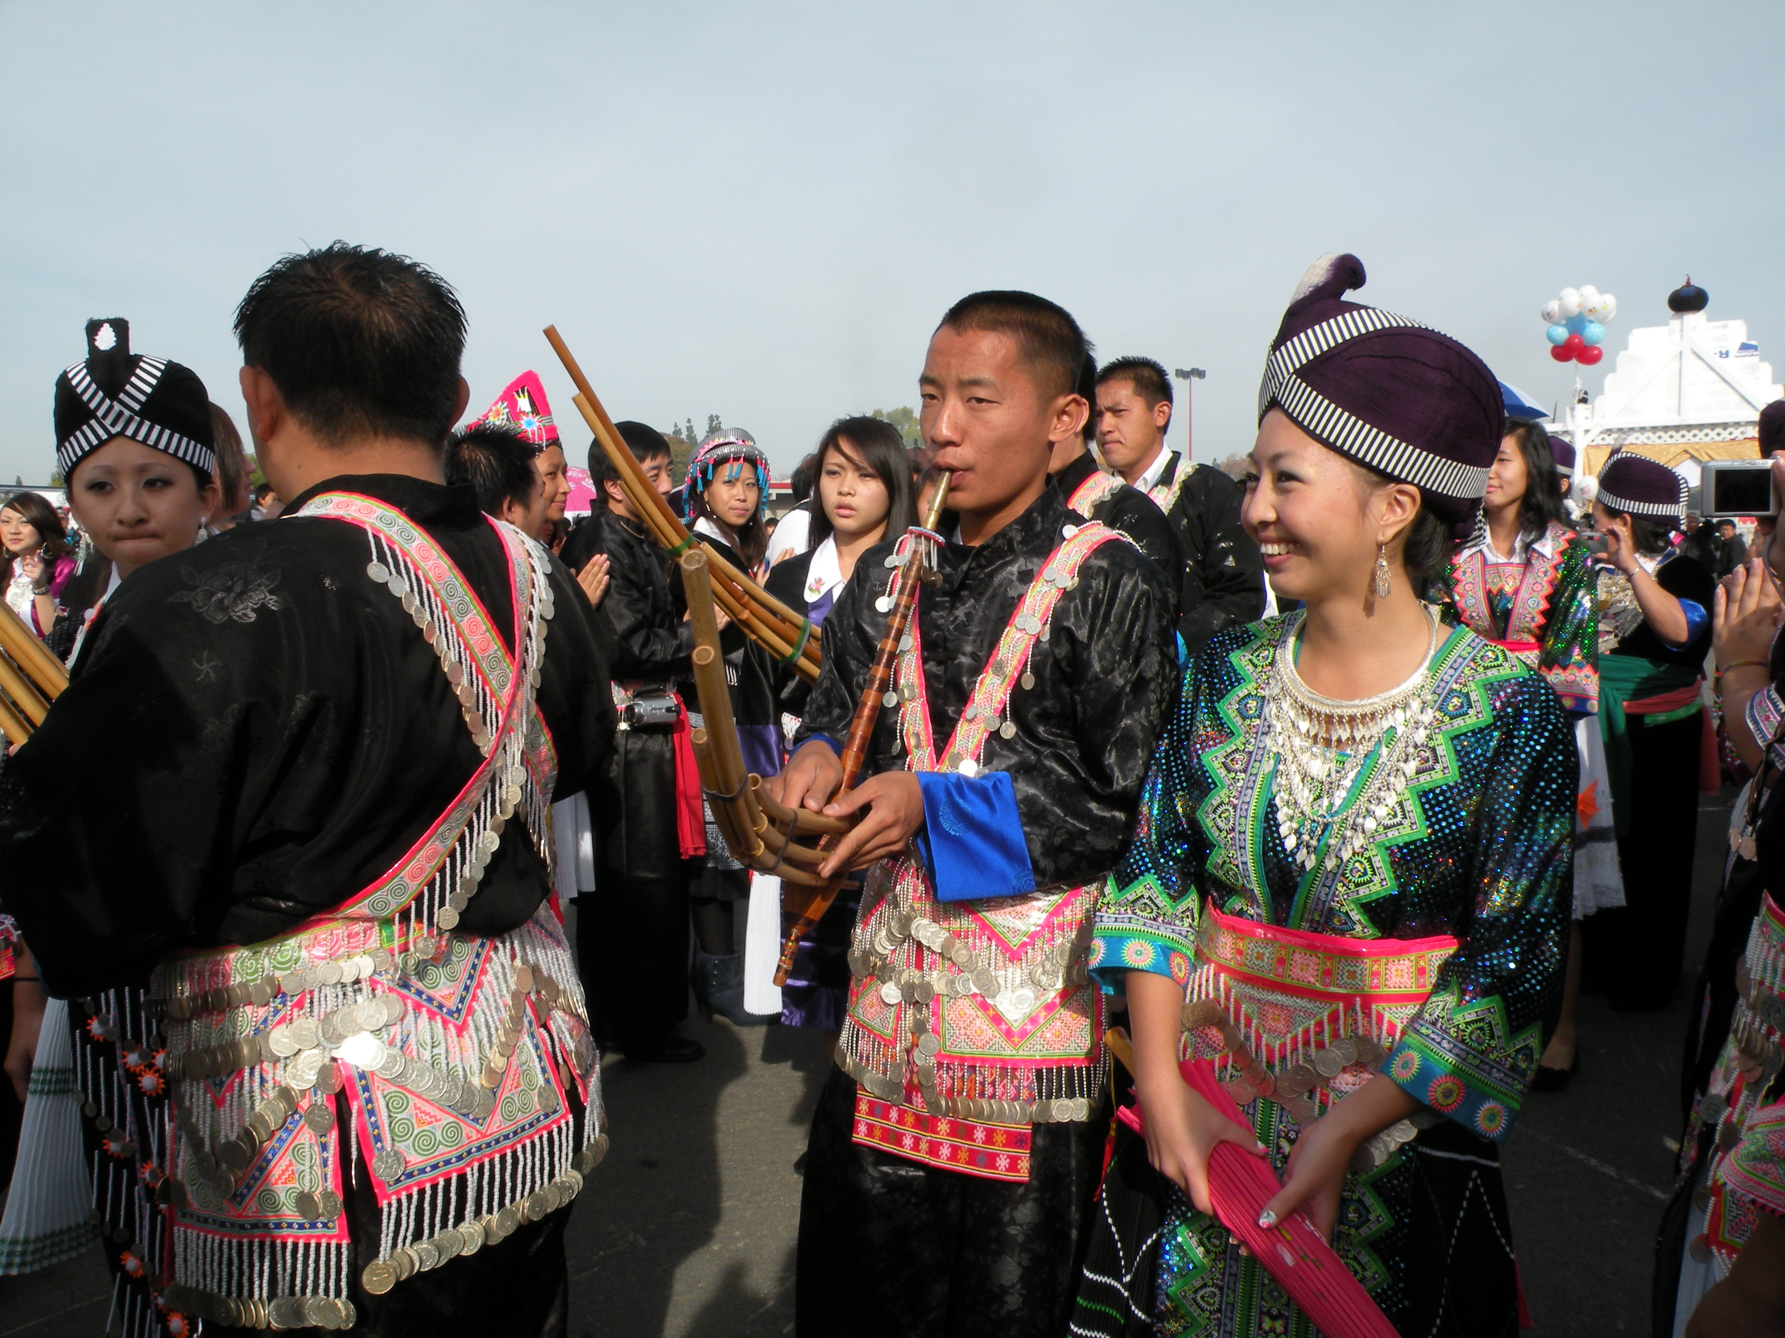
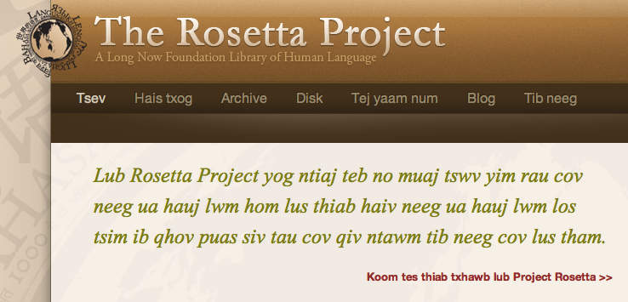
Purpose Create: Bing Translate for Hmong Daw
9 million speakers, Latin script in primary use.
Large immigrant population in California, challenge is access to information for Hmong dominant speakers, language shift among children.
Project of Microsoft Research based on earlier work with Haitian Creole
Microsoft research partnered with Hmong Daw community to train the translator – crowdsourced the creation of a parallel document corpus.
Started in November 02011, launched in March 02012.
Now websites can be localized in Hmong Daw with Bing translate
Rosetta Project website localized in Hmong Daw
http://www.bing.com/translator/

Slide 12
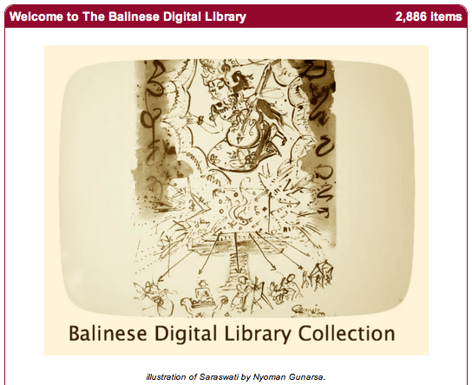
Purpose create - Internet Archive Balinese Lontars
How do we enable 1,000 or more languages to thrive well into the future? Bring them into the digital domain.
New Balinese collection at the Internet Archive a pilot – digitized nearly the entire set of literary works for Balinese, recorded on palm leaves (“lontar manuscripts”)
Next steps - need transcriptions (difficult OCR, most speakers have limited literacy in Balinese), translations into Indonesian
http://archive.org/details/Bali

Slide 13
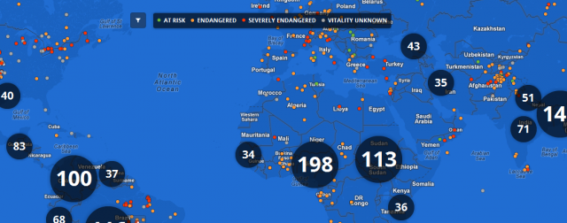
Purpose Collect – Endangered Languages Project
Launched as a Google initiative in partnership with NSF funded project to catalog the world’s endangered languages
One page for each endangered language, where speakers and linguists can upload related documents and media (vetted by an editorial team)
Very new – if it succeeds, will build a rich store of multilingual corpora
http://www.endangeredlanguages.com/

Slide 14
Purpose collect – the PanLex Project
Long Now Foundation project
Massively multilingual lexical database, with the goal of assembling and linking all of the words of all the world’s languages.
Currently has 500 million documented translations between 17 million expressions, and can infer billions more.
Coverage is for about 6,000 languages – many of which have no other translation resources
Has demonstrated successful lemmatic translation between unrelated languages.
http://panlex.org

Slide 15
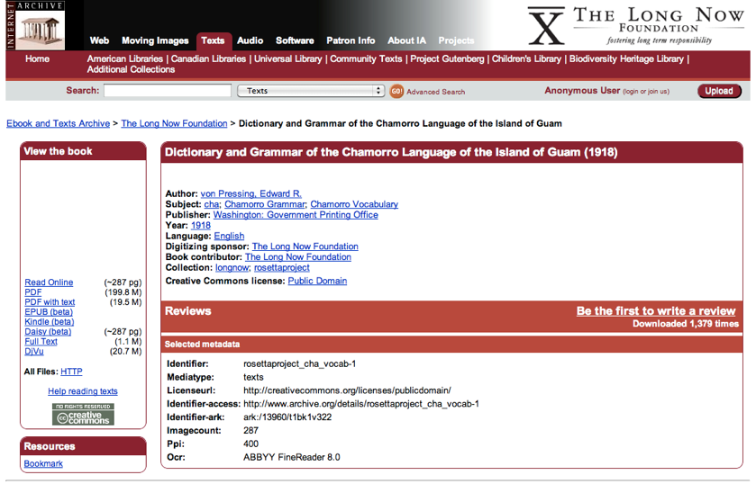
Purpose collect – The Rosetta Project Archive of the World’s Languages
Special Collection in the Internet Archive – open access
Thousands of texts, also audio and video in over 2,500 languages
Many parallel texts and wordlists
http://archive.org/details/rosettaproject

Slide 16
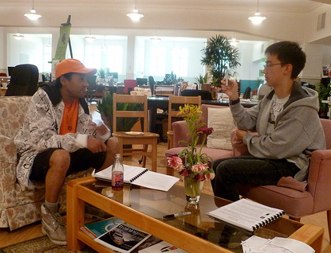
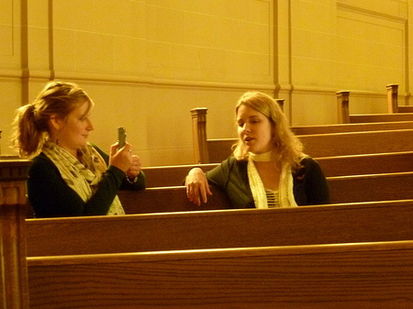
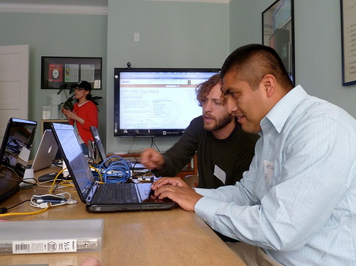
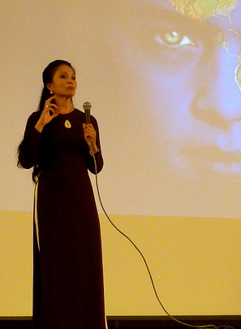
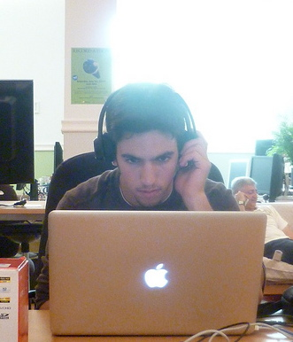
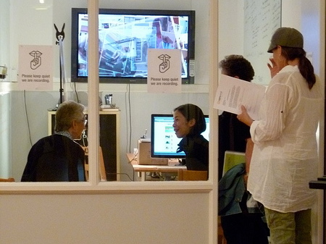
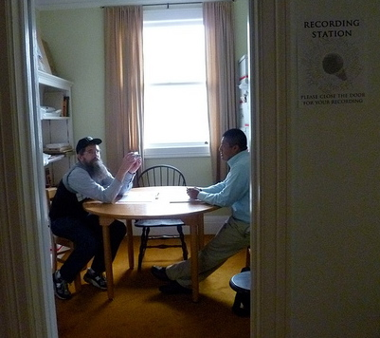
Purpose create / archive – Rosetta Record-a-thon
http://archive.org/details/rosettaproject_recordathon

Slide 17
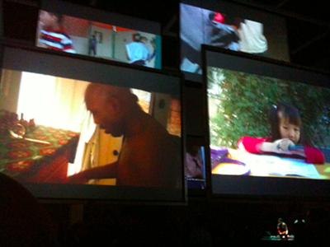
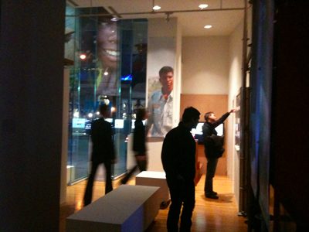
Incidentally create – Global Lives Project
http://www.globallives.org

Slide 18
Sticky challenges
Document transcription by hand – Robust OCR still limited to relatively few languages and scripts, still very tricky with manuscripts (challenges for both PanLex and the Internet Archive Balinese project).
Reducing the need for audio transcription as essential pivot (challenge for Rosetta Record-a-thon project) – more recent advances in automatic speech recognition (ASR) methods could help.
The huge size of the corpus needed for robust translation into and out of the language – strategies like PanLex’s lemmatic translation could help as an alternate strategy.
Getting more language data for more languages – ‘if you build it, will they come?’ (a challenge for the Google Endangered Language Project as well as the Rosetta Project, generally)
Making sure that datasets are both open, and archived in a repository committed to long-term preservation and access – because the resources we are assembling for long-tail languages are a record of our humanity.

Slide 19
Thank you!
Laura Welcher
The Rosetta Project at
The Long Now Foundation
laura@longnow.org

Slide 20
Sources cited:
Krauwer, Steven. 2003. The Basic Language Resource Kit (BLARK) as the first milestone for the language resources roadmap. In Proceedings of 2nd International Conference on Speech and Computer (SPECOM2003).
Lewis, W. D. 2006. ODIN: A Model for Adapting and Enriching Legacy Infrastructure, in ‘Proceedings of the e-Humanities Workshop held in cooperation with e-Science 2006: 2nd IEEE International Conference on e-Science and Grid Computing’, Amsterdam http://faculty.washington.edu/wlewis2/papers/ODIN-eH06.pdf
Maxwell, M and B. Hughes. 2006. Frontiers in linguistic annotation for lower-density languages. In Proceedings of the Workshop on Frontiers in Linguistically Annotated Corpora 2006, pages 29–37, Sydney, Australia, July. Association for Computational Linguistics.
Scannell, K. 2007. The Crúbadán Project: Corpus building for under-resourced languages. In C. Fairon, H. Naets, A. Kilgarriff, G-M de Schryver, eds., “Building and Exploring Web Corpora”, Proceedings of the 3rd Web as Corpus Workshop in Louvain-la-Neuve, Belgium. http://borel.slu.edu/pub/wac3.pdf

