Slide 1
Leveraging Social Media Data as Real-Time Indicators of X
September 7, 2012

Slide 2
Outline
Opportunities and Challenges in Big Data
Sentiment Tracking
Methods
Validating Results
Case Study: Heat Mapping
Case Study- Economic forecasting
Notes:
over the past few days I’ve been able to see a number of wonderful talks at this conference that showed the breath and depth of work seeking to harness the data in ways that are novel and important in some ways providing new answers to old questions in others ways of providing answers to questions we thought were not possible to answer. Thoughts on big data how it relates to HIS’s corporate mission and talk specifically about a key area of innovation that HIS is excited to announce in conjunction with Janice analytics a startup firm based out of Boston. Genesis technology which is built upon their experiences academics who produced the 1st real-time twitter sentiment tracker in the world is the kind of product innovation that we seek to incorporate into a variety of areas and we believe will be one of the examples of technology that makes the promise of the data something that turns into reality a be talking as well about some case studies of how you can take real-time sentiment technology applied into key areas including security and economic forecasting. Given the level of sophistication of this audience I know they would expect nothing less than some hard results they can stand up to scrutiny and I hope to provide them today which shows how real-time social media streaming technology can be used to both prevent and predict events in the real world.

Slide 3
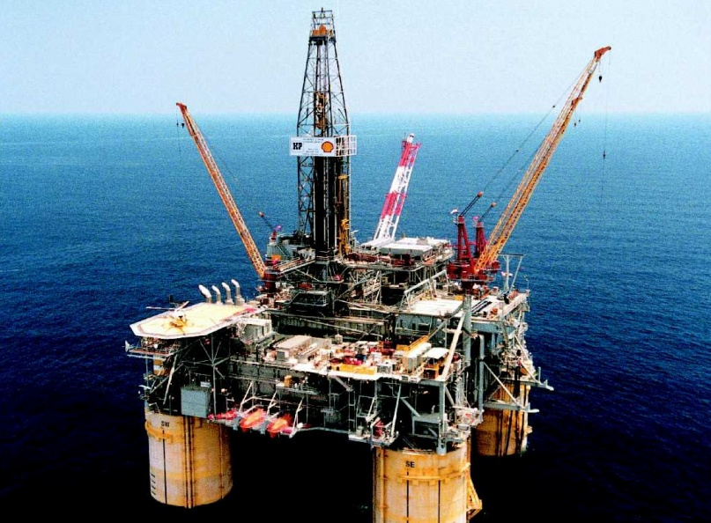
The Energy Market as a Metaphor
Big Data
Energy
Variety of Sources
High Volume
Converting to valuable product is a particular challenge that varies on topic area
Variety of sources
Tremendous potential value
Extraction, delivery and conversion a challenge
Notes:
As a bit of background about myself I started out in the energy sector after obtaining my PhD focusing on power grids I moved onto Cambridge energy research Associates or S which was eventually acquired by HIS. My background in energy has proved surprisingly useful to me as I have enter the world of big data and large be data analytics. Why is that was it turns out the energy market is an apt metaphor for the oncoming big data revolution both are incredibly important resources that come from a variety of sources the possession of such data or resources is greatly valuable and the search for new sources of resources or data is incredibly important. However, turning these resources in the something useful and were manageable in a way that allows for economies of scale and scope is a challenging task that varies aced upon the end-user needs as well as the poor quality of the data itself and the cost of wiring it in the 1st place. At Sierra, we recognized that the most promising energy technologies were those that could convert new sources or resources into a quality source of economic generation. However, we also appreciated the difficulty of converting such material in the something useful, while also recognizing that the best options in any energy plan or corporate strategy is to get the best possible and purest forms of these resources to minimize the difficult tasks of converting it into something useful

Slide 4
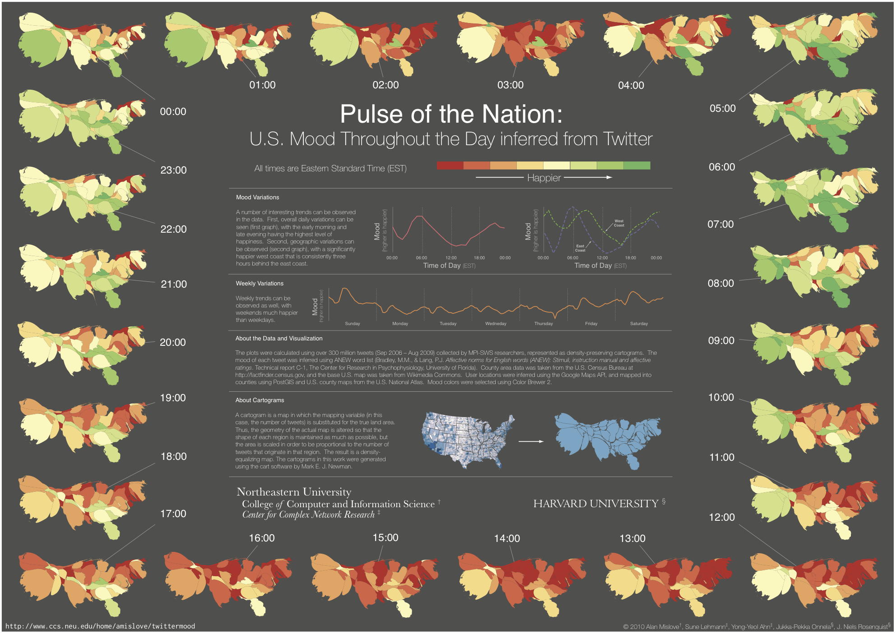
Key Product Area: Real-time sentiment
Starting Point – Pulse of the Nation – “Twittermood” (2010)
Video of Twittermood
Notes:
to any of you recognize for looking at right now this is a real time map of sentiment more mood if you will of the United States over a two-week period in the spring of 2010 using cartogram technology that allows for the overall area of various states to be representative of the number of tweets one can see patterns over the course of a day clearly for example I would suggest the people to move to California or the West Coast. During this technology known as pulses the nation, one one of Master Bulls coveted (I should note that is an old-school suit I’m using my colleague Janice’s language year of coveted” 2010 visual of the year award. This initial foray into sentiment suggested to them that there may be commercial opportunities and they went to form a company Janus analytics that sought to test how accurate sentiment tracking could be in real time not just in the United States but around the world. For those of you in the audience were not as familiar with natural language processing I now would like to give a brief to her of how this technology works evidence to suggest that it is internally valid, and provide compelling cases of extra validity as well that will be part of the innovation research agenda at HIS for many years to come.

Slide 5
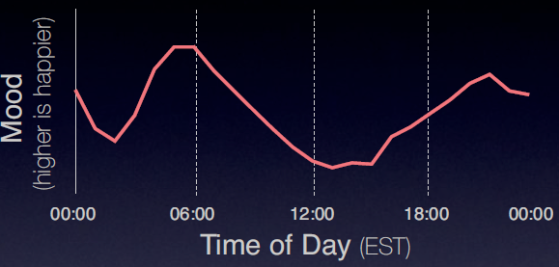
Analysis Approach and Methods
Sentiment analysis well-studied in the academic literature
NLP techniques often expensive
Luckily, Twitter messages are short
First cut: Look for occurrences of words (Use ANEW or EMOT word list)
Second cut: associate words and emoticons
TWEET EXAMPLES:
My new Ford Focus needs repair again, so frustrating ☹
Just back from road trip, loved the comfort of my new Accord ☺
Visualize trends over course of day, week and can overlay geography with location of users
Mood Score
Notes:
WILL NEED TO LINK WITH NEWER NLP MODEL (EMOTICON BASED) AS THIS COULD BE SOMEWHAT CONFUSING

Slide 6
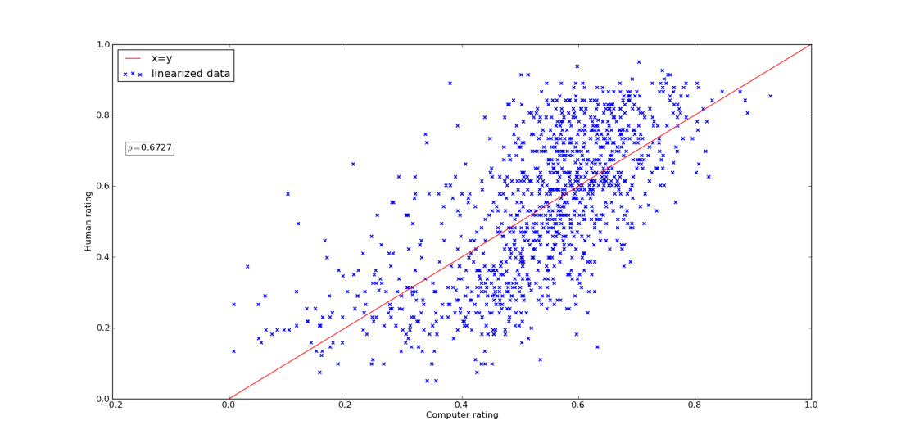
OPTIMIZING SENTIMENT ACCURACY
Amazon’s Mechanical Turk Test is used to compare our proprietary sentiment scoring of tweets with those of human raters.
Best inter-rater reliability correlation between humans is 0.80 (gold standard).
Our test of our algorithm’s sentiment assignment resulted in Pearson and Spearman correlations of ~0.75.

Slide 7
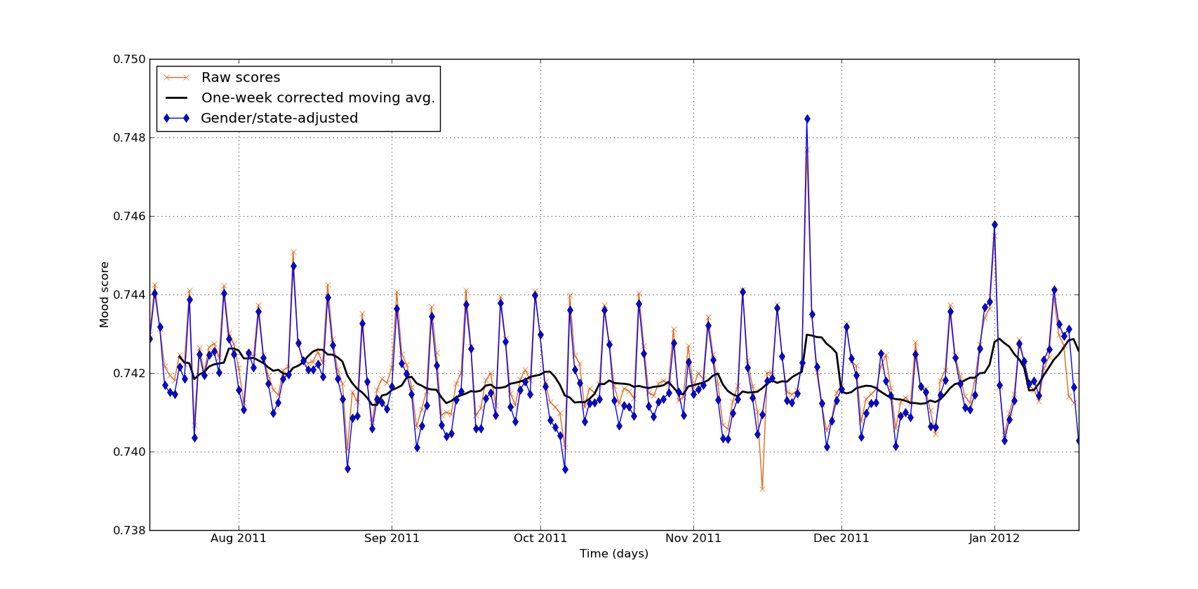
CONTROLLING FOR SAMPLE BIASES
We adjust the daily average by population size and gender make-up from census data. A tweet from some state can be weighted by the relative proportion of that state’s population to the U.S. It can be further weighted by gender ratio within the state.

Slide 8
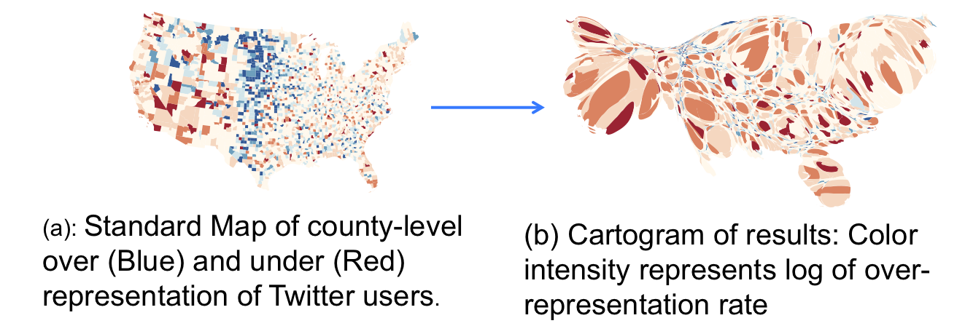
Correcting for Population Levels

Slide 9
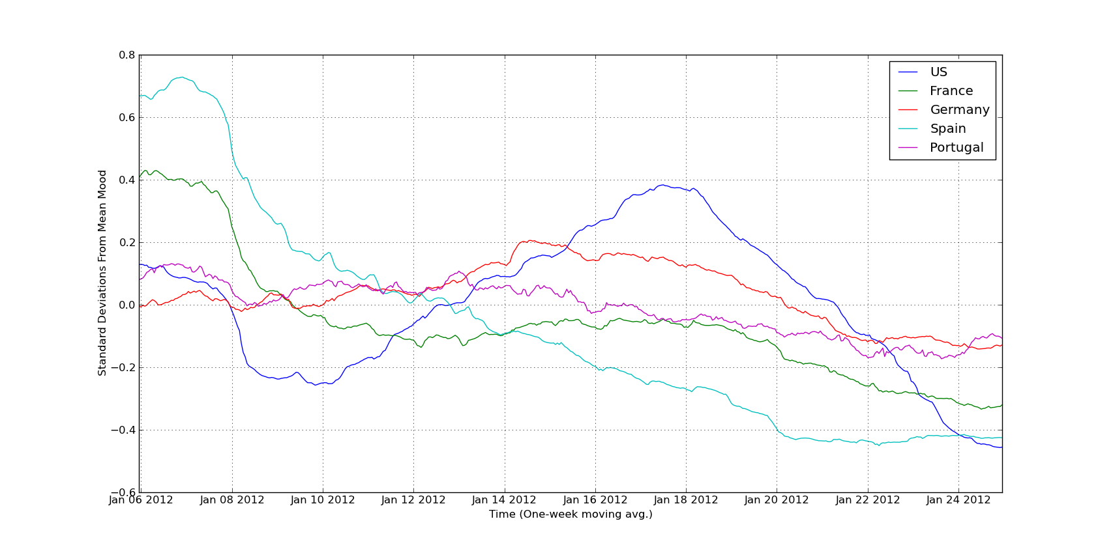
MOVING BEYOND U.S. BORDERS
Compared U.S. data to data of 4 European countries (using different languages) over the past month.
One-week moving average shows broad trends, with some similarity in overall shape, differences in degree of variation.

Slide 10
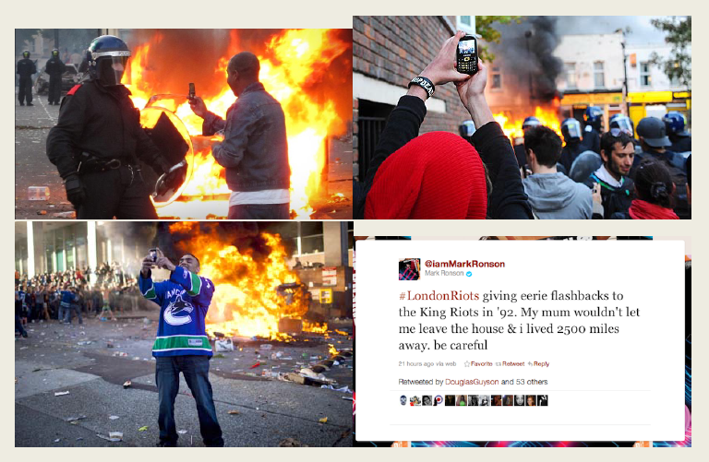
The Revolution Will BE Tweeted

Slide 11
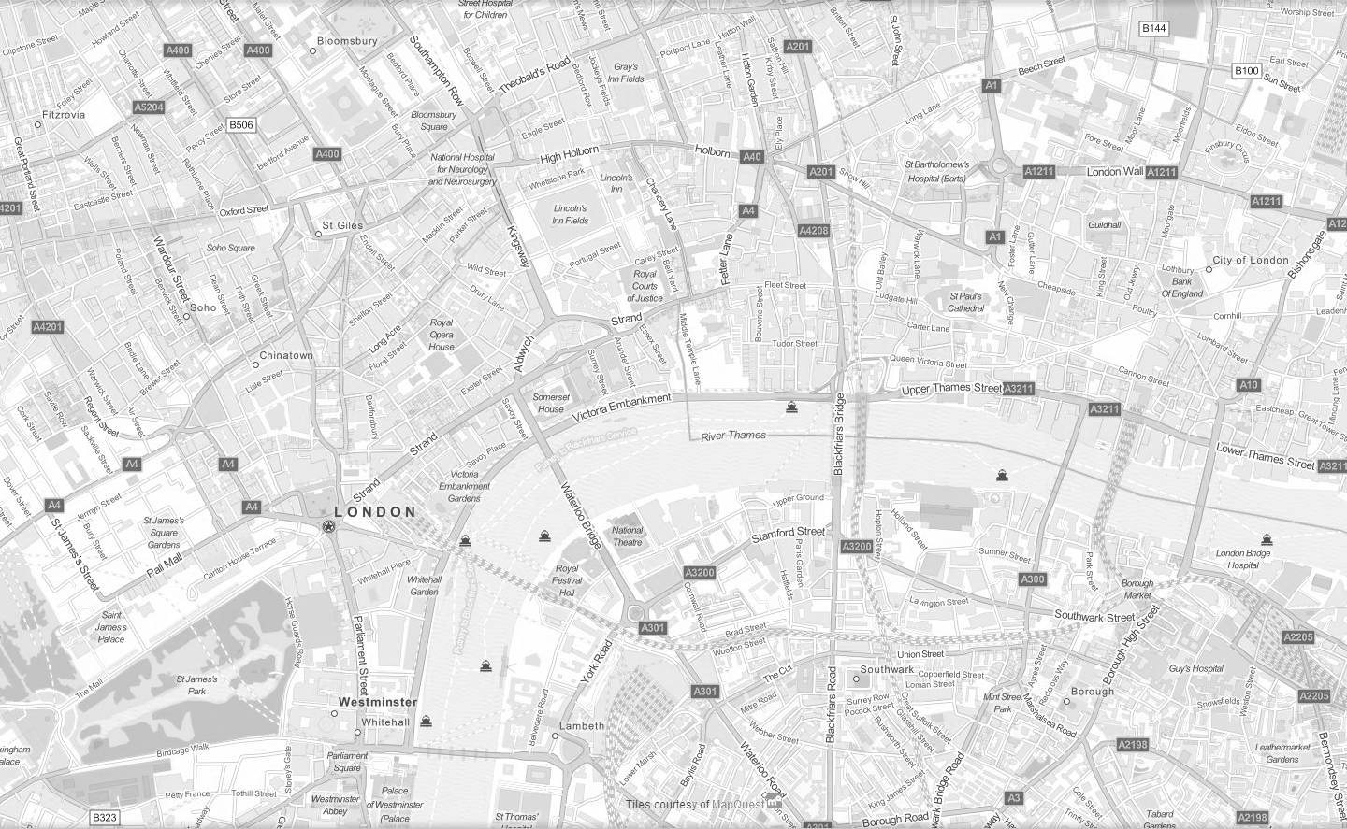
Central London

Slide 12
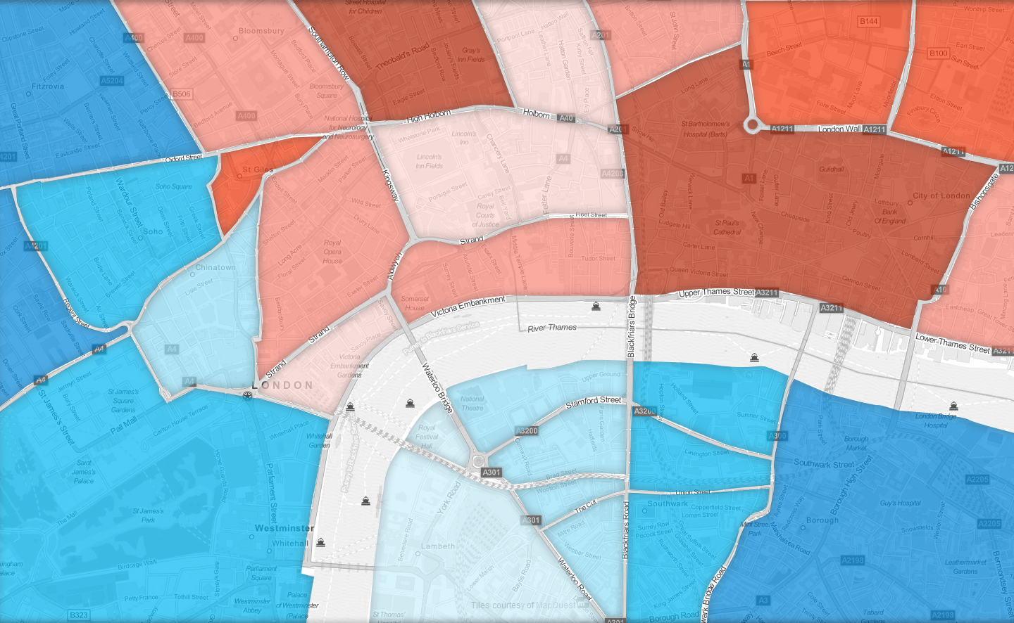

Slide 14
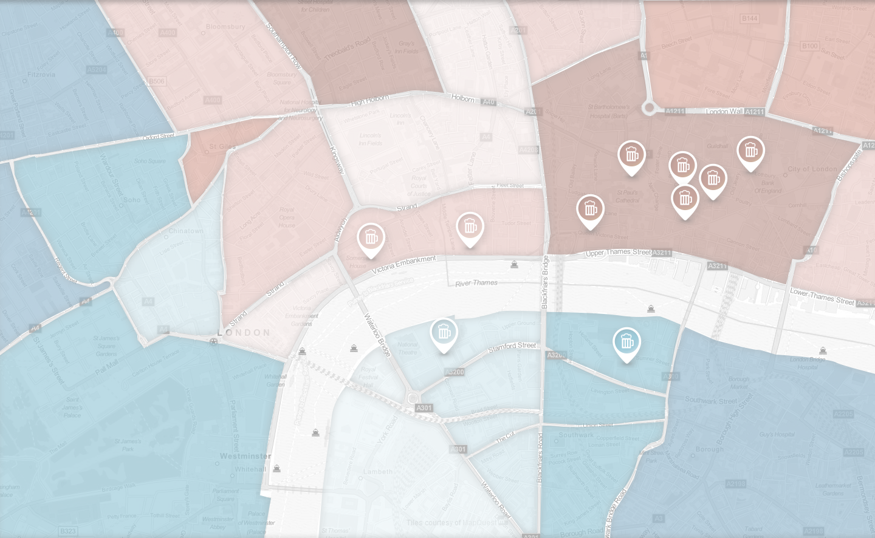
Alcohol
Compilation of Trigger Messages
Search for…
Top Tweets
"...and another round of Chivas
goes down!"
'....we are pissed..."
"...bloody City, chokes again, send me another, bartender..."

Slide 15
Sentiment + the economy
Validity of mood scores:
Internal: Our algorithm does an extremely good job of matching human scoring of mood
External: When we construct a ‘sentiment’ measure from the individual tweets, this measure moves in ways that are not surprising. High on Christmas, low after earthquakes
External: How is this sentiment measure correlated with economic activity?
Notes:
over the past few days I’ve been able to see a number of wonderful talks at this conference that showed the breath and depth of work seeking to harness the data in ways that are novel and important in some ways providing new answers to old questions in others ways of providing answers to questions we thought were not possible to answer. Thoughts on big data how it relates to HIS’s corporate mission and talk specifically about a key area of innovation that HIS is excited to announce in conjunction with Janice analytics a startup firm based out of Boston. Genesis technology which is built upon their experiences academics who produced the 1st real-time twitter sentiment tracker in the world is the kind of product innovation that we seek to incorporate into a variety of areas and we believe will be one of the examples of technology that makes the promise of the data something that turns into reality a be talking as well about some case studies of how you can take real-time sentiment technology applied into key areas including security and economic forecasting. Given the level of sophistication of this audience I know they would expect nothing less than some hard results they can stand up to scrutiny and I hope to provide them today which shows how real-time social media streaming technology can be used to both prevent and predict events in the real world.

Slide 16
State-level analysis
Notes:
over the past few days I’ve been able to see a number of wonderful talks at this conference that showed the breath and depth of work seeking to harness the data in ways that are novel and important in some ways providing new answers to old questions in others ways of providing answers to questions we thought were not possible to answer. Thoughts on big data how it relates to HIS’s corporate mission and talk specifically about a key area of innovation that HIS is excited to announce in conjunction with Janice analytics a startup firm based out of Boston. Genesis technology which is built upon their experiences academics who produced the 1st real-time twitter sentiment tracker in the world is the kind of product innovation that we seek to incorporate into a variety of areas and we believe will be one of the examples of technology that makes the promise of the data something that turns into reality a be talking as well about some case studies of how you can take real-time sentiment technology applied into key areas including security and economic forecasting. Given the level of sophistication of this audience I know they would expect nothing less than some hard results they can stand up to scrutiny and I hope to provide them today which shows how real-time social media streaming technology can be used to both prevent and predict events in the real world.

Slide 17
Unemployment + mood
Notes:
over the past few days I’ve been able to see a number of wonderful talks at this conference that showed the breath and depth of work seeking to harness the data in ways that are novel and important in some ways providing new answers to old questions in others ways of providing answers to questions we thought were not possible to answer. Thoughts on big data how it relates to HIS’s corporate mission and talk specifically about a key area of innovation that HIS is excited to announce in conjunction with Janice analytics a startup firm based out of Boston. Genesis technology which is built upon their experiences academics who produced the 1st real-time twitter sentiment tracker in the world is the kind of product innovation that we seek to incorporate into a variety of areas and we believe will be one of the examples of technology that makes the promise of the data something that turns into reality a be talking as well about some case studies of how you can take real-time sentiment technology applied into key areas including security and economic forecasting. Given the level of sophistication of this audience I know they would expect nothing less than some hard results they can stand up to scrutiny and I hope to provide them today which shows how real-time social media streaming technology can be used to both prevent and predict events in the real world.

Slide 18
Sentiment + the economy
Takeaway: sentiment measure has some incremental predictive power for state-level changes in unemployment.
Evidence from financial markets: (daily) increases in sentiment measure followed by increases in market volatility.
Overall: evidence for external validity of sentiment indicator.
Notes:
over the past few days I’ve been able to see a number of wonderful talks at this conference that showed the breath and depth of work seeking to harness the data in ways that are novel and important in some ways providing new answers to old questions in others ways of providing answers to questions we thought were not possible to answer. Thoughts on big data how it relates to HIS’s corporate mission and talk specifically about a key area of innovation that HIS is excited to announce in conjunction with Janice analytics a startup firm based out of Boston. Genesis technology which is built upon their experiences academics who produced the 1st real-time twitter sentiment tracker in the world is the kind of product innovation that we seek to incorporate into a variety of areas and we believe will be one of the examples of technology that makes the promise of the data something that turns into reality a be talking as well about some case studies of how you can take real-time sentiment technology applied into key areas including security and economic forecasting. Given the level of sophistication of this audience I know they would expect nothing less than some hard results they can stand up to scrutiny and I hope to provide them today which shows how real-time social media streaming technology can be used to both prevent and predict events in the real world.

