Slide 1
Wolfram
DATA SUMMIT
2012
September 6, 2012
Sharing and Protecting Confidential Data:
Real-World Examples
Timothy M. Mulcahy
Principal Research Scientist
NORC Data Enclave Program Director

Slide 2
The challenge before us…
Develop data access methods that achieve the often conflicting goals of:
- Data confidentiality
- Protecting privacy
- Maintaining data quality, and
- Making data accessible
Notes:
Sharing research data with others as an integral part of the scientific process
Federal funding agencies increasingly are strongly encouraging (if not mandating) that their grantees share research data with others to promote new discoveries meet the replication standard (Gary King, date).
Data providers are ethically and often legally obligated to protect the confidentiality of data subjects' identities and sensitive attributes.
This creates a tension: how to share research data while also protecting confidentiality?
To operate efficiently and effectively, governments, businesses, households, and other organizations depend on timely, objective, and credible statistics. Any loss of trust in the integrity of the Federal statistical system and its products will lessen respondent cooperation with Federal statistical surveys, decrease the quality and increase the costs of statistical system products, and foster uncertainty about the validity of measures our Nation uses to monitor and assess its performance and progress.

Slide 3
Resetting perceptions
Fundamental perceptions need to be revisited and adjusted for accessing sensitive data
Classic dissemination models need to change
No longer pushing out sensitive data (e.g., via CDs and contracts to “trusted researchers”)
Pulling in trusted researchers through safe access nodes to secure systems
Ensuring safe outputs / statistical disclosure control
Notes:
When dealing with sensitive data …

Slide 4



The licensing (“trust”) model
?
?
?
?
?
?
?
?
Notes:
Each CD that is sent to authorized researchers represents a distinct potential breach point
Data Producers must keep track of who has what data
PIs are responsible for updating Producer on changes to researcher – e.g., update the contract every time an authorized researcher on the team leaves the project or university and update all new researchers with access.
Producer must trust the PI
Sneaker net / onsite surprise visits are simply not sufficient for appropriate monitoring

Slide 5







Controlled access model
Pull in safe people to safe setting
Secure Lab
Data
Work Area
Disclosure Review
Online transfer site
Exports/Output
Imports/Input
Notes:
- All data remains in the secure lab
- Only safe results are exported after thorough disclosure review

Slide 6
The first step…
Every data producer/provider that seeks to extend access to confidential data must:
Clearly define goals & objectives
Identify desired audience for data
Determine risk tolerance vs. data utility vs. researcher convenience
*In practice this means weighing the balance/ tradeoff between disclosure risk, analytic utility, and researcher convenience
Notes:
Data producers/providers must weigh the relative advantages & disadvantages of available data disseimation options.

Slide 7
The second step…
Identify, modify, or develop the most appropriate data access modality among the wide continuum of available options
Licensing and distribution of data
Public use files
Buffered remote access (data extracts, cubes/tables)
Remote query execution/ tabulation engines
Research data centers
Data enclaves / virtual data centers
Notes:
All of these modalities carry +/-

Slide 8
Risk-utility tradeoff
The primary risk factor of data access is disclosure
  Individual information must be handled very carefully
The concept of risk-utility tradeoff has been widely cited to explain decision making processes
In the context of data access, there is a tradeoff between disclosure risk and data analytic utility
  As additional measures are introduced to protect data confidentiality, data analytic utility will be reduced
  In other words, the lower the risk, the lower the utility

Slide 9
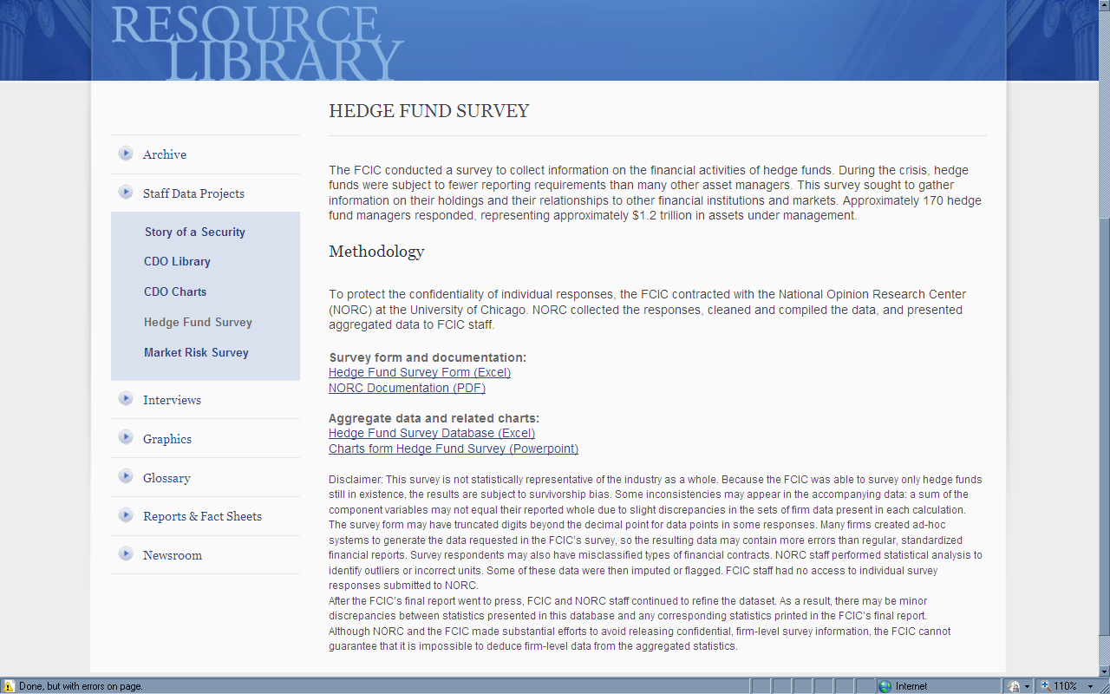
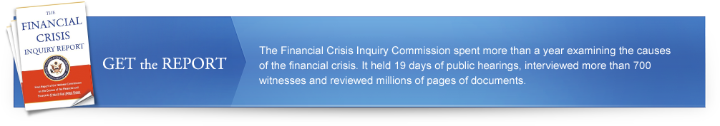
Public use datasets
Notes:
As far as data analytic utility is concerned, PUFs are bound by certain limitations
De-identification implies analytic utility loss
Some useful information must be at least partially suppressed to protect confidentiality
Value Add: PUFs may be made widely available for public consumption
By default, however, PUFs exclude some useful information that is crucial for in depth researcher
Problem: How can we disseminate data in a way that minimizes risk but also maximizes utility?

Slide 10
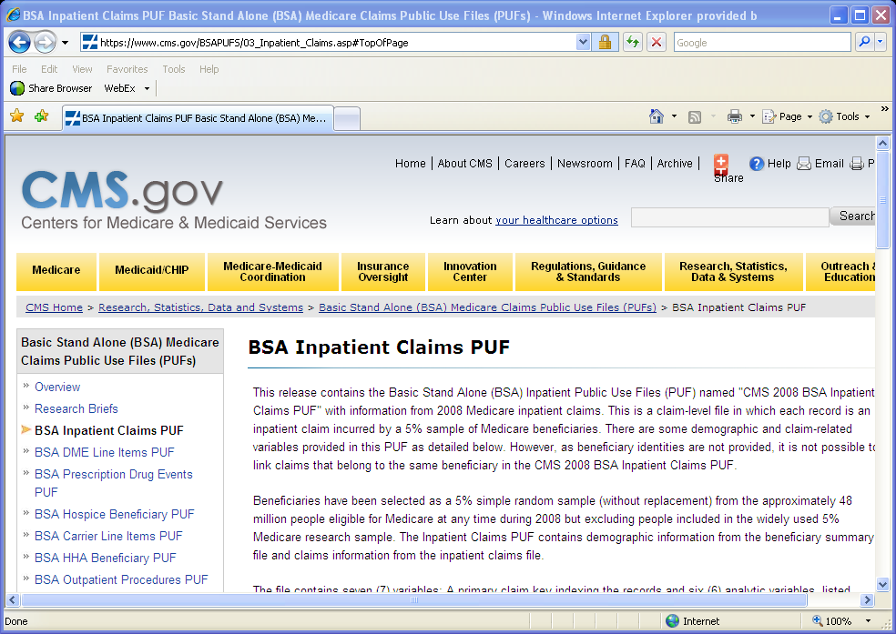
Public use datasets
Notes:
As far as data analytic utility is concerned, PUFs are bound by certain limitations
De-identification implies analytic utility loss
Some useful information must be at least partially suppressed to protect confidentiality
Value Add: PUFs may be made widely available for public consumption
By default, however, PUFs exclude some useful information that is crucial for in depth researcher
Problem: How can we disseminate data in a way that minimizes risk but also maximizes utility?
WE ARE NOW CREATING SYNTHETIC PUBLIC USE FILES – i.e., SYN-PUFs

Slide 11
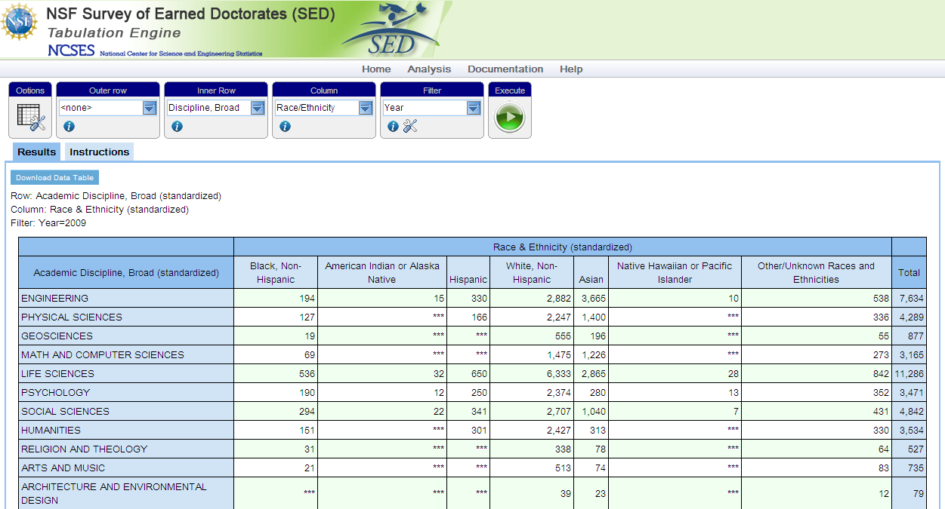
Online queries and tabulations
Notes:
Example of public facing online tabulation engine.
Users may submit queries that include confidential variables
Users can filter by year, gender, race/ethnicity, citizenship, discipline, institution

Slide 12
Confidentiality-utility curve
Physical and/or Remote Access Data Enclaves
Statistical Tables & Data Cubes
Public Use Data-File
Confidentiality
Synthetic Micro-Data
Remote Batch Processing
Licensing
Analytic Utility
Notes:
Licensing: very high disclosure risk
Remote batch processing: time-consuming and costly
Synthetic microdata: low analytic utility, highly dependent on model accuracy
RDCs and data enclaves: high data analytic utility while maintaining high standard of data confidentiality
Data security – the ability to control disclosure risk, ensure privacy, and thus maintain data confidentiality
Both RDCs and data enclaves allow secure microdata access: similar level of data analytic utility
RDC: researchers physically access data stored at a secure physical facility
Data Enclave: researchers remotely access data stored at a file server through a secure system on a virtualized environment
Both modalities provide high confidentiality protection: information inflow & outflow are monitored and controlled.

Slide 13
The third factor
Confidentiality and utility are not the only factors that influence the choice of data access modality
The third factor: CONVENIENCE
Producers’ perspective:
  How costly is it to implement an RDC or enclave?
  How easy is it to update and document the data?
  How easy is it to monitor researchers’ work and output requests?
Researchers’ perspective:
  How far do they need to travel to the nearest RDC?
  How easy is it for them to conduct follow-up work?
  How quickly does the RDC review and approve output requests?
  How easy is it to seek assistance?
  Is there any peer-to-peer researcher interaction/collaboration?

Slide 14
Given the same level of data utility and security…
Physical Data Enclaves
Remote Access Data Enclaves
Confidentiality
Value provided with a secure physical enclave
Value added with a secure remote access enclave
Convenience

Slide 15

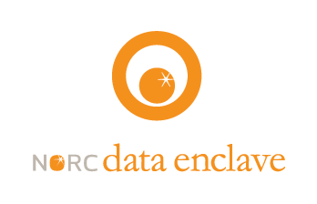


The USDA experience
Geographically dispersed researchers travel to secure RDCs
Instead of creating additional costly brick and mortar RDCs, USDA can now roll out a virtual RDC to any university in the country
Thin client terminals are installed in secure locations at researchers’ universities
Notes:
Problem: USDA needed to disseminate survey data to the agricultural economics research community
The Agricultural Resources Management Survey
As a cost savings move, they are closing over 500 RDCs across the country – moving to a regional model that leverages secure virtual data enclave approach
Implementing a remote access solution allowed them to engage a larger number of more dispersed researchers and centralize their researcher outreach

Slide 16
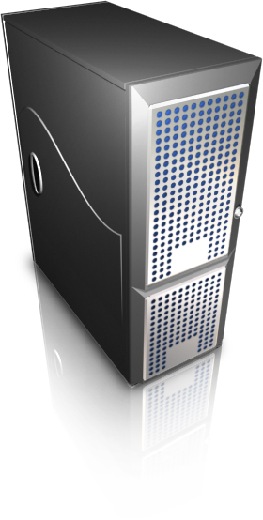
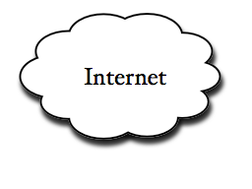





What is the enclave ?
The Enclave is an environment that allows for secure remote access to confidential microdata.
Through the use of a secure terminal session, researchers analyze sensitive data in a convenient and cost-effective manner without the data ever leaving the FISMA compliant secure data center.
Notes:
The enclave is a “virtual Research Data Center”: recent technological innovations have allowed us to deploy a remote access methodology with the same level of security protections traditionally found at brick and mortar facilities. Researchers have access to a terminal session on our secure servers, meaning they can run analyses on the data, but the data never leave our facilities.

Slide 17


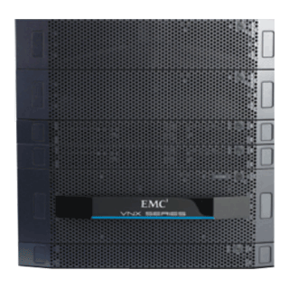
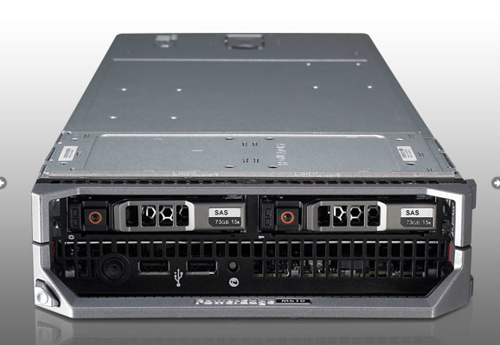

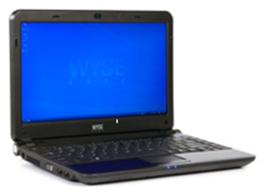
How do users access data?
Virtualization Servers
Trusted User
(with secure credentials)
Trusted Token
(second authentication factor)
Trusted Endpoint
(Thin Client)
VPN
VPN
Secure Data Storage

Slide 18
What functionality is available in the enclave?
Statistical Applications
  SAS, Stata, SPSS, R, Matlab, GAMS, LimDep / Nlogit, LISREL & more
Databases
  SQL, MySQL, BaseX
Productivity Software
  MS Office, Code Editors
Development
  Python, Perl, C++, Java
We are constantly expanding our offering to accommodate user needs.

Slide 19
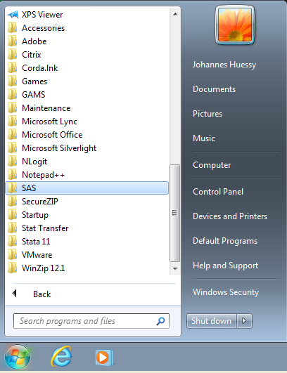
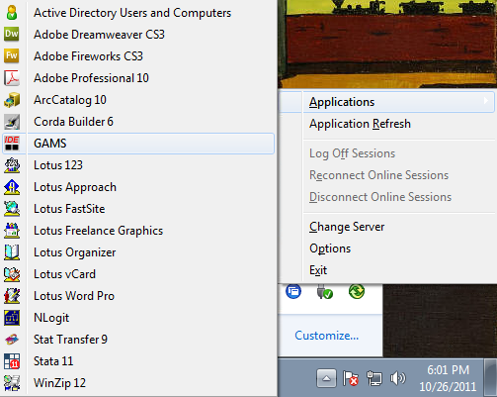
Streaming applications

Slide 20
Data linking
Data Linking is greatly facilitated via enclave access, e.g., by providing secure access to patient and claim identifiers:
  Approved data users can independently link datasets.
  Approved data users upload data to which they have been granted access and restrictions can be put in place to prevent inappropriate file sharing.
  Data Enclave staff can assist approved data users in data linking.
  The operation of an Enclave requires statisticians to be on staff who can assist with more complex linking algorithms.

Slide 21
Data analyses
Data Queries Run on Advanced Computational Engines
As the size and complexity of the data grows, a straightforward virtual desktop infrastructure can become inefficient. Advanced data engines are necessary to provide adequate functionality:
  Parallel Processing
  Advanced Databases
  Tabulation Engines
  Extraction Tools
Less time spent waiting for analyses to complete
More time available for interpretation
Increased publication quality and volume potential
Efficient Access

Slide 22
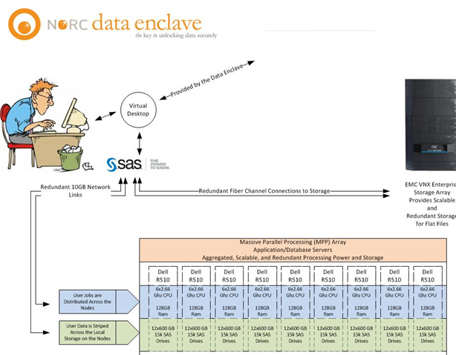
Massive parallel processing (MPP) solutions
Notes:
Aggregated, scalable and redundant, parallel processing power and storage
Application/Database servers

Slide 23
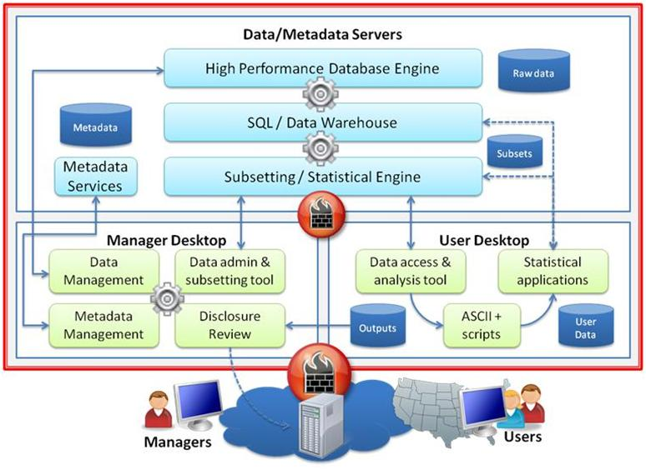
MPP solutions for big data communities

Slide 24
Timothy Mulcahy, NORC Data Enclave Program Director
(301) 634-9352
mulcahy-tim@norc.org
Sponsors:
National Institute of Standards and Technology; Centers for Medicare and Medicaid Services; National Science Foundation; Kauffman Foundation; National Agricultural Statistics Service; Economic Research Service; Annie E. Casey Foundation; Financial Crisis Inquiry Commission; National Bureau of Economic Research; Private Capital Research Institute; Georgetown University; Oregon State University; Duke University; Kresge Foundation, Mellon Foundation, and MacArthur Foundation

