Slide 1
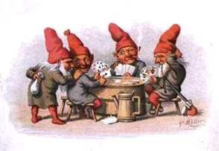
The Trouble with House Elves:
Computational Folkloristics, Classification, and Hypergraphs
Timothy R. Tangherlini
UCLA
James Abello
DIMACS / Rutgers Univ.

Slide 2
A story…
It was the old counselor from Skaarupgaard who came riding with four headless horses to Todbjærg church. He always drove out of the northern gate, and there by the gate was a stall, they could never keep that stall door closed.
They had a farmhand who closed it once after it had sprung open. But one night, after he'd gone to bed, something came after the farmhand and it lifted his bed straight up to the rafters and crushed him quite hard. Then the farmhand shouted and asked them to stop lifting him up there. "No, you've tormented us, but now you'll die..."
I heard that's how two farmhands were crushed to death. He wanted to close the door and then they never tried to close it again.

Slide 3
A quick poll…
What is this story about?

Slide 4
The problem(s)…
How do you find a story like this?
-classified as a story about manor lords
-named entities (names, places) are easily substituted and do not necessarily carry additional information
How do you find other stories related to this one?
-folklore is based on the study of related stories, and so this is a fundamental problem

Slide 5
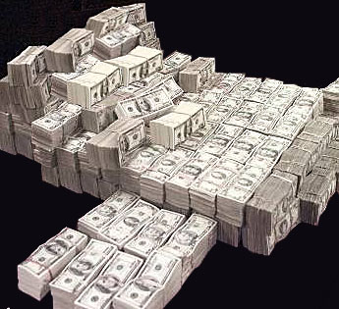
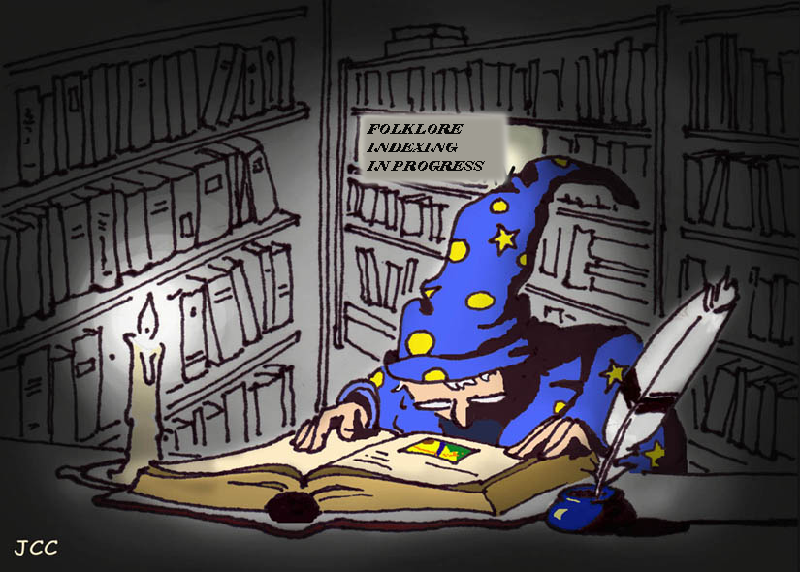
Current Folklore Classification Systems are…
Costly and do not scale well
Idiosyncratic

Slide 6
The need
A flexible system of classification, search and discovery that:
Allows a user to define the criteria on which a search / discovery process is to be based
Does not a priori privilege one view of the data at the expense of another
Presents the corpus space in an intuitively navigable fashion

Slide 7
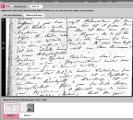
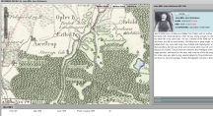
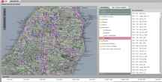
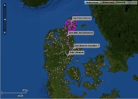
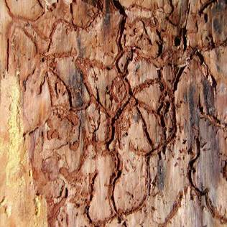
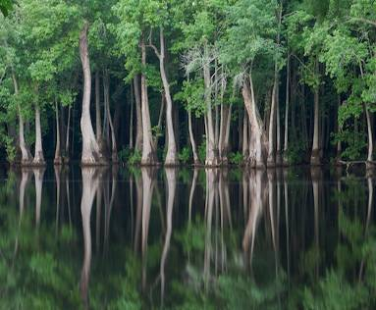
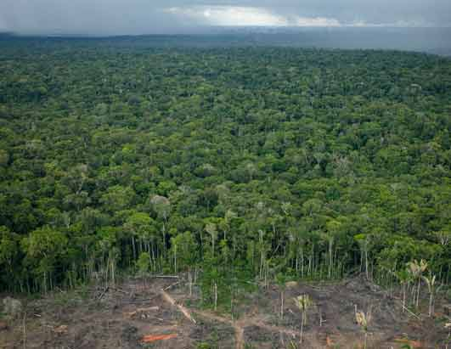
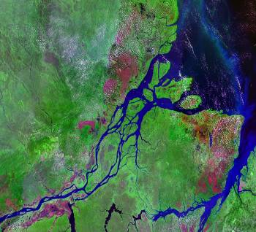
Distant Reading to Micro-Reading
Allows a user to explore the space from a variety of levels
“Distant reading”
“Close reading”
And all levels in between

Slide 8
Evald Tang Kristensen Collection

Slide 9
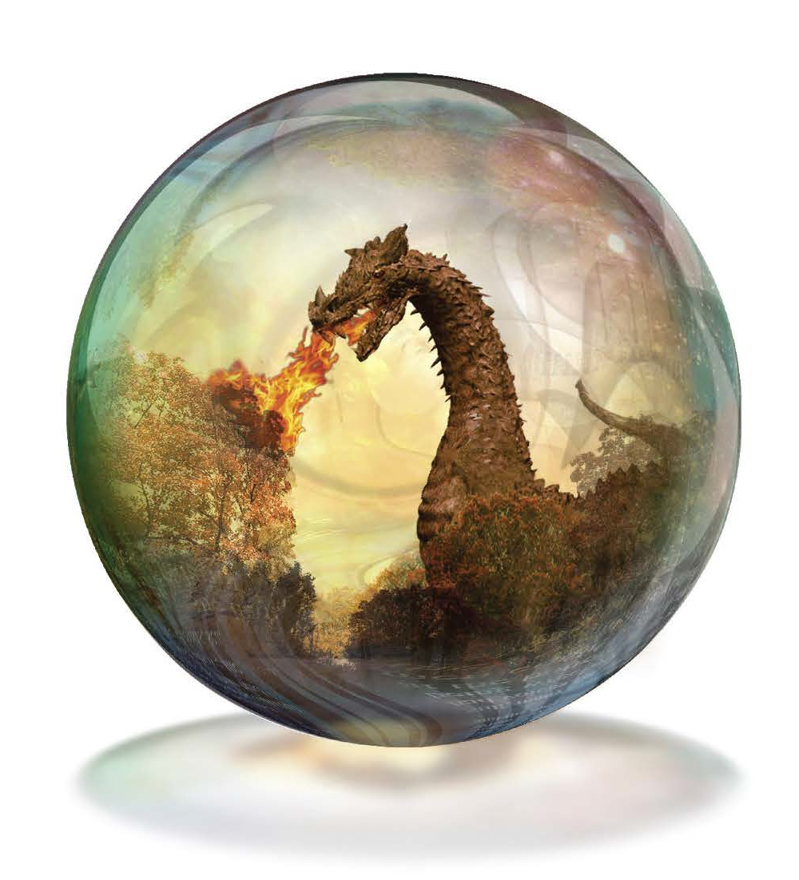
What we did
Took a poorly labeled corpus of 1000 stories from the Tang Kristensen folklore collection
And devised different representations of those stories and the overall corpus
Based on these representations of both stories and the relationships that define the corpus, developed a hypergraph representation of the corpus

Slide 10
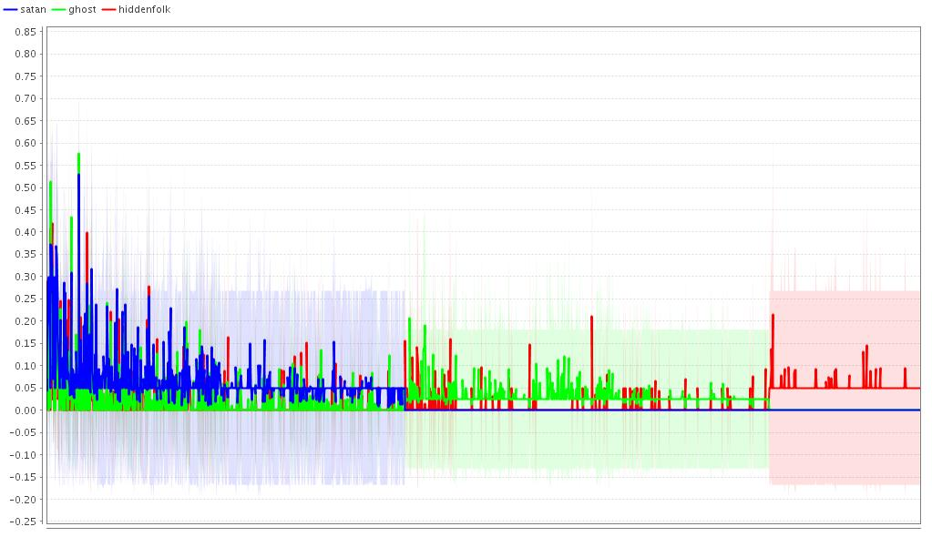
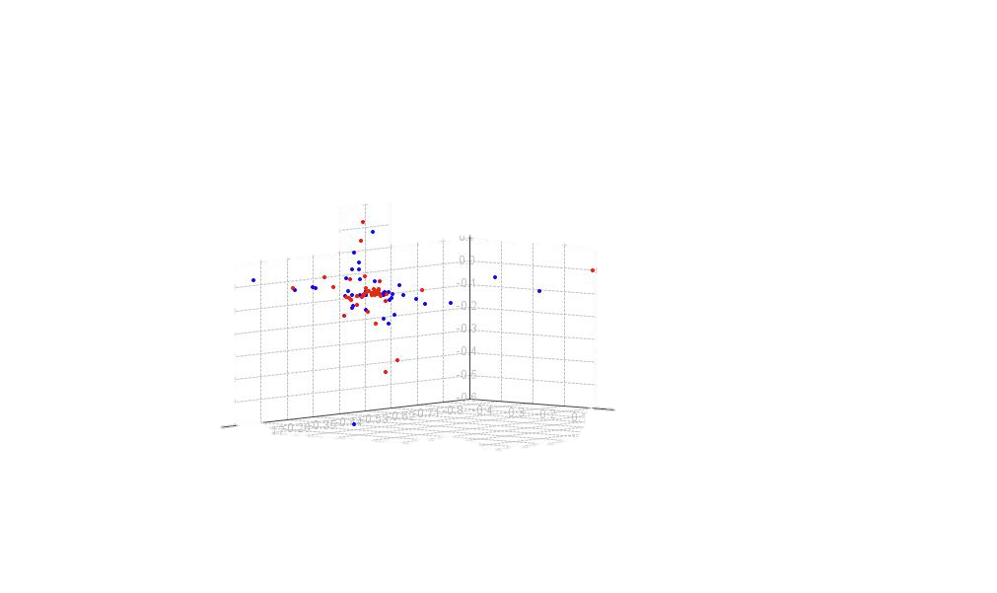
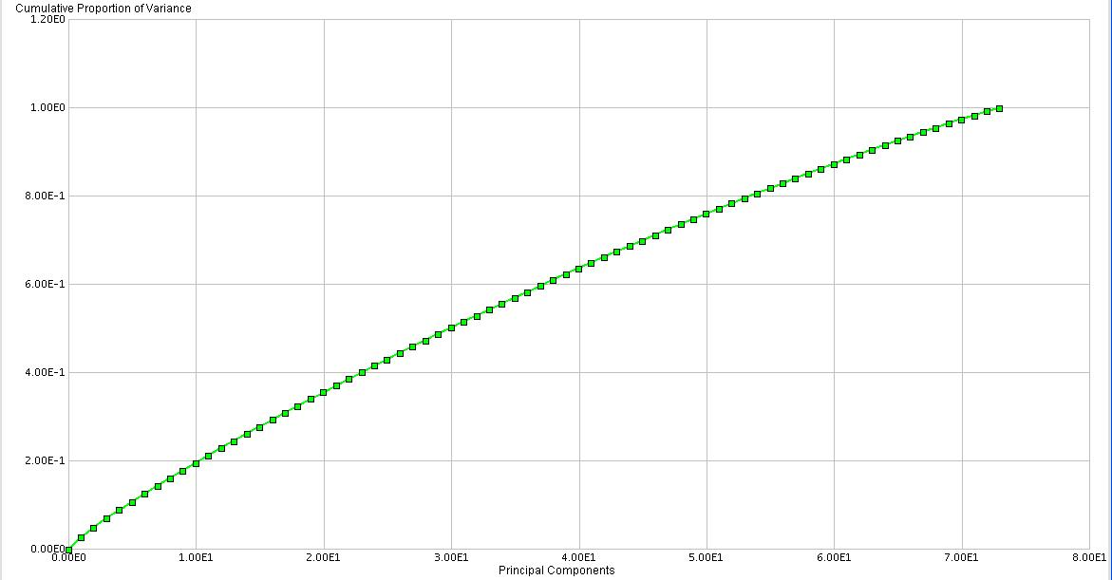
Standard computational approaches to classification
Naïve Bayes Classifiers
Straight forward (based on term frequency)
Easily Understood
Multiple binary tasks
Noisy
Support Vector Machines
Based on TF*IDF vector representation
Very fast
Multiple binary tasks
Large training sets
Principle Components Analysis
Complex mathematics
Not easily understood
Results are mysterious

Slide 11
Naïve Bayes Classifier

Slide 12
So what?
Certain categories are easily recognized by simple text classifiers
Some existing topic categories are “catch-all” and not useful for most research
Hekse og deres idrætter
Witches and their sport
Forskjellige spøgeri og gjenfærds nedmaning
Different types of ghosts and their conjuring
Gjenfærd på forskellige steder
Revenants in different places
Bjærgmænd
Mound dwellers
Can I use the hypergraph to refine these classifications and to discover new areas of interest?

Slide 13
Building a hypergraph: Connecting existing things
Folklore is the circulation of traditional expressions in an across social networks, embedded in time and place
To model this, we need to connect
storytellers to places
storytellers to stories
stories to places
storytellers to fieldtrips (dates/places)
stories to existing indices
Aarne-Thompson-Uther index (ATU)
Migratory legend index (ML)
Ballad index (DgF)
Tang Kristensen topic indices

Slide 14
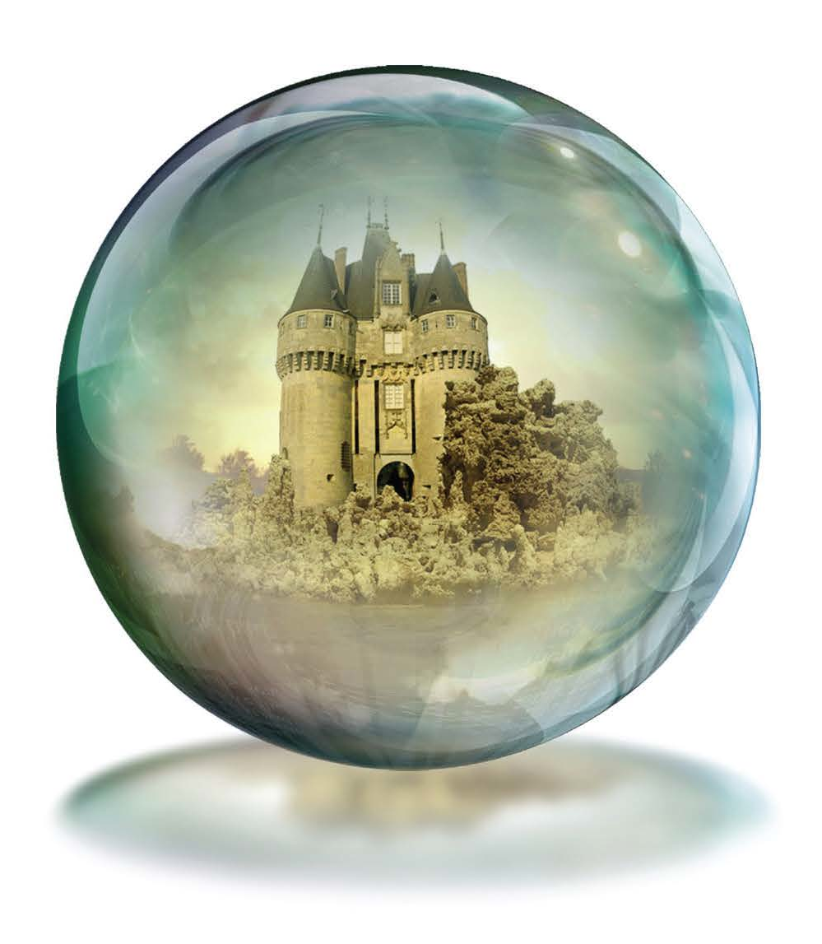
Building a hypergraph: Adding more information
Keyword indexing
Extract keywords from texts
Requires language expertise
Named Entity Detection
Indices are incomplete / additional place names and personal names
Shallow ontology
Devise a two-level ontology for collection
Genre classification
Rapid classification based on Tang Kristensen’s collections
Future additions?
Topic modeling (experimental)—LDA

Slide 15
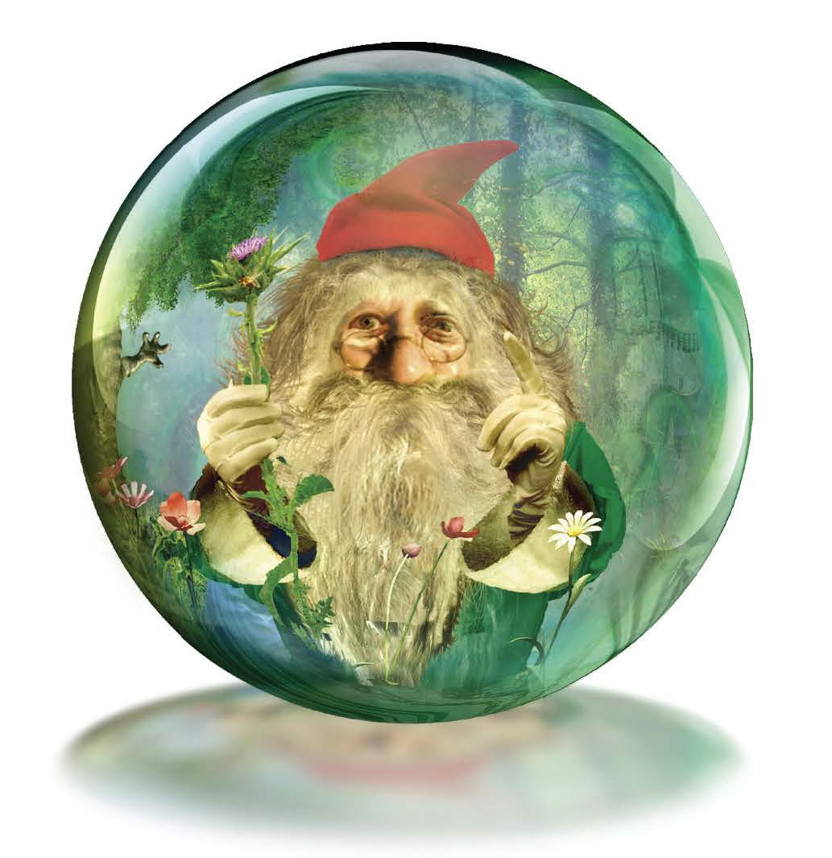
Using a hypergraph to solve our problem(s)
Limit the edgelist to story data
Keywords
Topic Index
Shallow Ontology
Named entities
Sort the network
Similarity measures
Clustering
Look for stories in the target story’s neighborhood
**layout is no longer random

Slide 16
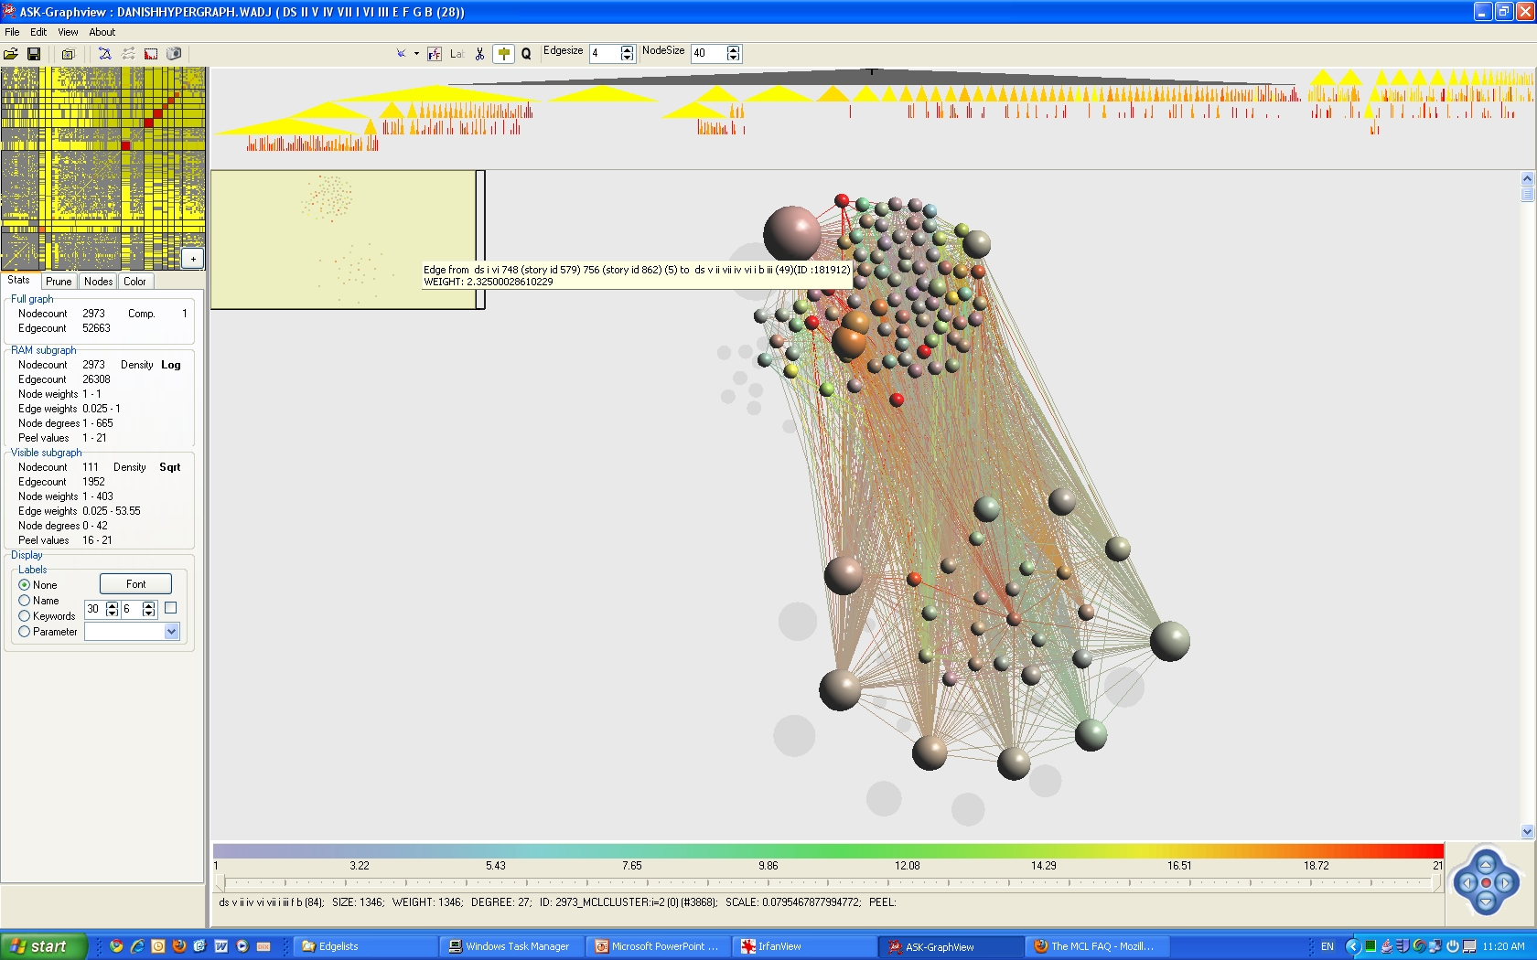
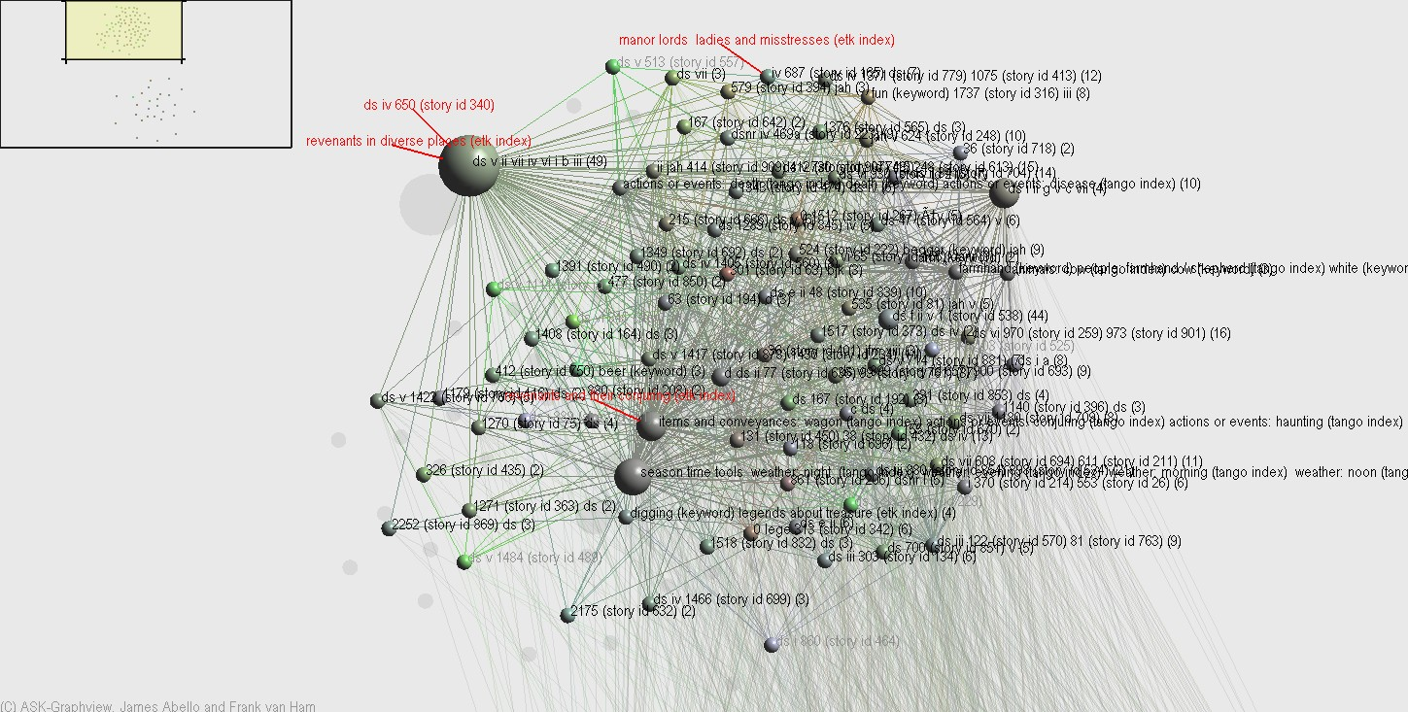
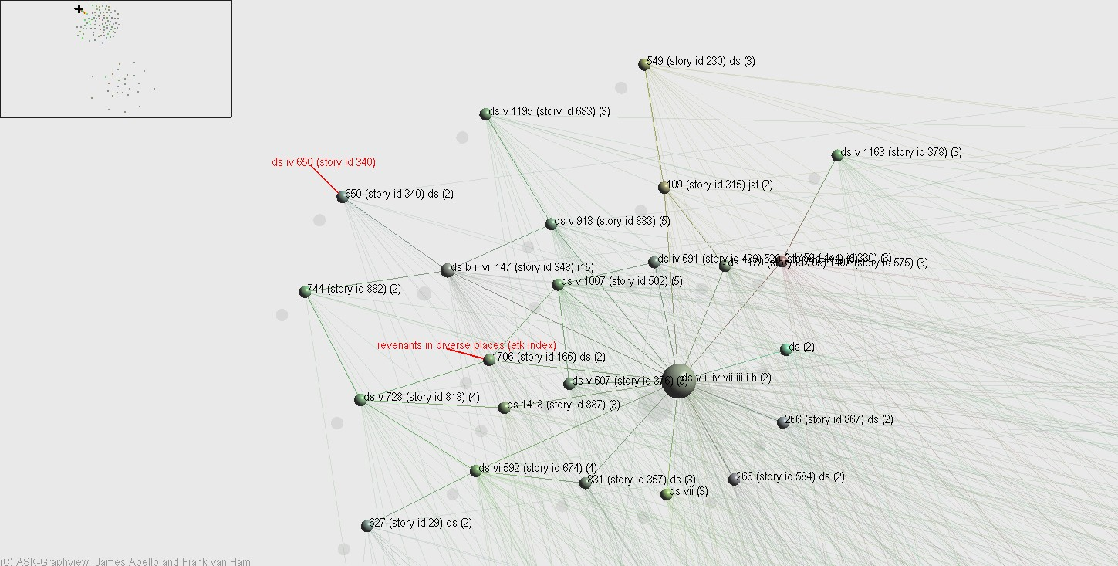
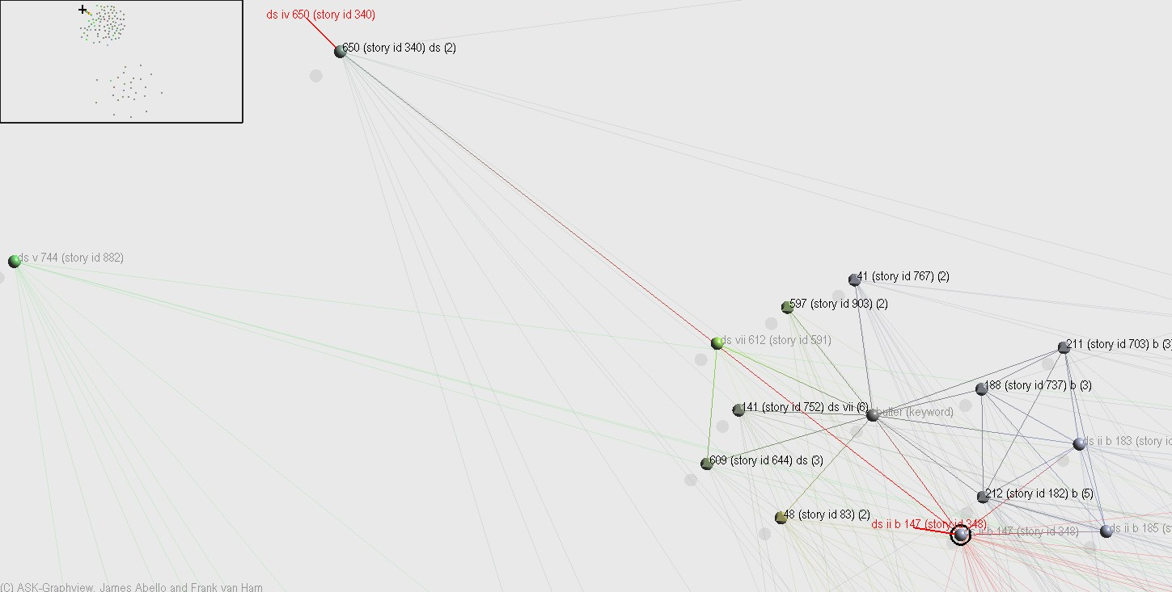
The hypergraph navigator

Slide 17
Helps us find an unexpected story
A story about a house elf at a farm in Egå...
When they got home, the farmhand was happy because now he’d gotten something to use for fodder, and afterward nis could go and feed the animals just as much as he wanted to. Then they got another farmhand, and he didn’t want to let nis go on like that. But the farmhand got lifted up in his bed and all the way up to the rafters, so he lay there dead when people got up the next morning.

Slide 18
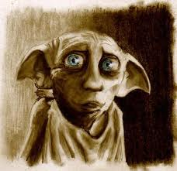
New research question
What is the relationship between ghosts and house elves?

Slide 19
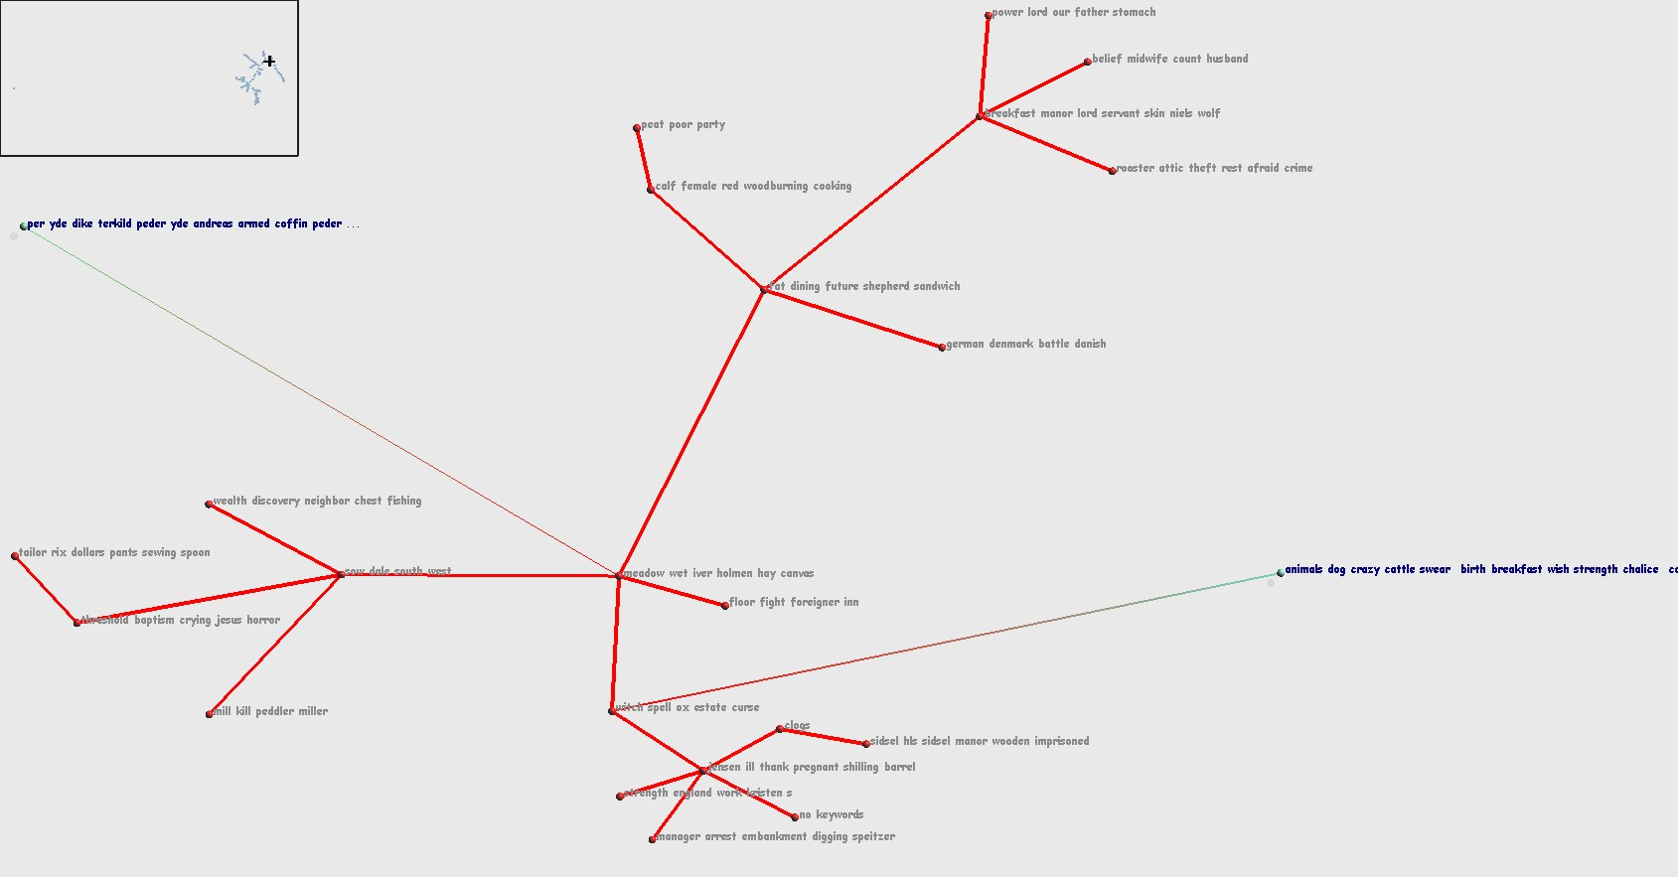
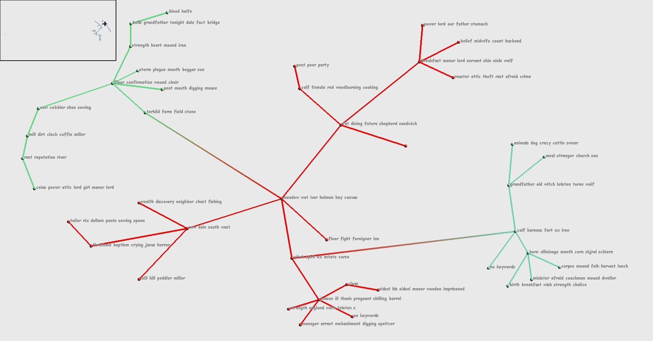
Exploring clusters

Slide 20
Expert input
Cluster “curation”
Label clusters
Accept/reject groupings based on domain knowledge
Feedback loop – rerun algorithms incorporating feedback
Develop a flexible method for discovery
Develop a better understanding of the connection and influence between people, places and stories

Slide 21
Key findings
The field of computational folkloristics weds algorithmic approaches to classic interpretive problems from the field of folklore.
A multimodal network representation of a folklore corpus (hypergraphs) liberates folklore exploration from the limitations of existing classification schemes.
Imagine a system in which the complexities of a folklore corpus can be explored at different levels of resolution, from the broad perspective of “distant reading” down to the narrow perspective of traditional “close reading.”

Slide 22
Thanks
Research team—Abello, Tangherlini, Peter Broadwell, Nischal Devanur
Funding from the National Endowment for the Humanities, the American Council of Learned Societies, and Google Books
Special thanks to Wolfram Data Summit

