Slide 1
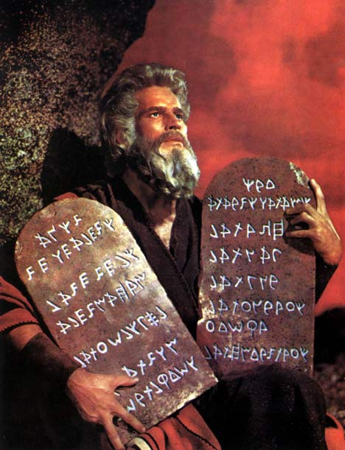

No More Tablets of Stone
Enabling the User to Weight Our Data and Shape Our Research?
GDP 5.321
Health 98.4°
Trade +/-67.90
Debt -99999
Happiness ??
Education B-
Environment ✗
GDP 5.321
Health 98.4°
Trade +/-67.90
Debt -99999
Happiness ??
Education B-
Environment ✗
Toby Green,
OECD
Wolfram Data Summit, Washington DC
September 2012

Slide 2
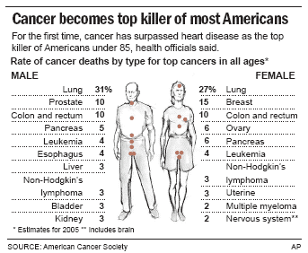
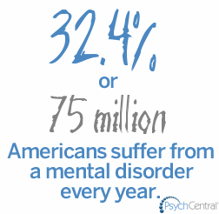
Should we spend more on cancer research or mental health research?
Is society using the right data to take the best decisions?
$2.2BN
0.5% of Americans will get cancer this year, that’s 1.6 million people.
$5.5BN
Source: NIH

Slide 3
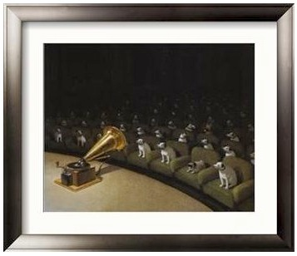
Are we the iGramophone?

Slide 4
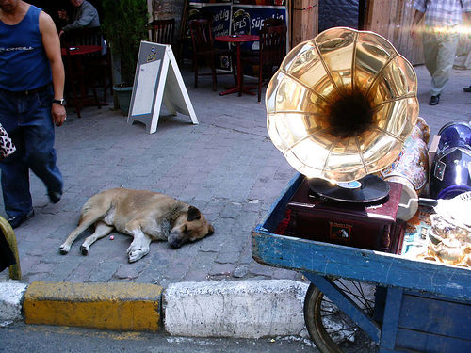
Putting our audience to sleep?

Slide 5
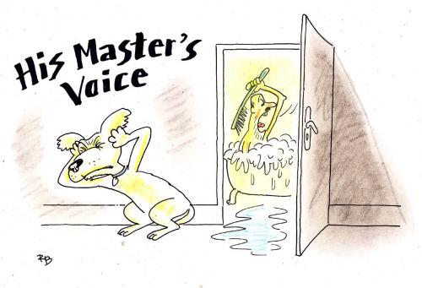
Singing the wrong tune?

Slide 6
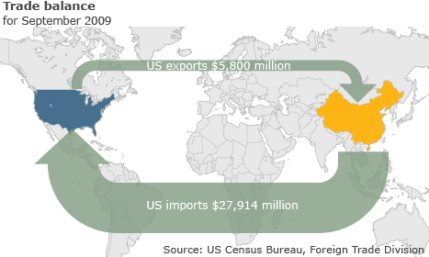
The wrong tune?

Slide 7
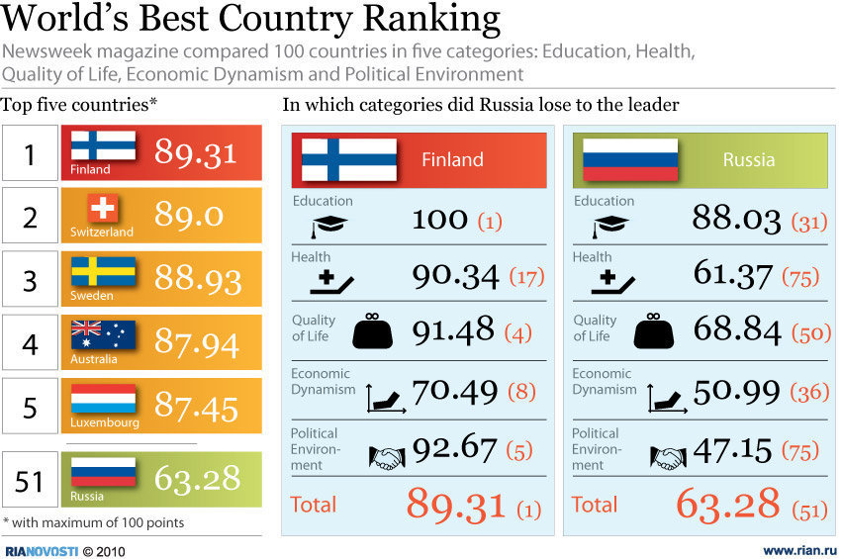
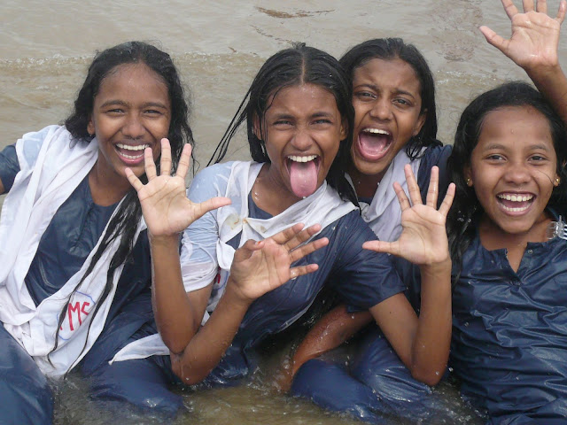
The wrong tune?
But what about community?

Slide 8

Are we listening?

Slide 9
Measuring the Progress of Societies
OECD Better Life Index

Slide 10
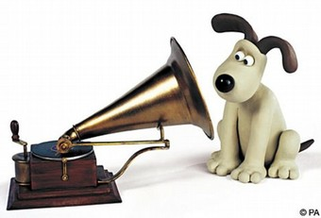
e
http://blirt.oecdcode.org/
Because maybe our audiences can teach us something we didn’t know.

Slide 11
e
Thank you
Toby.Green@oecd.org
“Without data, you are just someone else with an opinion.”
Andreas Schleicher

